Slide 1

ScreenSense – Kid's Screentime Analytics
Insights from Indian Kids Screentime 2025 Dataset
By Naresh Patel

Slide 2
Project Overview
What This Project Delivers
Real-World Impact
This comprehensive analytics project examines digital behavior patterns of Indian children through an interactive Power BI dashboard built from 9,712 real-world records.
These insights empower parents to make informed decisions about screentime limits, help educators understand digital learning patterns, and guide policymakers in creating evidence-based regulations.
The analysis spans critical dimensions including age groups, gender differences, urban-rural divides, device preferences, and health risk factors.
Dataset Source: Indian Kids Screentime 2025 (Kaggle)

Slide 3

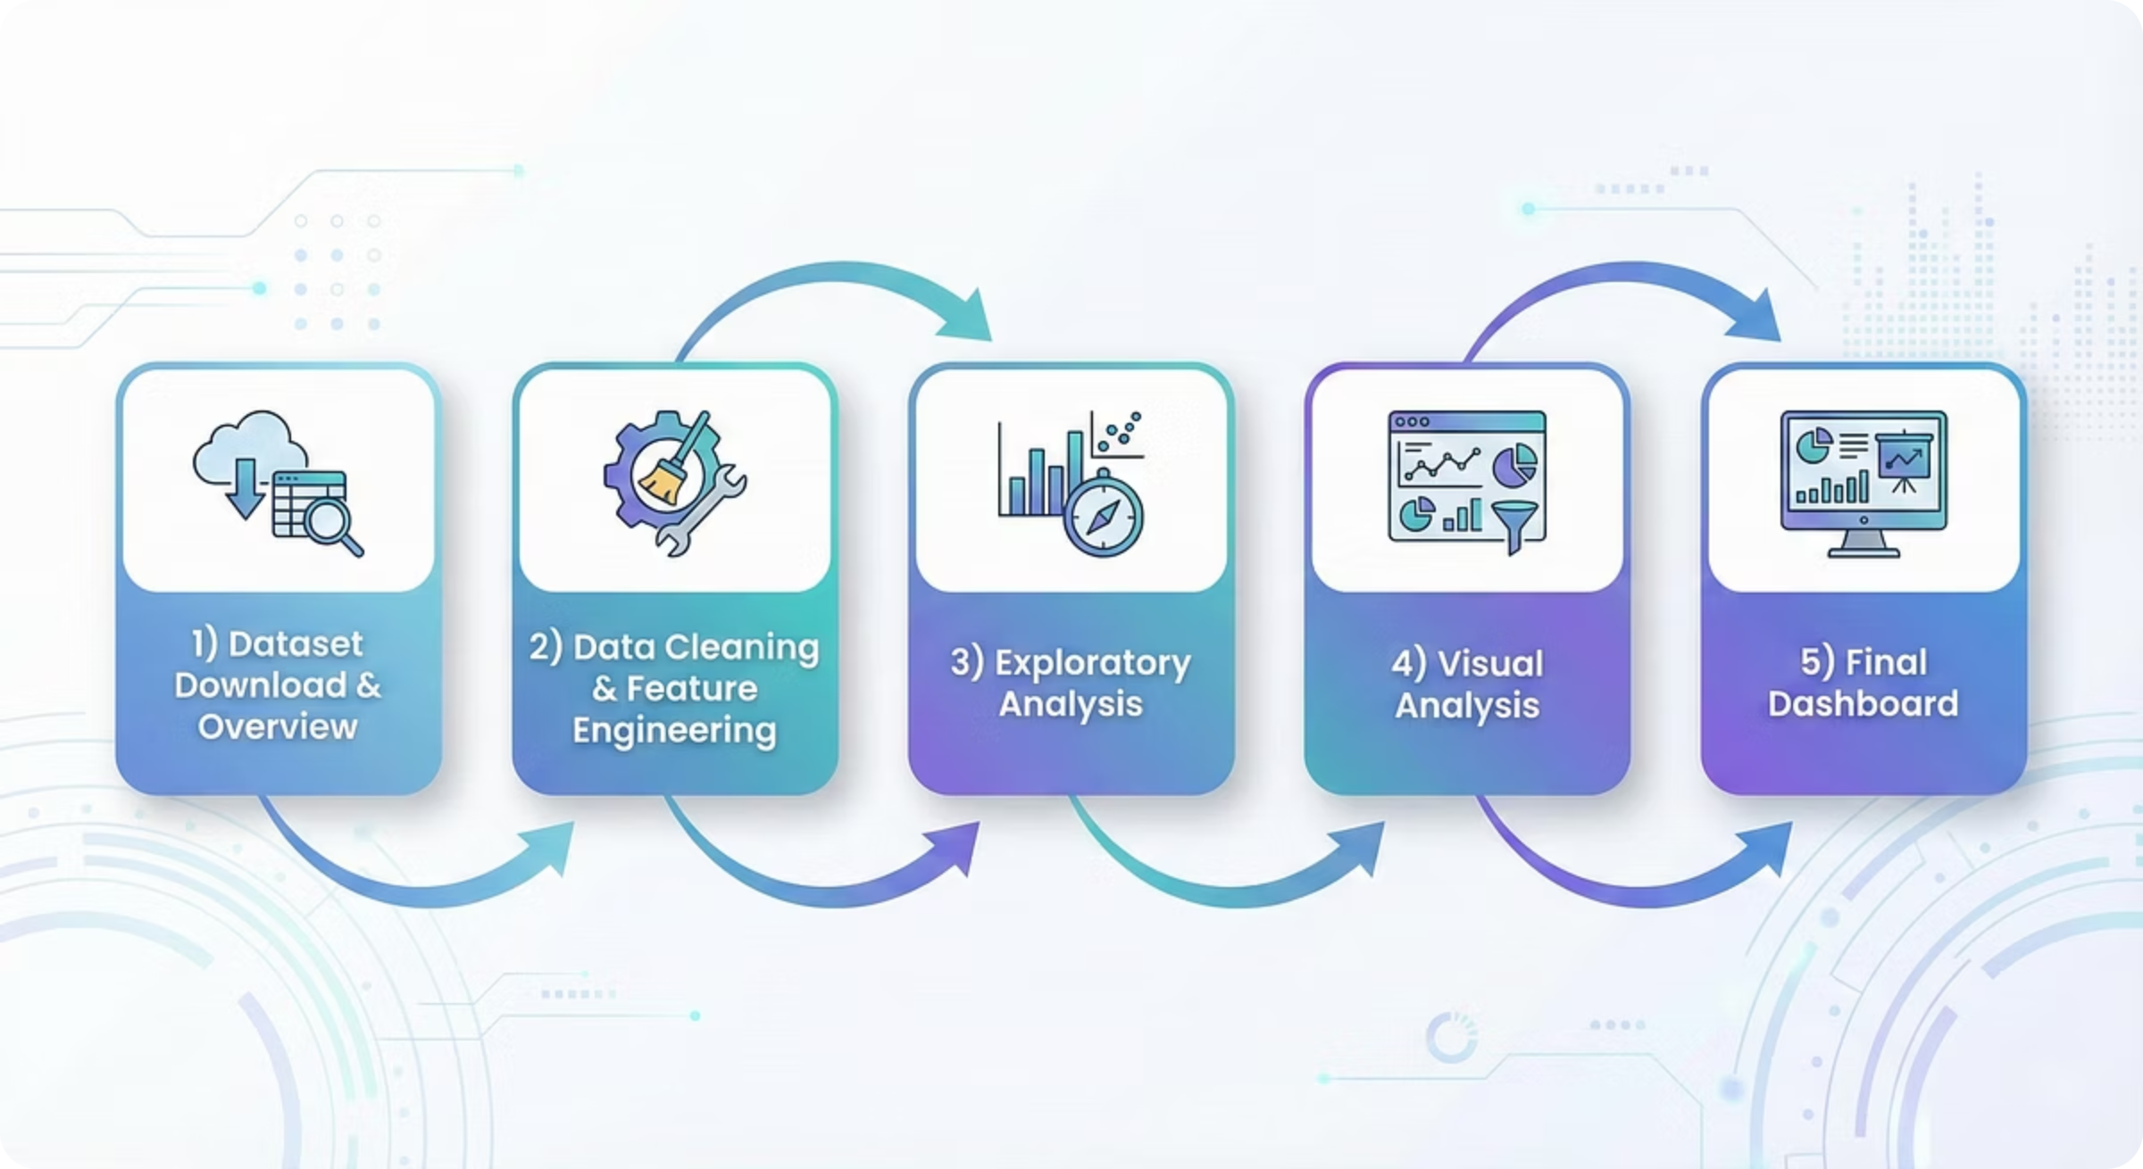
Project Workflow
01
02
Data Cleaning & Feature Engineering
Visual Exploration
Developed comprehensive visualizations revealing usage trends, weekday versus weekend patterns, device preferences across demographics, and behavioral differences between urban and rural children.
Standardized inconsistent categories and resolved missing values across all fields. Created analytical features including Age Band groupings, ScreenTime Level classifications, Risk Category scoring, and Behavior Type segmentation.
03
Dependency & Cohort Analysis
Built advanced analytical tools including correlation heatmaps and ridgeline charts. Introduced the Digital Dependency Score metric to quantify concerning usage patterns and identify at-risk groups.

Slide 4

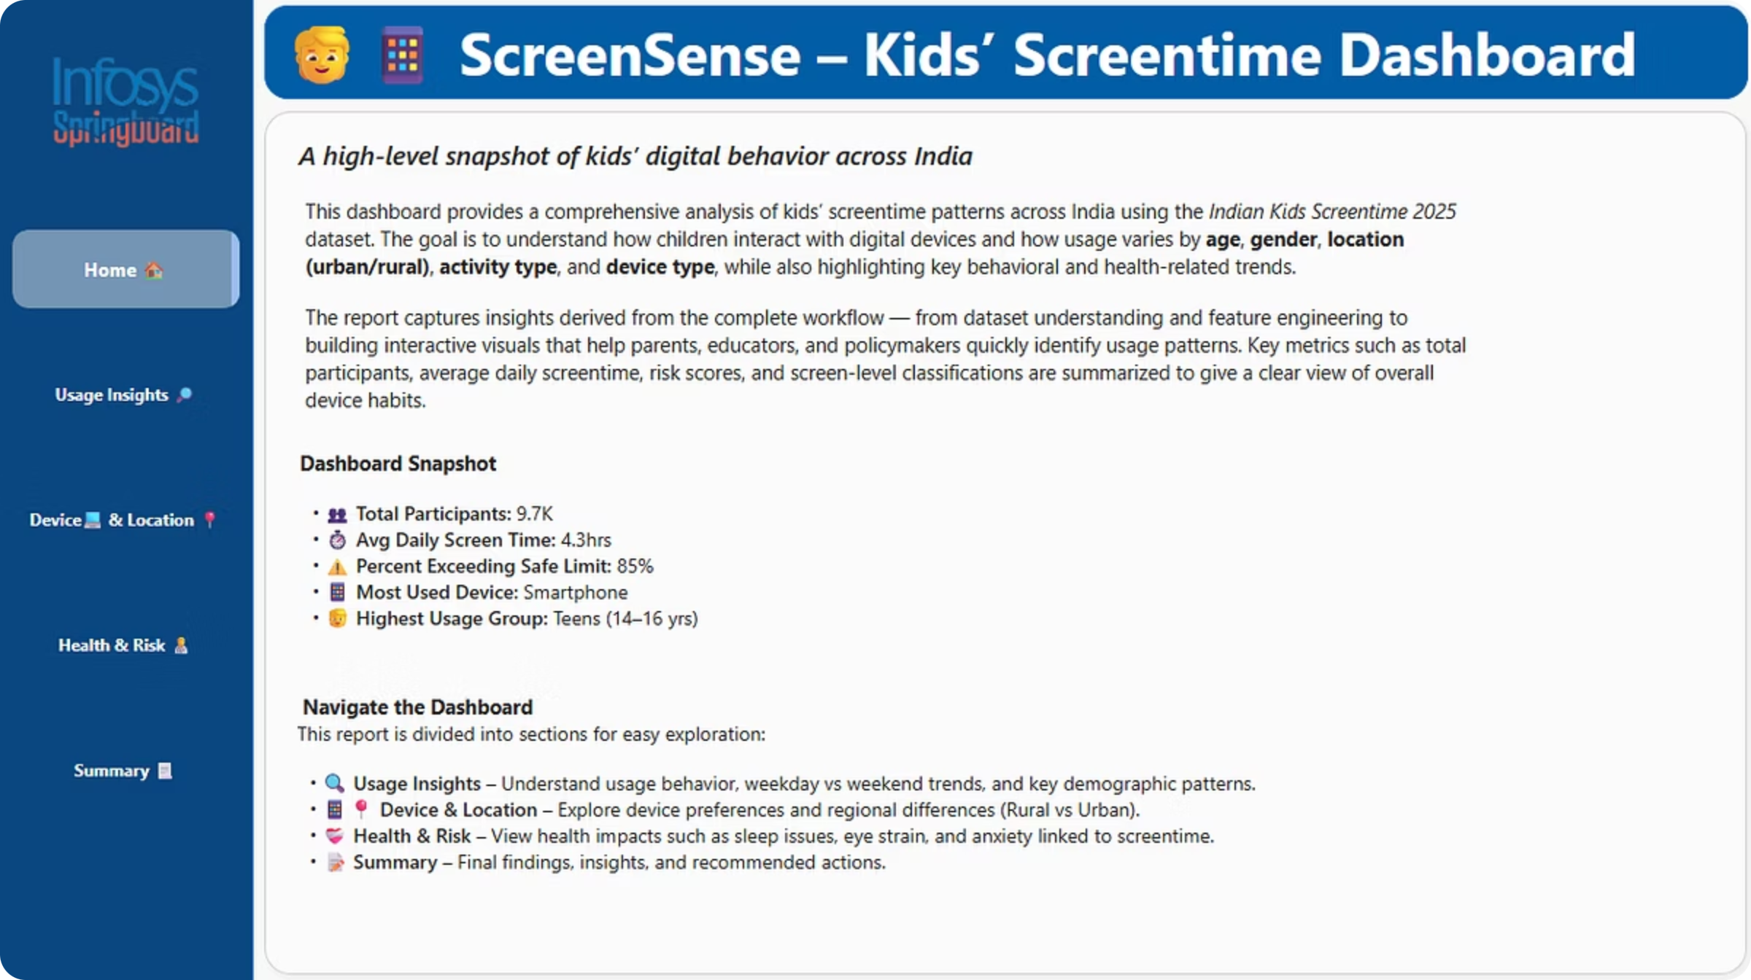
Dashboard Overview Page
Total Participants
9,712 children across India providing comprehensive coverage
Avg Daily Screentime
4.3 hours per day revealing significant digital engagement
Exceeding Safe Limits
Concerning percentage requiring immediate attention
Highest Usage Group
Teenagers (14-16 yrs) leading screentime metrics
The Overview Page provides instant access to critical metrics while offering seamless navigation through four key sections: Usage Insights, Device & Location Analysis, Health & Risk Assessment, and Executive Summary.

Slide 5
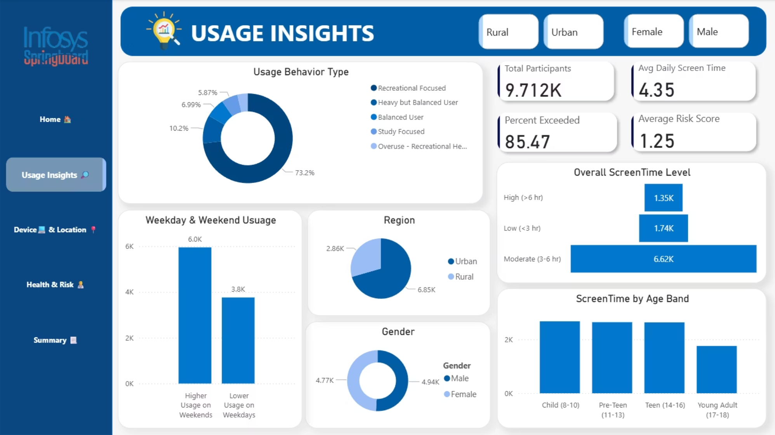
Usage Insights
Behavioral Patterns Revealed
Weekend spike: Children spend significantly more time on screens during weekends compared to weekdays
Recreational dominance: Over 73% of usage falls into the recreational-focused category
Average engagement: 4.3 hours daily represents substantial digital immersion
Teen leadership: Ages 14-16 show the highest usage rates
The dashboard enables dynamic filtering by urban versus rural location and gender, allowing stakeholders to drill down into specific demographic segments without overwhelming the primary view.

Slide 6

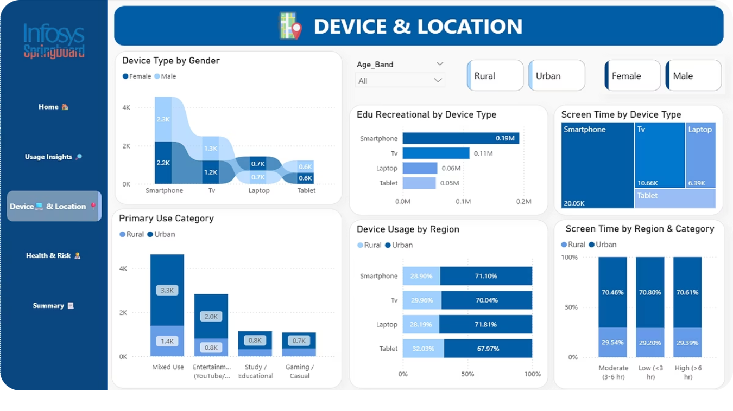
Device & Location Insights
Smartphone Supremacy
Urban-Rural Divide
Purpose Patterns
Smartphones dominate across all age groups, with particularly strong preference among teenagers. This trend holds consistent in both urban and rural settings.
Urban children demonstrate higher overall screentime and access to multiple device types, while rural children show more concentrated smartphone usage.
Entertainment and mixed-use categories dominate device usage, with educational purposes representing a smaller but important segment that varies by region.
Age band, regional location, and gender filters work together to reveal nuanced device preference patterns across different demographic intersections.

Slide 7



Health & Risk Insights
Poor Sleep Quality
Eye Strain
Anxiety Issues
Leading health concern linked directly to evening and night-time screen usage patterns
Second most reported issue, particularly acute among smartphone users and extended session participants
Significant mental health correlation observed in high-usage groups, especially teenagers
Critical Correlations
Geographic Patterns
Higher screen usage shows strong positive correlation with elevated health risks. Smartphone users report the highest number of cumulative health impacts.
Urban children report marginally higher digital-health issues, potentially due to increased device access and longer usage sessions.

Slide 8


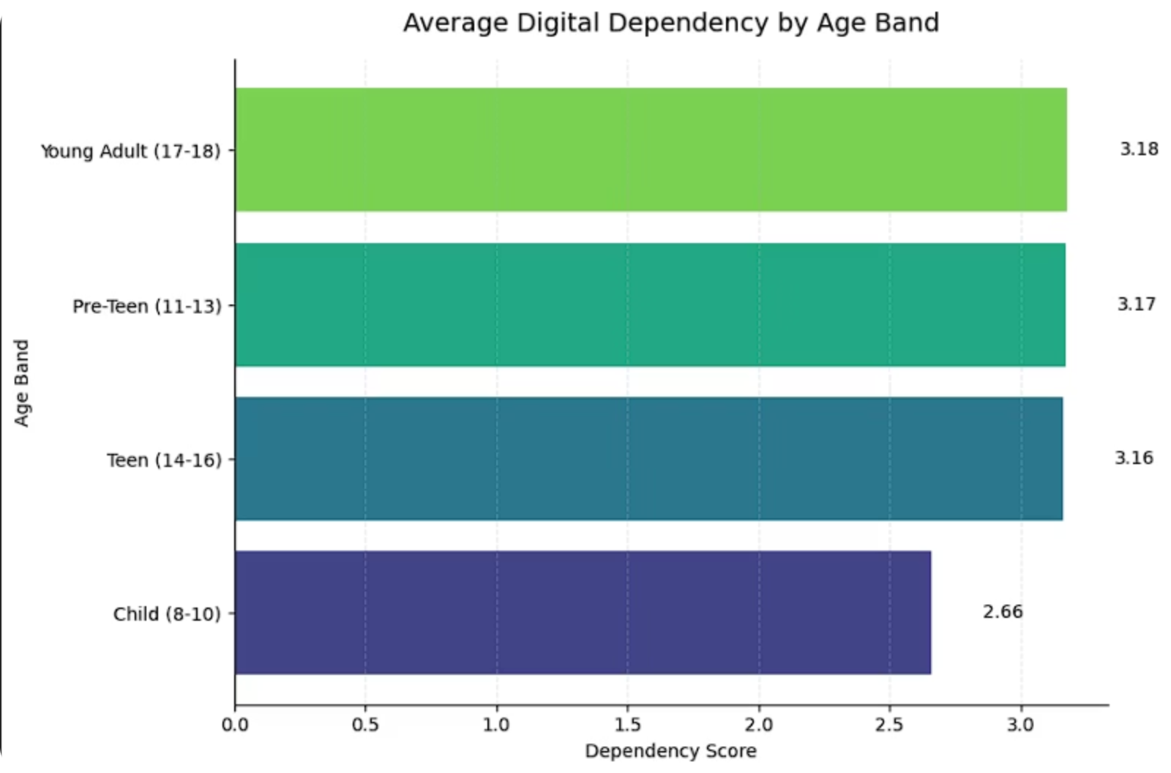


Advanced Analytics
Health-Screentime Correlation
Statistical analysis reveals direct relationships between daily screentime duration and reported health issues, with effects accelerating above 6 hours daily.
Age × Device Heatmap
Visualization exposes how device preferences evolve with age, showing smartphone adoption increasing dramatically from age 10 onwards.
Cohort Pattern Analysis
Age-based cohorts reveal distinct screentime trajectories, with teenagers showing exponential growth in both duration and dependency indicators.
Low
Med
High
Younger Children
Pre-teens
Teenagers
Ages 8-10 primarily in low dependency range
Ages 11-16 transitioning to medium dependency
Ages 17-18 showing concerning high dependency

Slide 9
Key Findings
1
2
Weekend Usage Spike
Smartphone Dominance
Screentime increases consistently on weekends across all demographics, suggesting opportunity for structured alternatives
Mobile devices represent primary access point for digital content across every age group and location type
3
4
Moderate Range Majority
Teenage Risk Peak
Most children fall within 3-6 hours daily, representing both risk and opportunity for intervention
Adolescents demonstrate highest risk scores and dependency levels, requiring targeted support strategies
5
6
Urban Health Concerns
Shifting Usage Purpose
City-dwelling children report slightly elevated digital-health problems compared to rural counterparts
Recreational usage grows with age while educational applications decline, suggesting need for engagement strategies

Slide 10

Recommendations & Conclusion
Evidence-Based Recommendations
Digital Balance Routines
Implement screen-free periods, especially during the hour before bedtime, to improve sleep quality and reduce eye strain.
Purpose-Driven Usage
Shift the balance toward educational and creative applications while maintaining reasonable recreational time for social development.
Health Awareness Campaigns
Increase education around eye health exercises, mental wellness practices, and the importance of physical activity breaks.
Technology-Aided Solutions
Leverage parental control apps and monitoring tools to track usage patterns and enforce healthy limits collaboratively.
Structured Digital Learning
Provide high-quality educational content that naturally reduces excessive recreational screen consumption through engagement.
Final Insight: This dashboard transforms raw screentime data into actionable intelligence, empowering parents, educators, and policymakers to make evidence-based decisions that enhance child digital well-being across India.

