Slide 1


MEDISTOCK
MEDICAL INVENTORY
MANAGEMENT PLATFORM

Slide 2




Technology Stack: Java Full Stack Technologies
Node.js
MySQL
Ensures secure and organized management of medical inventory records.
Java | Spring Boot
Manages backend logic and connects the application with the database.
React.JS
Builds a dynamic and interactive user interface for the Medi Stock application.
Postman
Enables testing and validation of REST APIs and backend responses.

Slide 3
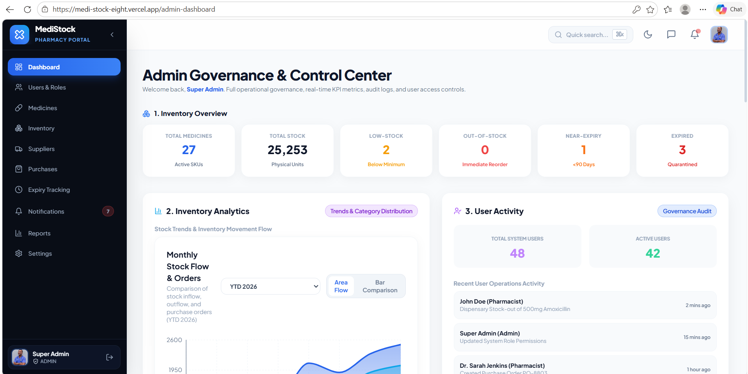
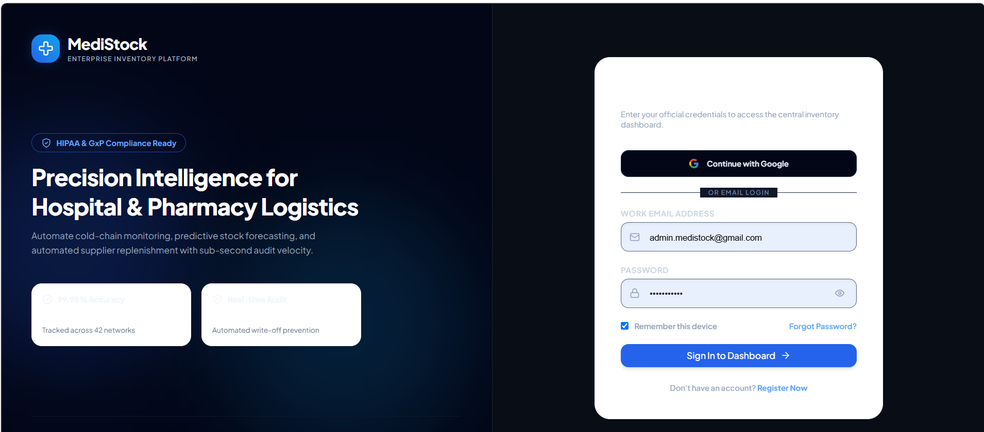
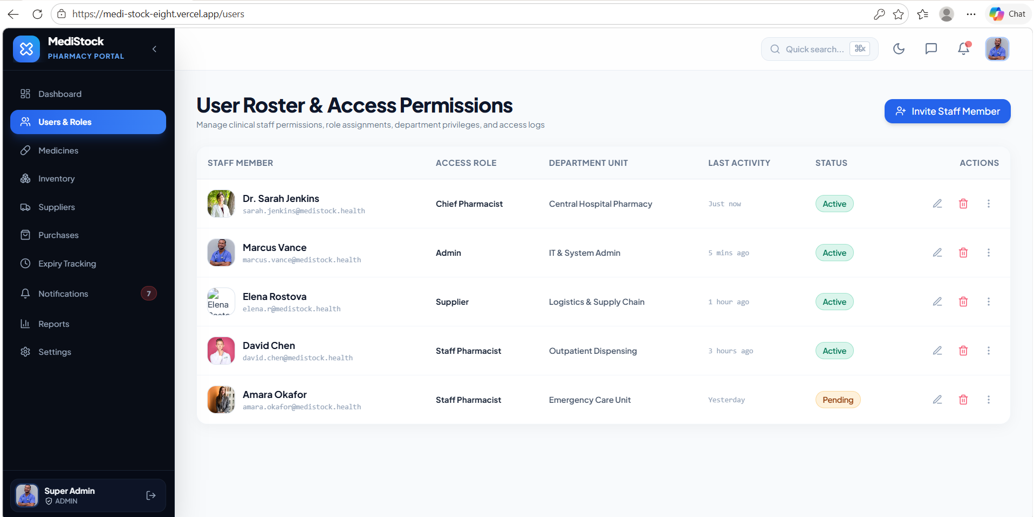
Core Features of
MediStock
1. User Authentication – Secure login with role-based access control for Admin, Pharmacist, Staff, and Supplier.

Slide 4
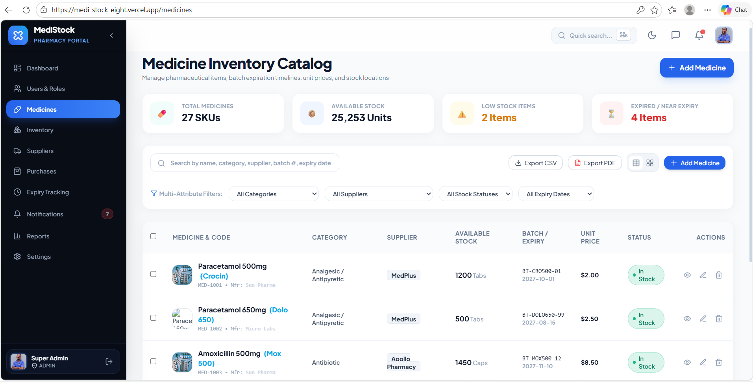
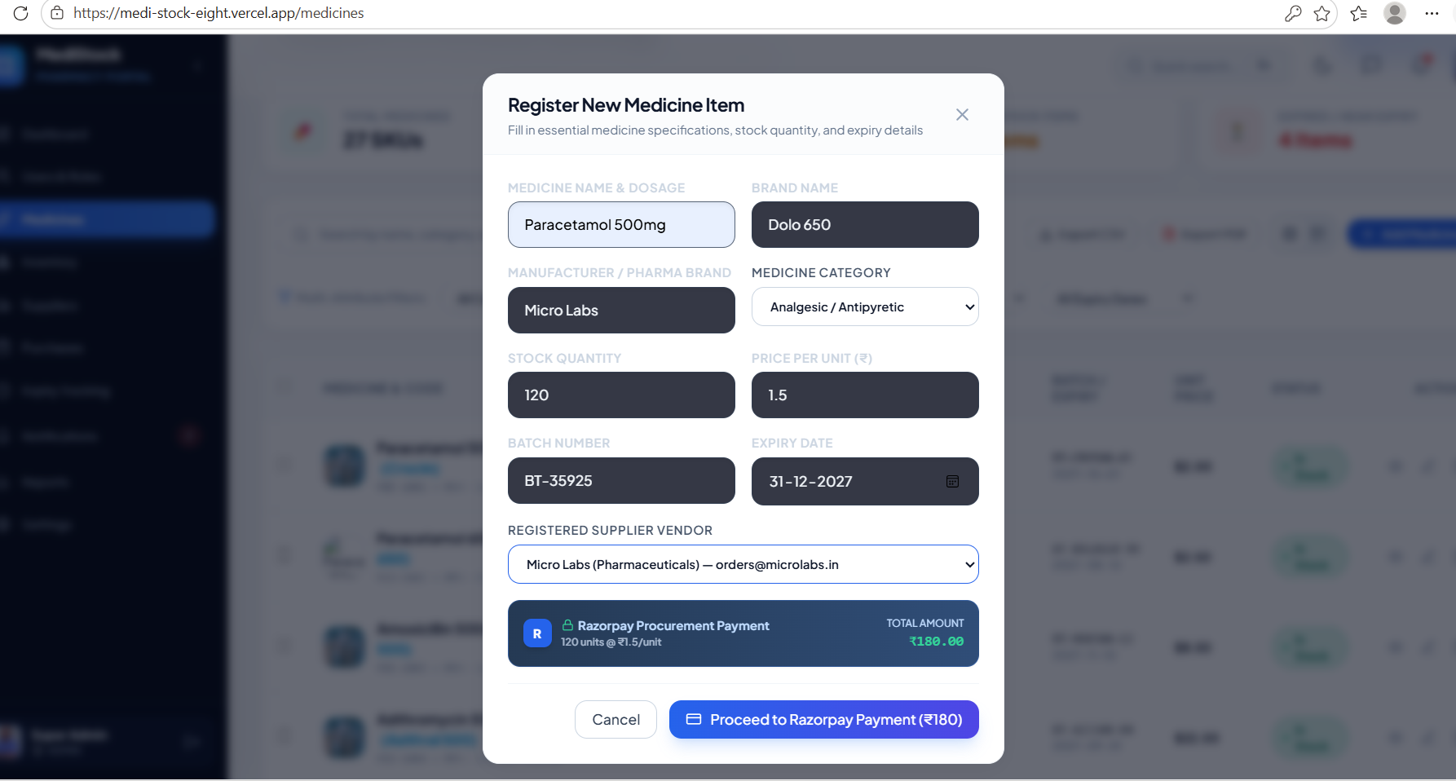
2. Medicine Stock Management – Add, update, and monitor medicine stock.

Slide 5
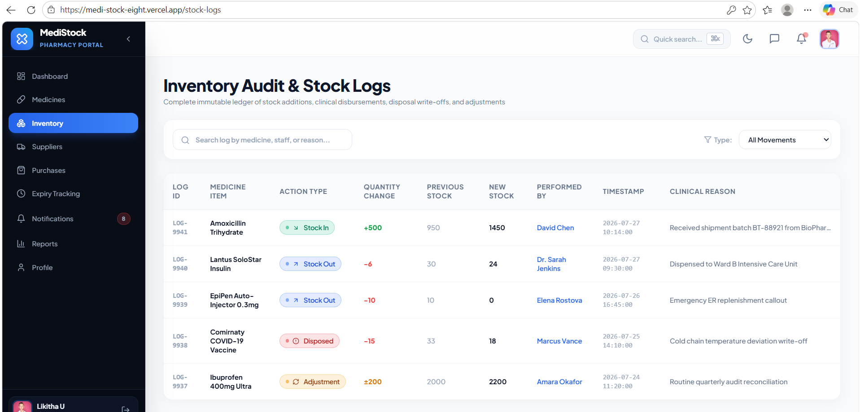
3. Inventory Tracking – Keep track of available quantities and stock changes.

Slide 6
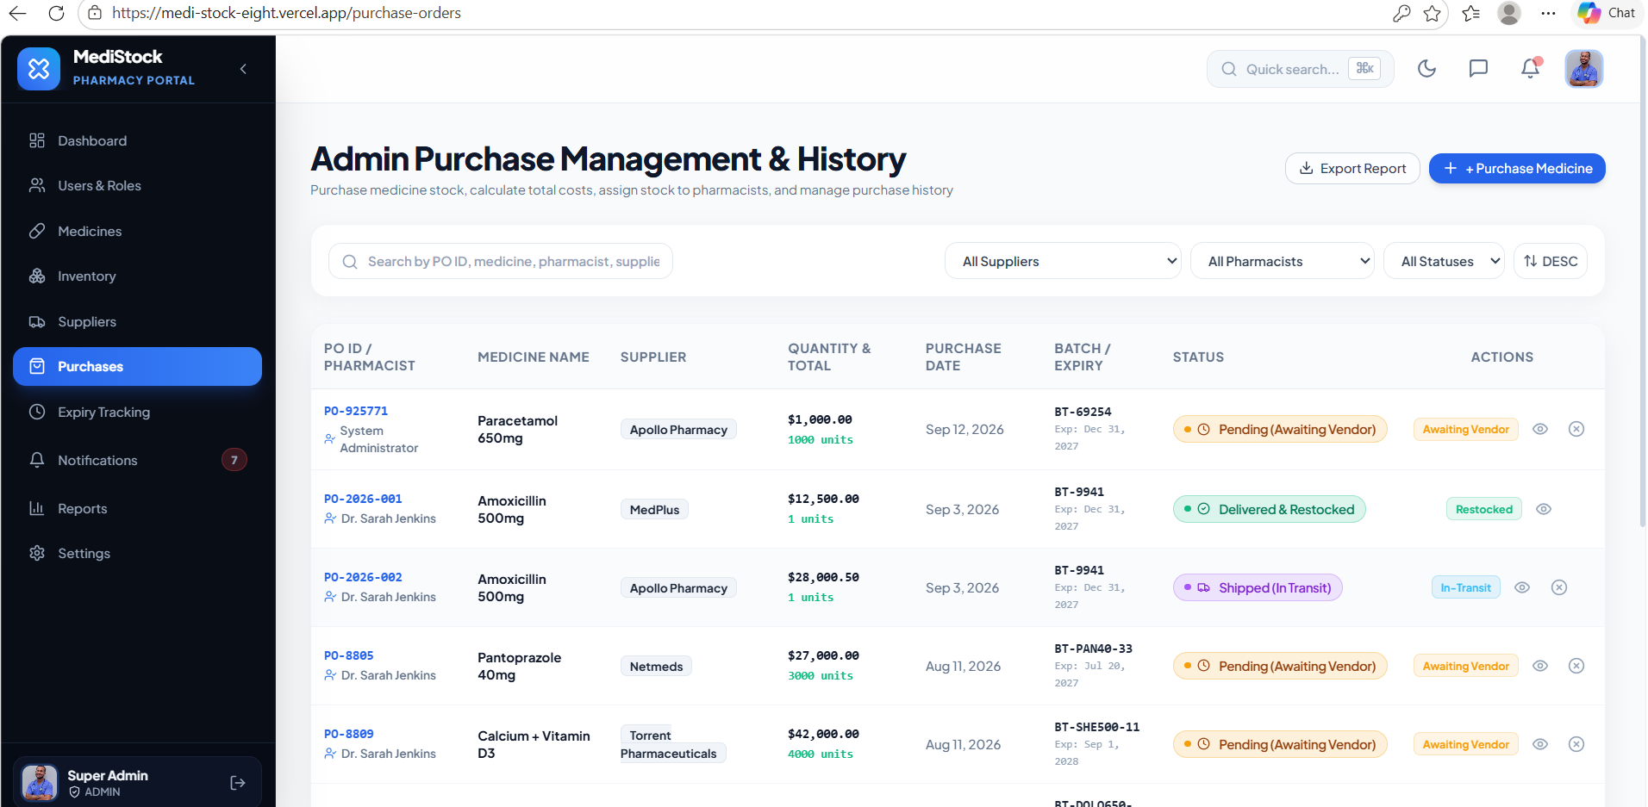
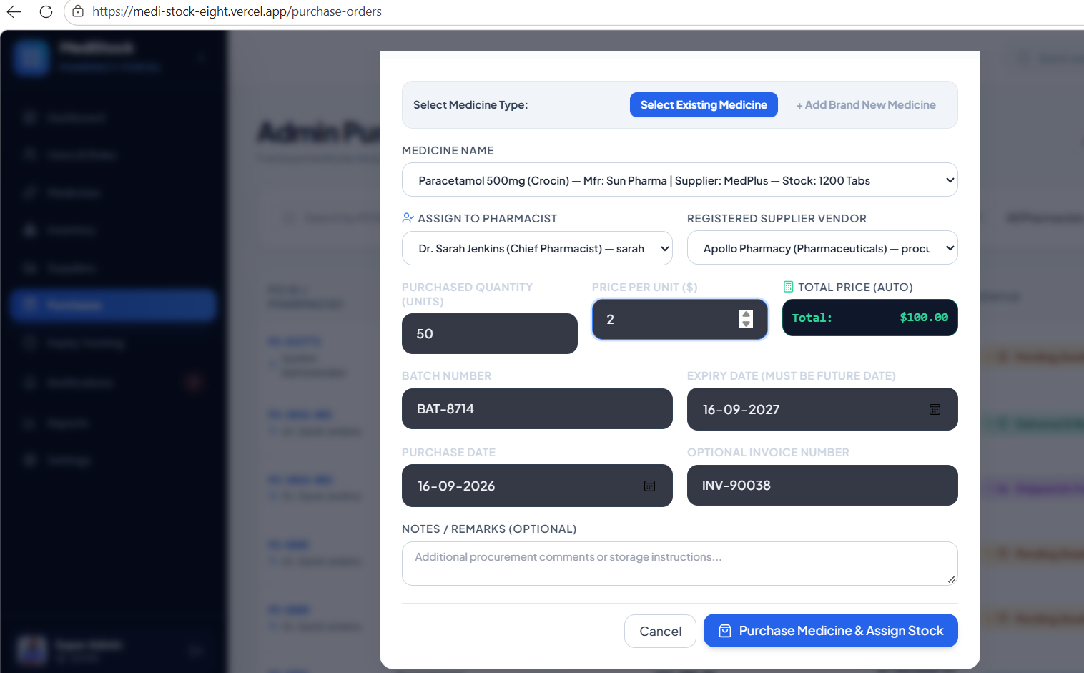
4. Purchase Orders – Create, manage, track, and update medicine purchase orders from suppliers to maintain optimal stock levels.

Slide 7
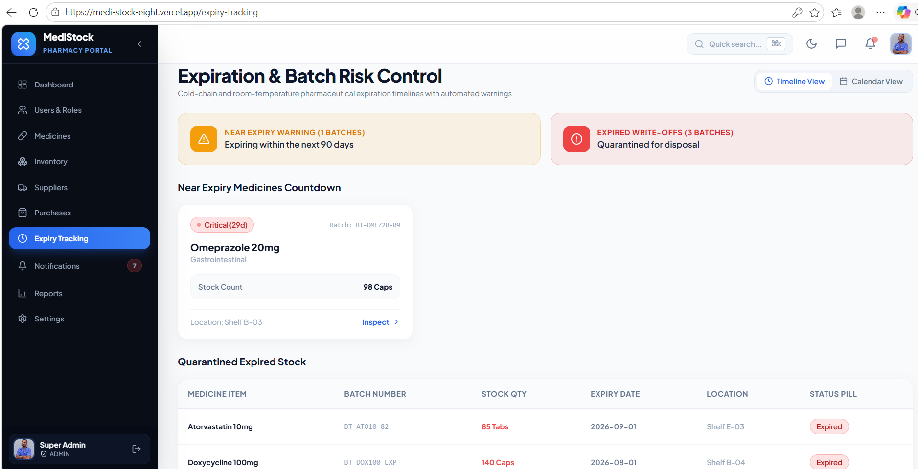
5. Expiry Tracking – Monitor medicine expiry dates and generate alerts to prevent expired stock usage and reduce inventory losses.

Slide 8
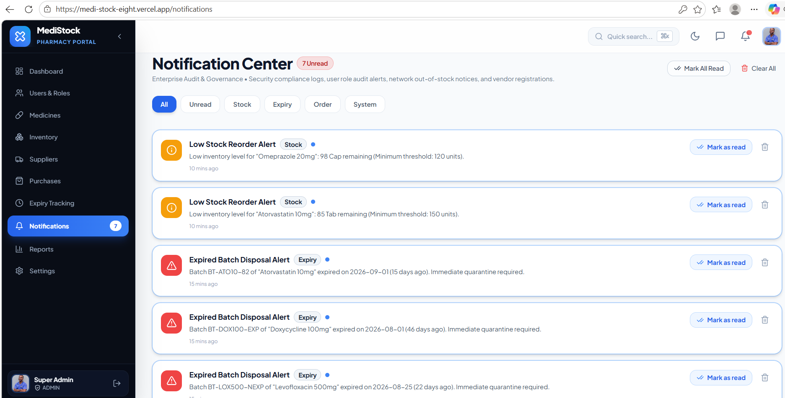
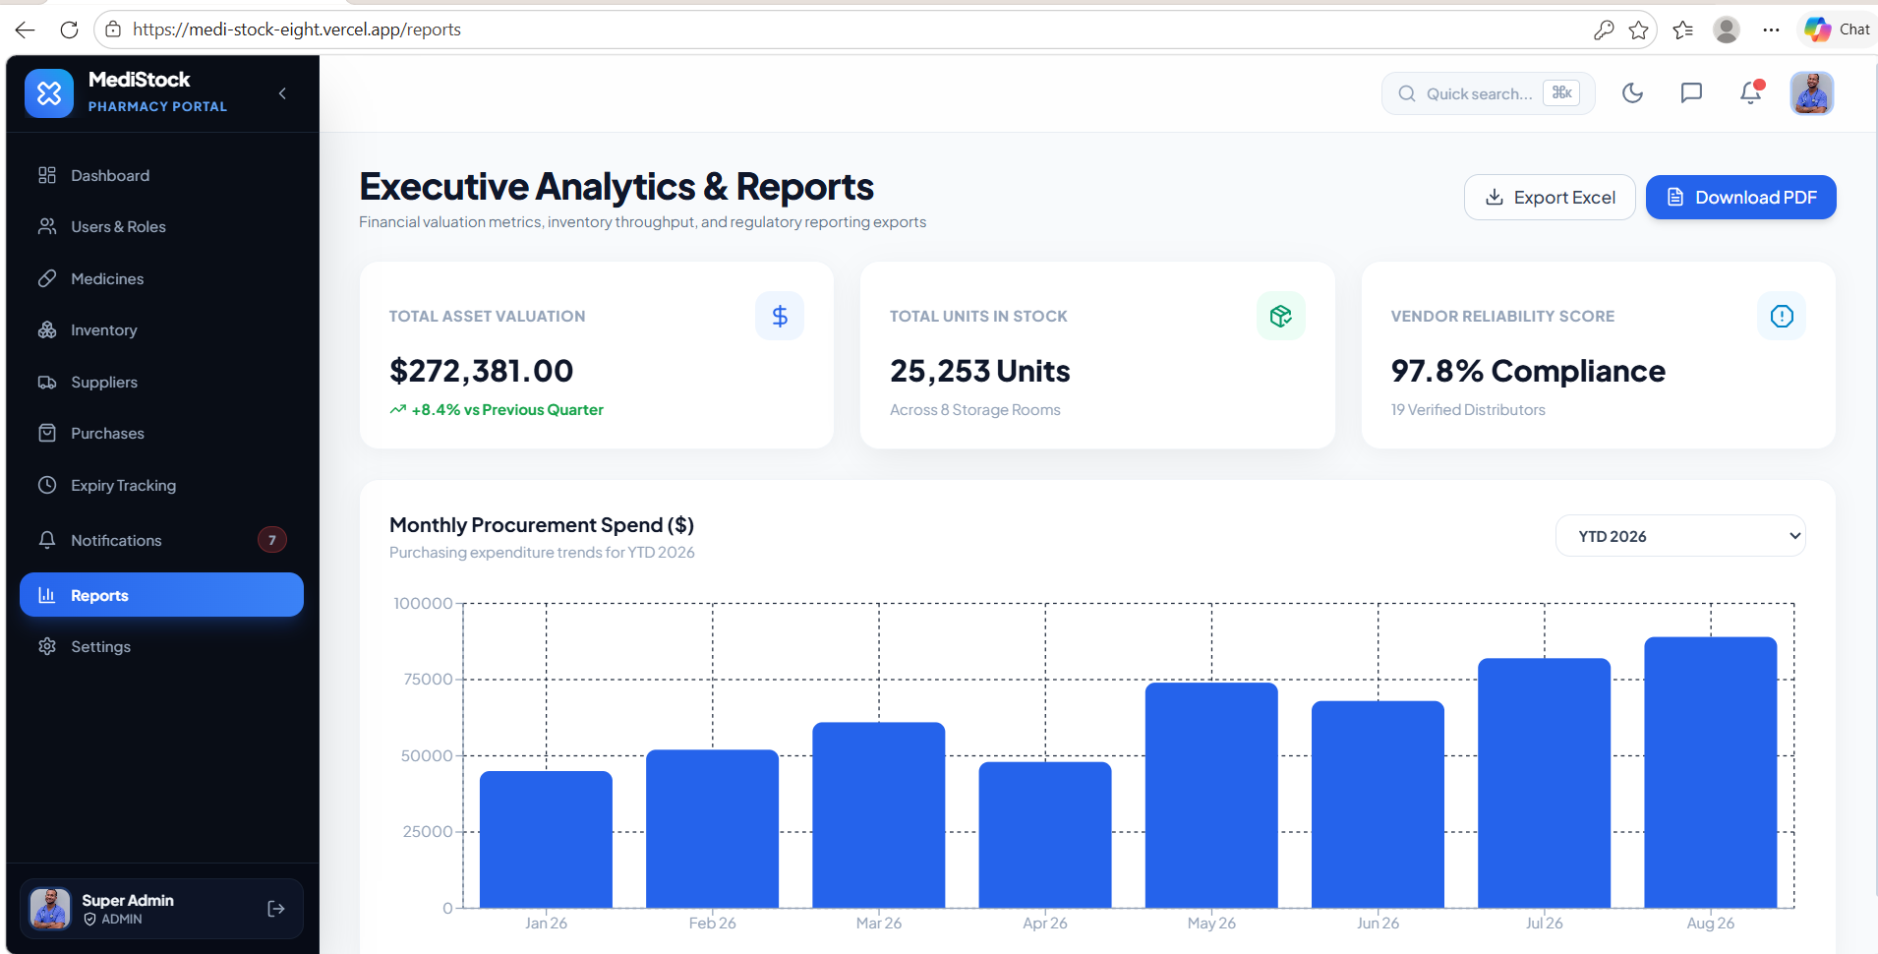
6. Notifications & Reports – Receive timely alerts for low stock and expiring medicines, with detailed reports for inventory monitoring and decision-making.

Slide 9
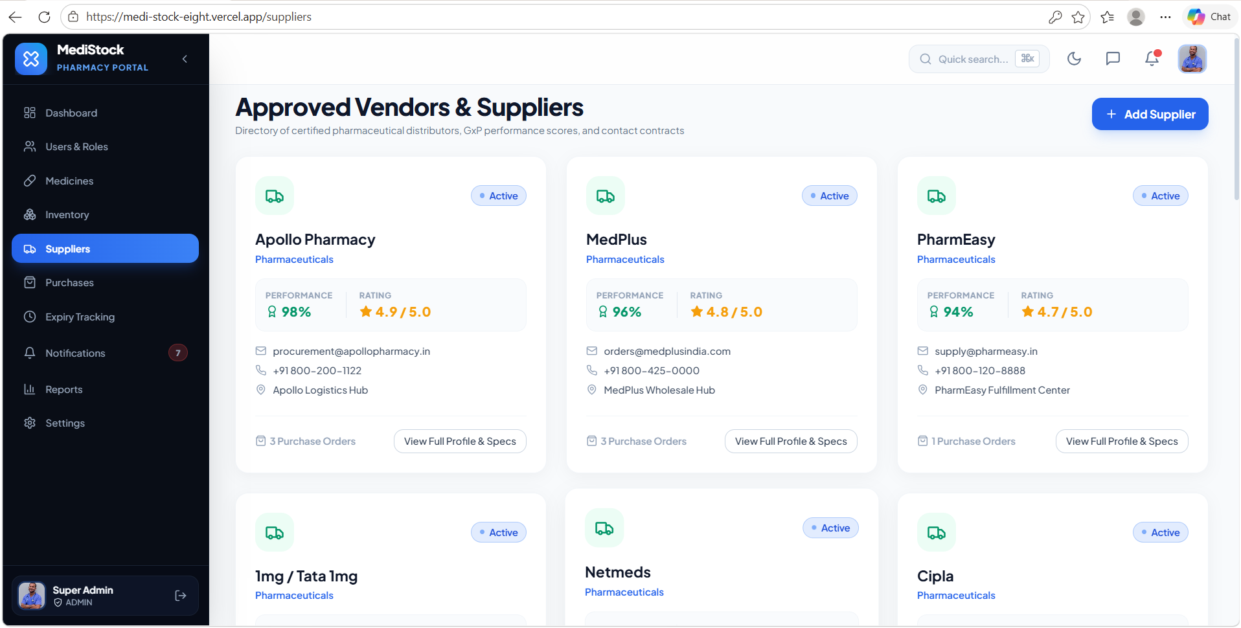
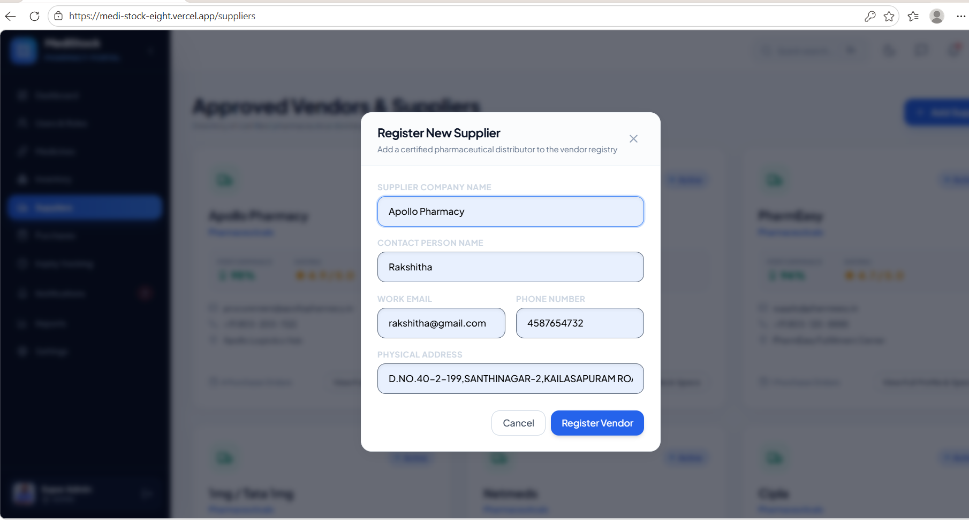
7. Supplier Management – Manage supplier details, purchase orders, and medicine supply records efficiently.

Slide 10
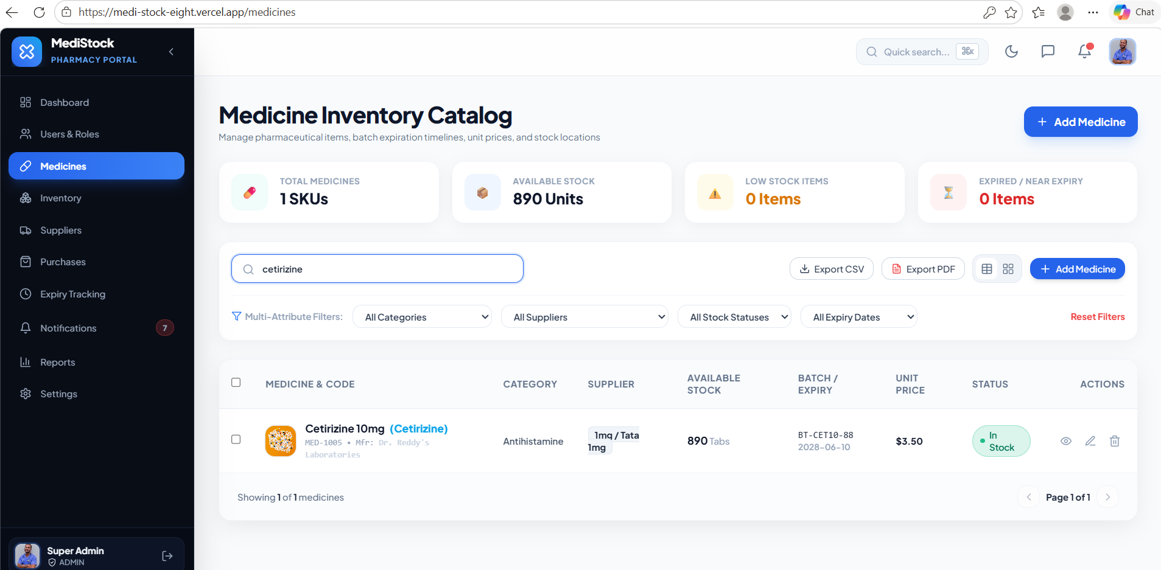
8. Search & Manage Medicines – Easily find and manage medicines within the system.

Slide 11
Challenges
In
MediStock
1
2
Stock Accuracy
Maintaining correct and up-to-date medicine quantities.
Ensures reliable information about available stock.
Medicine Management
Organizing and managing medicine information efficiently.
Helps keep medicine records clear and accessible.
3
4
Inventory Tracking
Monitoring stock levels and changes in inventory.
Helps identify current stock availability
Manual Data Handling
Reducing errors and effort involved in managing inventory records.
Improves the efficiency of maintaining inventory information.

Slide 12
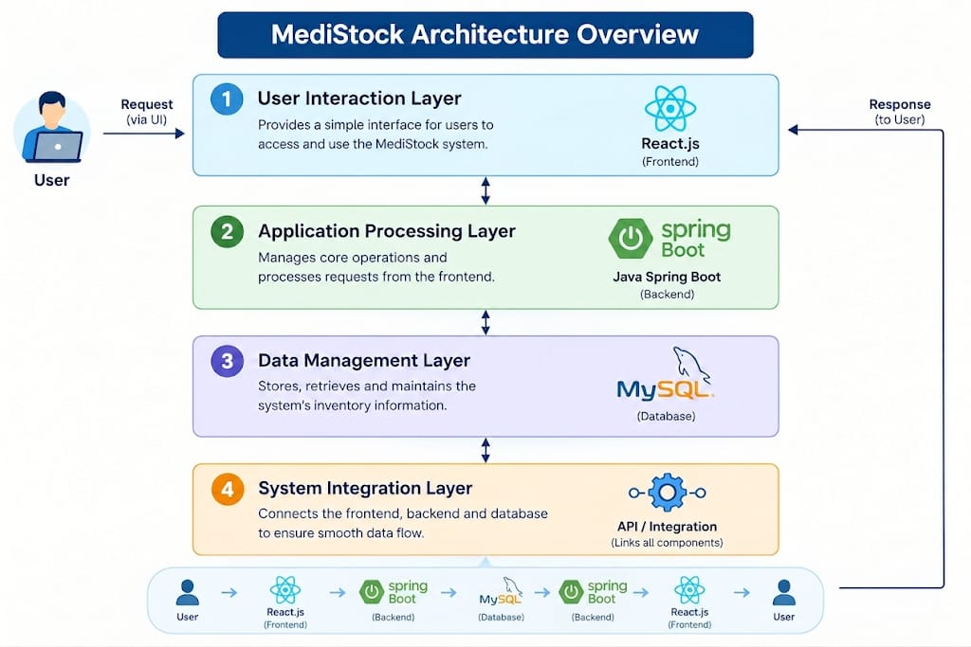
MediStock Architecture Overview
1. User Interaction Layer – Provides a simple interface for users to access and use the MediStock system.
2. Application Processing Layer – Manages core operations and processes requests from the frontend.
3. Data Management Layer – Stores, retrieves, and maintains the system’s inventory information.
4. System Integration Layer – Connects the frontend, backend, and database to ensure smooth data flow.

Slide 13
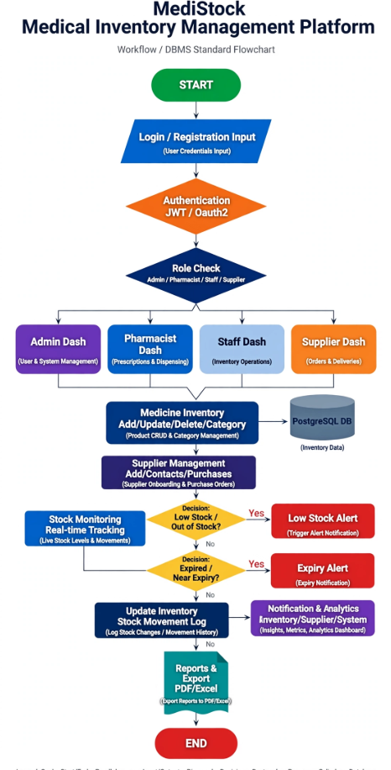
WorkFlow Of
MediStock

Slide 14
Challenges Faced & Solutions Applied in MediStock
1
2
Multiple Medicine Records
Information Consistency
Managing different medicine details can become difficult as records increase.
A centralized system keeps all medicine information organized and accessible.
Manual updates can lead to outdated or inconsistent inventory details.
The application allows information to be updated directly and maintained systematically.
3
4
Quick Data Access
Reliable Data Storage
Searching through separate records can take unnecessary time.
The system provides a simple interface for accessing required medicine information quickly.
Inventory information needs to be stored safely and in an organized format.
MySQL provides structured and persistent storage for the application's data.

Slide 15
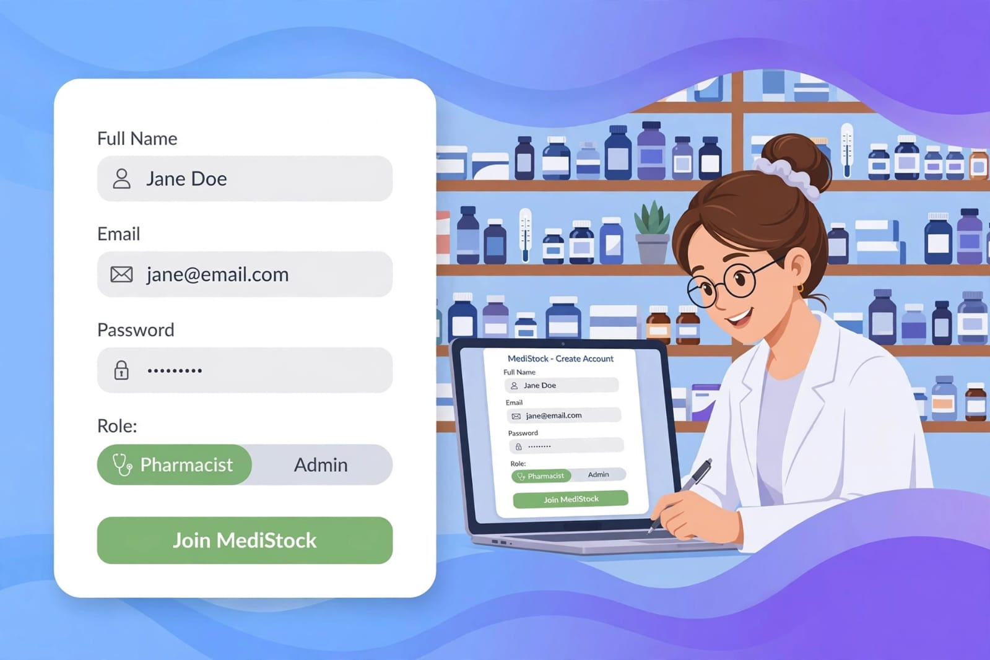
MediStock Admin Registration Process
MediStock Registration & Access
Simple User Registration
Users can complete the registration process by providing the required details to create an account.
Secure Authentication Features
User credentials are verified during login to provide controlled access to the MediStock platform.
Inventory Management Access
After authentication, users can access the dashboard to view and manage medical inventory information.

Slide 16
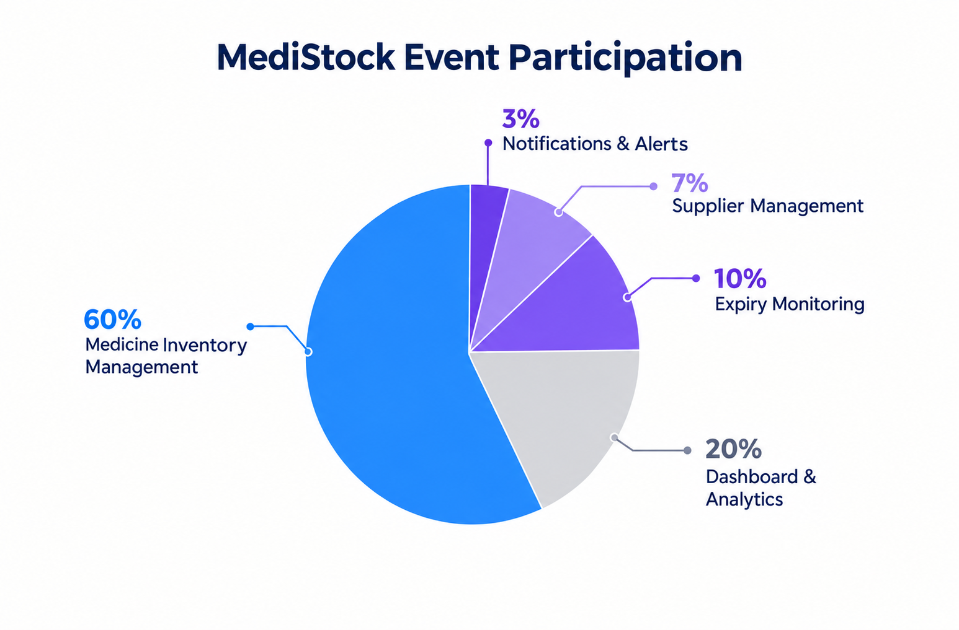
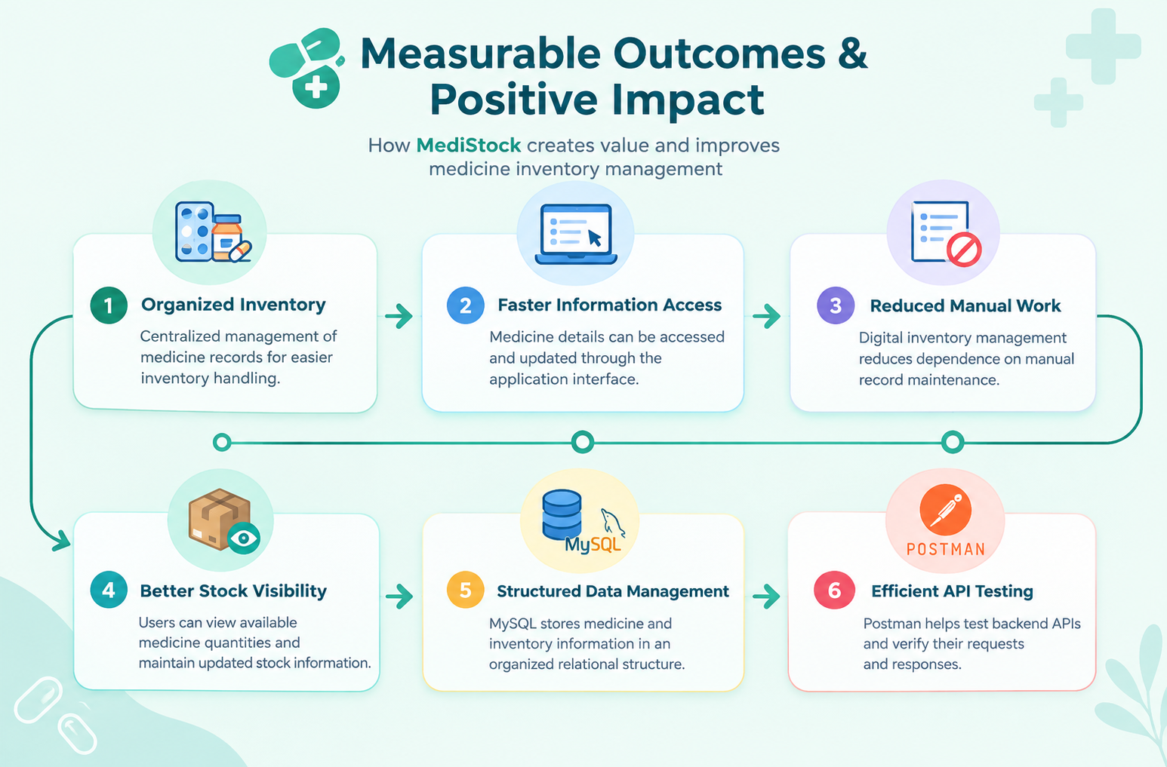

Measurable Outcomes and Positive Impact
Improved Inventory Management
Reduced Manual Effort
Improved Inventory Experience
MediStock provides a more organized and efficient way to manage medicine records, stock quantities, and inventory information.
MediStock reduces the need for manual inventory record handling, making medicine management more organized and efficient.
MediStock provides a simple and organized interface, making it easier to navigate, access, and manage medicine inventory information.

Slide 17
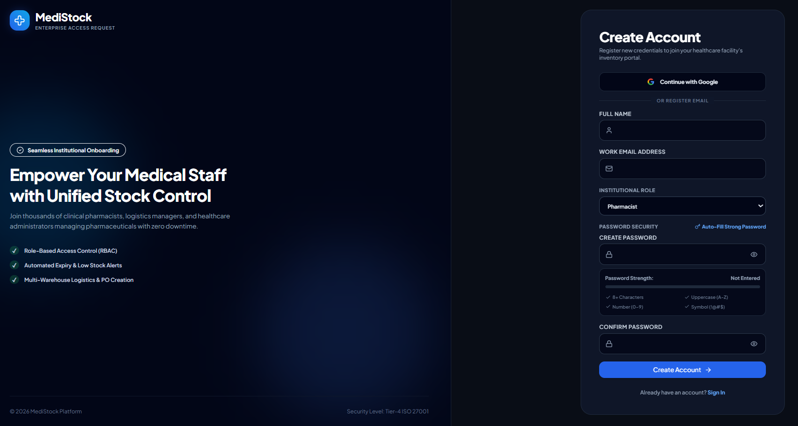
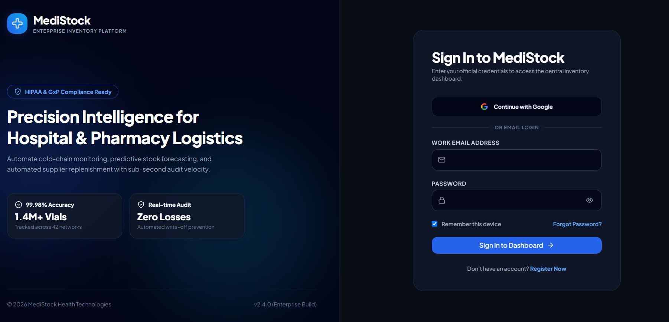
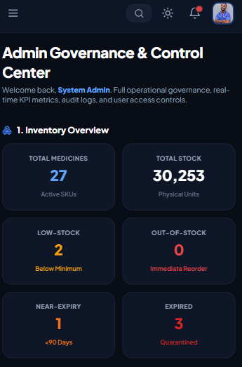
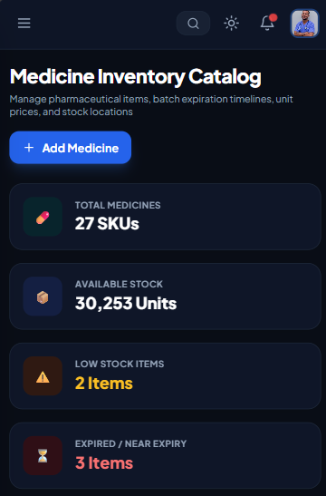
Outcomes Of MediStock

Slide 20
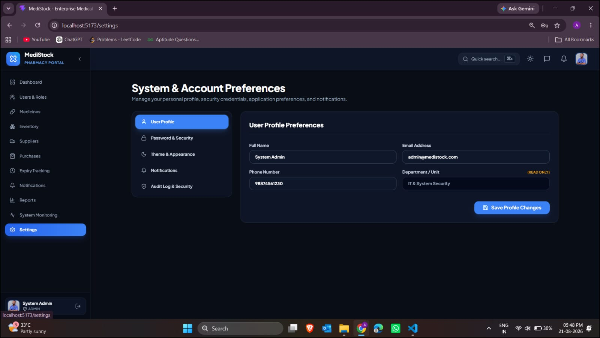

Slide 21
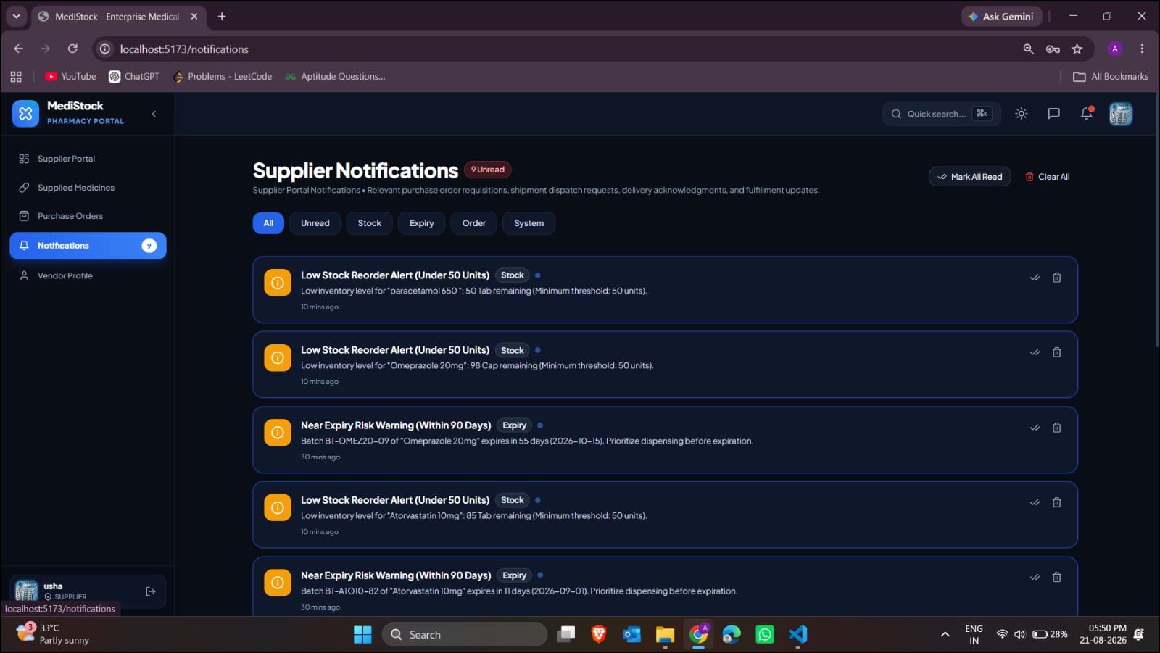
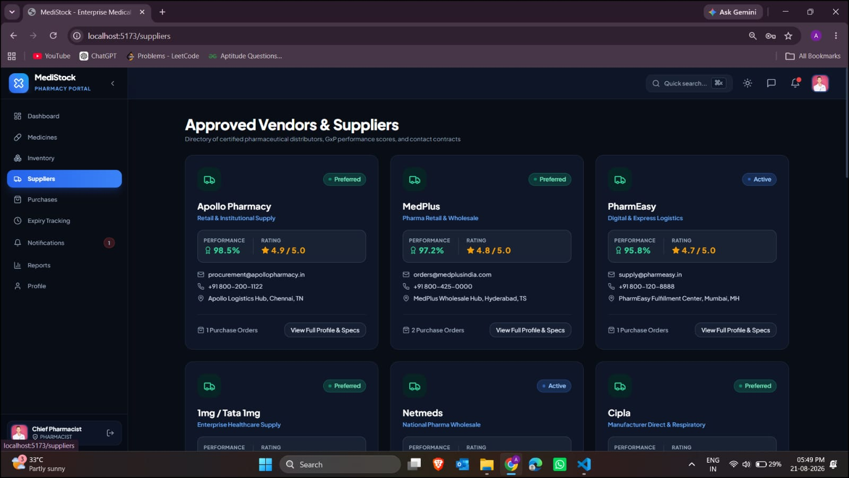

Slide 22


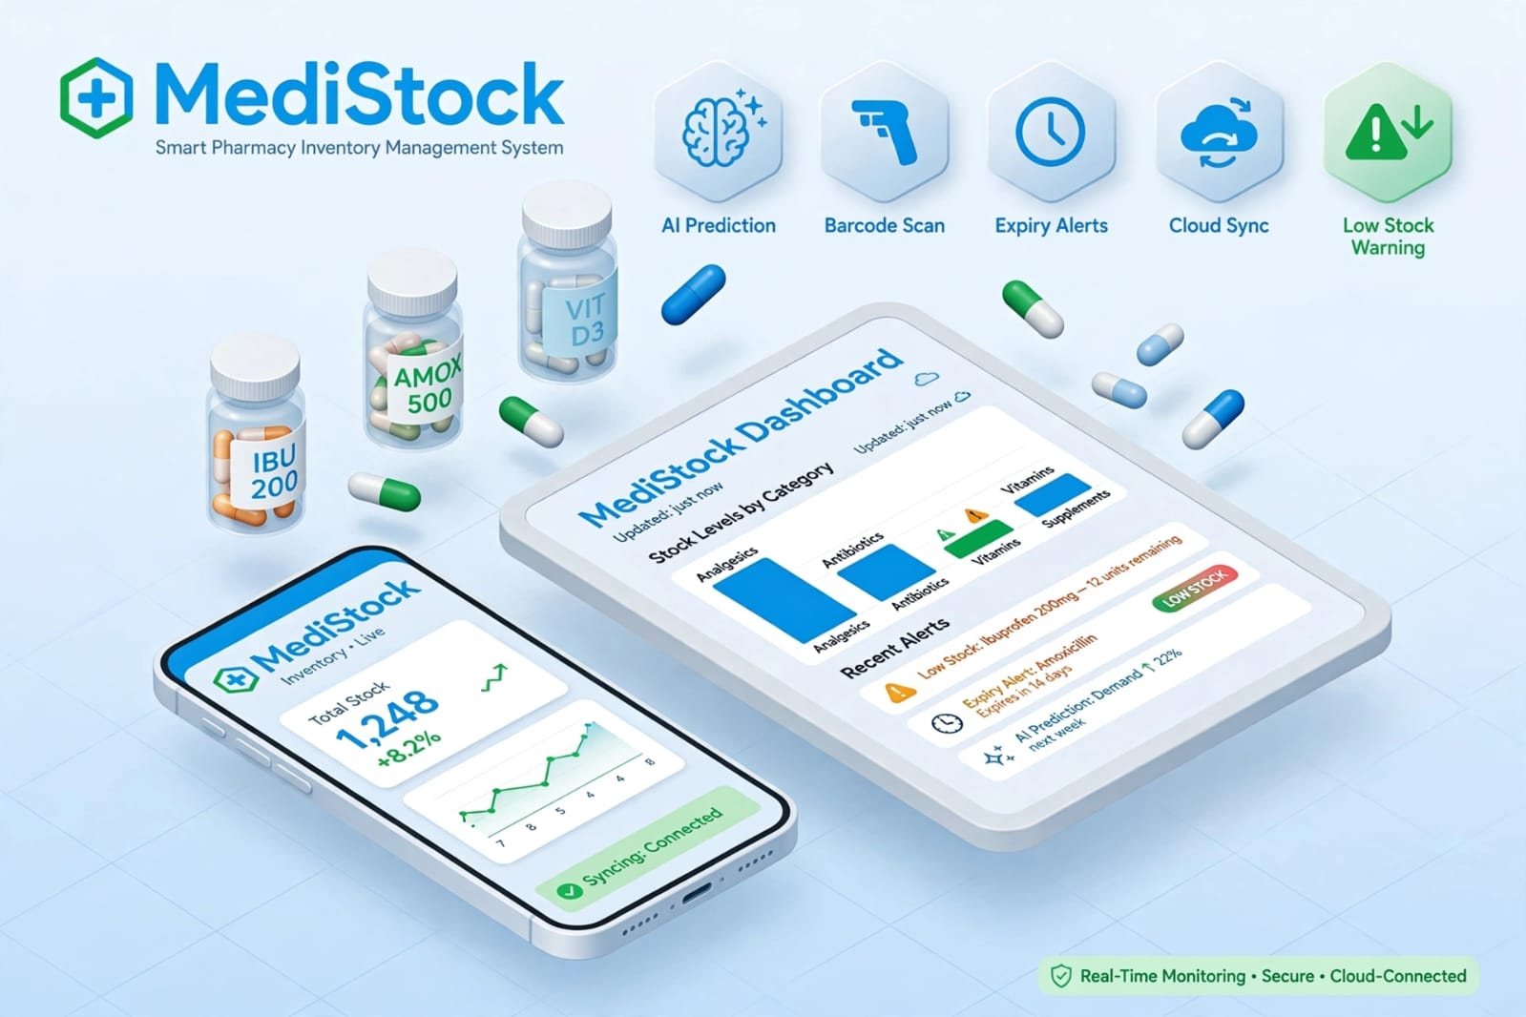
Future Enhancements Of MediStock
AI Recommendations for Enhanced Inventory Management
Inventory Analytics for Better Insights
Secure & Efficient Inventory Management
Smart Stock Insights: Use inventory data to identify stock trends and support better medicine management decisions.
Intelligent Alerts: Provide timely notifications for important stock conditions and help users respond efficiently.
MediStock presents inventory information in a clear visual format for easier monitoring and understanding.
It helps users review stock levels and identify inventory changes more efficiently.
MediStock streamlines medicine stock management through an organized and user-friendly inventory system.
It maintains accurate inventory information while reducing manual effort and improving overall efficiency.

Slide 23
TEAM MEMBERS
Anil Upputuri
Chekkili UshaSree
Chandur Supriya

Slide 24
Presentation Video...
https://drive.google.com/file/d/1k7EpoDi8cXpbXP86h3MRU2nQAyO9_sjS/view?usp=sharing

Slide 25
Q n A

Slide 26

Thank You

