Slide 1




Slide 2




Technology Stack: MediStock Framework Explained
Spring Boot: The Backend Framework
MYSQL: The Database
React.js: The User Interface Library
Security: Authentication & Access Control
Spring Boot provides the backend services and REST APIs for inventory management, expiry tracking, stock alerts and reporting.
MYSQL stores stock, expiry, batch and inventory-related data in a structured and reliable database.
React.js is used to build the interactive frontend of MediStock, including the dashboard, inventory views, alerts and report interfaces.
Spring Security with JWT/OAuth2 helps secure the application, authenticate users and protect backend APIs.

Slide 3
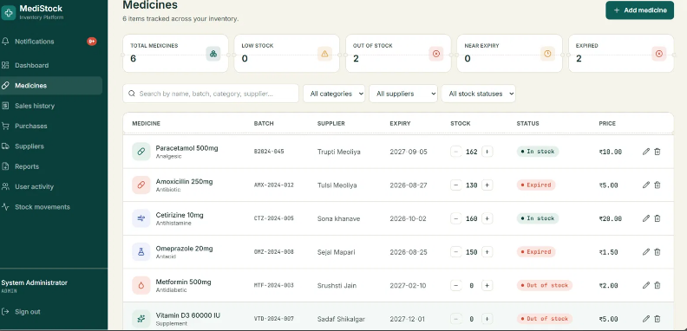
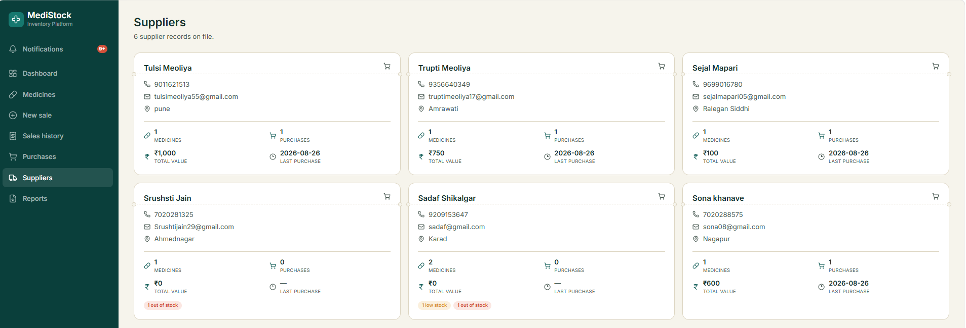
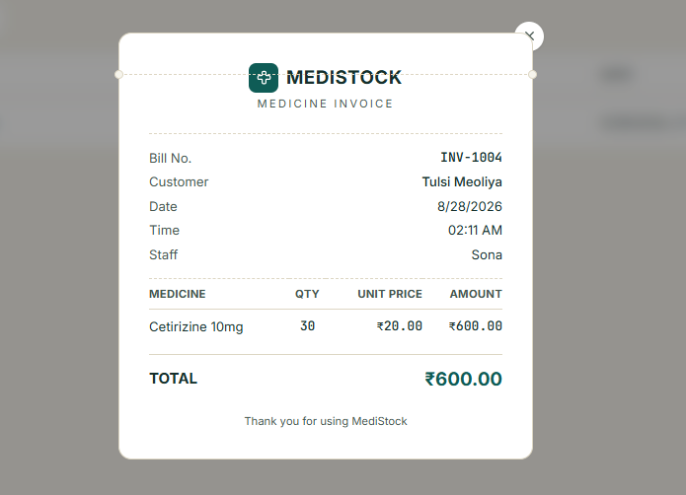
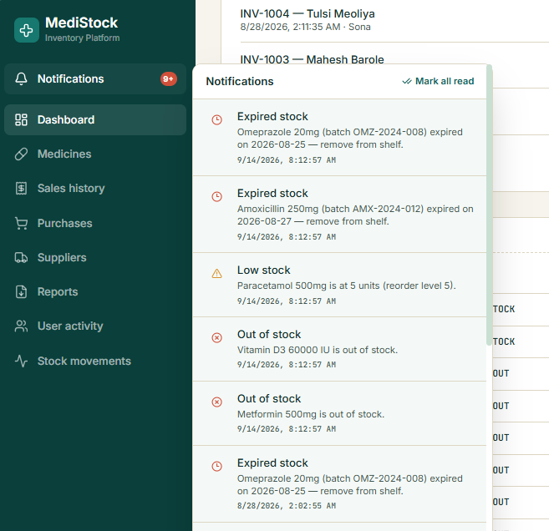
Core Features of MediStock Platform
Stock Alerts Made Easy
Manage suppliers Interface
Invoice Generation Module
Expiry Monitoring Made Easy

Slide 4
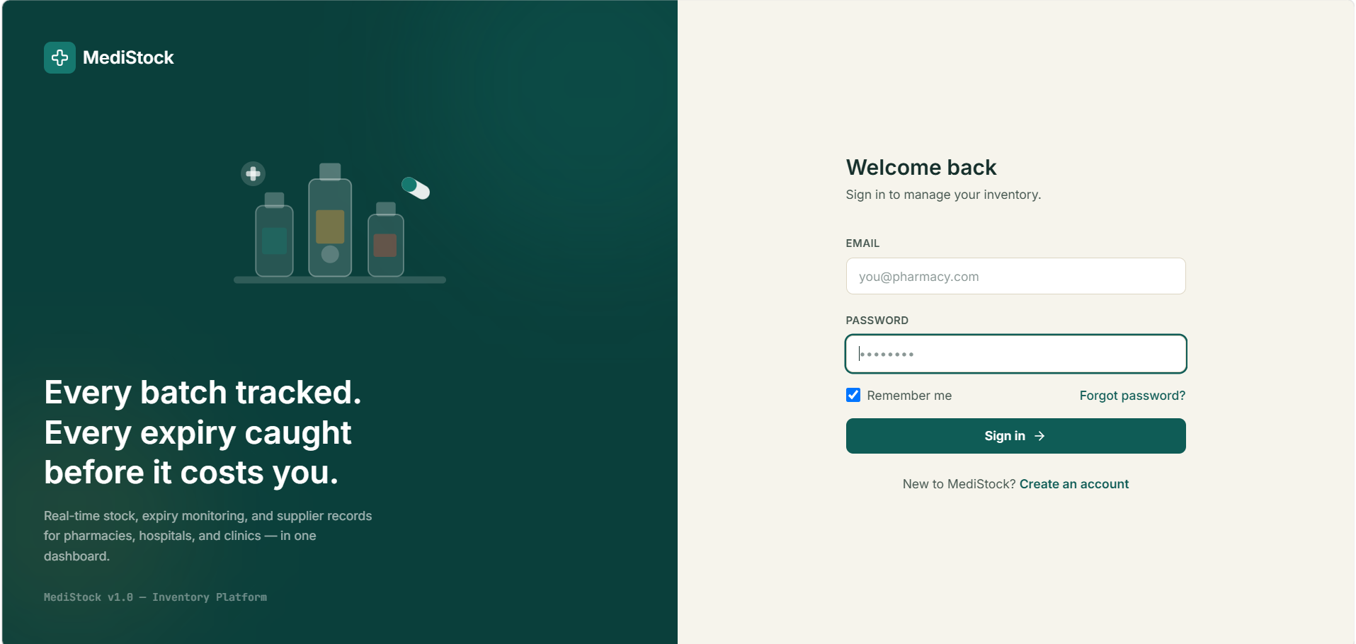
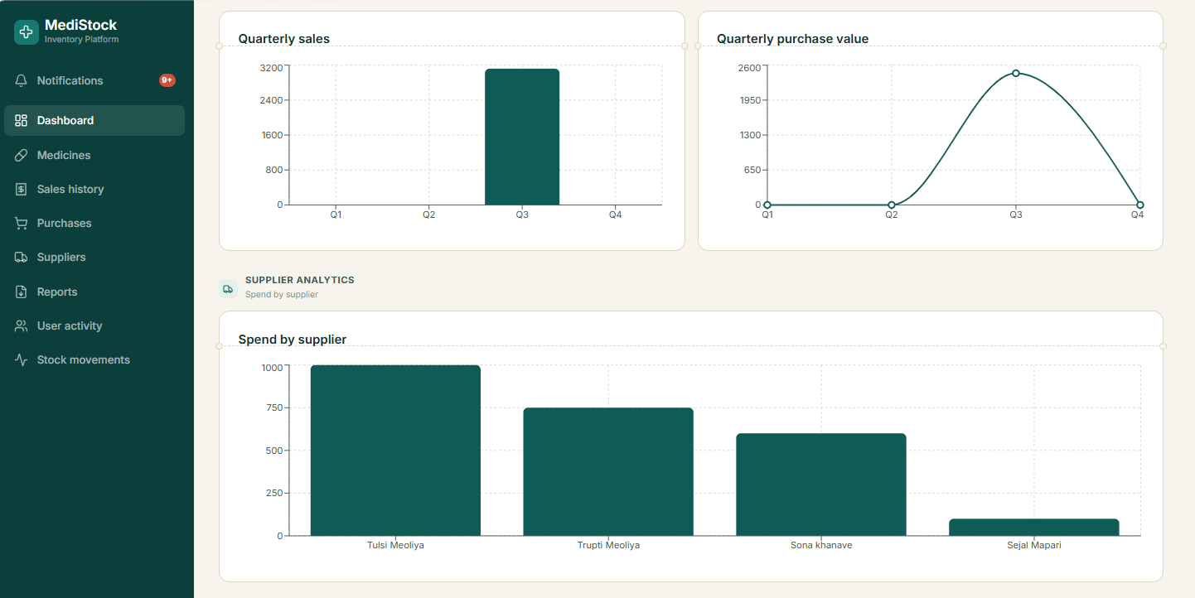
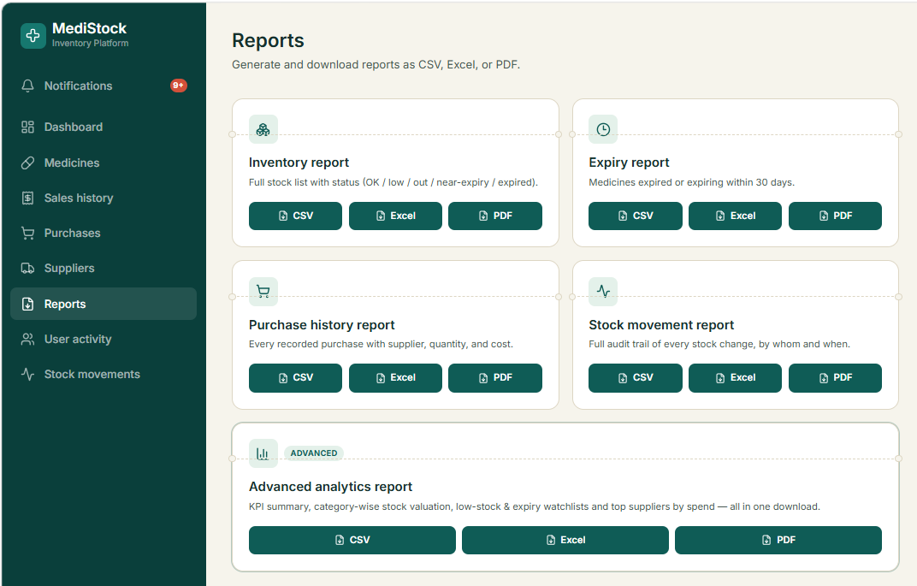
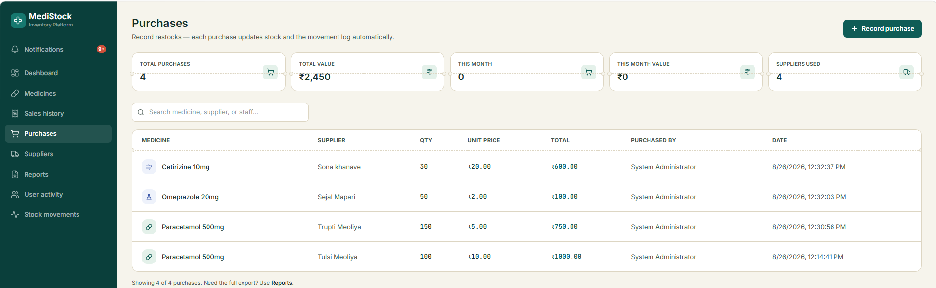
Core Features of MediStock Platform
User Authentication & Role-Based Access
Dashboard & Analytics
Reports
Purchase Management

Slide 5
Challenges Facing Medical Inventory Management
1
2
Manual Stock Handling
Expiry Tracking Risk
Maintaining accurate and up-to-date medicine stock records manually is difficult.
Medicines are at risk of expiring without timely identification of expiry dates.
3
4
Low-Stock Detection
Centralized Stock View
Difficulty in identifying medicines that are running low or out of stock.
Getting a single, complete overview of stock, purchases, and inventory activities is challenging.
5
6
Supplier & Order Handling
Role-Based Access
Managing suppliers, purchase orders, and medicine replacement becomes complex.
Different users require different levels of access to system functionalities.

Slide 6
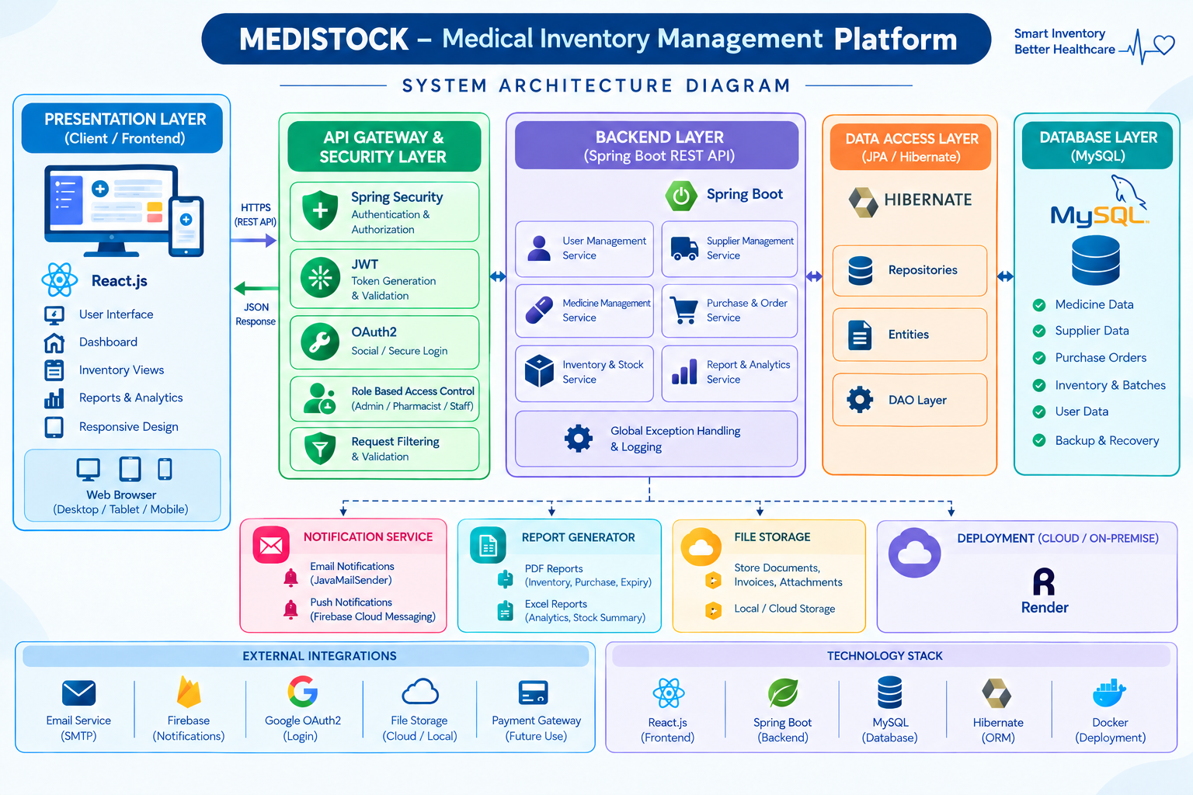
System Architecture Overview
MEDISTOCK is a medical inventory management system built using React.js for the frontend, Spring Boot for the backend, and MySQL for data storage. It uses Spring Security, JWT and OAuth2 for secure authentication, while Hibernate/JPA manages database communication. The system handles medicines, suppliers, purchases, inventory, reports, notifications, and file storage, with deployment through Render.

Slide 7
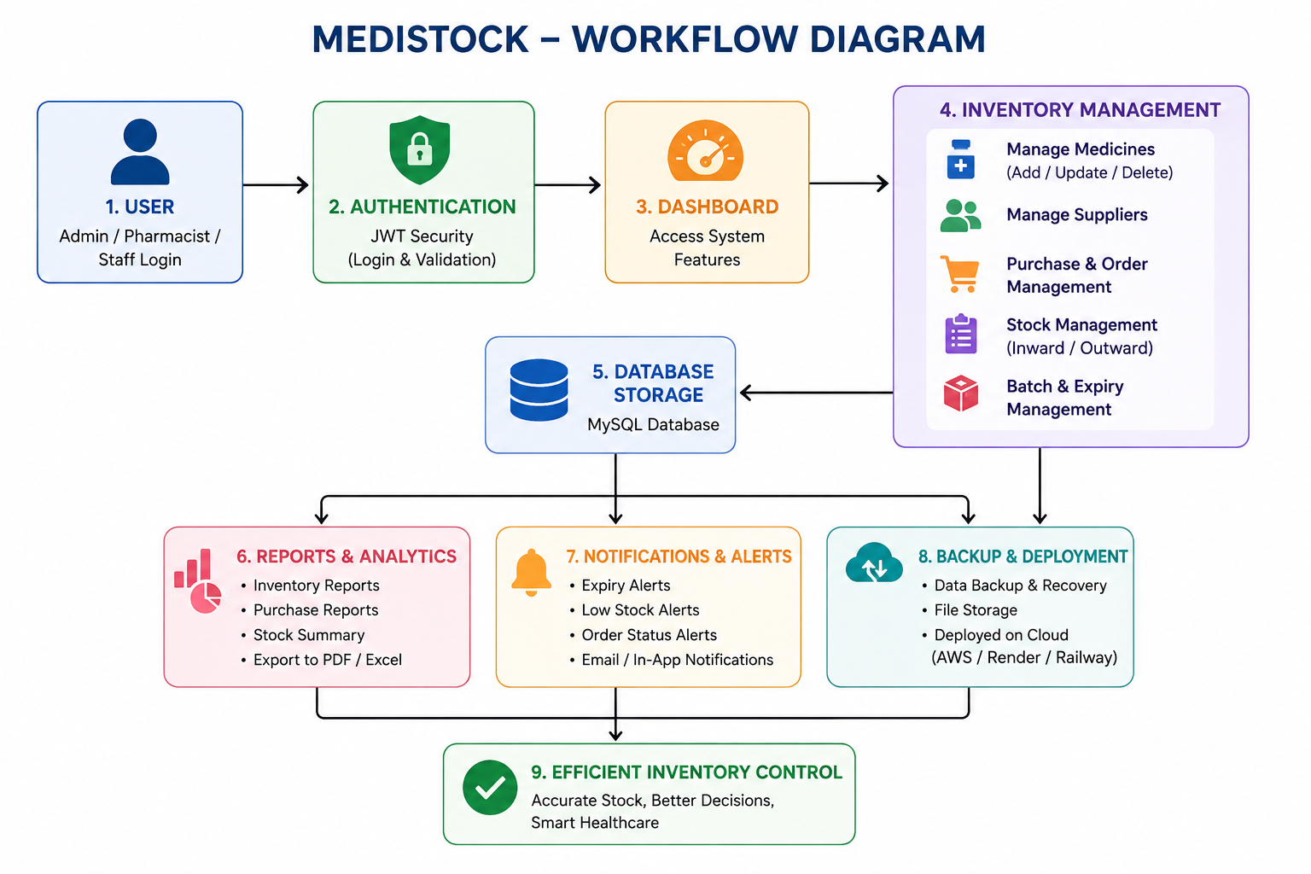
Workflow Diagram
MEDISTOCK workflow starts with user login and JWT authentication, followed by dashboard access. Users can manage medicines, suppliers, purchases, stock, batches and expiry. All data is stored in MySQL, while the system provides reports, notifications, backups and cloud deployment, resulting in efficient and accurate inventory control.

Slide 8
Challenges and Solutions in MediStock
1
2
Manual Inventory Management
Out-of-Stock Situations
Automate inventory records and stock updates. Reduce manual work and data-entry errors. Maintain accurate and up-to-date stock information.
Continuously monitor medicine stock levels. Compare available stock with minimum stock thresholds. Alert staff when medicines are low or out of stock.
3
4
Delayed Notifications
Difficult Decision Making
Staff may not receive timely information about low-stock medicines. Notify staff about near-expiry and expired medicines.
Enable timely action and restocking.
Provide real-time inventory information in one place. Display stock, expiry, and inventory trends clearly. Support faster and data-driven decisions.

Slide 9
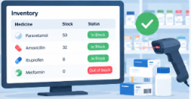


Measurable Outcomes and Positive Impact
Real-Time Stock Accuracy
Minimized Medicine Expiry Losses
Efficient Stock Monitoring and Control
Automated inventory tracking keeps medicine records up to date and reliable. It minimizes human mistakes and helps maintain accurate stock information across the system.
The system tracks expiry dates and sends timely alerts. This helps staff take preventive action and reduce medicine wastage.
Real-time inventory monitoring provides clear visibility of stock levels. Instant alerts support better inventory management and decision-making.

Slide 10
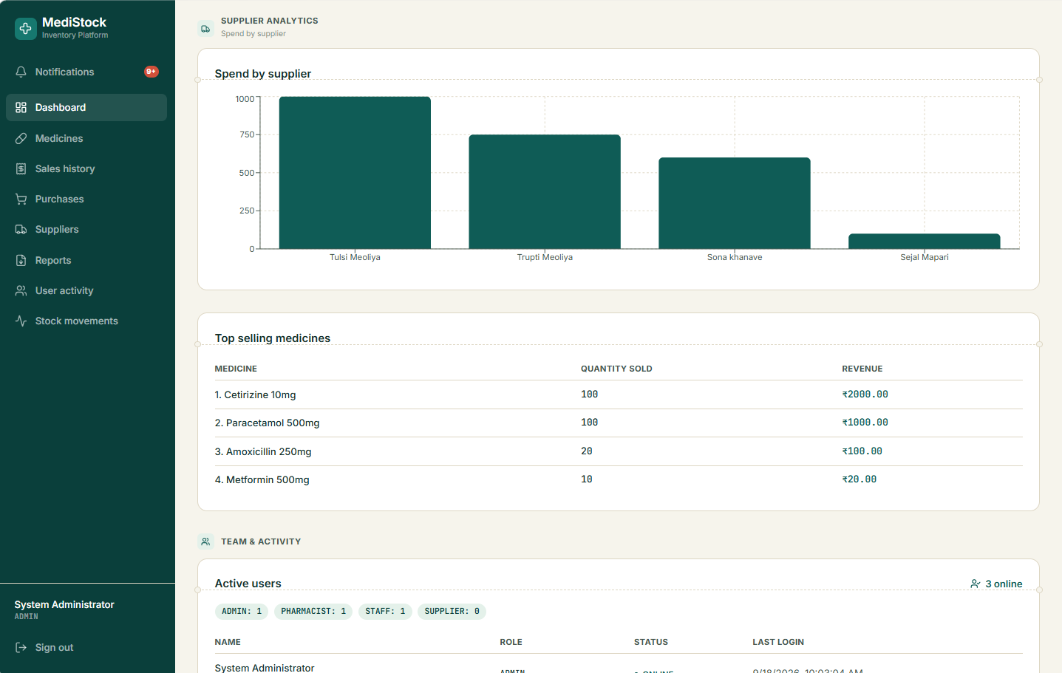
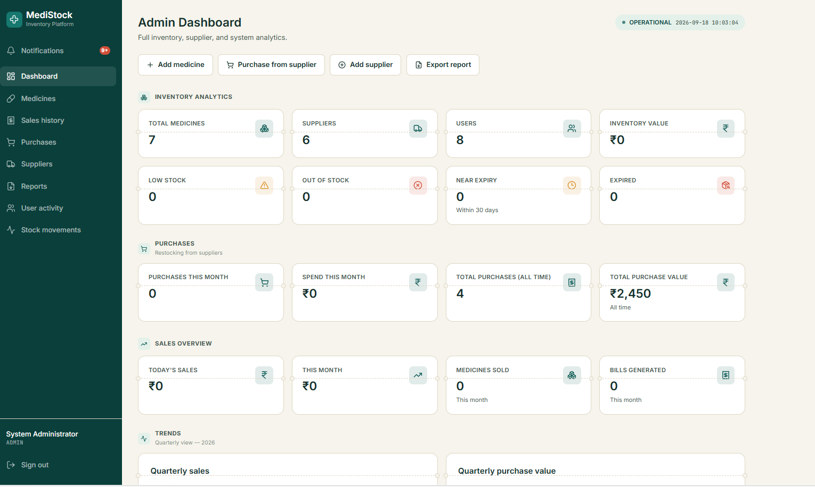
Outcome
Login Page
Supplier & Sales Analytics
Admin Dashboard

Slide 11
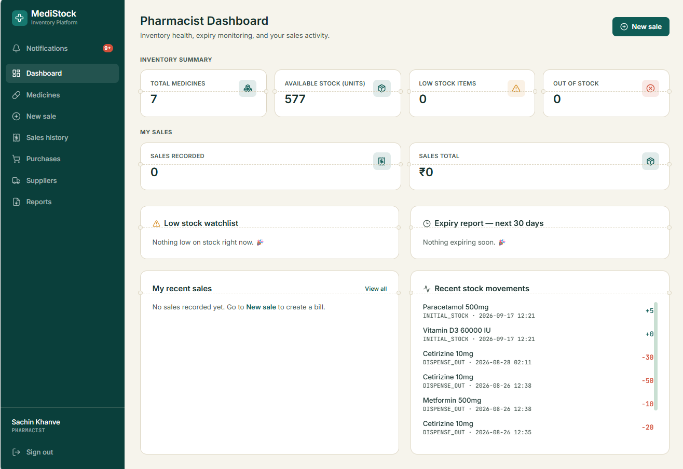
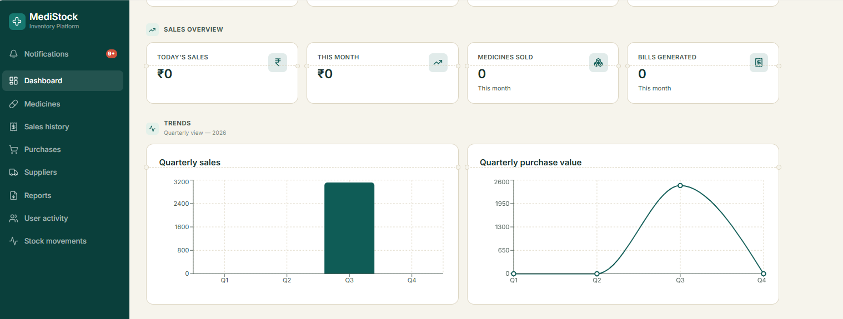
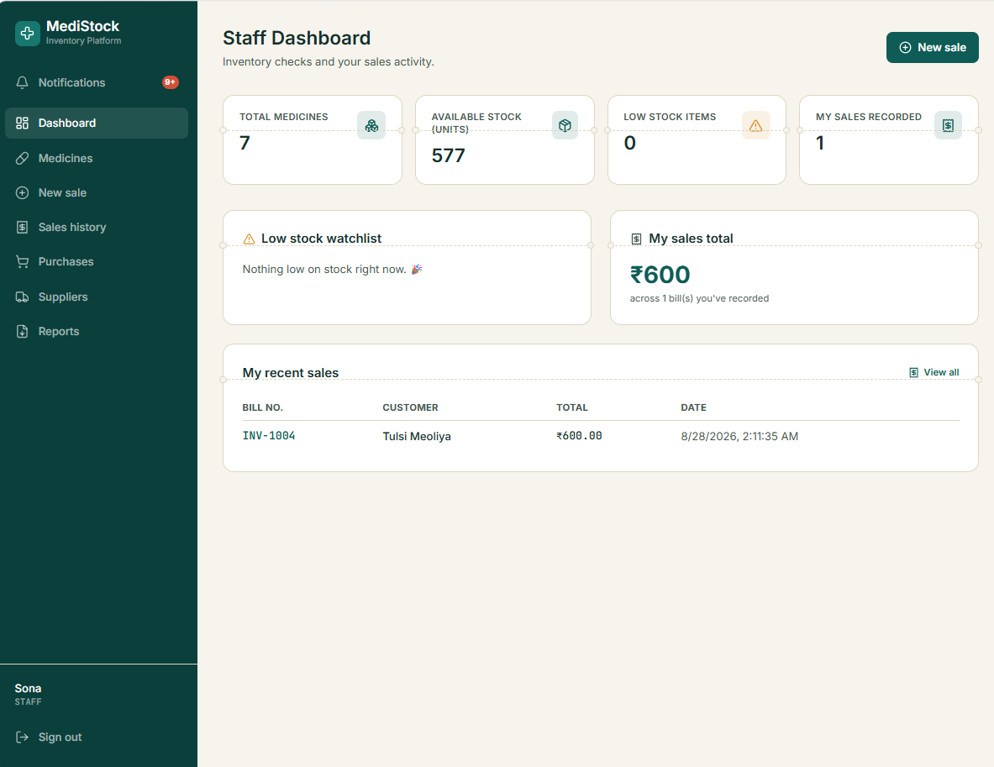
Pharmacist Dashboard
Sales & Purchase Analytics
Staff Dashboard

Slide 12

Medical Inventory Management Process
Easy Medicine Management
The system allows staff to easily add, update, delete and manage medicine details, including stock and expiry information.
Secure Authentication
JWT-based authentication and role-based access control help protect inventory data and provide secure access to authorized users.
Smart Dashboard Access
The Medistock dashboard provides real-time information about stock levels, expiry alerts, purchases, suppliers, reports and inventory analytics.

Slide 13



Future Enhancements for MediStock
AI-Powered Inventory Optimization
Advanced Analytics Dashboard
Automated Supplier Management
  Analyze inventory patterns automatically.
  • Generate smart stock recommendations.
  • Improve inventory planning and efficiency.
  Provide detailed inventory insights.
  • Track medicine usage and stock trends.
  • Support data-driven decision making.
  Streamline supplier communication.
  • Automate purchase order generation.
  • Improve procurement efficiency.

Slide 14
TEAM-1 MEMBERS
Tulsi Meoliya
Sai Krishna Balaji

Slide 15
Presentation Video...
https://drive.google.com/file/d/1Ws44X9cS4hBiXbP0O4oVgGcgZFXy_fbF/view?usp=drivesdk

Slide 16
Q n A

Slide 17

Thank You

