Slide 1
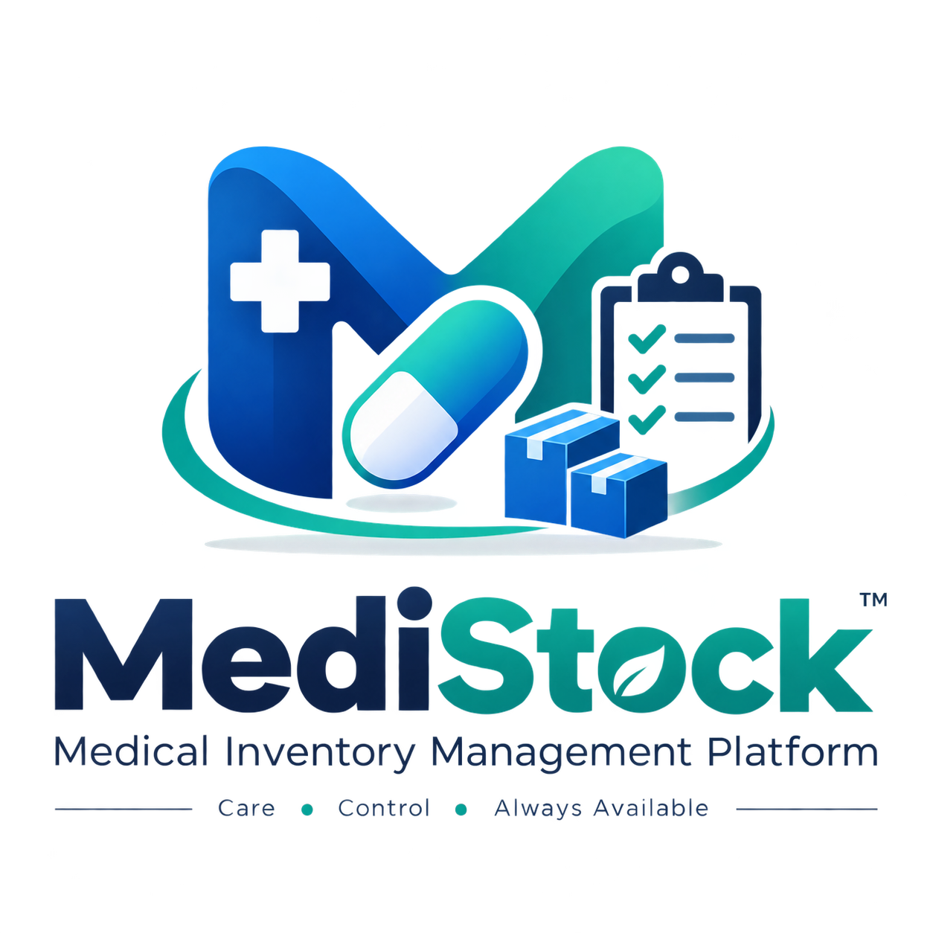
INFOSYS SPRINGBOARD INTERNSHIP
MediStock
Medical Inventory
Management Platform
TEAM 9
Nalla Bhavitha • Vishnu Vardhan • Raj Kumar
A secure, role-based platform for medicine inventory, procurement, sales, expiry monitoring, alerts and analytics.

Slide 2
Project Understanding & Objectives
What MediStock is designed to solve — and how the platform addresses it.
A centralized digital inventory platform for pharmacies, hospitals and healthcare organizations.
01
02
03
Single source of truth
Act before shortages or expiry
Turn records into insight
Medicines, batches, stock, suppliers, purchases and sales are managed through connected workflows.
Low-stock, out-of-stock and expiry monitoring brings operational risks into focus.
Dashboards, analytics, notifications and exportable reports support day-to-day inventory decisions.
DESIGN GOAL
Secure • Scalable • Maintainable • Production-deployable

Slide 3
Problem Statement
The operational gaps MediStock addresses.
01
Manual Records
02
Stock Visibility
Registers and disconnected spreadsheets make inventory updates slower and more error-prone.
Without timely visibility, low-stock and out-of-stock medicines can be missed.
03
Expiry Risk
04
Supplier Fragmentation
Batch-level expiry information needs continuous monitoring to reduce avoidable expiry losses.
Supplier contacts, purchase history and order status are harder to coordinate when kept separately.
MediStock converts these disconnected activities into a connected, role-based workflow.

Slide 4

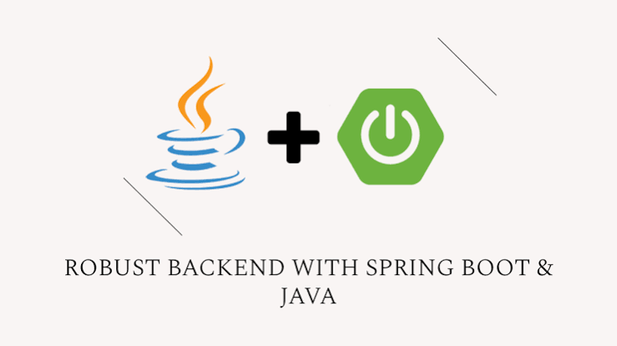


Technology Stack
Technology choices used in the implemented Medi stock application.
FRONTEND
BACKEND
DATABASE
SECURITY & TOOLS
React • Vite
Tailwind CSS
React Router • Axios
Java 21
Spring Boot
Spring Data JPA
Hibernate
PostgreSQL
JPA / Hibernate
Relational data model
Database scripts
Spring Security
JWT •BCrypt
Maven • Postman
Git • GitHub
R
Application flow: React UI → REST APIs → Spring Boot services → JPA/Hibernate → PostgreSQL

Slide 5
Core Feature Suite
Functional modules implemented across the application.
01
02
03
Inventory & Batches
Stock Operations
Expiry Tracking
Medicine CRUD, categories, batch control, quantity, pricing, supplier and expiry data.
Stock in/out, adjustments, stock history, low-stock and out-of-stock monitoring.
Batch-level expiry status and dedicated tracking for expiring and expired stock.
04
05
06
Procurement
Sales & Prescriptions
Notifications & Reports
Supplier directory, purchase orders, shipment tracking and supplier catalogue.
Customer sales, prescription workflows, automatic stock deduction and billing.
Role-aware alerts, analytics and exportable inventory, purchase and expiry reports.

Slide 6
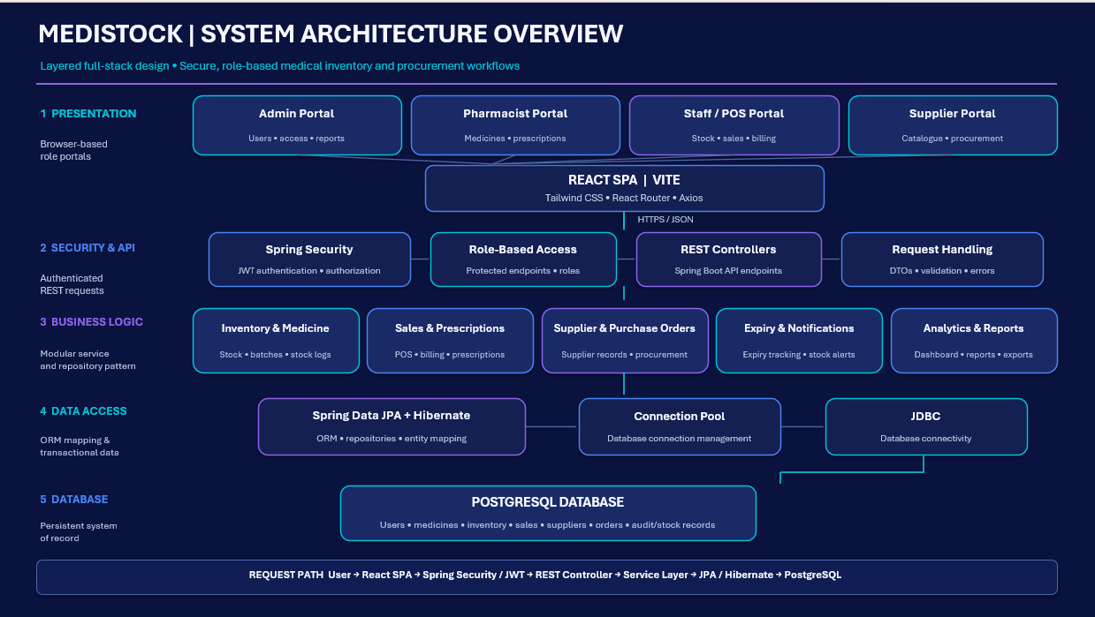
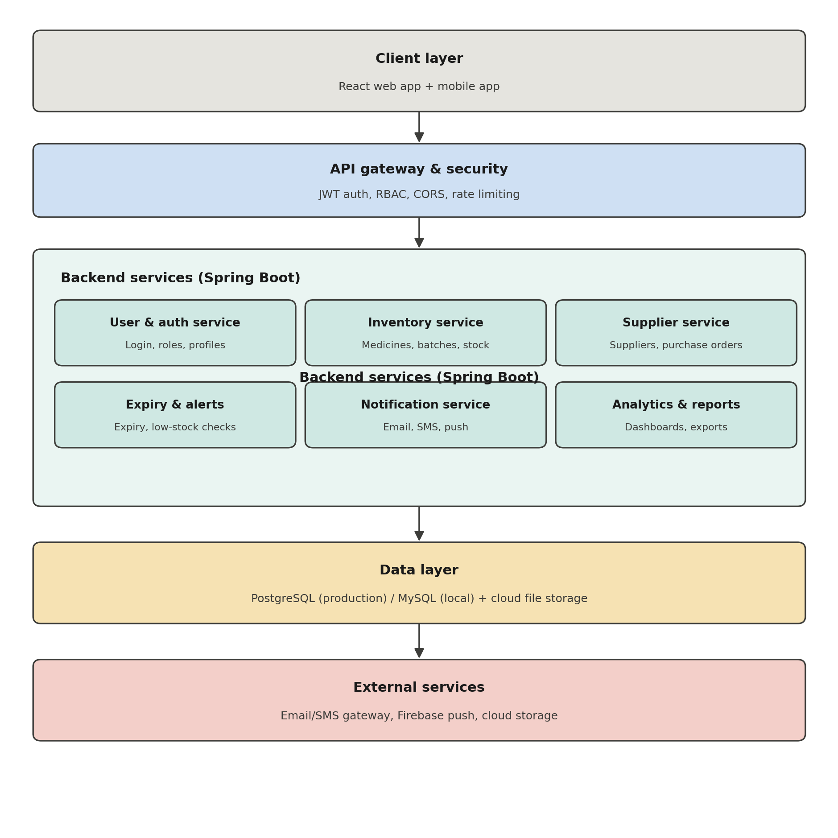
System Architecture
Layered application design separating UI, security, business services and persistence.
CLIENT
DATA
React + Vite
Responsive UI
PostgreSQL
JPA / Hibernate
API / SECURITY
SERVICES
REST + JWT
RBAC + CORS
Inventory • Sales
Procurement • Analytics

Slide 7
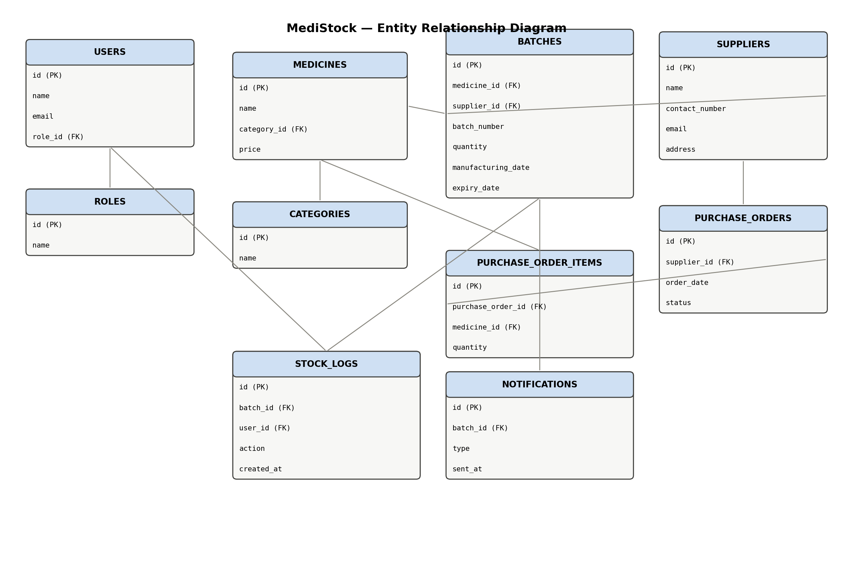
Database Design
Relational model supporting inventory, procurement, operations and access control.
Key relationships: Users/Roles • Medicines/Categories/Batches • Suppliers • Purchase Orders • Stock Logs • Notifications

Slide 8
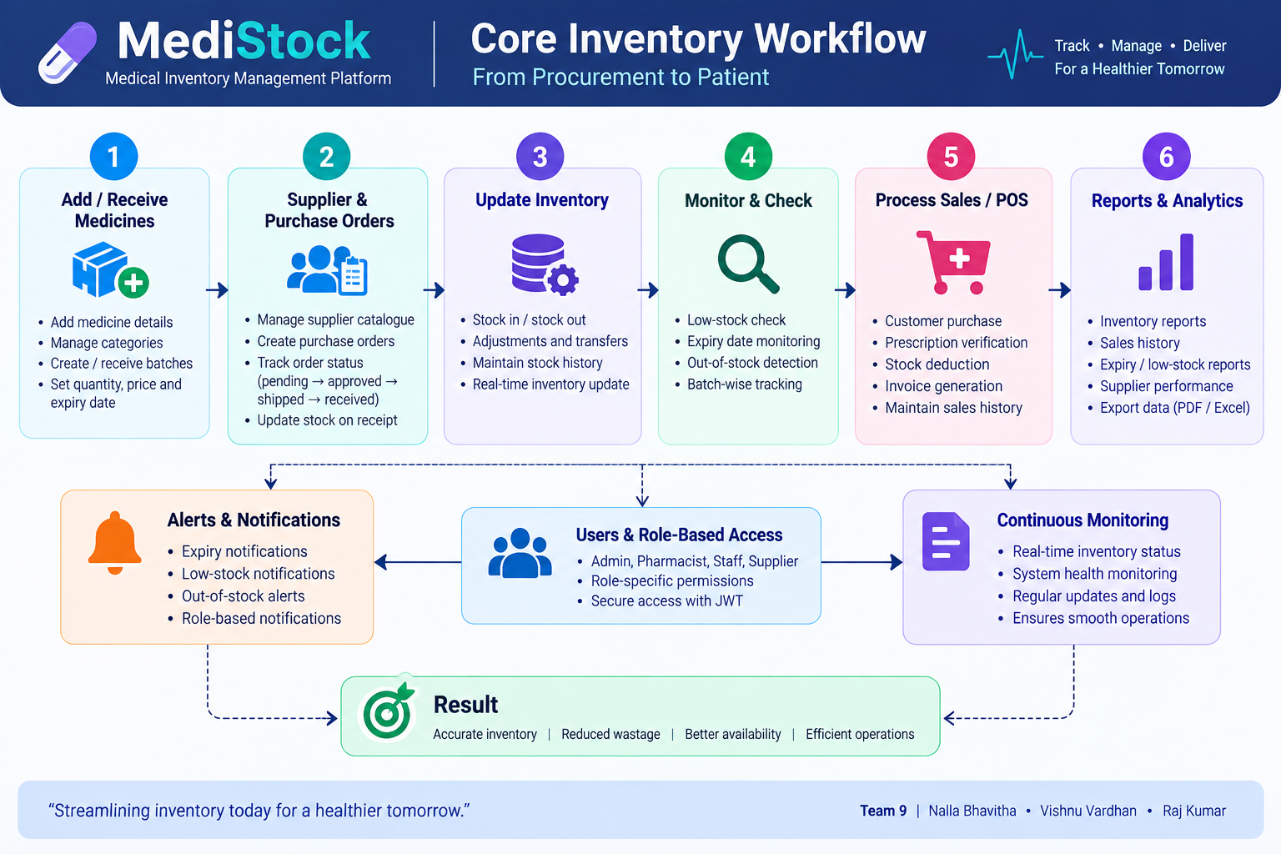
Core Inventory Workflow

Slide 9
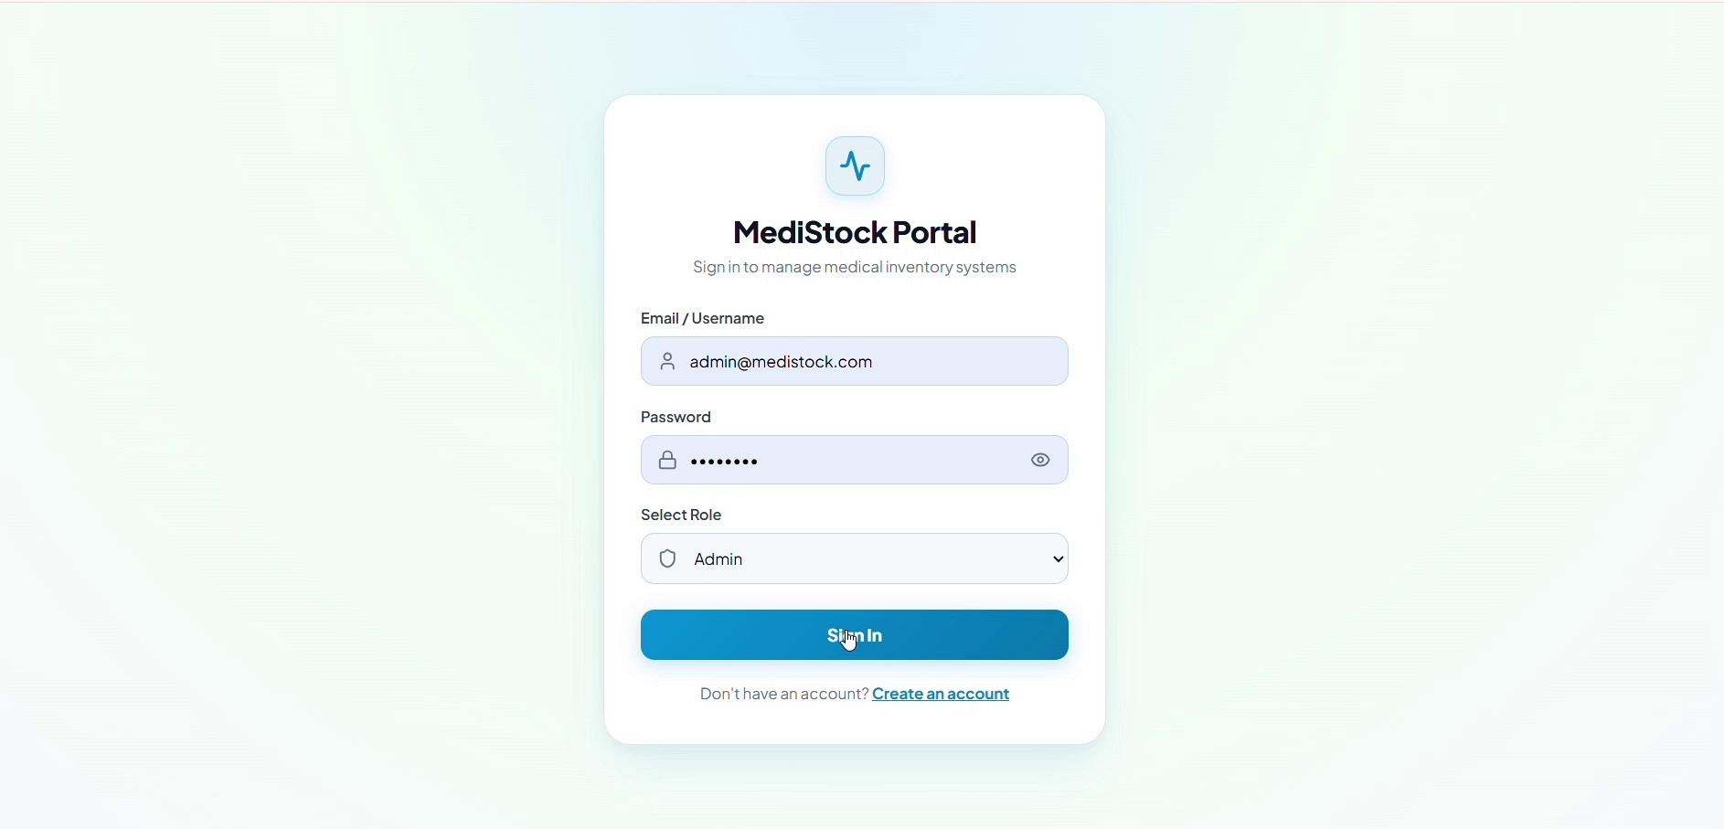
Secure Authentication & Role-Based Access
Security controls
• Login-based access
• JWT for protected API requests
• BCrypt password protection
• Role-based permissions
• Implemented workflows for Admin, Pharmacist, Staff and Supplier
Security is applied at the API/application layer rather than relying only on the UI.

Slide 10
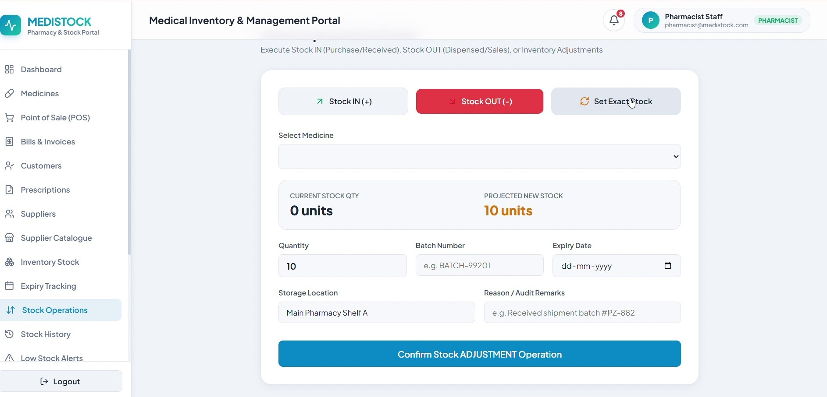
Inventory & Stock Operations
Operational stock movement with batch and quantity context.
Implemented workflow
• Stock IN / OUT operations
• Quantity and batch information
• Stock adjustments
• Inventory status monitoring
• Stock history / audit trail
• Backend persistence through JPA

Slide 11
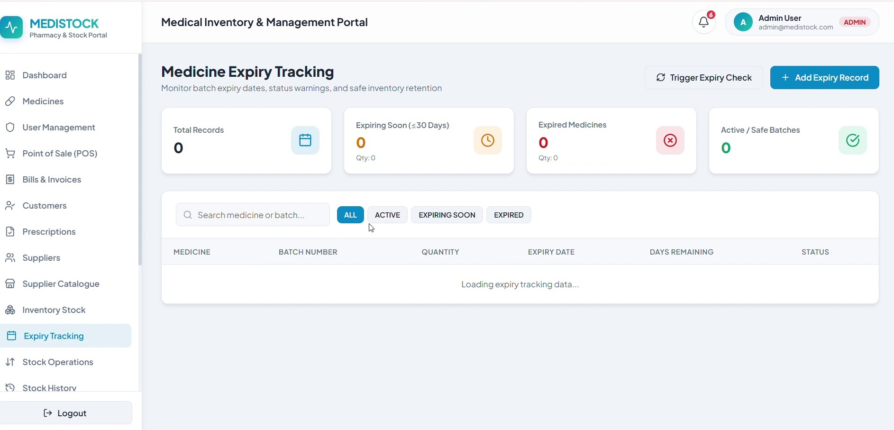
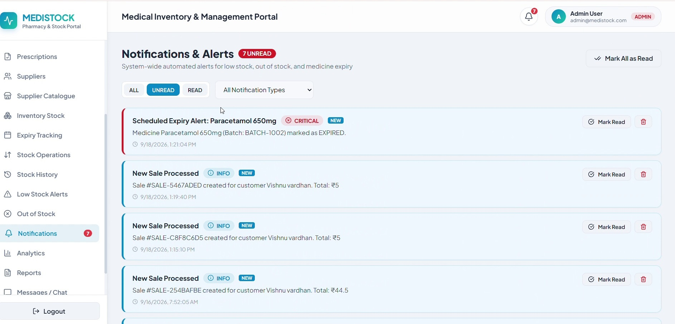
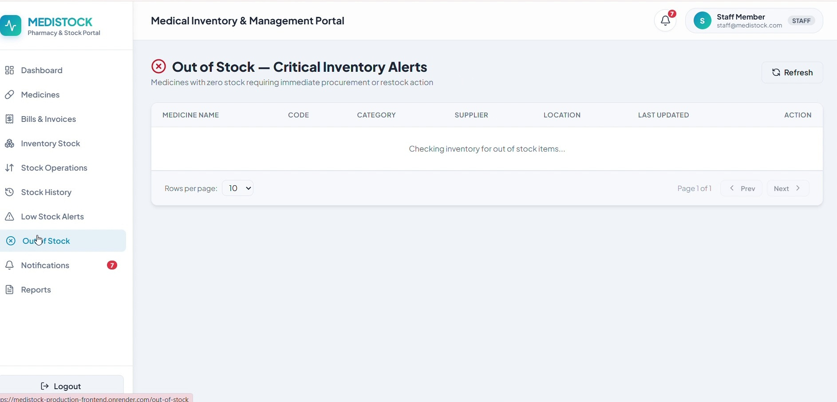
Expiry, Low-Stock & Out-of-Stock Monitoring
EXPIRY TRACKING
NOTIFICATIONS
OUT-OF-STOCK
Dedicated screens make inventory risks visible instead of hiding them inside raw data.
Expiry status • low-stock alerts • critical stock visibility

Slide 12
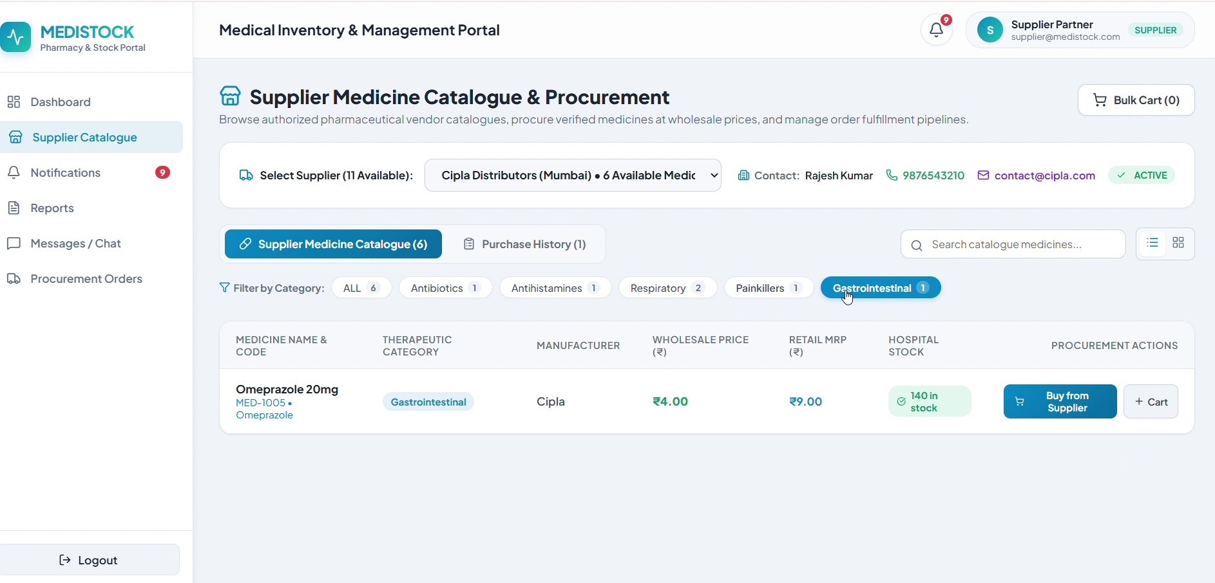
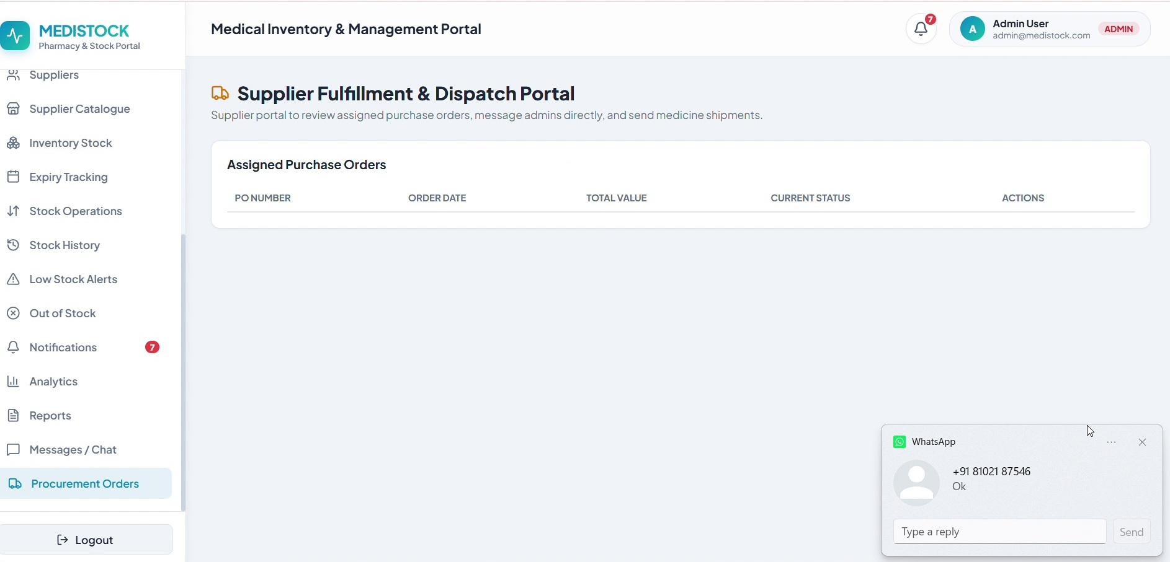
Supplier Management & Procurement
SUPPLIER CATALOGUE
SUPPLIER FULFILMENT

Slide 13
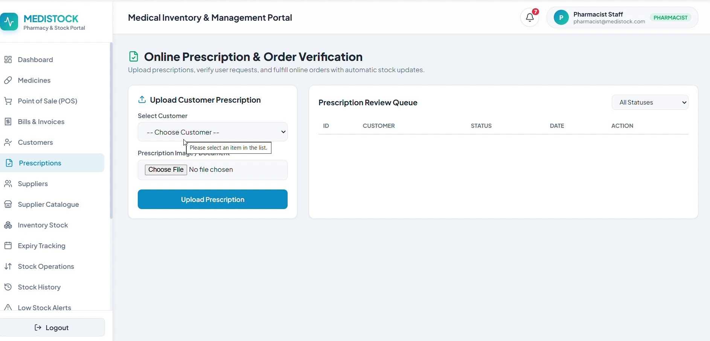
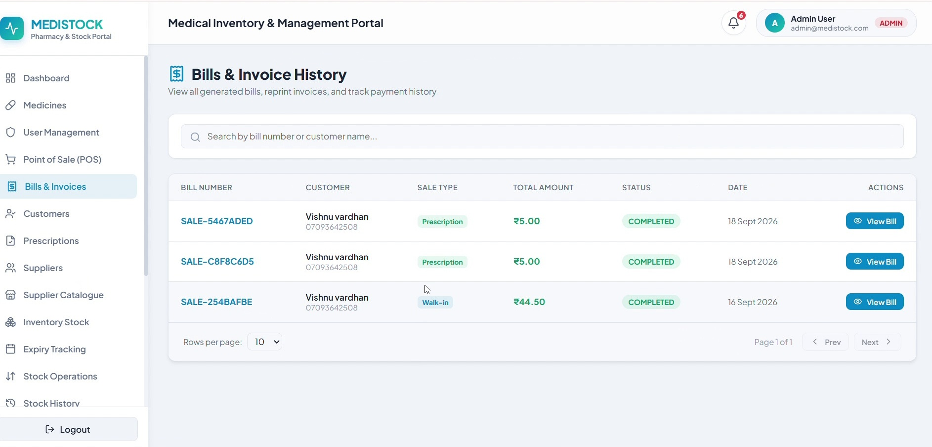
Prescription Management, Sales & Billing
PRESCRIPTION REVIEW & VERIFICATION
BILLS & INVOICE HISTORY

Slide 14
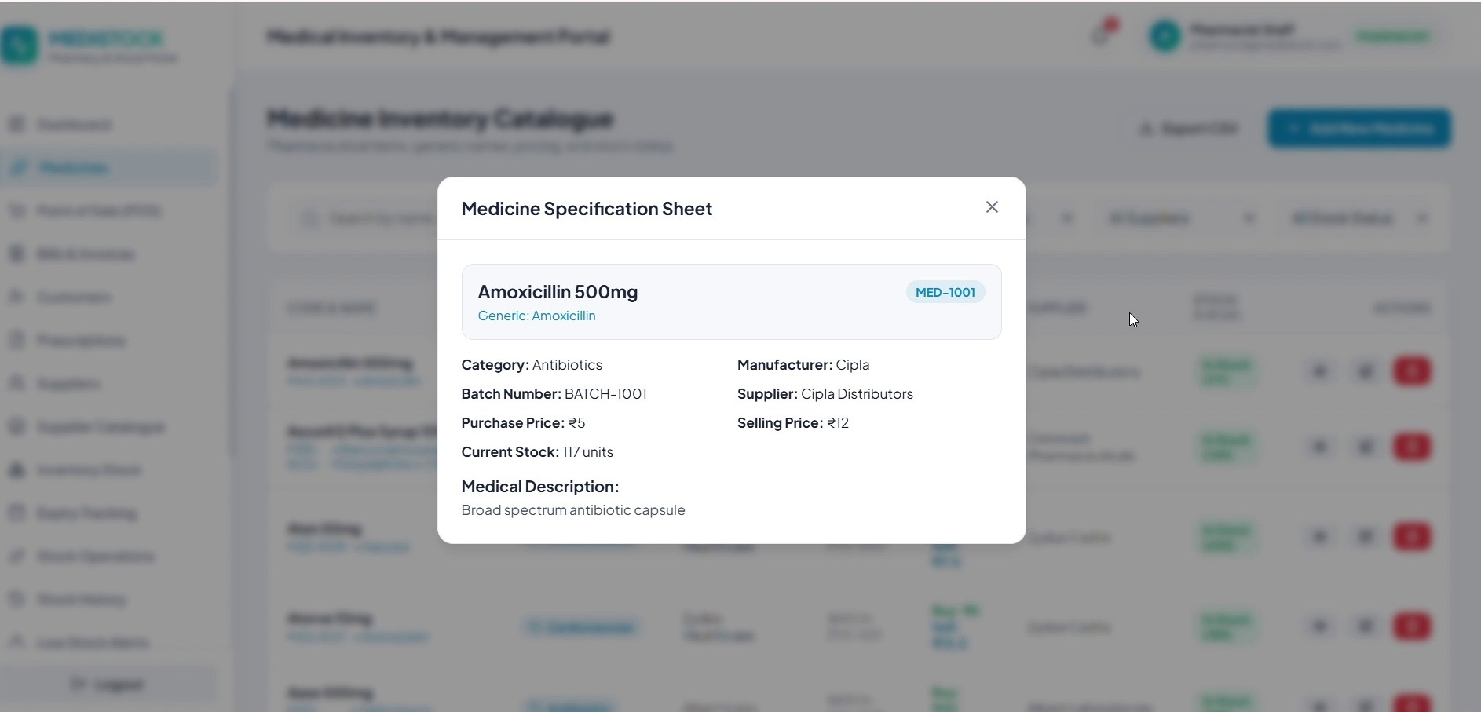
Medicine Management & Traceability
Medicine inspection provides an operational view of:
• Medicine identity and category
• Manufacturer / supplier
• Batch number
• Purchase and selling price
• Current stock and expiry information
Traceability connects medicine master data with day-to-day inventory operations.

Slide 15
Deployment & Live Demonstration
The project is deployed and can be demonstrated through the live application.
LIVE APPLICATION
LIVE DEMO RECORDING
MediStock Production
Project Walkthrough
Open Deployed Application
Open Live Demo Recording
https://medistock-production-frontend.onrender.com
Google Drive recording link
Login → Dashboard → Inventory → Alerts → Procurement → Prescriptions / Billing → Profile

Slide 16
Q & A
Thank You
MediStock — Medical Inventory Management Platform
Team 9 • Infosys Springboard Internship
Nalla Bhavitha • Vishnu Vardhan • Raj Kumar

