Slide 1
IT Support Team Performance Using Analytics
Name: S.Saketh Bharadwaj
Course: Virtual Internship 6.0-Data Visualization
Instructor: Usha

Slide 2
Introduction
IT support teams are essential for maintaining smooth business operations. They handle technical issues, service requests, and system failures.
This project focuses on analyzing IT support ticket data to understand performance trends and improve service efficiency using data analytics.

Slide 3
Objectives
Analyze ticket data
Evaluate performance
Improve resolution time
Provide insights

Slide 4
Dataset
IT support ticket dataset
Includes type, priority, category, resolution time

Slide 5
Tools Used
Power BI
Jupyter Notebook(Pandas, NumPy)

Slide 6
Key Metrics
The following key performance indicators were used:
- Total Number of Tickets
- Number of Closed Tickets
- Average Resolution Time
- Average Response Time
- Ticket Distribution by Priority and Category
These metrics help evaluate the efficiency of the IT support team.

Slide 7
Dashboard
An interactive dashboard was created to visualize ticket data and performance trends.
The dashboard includes:
- Ticket distribution by type and priority
- Resolution time analysis
- Country-wise performance
- Product and category analysis
This provides a complete overview of IT support operations.

Slide 8
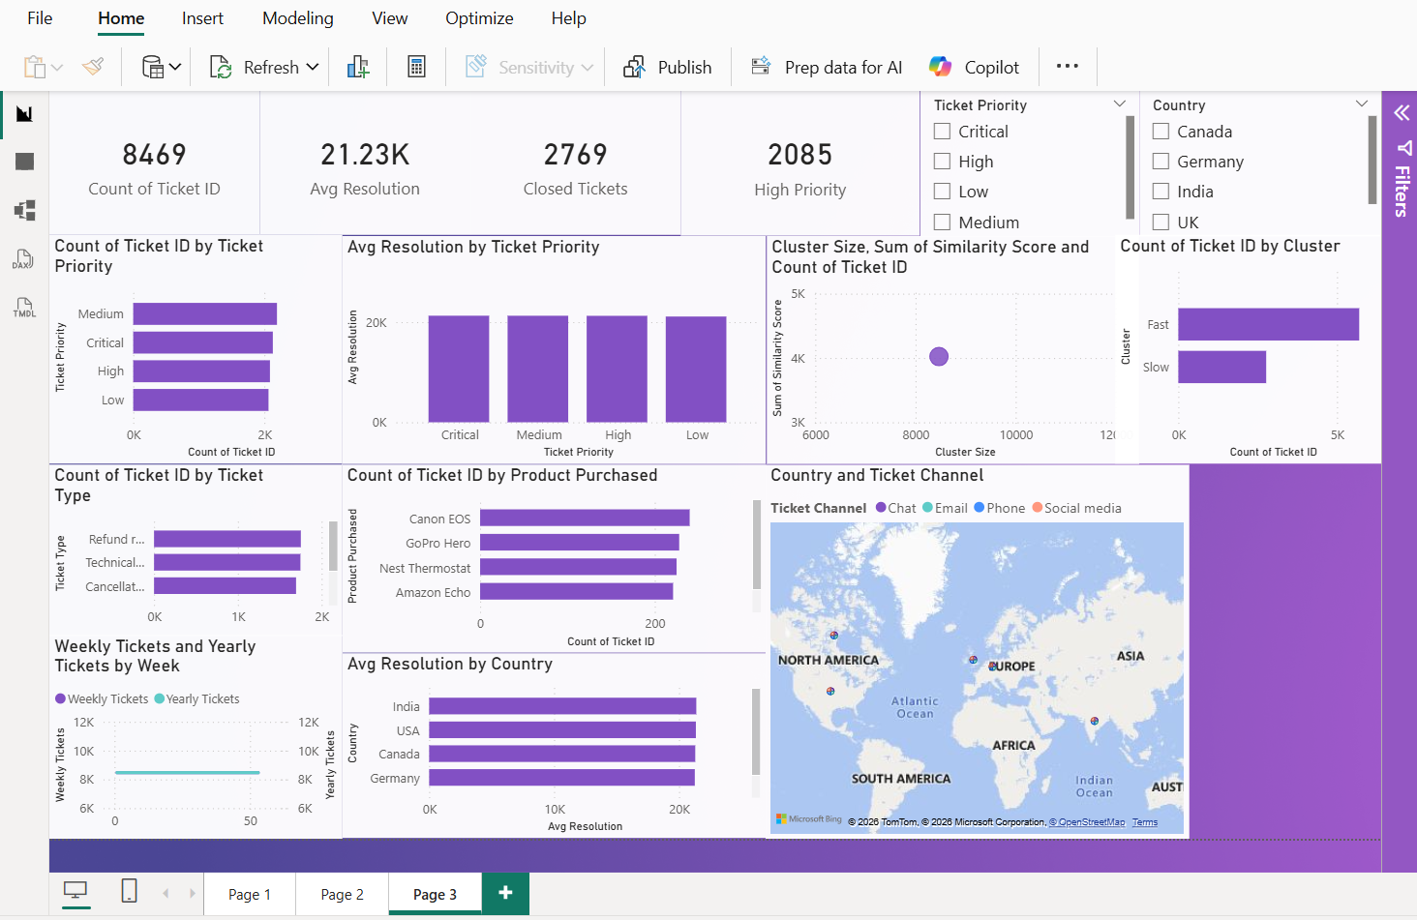

Slide 9
Recommendations
Improve high priority handling
Focus on repeated issues
Optimize resources

Slide 10
Conclusion
This project successfully analyzed IT support ticket data to evaluate performance and identify inefficiencies.
The insights gained can help improve resolution time, optimize resources, and enhance overall service quality.

