Slide 1
ImpactSense
ML-driven Earthquake Impact Predictor
Seismic inputs → Actionable risk outputs
GREEN
YELLOW
ORANGE
RED
Professional · Minimalist · 7 Slides

Slide 2
01
Problem Statement
⚡
📊
🎯
Difficult Interpretation
Raw Parameters
Need for Decision Support
Earthquake alerts are often difficult to interpret quickly in high-pressure response situations.
Seismic parameters — magnitude, depth, CDI, MMI, significance — don't directly communicate risk severity to non-specialists.
Teams need a fast, visual, and reliable interface that converts seismic inputs into actionable alert categories.
ImpactSense

Slide 3
02
Proposed Solution
ML Prediction Pipeline
Retro-Style Web Interface
Build an ML-driven Earthquake Impact Predictor that maps seismic inputs to alert classes.
Use tuned classification models trained on processed earthquake data and deploy the best-performing model for inference.
Input validation and clamping
Probability map by class
Impact score (0–100)
Alert Classes:
GREEN
YELLOW
ORANGE
RED
Risk level output
Low
Moderate
High
Critical
Visual intensity feedback (shake effect)
ImpactSense

Slide 4
03
Tech Stack
Data & Modeling
Backend (Local)
Backend (Deploy)
▸ Python, pandas, numpy
▸ Flask app
▸ Vercel serverless
▸ scikit-learn, xgboost
▸ UI/app.py
▸ Python endpoints
▸ shap, joblib
▸ UI/api/
Frontend
Deployment
Artifacts
▸ Static HTML/CSS/JS
▸ Vercel
▸ Pickle models
▸ UI/public/
▸ vercel.json routing
▸ saved_models/*.pkl
ImpactSense

Slide 5
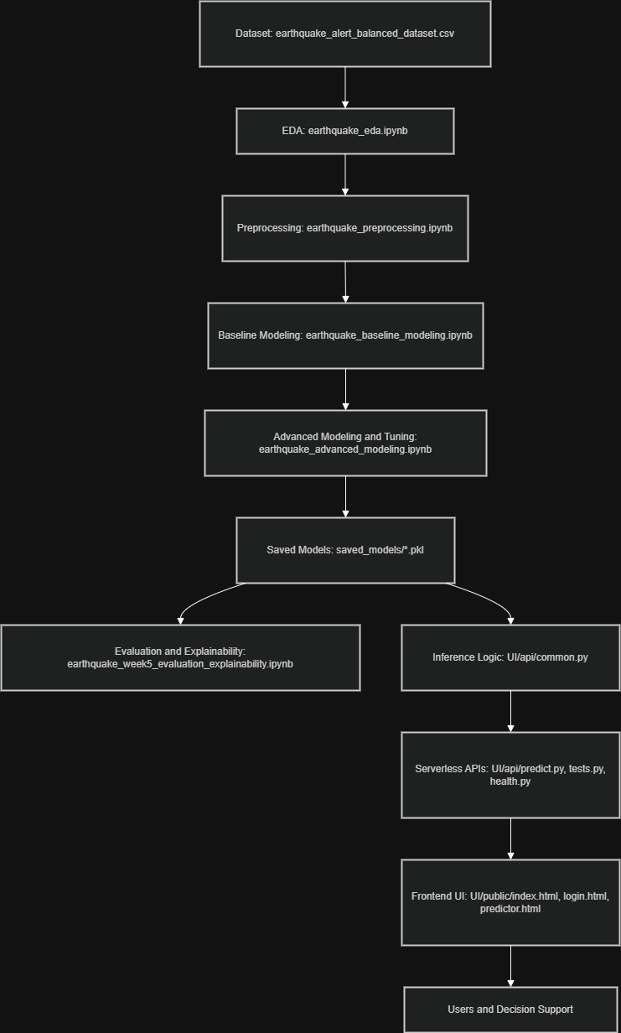
04
Workflow Diagram
ImpactSense

Slide 6
05
Feasibility and Viability
Technical Feasibility
Operational Viability
Risk Considerations
Complete pipeline already implemented from data prep to deployment
Lightweight deployment model (static frontend + serverless backend)
Model predictions depend on training data quality and representativeness
Saved model artifacts and API endpoints are available and integrated
Low infrastructure overhead and easy maintenance
Should be used as a decision-support tool, not a sole warning authority
Input sanitization and edge-case tests improve runtime reliability
Easy extension for additional features or model upgrades
ImpactSense

Slide 7
06
Impact and Benefits
⚡
Faster Interpretation
🎯
Better Decision Support
🛡️
Improved Robustness
Faster interpretation of seismic events through intuitive class-color outputs
Impact score and risk level combined in a single view for immediate clarity
Improved robustness via validation, clamping, and edge-case testing
🤝
Broader Communication
🔧
Modular Architecture
Better communication across both technical and non-technical users
Reusable modular architecture for future disaster analytics modules
ImpactSense

Slide 8
07
Conclusion
1
ImpactSense demonstrates an end-to-end ML-to-deployment workflow for earthquake impact prediction.
2
Converts complex seismic measurements into actionable risk outputs using a deployable web system.
3
Current production architecture supports both local Flask execution and Vercel serverless deployment.
🌐 Live Website
💻 Repository
https://impact-sense-nine.vercel.app/
github.com/Narayanan-D-05/ImpactSense
ImpactSense — github.com/Narayanan-D-05/ImpactSense

