Slide 1
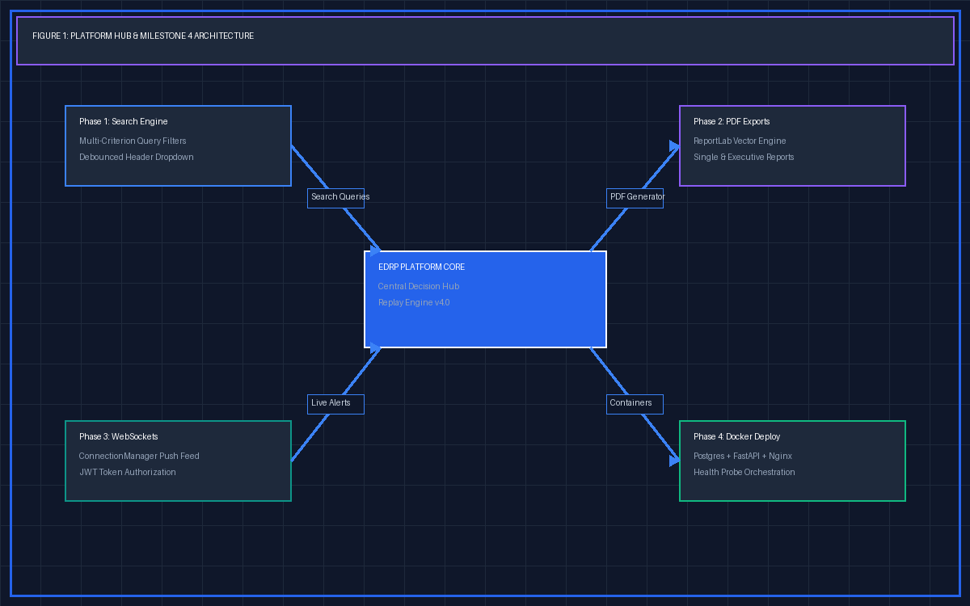
Expert Decision Replay Platform
Milestone 4 Technical Overview & Docker System Mechanics
Complete 10-Slide Deck with Visual Architecture Diagrams for Every Slide

Slide 2
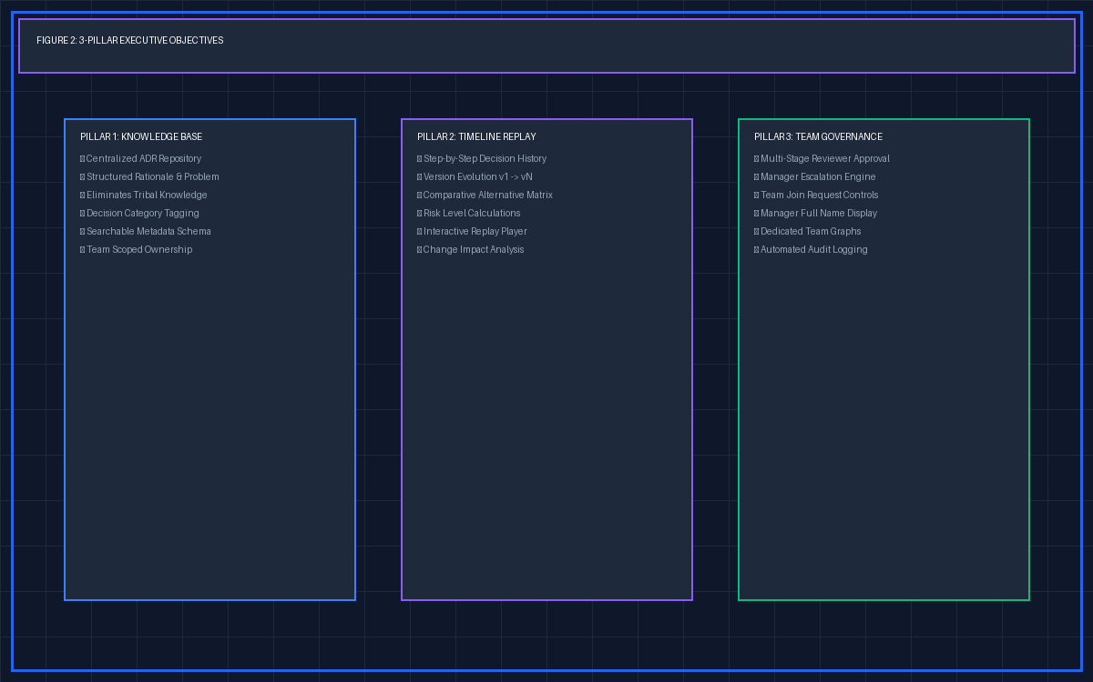
MILESTONE 4 TECHNICAL PRESENTATION
Executive Summary & System Objectives
• Centralized Knowledge Repository: Eliminates tribal knowledge by recording structured Architectural Decision Records (ADRs).
• Multi-Decision Timeline Replay: Step back and forward through decision evolution history.
• Team Governance & Approval Workflows: Multi-stage reviewer approvals, escalations, and manager join request controls.
• Milestone 4 Deliverables: Phases 1-5 complete: Search, PDF Exports, WebSockets, Dockerization, AI Insights & Separate Team Knowledge Graphs.

Slide 3
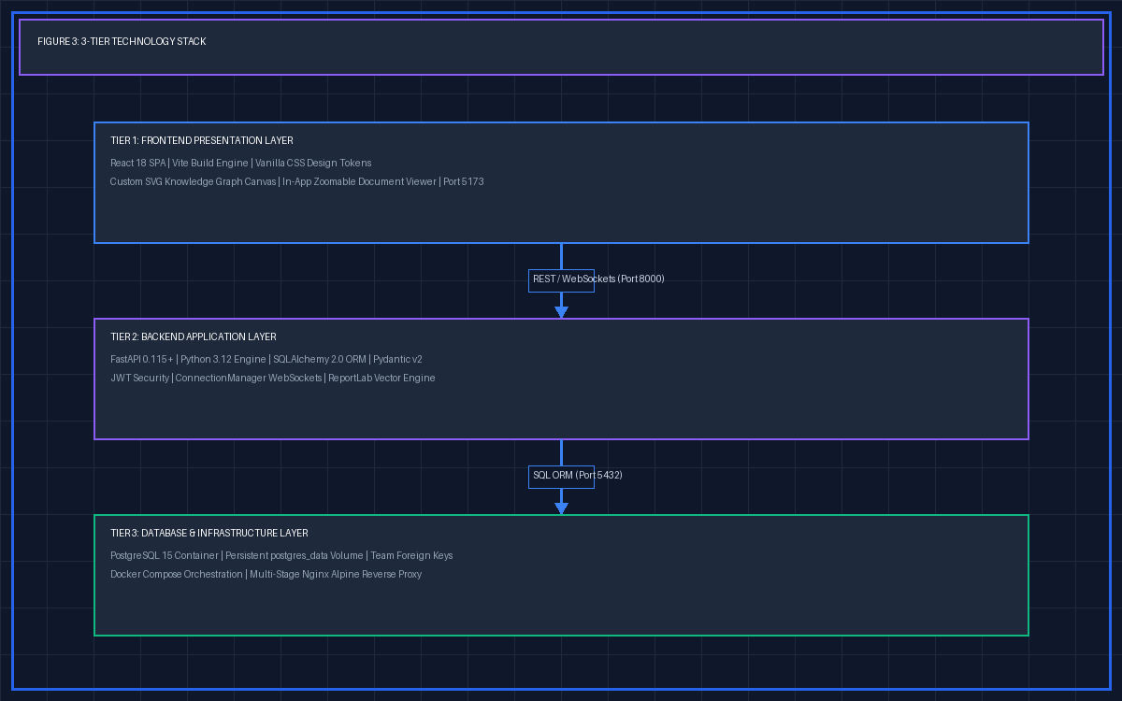
MILESTONE 4 TECHNICAL PRESENTATION
Enterprise Technology Stack & Architecture
• Frontend Application Tier: React 18, Vite Build System, Vanilla CSS Token System, Custom SVG Knowledge Graph Canvas, Zoomable In-App Document Viewer.
• Backend Service Tier: FastAPI 0.115+, Python 3.12 Engine, SQLAlchemy 2.0 ORM, Pydantic v2 Schema Validation, ReportLab Binary PDF Generator.
• Database & Deployment Tier: PostgreSQL 15 Relational Database, Docker Compose Orchestration, Nginx Alpine Reverse Proxy, 46 Automated Pytest Unit Tests.

Slide 4
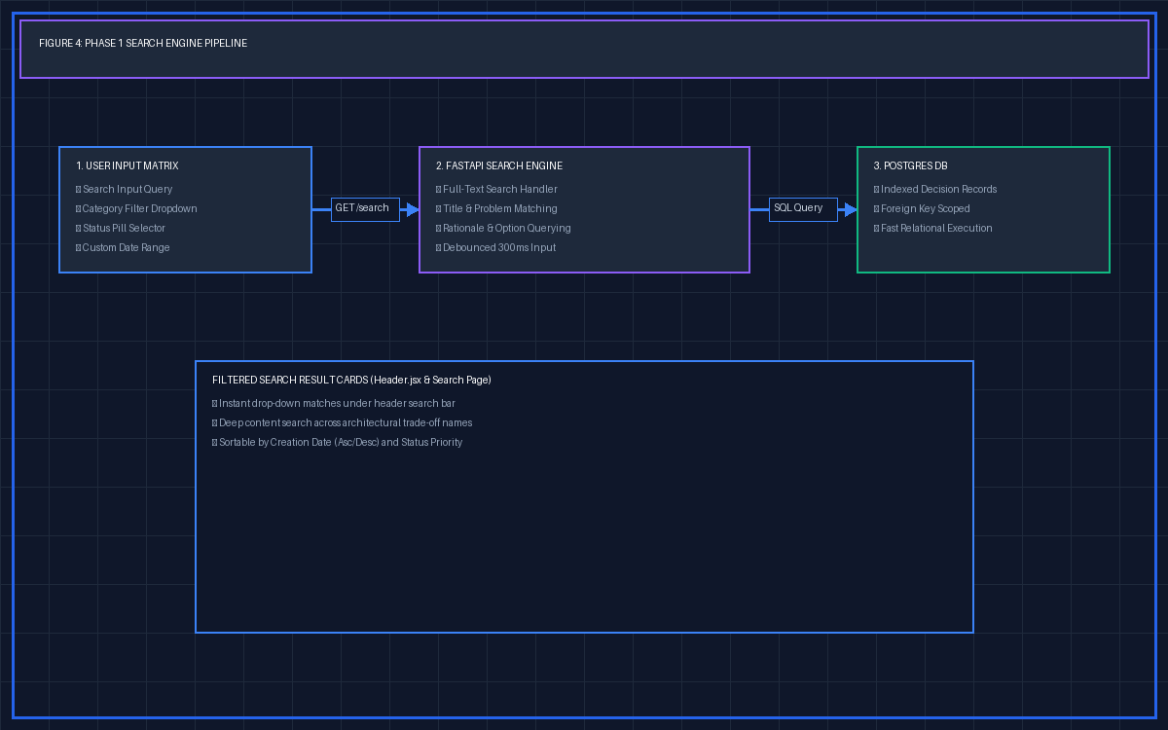
MILESTONE 4 TECHNICAL PRESENTATION
Phase 1: Multi-Criterion Search & Filtering Engine
• REST API /decisions/search Endpoint: Supports Category, Status, Date Range (from_date, to_date), and Keyword search parameters simultaneously.
• Full-Text Deep Querying: Searches decision titles, problem statements, rationale, and alternative option names/descriptions.
• Global Header Component (Header.jsx): Instant debounced drop-down search results available globally across all pages.
• Dynamic Sorting Controls: Sort by creation date (newest/oldest), title alphabetical, or status priority.

Slide 5
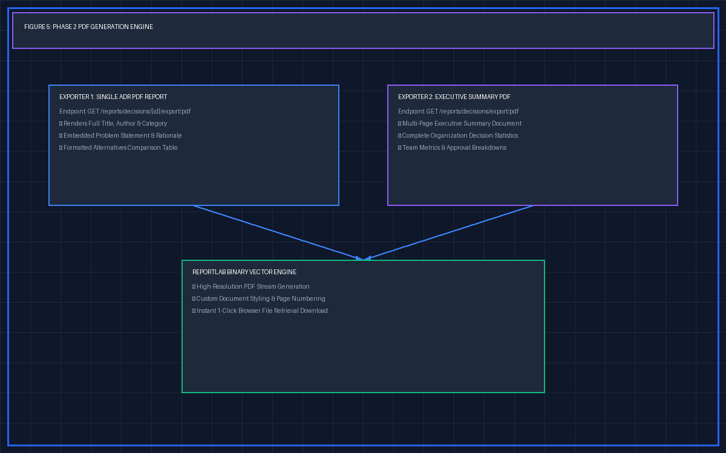
MILESTONE 4 TECHNICAL PRESENTATION
Phase 2: PDF Document Generation System
• Single Decision ADR PDF Export: GET /reports/decisions/{id}/export/pdf — Renders decision metadata, author details, rationale, and alternatives evaluation matrix.
• Executive Summary PDF Report: GET /reports/decisions/export/pdf — Multi-page formatted executive report designed for leadership & compliance auditing.
• ReportLab Vector Engine: Generates high-resolution binary vector PDFs with 1-click browser download integration.

Slide 6
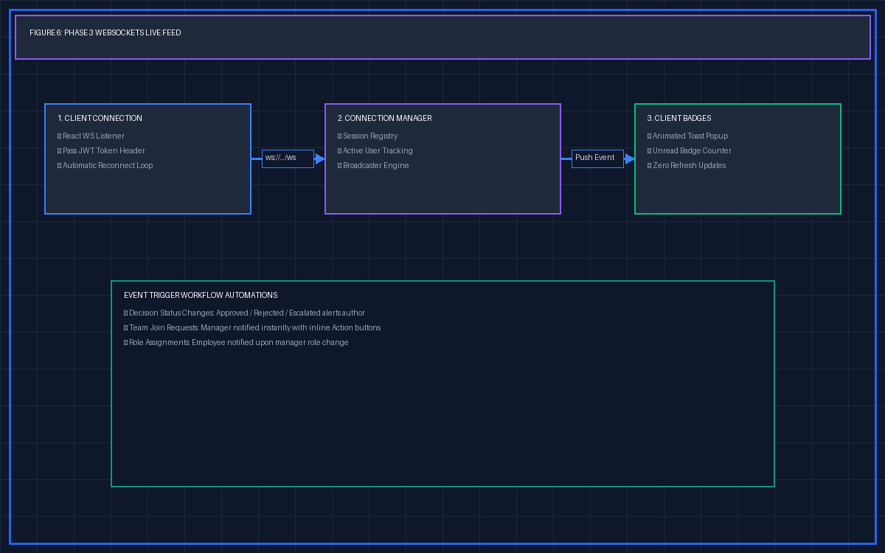
MILESTONE 4 TECHNICAL PRESENTATION
Phase 3: Real-Time WebSockets & Push Alerts Feed
• ConnectionManager (security/websocket_manager.py): Manages active user WebSocket sessions with JWT authentication token validation.
• Live Event Broadcasting: Broadcasts real-time notifications when decisions are approved/rejected, join requests submitted, or team roles assigned.
• Persistent Client Listener (Header.jsx): Maintains persistent WebSocket connection with automatic ping/pong keep-alive and reconnection logic.
• Instant Push Alerts: Displays animated pop-up toast alerts and increments unread notification badge counts without page refreshes.

Slide 7
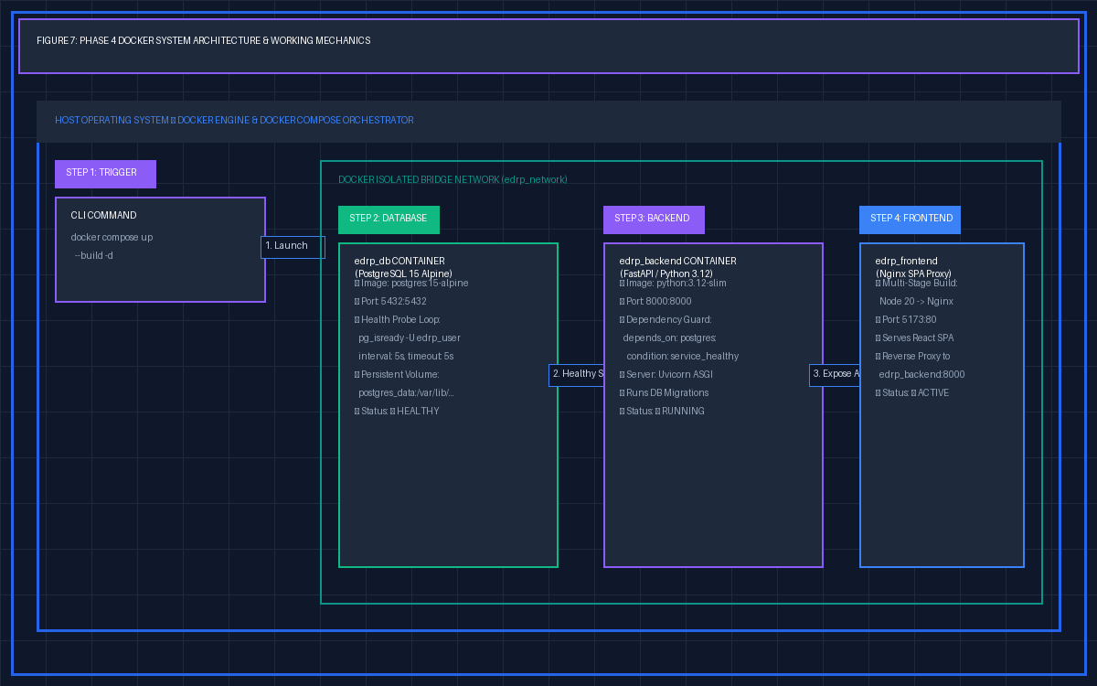
MILESTONE 4 TECHNICAL PRESENTATION
Phase 4: Docker Containerization & System Mechanics
• Container Startup & Health Probe: PostgreSQL container (edrp_db) initializes first; probes pg_isready -U edrp_user -d edrp_db every 5 seconds.
• Backend Dependency Guard: edrp_backend specifies depends_on: postgres: condition: service_healthy. FastAPI starts ONLY after database is 100% ready.
• Frontend Nginx Production Stage: edrp_frontend uses multi-stage build (Node 20 build -> Nginx Alpine) serving compiled React SPA on port 5173.
• Network & Volume Persistence: Containers communicate across internal Docker bridge (postgres:5432). Volume postgres_data preserves database state across restarts.
• Single-Command Execution: Running 'docker compose up --build -d' compiles assets, creates networks, and launches all 3 containers in background mode.

Slide 8
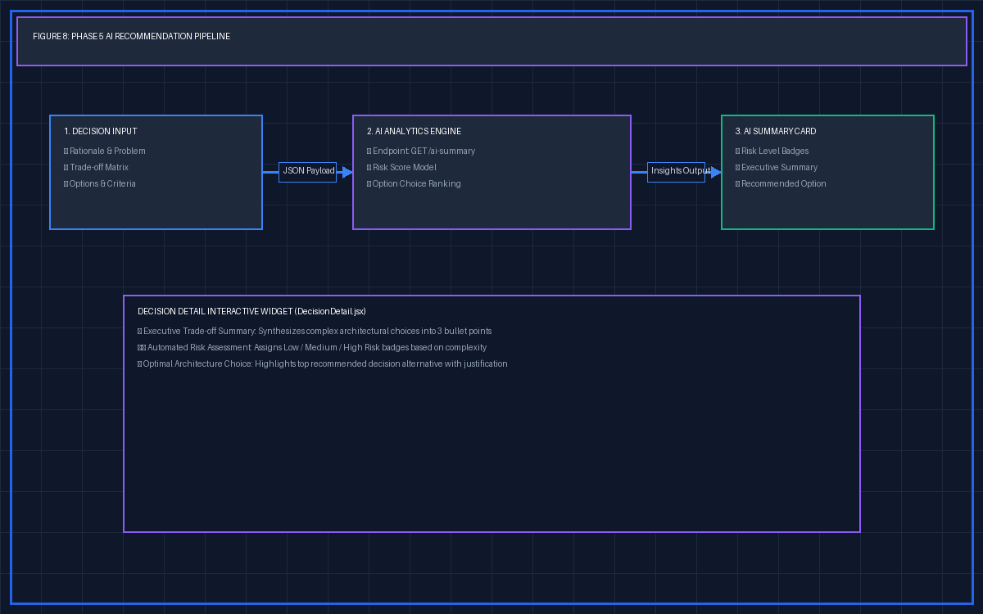
MILESTONE 4 TECHNICAL PRESENTATION
Phase 5: AI Insights & Recommendation Engine
• GET /decisions/{id}/ai-summary Endpoint: Analyzes decision rationale, problem statement, and alternatives matrix to return AI-driven insights.
• Executive Technical Summaries: Generates concise executive summaries highlighting core architectural trade-offs.
• Automated Risk Assessment: Calculates risk scores and risk level badges (Low, Medium, High).
• Alternative Option Ranking: Recommends the optimal architectural choice based on trade-off metrics.
• Interactive UI Component (DecisionDetail.jsx): 1-click 'Generate AI Insights' widget displaying recommendation cards.

Slide 9
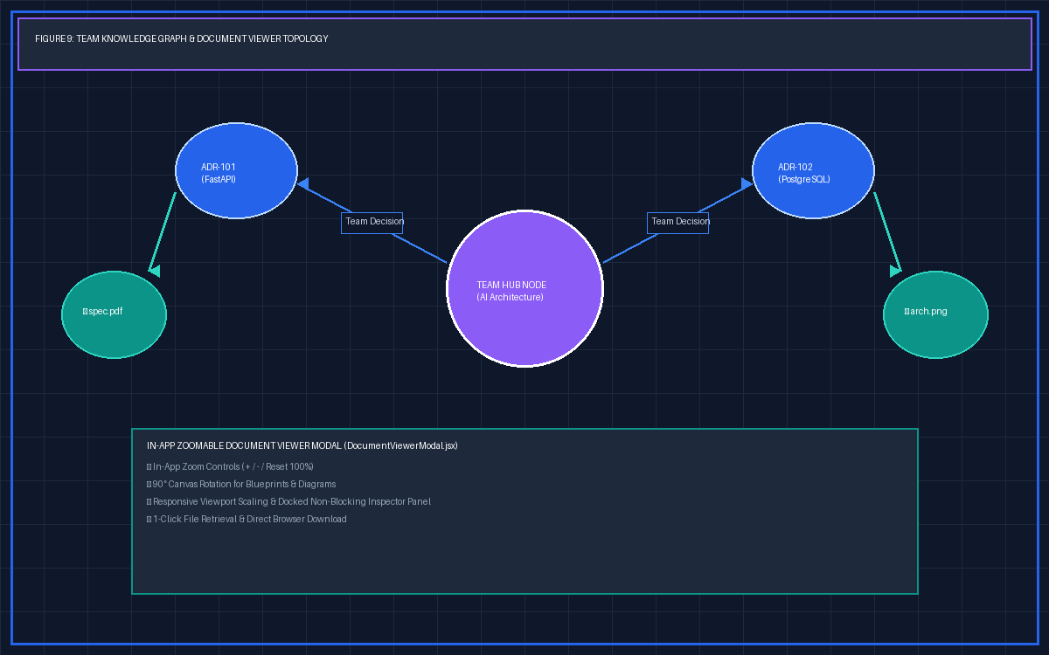
MILESTONE 4 TECHNICAL PRESENTATION
Platform Enhancements: Separate Team Graphs & Document Viewer
• Dedicated Separate Team Knowledge Graphs: Added team selection pills allowing users to view separate, team-centric Knowledge Graphs for every team in the organization.
• Central Team Hub Nodes: Renders Team Hub Nodes connecting team decisions and attached supported document nodes.
• In-App Document Viewer Modal (DocumentViewerModal.jsx): Opens attached blueprints, PDFs, and diagrams in a clean modal overlay with Zoom (+/-), 90° Rotation, and 1-Click Retrieval Download.

Slide 10
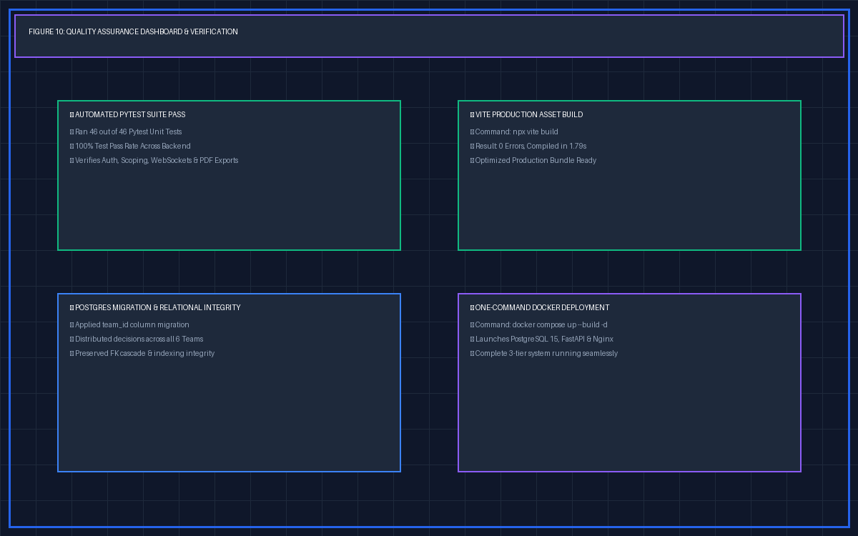
MILESTONE 4 TECHNICAL PRESENTATION
Quality Assurance & Project Verification
• Automated Pytest Suite Health: Executed complete Backend unit & integration test suite (pytest tests/). Outcome: 46 passed out of 46 tests (100% pass rate).
• Production Frontend Asset Build: Compiled production frontend assets using Vite (npx vite build). Outcome: Built in 1.79s with 0 errors.
• PostgreSQL Database Migration: Applied team_id column migration to PostgreSQL decisions table and verified relational integrity.
• Docker Multi-Container Orchestration: All 3 containers (PostgreSQL 15, FastAPI, Nginx) verified ready for one-command deployment (docker compose up --build -d).

