Slide 1

EDUVISION
Higher Education Performance Dashboard
Higher Education Analytics using QS & THE Rankings
Presented by
Puppala Lavanya

Slide 2
PROBLEM STATEMENT
One Question, Too Many Rankings
Higher education data is spread across different ranking sources, making it difficult to compare universities, analyze research performance, understand student diversity, and identify global education trends.
EduVision — Higher Education Performance Dashboard
2

Slide 3




PROPOSED SOLUTION
One Connected Dashboard Suite
We developed an interactive Tableau dashboard suite that combines QS and THE university ranking data, cleans and standardizes the data, creates key education KPIs, and provides interactive analysis through four connected dashboards.
Combine
Clean & Standardize
Engineer KPIs
4 Live Dashboards
EduVision — Higher Education Performance Dashboard
3

Slide 4


DATASETS
What Powers the Dashboards
QS World University Rankings 2026 — Top 1500
https://www.kaggle.com/datasets/dhrubangtalukdar/qs-world-university-rankings-2026-top-1500
THE World University Rankings 2016–2026
https://www.kaggle.com/datasets/raymondtoo/the-world-university-rankings-2016-2024/data
TOOLS
Python, Pandas & NumPy
Tableau
Data cleaning and transformation
Visualization and dashboard development
EduVision — Higher Education Performance Dashboard
4

Slide 5
METHODOLOGY
From Raw Rankings to Insight
1
2
3
4
5
6
Data Collection
→
Data Cleaning &
Transformation
→
KPI
Engineering
→
Dashboard
Development
→
Dashboard
Integration
→
Testing &
Validation
An 8-week, 4-milestone build producing one portfolio-ready Tableau workbook.
EduVision — Higher Education Performance Dashboard
5

Slide 6






KPI FORMULAS & DATA AVAILABILITY
How Every Metric Is Calculated
GRS — Global Ranking Score
RIS — Research Impact Score
Derived from QS and THE Overall Scores
Derived from available research indicators
FSR — Faculty–Student Ratio Score
ISP — International Student Percentage
Derived from Faculty–Student Ratio
Mapped from International Students Score
ARS — Academic Reputation Score
RPI — Research Productivity Index
QS Academic Reputation; THE Overall Score used as proxy
Derived from Citations per Faculty and Intl. Research Network
EduVision — Higher Education Performance Dashboard
6

Slide 7
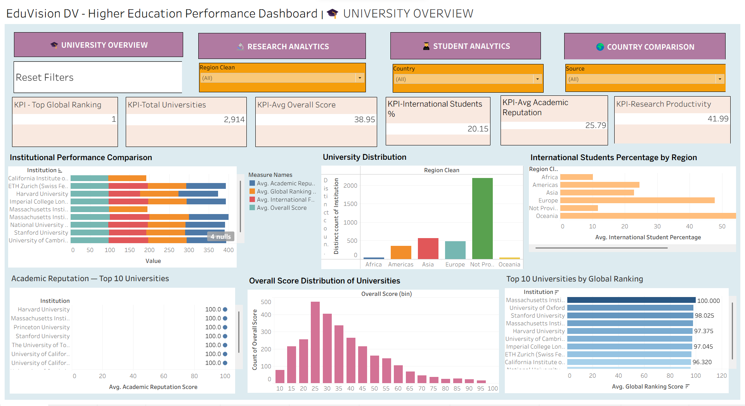
DASHBOARD 1 OF 4
University Overview

Slide 8

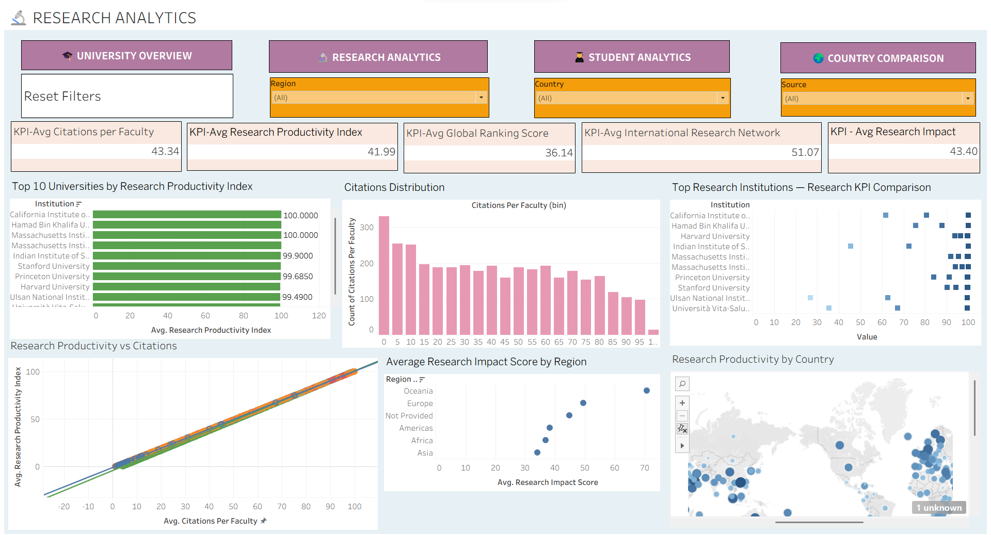
DASHBOARD 2 OF 4
Research Analytics

Slide 9

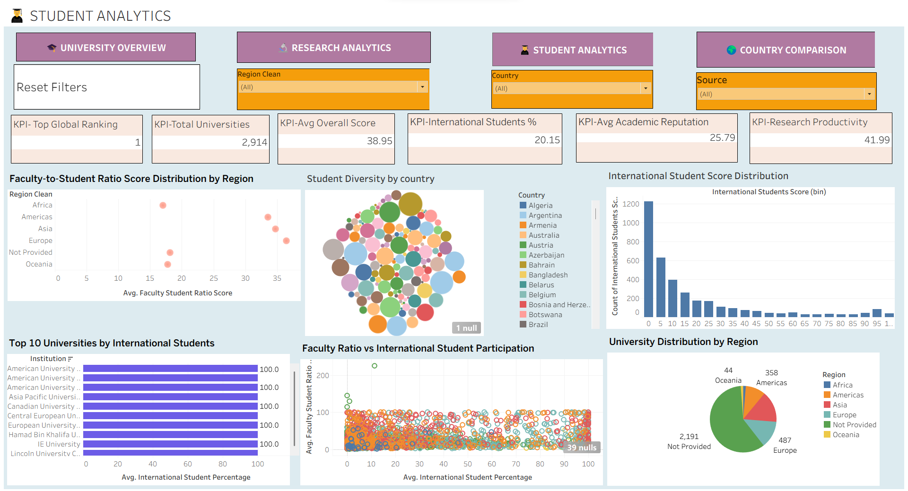
DASHBOARD 3 OF 4
Student Analytics

Slide 10

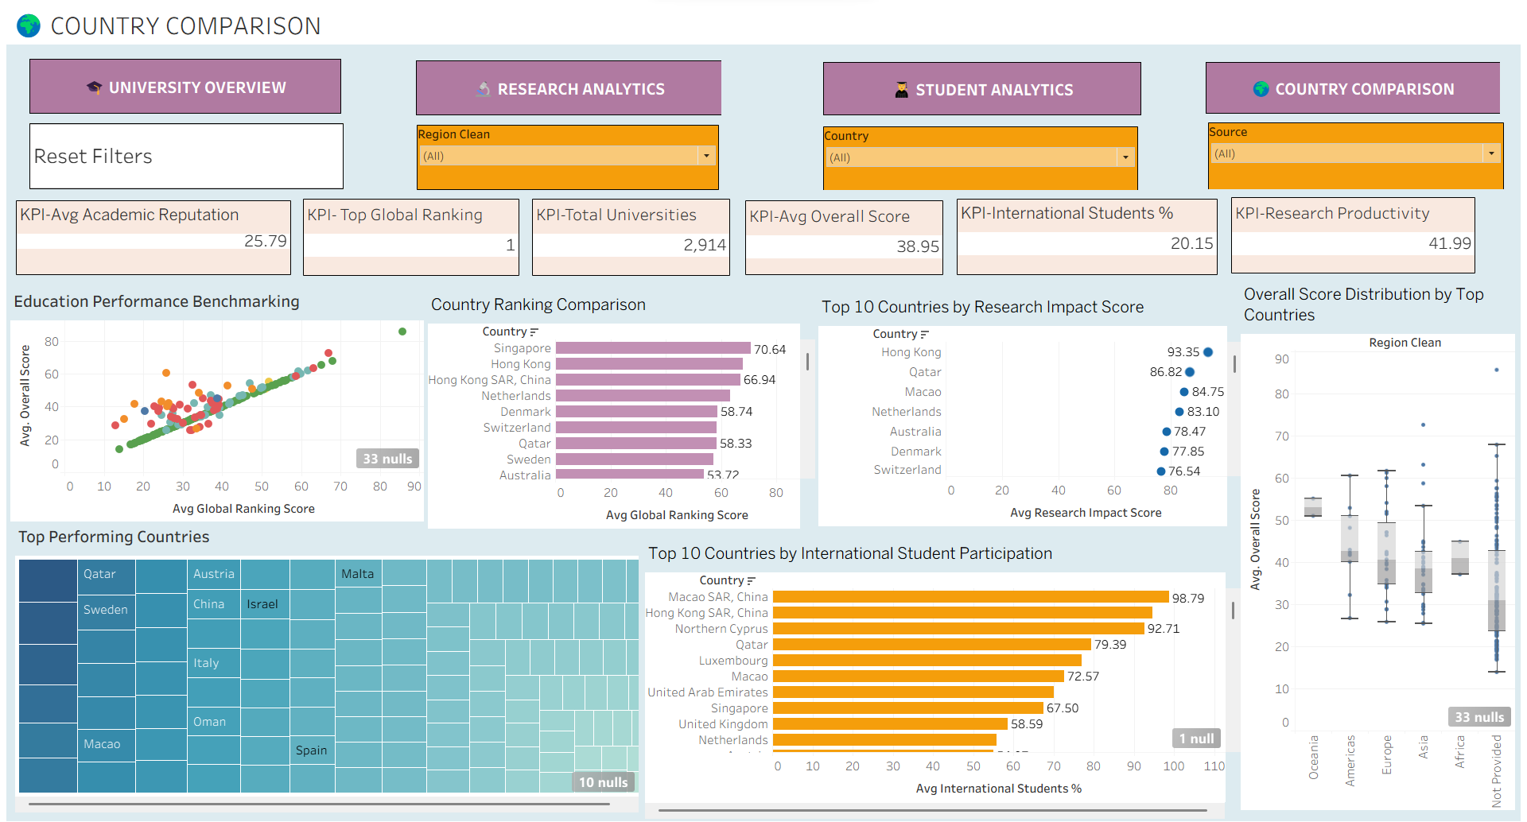
DASHBOARD 4 OF 4
Country Comparison

Slide 11

DASHBOARD INTEGRATION & INTERACTIVITY
One Workbook, Four Connected Views
Year, Region, Country and Source filters where applicable
Dashboard navigation
Interactive selections
University / Country comparison
Reset control
Drill-down and highlighting
EduVision — Higher Education Performance Dashboard
11

Slide 12

CONCLUSION
EduVision converts university ranking data from QS and THE into an interactive Tableau dashboard suite for analyzing university performance, research impact, student diversity, and country-level education trends.
4
6
2
Interactive dashboards
Education KPIs
Global ranking sources
EduVision — Higher Education Performance Dashboard
12

Slide 13
Thank You
Puppala Lavanya

