Slide 1

EduVision_DV: Higher Education Performance Dashboard

Slide 2
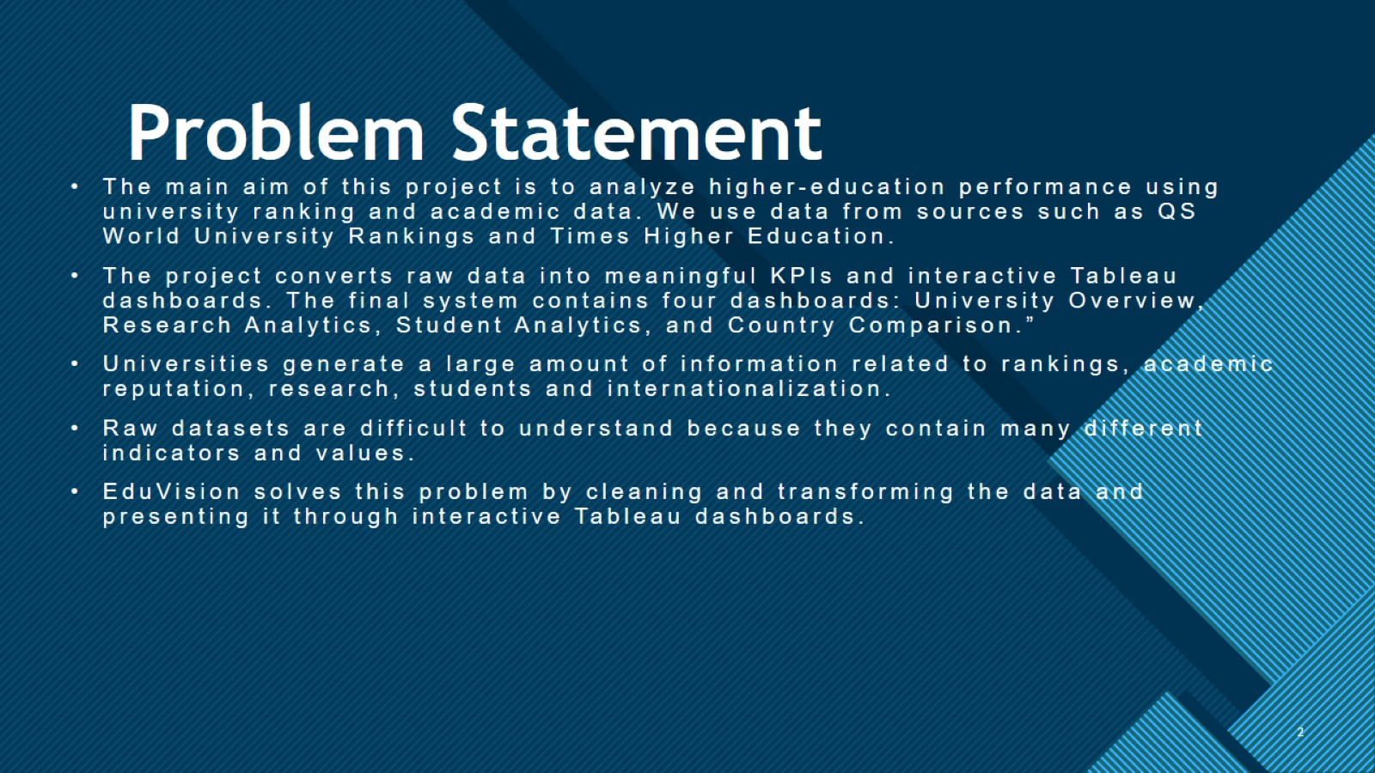
Problem Statement

Slide 3
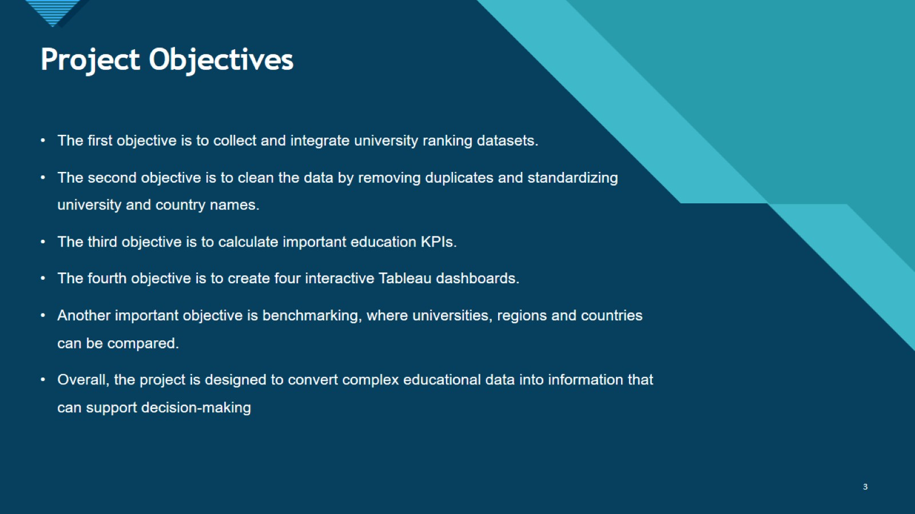
Project Objectives

Slide 4
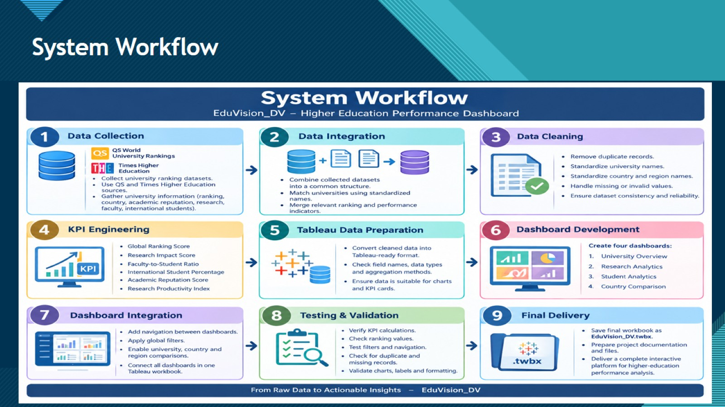
System Workflow

Slide 5
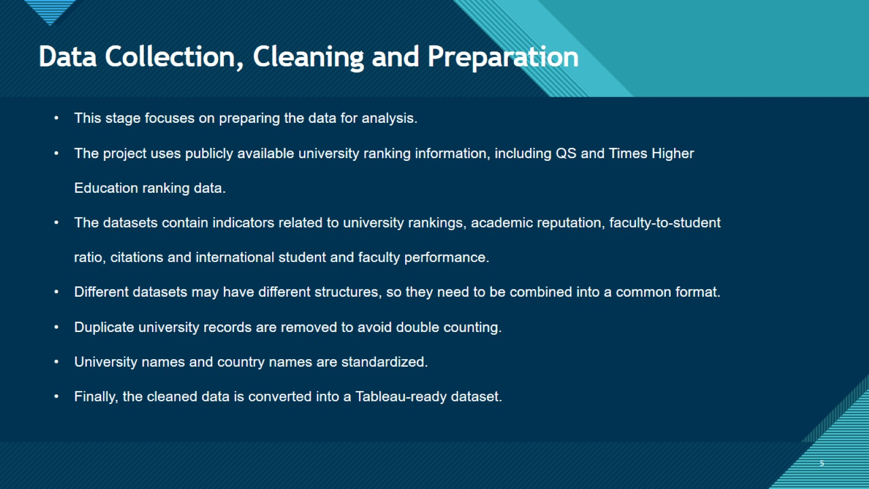
Data Collection, Cleaning and Preparation

Slide 6
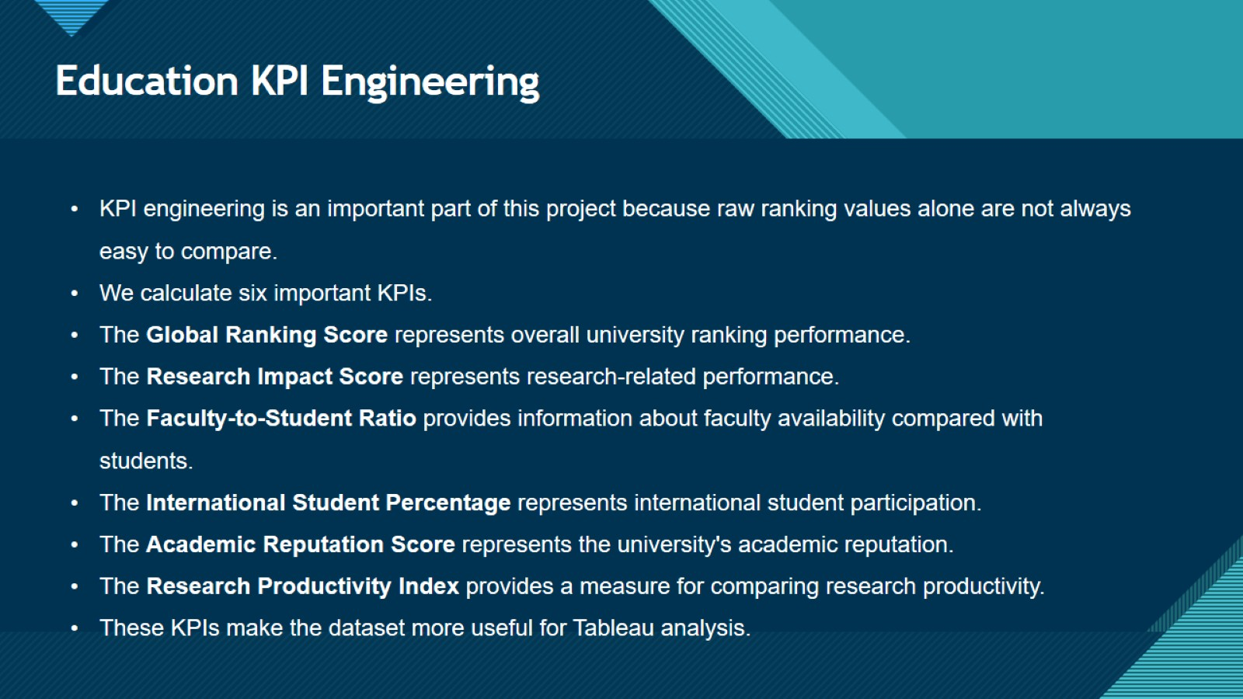
Education KPI Engineering

Slide 7
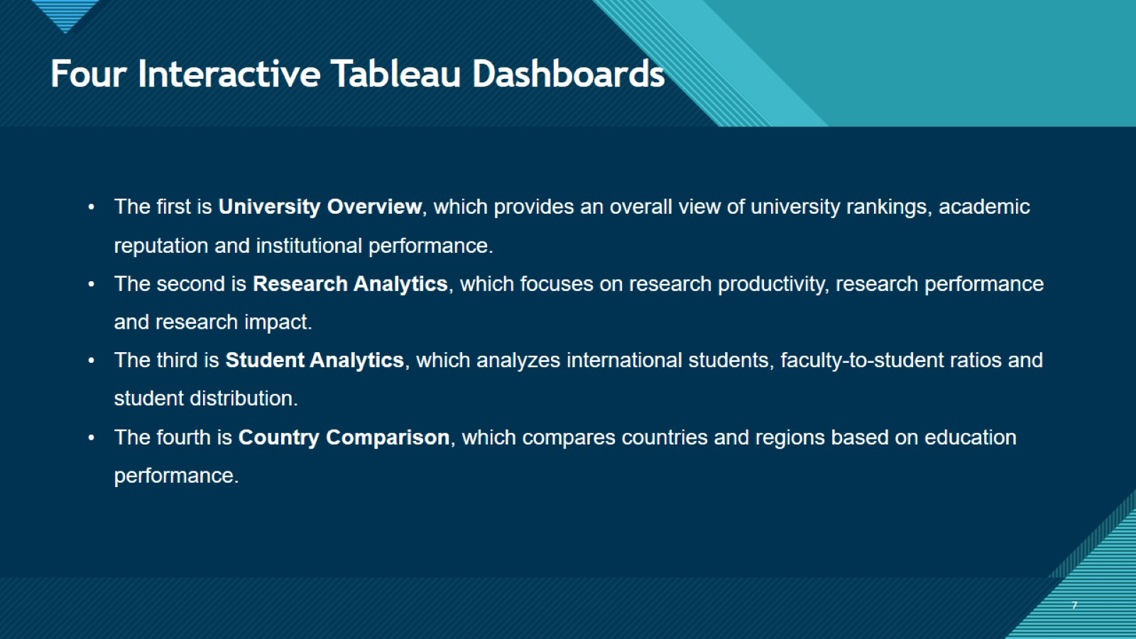
Four Interactive Tableau Dashboards

Slide 8
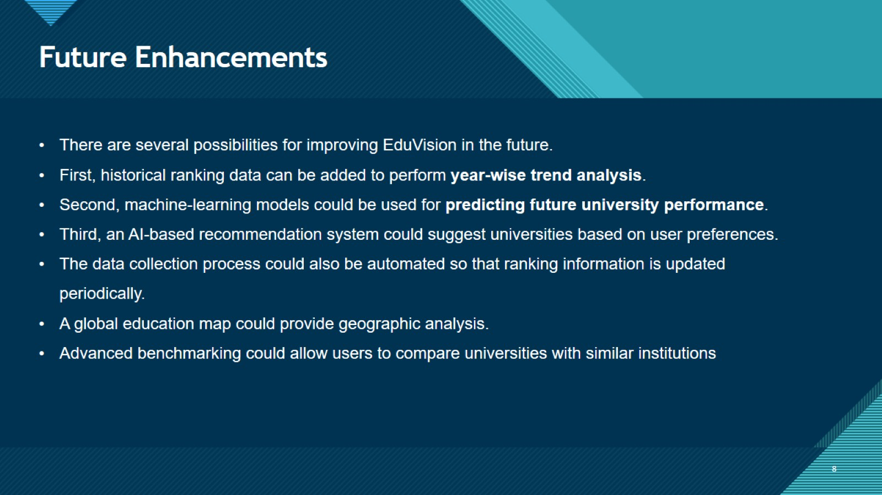
Future Enhancements

Slide 9
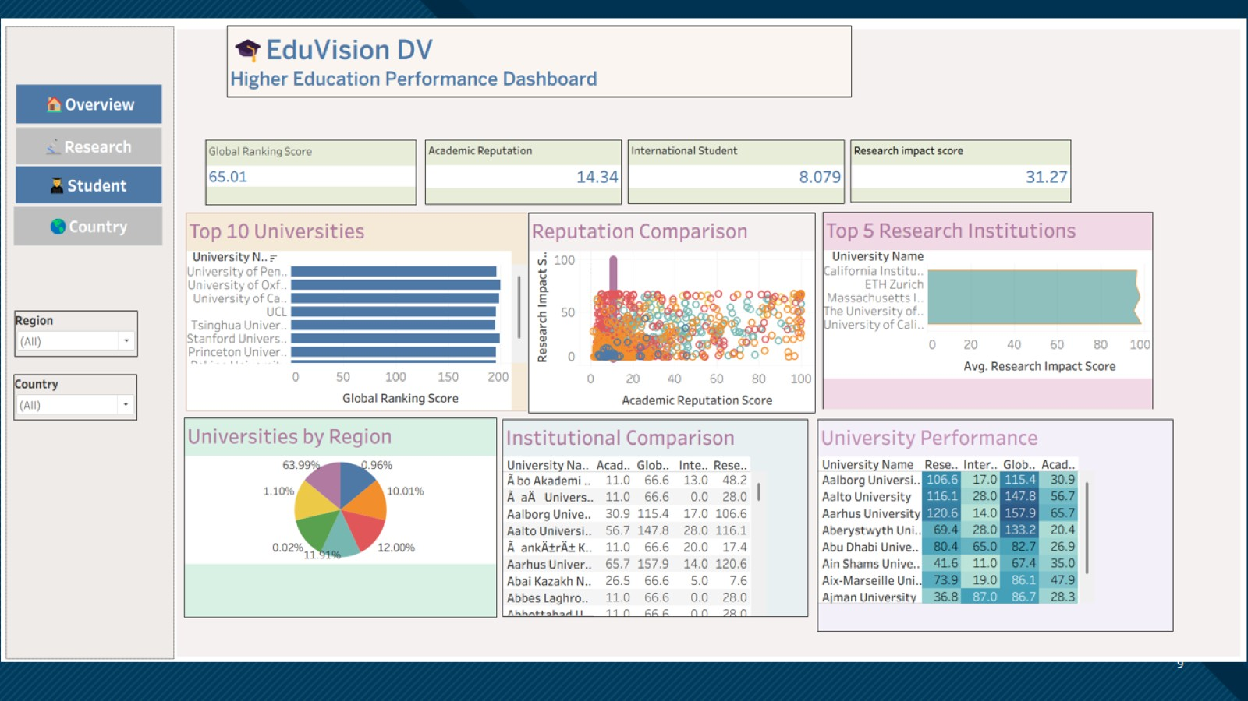

Slide 10
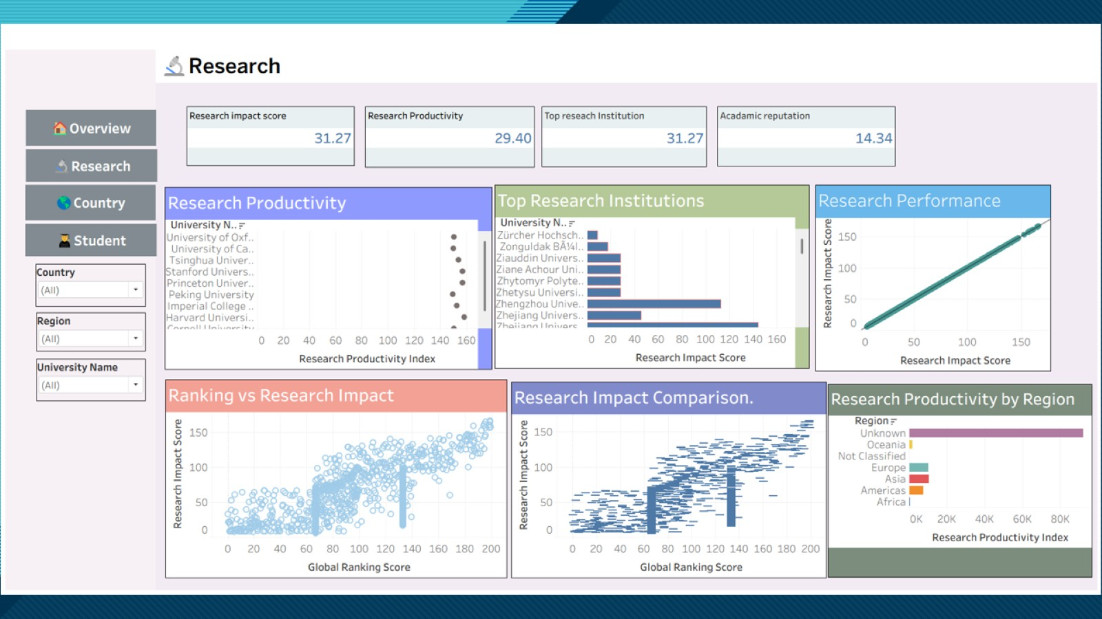

Slide 11
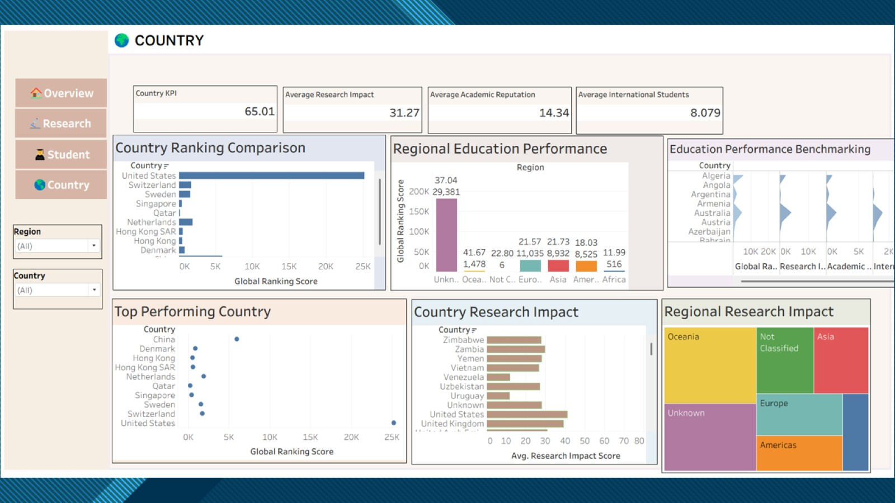

Slide 12
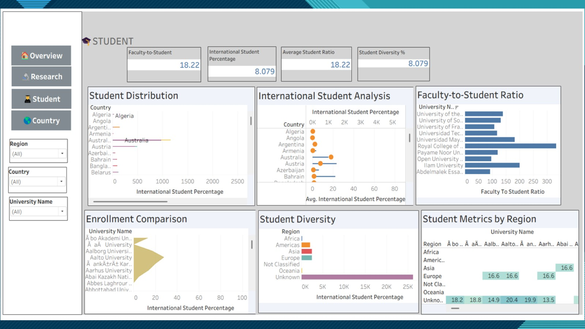

Slide 13
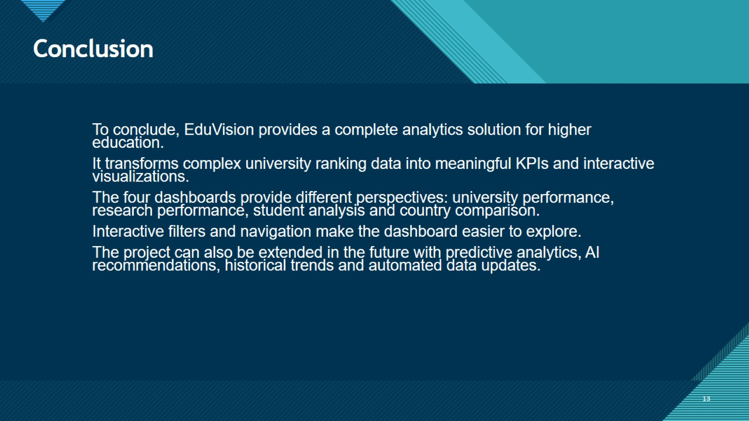
Conclusion

Slide 14


