Slide 1
EV
EDUVISION
A Dashboard for Comparing Universities Worldwide
An interactive Tableau suite built on QS and THE world university rankings
4 dashboards · 6 education KPIs · 769 universities · 90 countries
Notes:
Introduce EduVision: a Tableau dashboard suite that unifies QS and THE ranking data into one analytical workbook.

Slide 2
WHY I BUILT THIS
Too Many Rankings, No Clear Answer
Higher education data is scattered across competing ranking sources with different scales, indicators and coverage. Comparing institutions honestly — or spotting a regional trend — means stitching spreadsheets together by hand.
Fragmented sources
1
QS and THE score the same university on different scales.
No comparability
2
Ranks alone hide why one institution outperforms another.
The gap
Analysts, students and administrators all ask the same four questions — who leads globally, who leads in research, who attracts international students, and how does my country compare — but no single view answers them together.
Hidden diversity signal
3
Enrolment and international mix rarely sit beside rank.
Manual, static analysis
4
Spreadsheets can't filter by region or country on demand.
EduVision — Higher Education Performance Dashboard
2
Notes:
Frame the pain: fragmented, non-comparable, static ranking data.

Slide 3
THE APPROACH
Turning Two Rankings Into One Workbook
An interactive Tableau workbook that merges QS and THE rankings, standardises the indicators, engineers a common KPI layer, and surfaces it all through four linked dashboards.
01
02
03
04
Combine
Clean & standardise
Engineer KPIs
Four live dashboards
QS 2026 and THE 2016–2026 joined on a matched institution key.
Names, countries and regions normalised; scores rescaled 0–100.
Six derived education metrics computed in Python and Tableau.
Overview, Research, Student and Country views, fully filterable.
EduVision — Higher Education Performance Dashboard
3
Notes:
Four-step pipeline from raw rankings to a connected dashboard suite.

Slide 4
BEHIND THE SCENES
The Data and Tools I Used
QS World University Rankings 2026
TOOLCHAIN
Top 1500 institutions · academic and employer reputation, faculty–student ratio, citations per faculty, international mix.
Python
Kaggle · dhrubangtalukdar
Ingestion, matching and merging of the two ranking sources.
THE World University Rankings 2016–2026
Pandas & NumPy
Eleven years of overall and pillar scores, used for trend context and as a proxy where QS indicators are missing.
Cleaning, rescaling and KPI computation.
Kaggle · raymondtoo
Tableau
Visual design, calculated fields and dashboard actions.
Coverage after cleaning
769
90
5
6
Tableau Public
Publishing the workbook for interactive review.
universities
countries
regions
KPIs
EduVision — Higher Education Performance Dashboard
4
Notes:
Two Kaggle ranking datasets; Python for preparation, Tableau for delivery.

Slide 5
HOW I BUILT IT
The Build Process, Step by Step
An eight-week build across four milestones, ending in one portfolio-ready Tableau workbook.
1
Data collection
2
Cleaning & transformation
3
KPI engineering
Source QS 2026 and THE 2016–2026 exports and audit coverage.
Standardise names, handle nulls, rescale every indicator to 0–100.
Derive GRS, RIS, FSR, ISP, ARS and RPI as reusable fields.
university_raw_data.csv
university_cleaned.csv
university_final_dataset.xlsx
4
Dashboard development
5
Integration
6
Testing & validation
Build the four views with a shared layout and colour language.
Wire navigation, filter actions and a reset control across sheets.
Cross-check KPI values against source scores and fix edge cases.
eduvision_dashboard_v1.twbx
EduVision_DV.twbx
Dashboard Testing Report
EduVision — Higher Education Performance Dashboard
5
Notes:
Six phases across four milestones over eight weeks; each phase ends with a named deliverable.

Slide 6
THE METRICS
Six Numbers Behind Every Chart
GRS
RIS
FSR
Global Ranking Score
Research Impact Score
Faculty–Student Ratio
GRS = (QS overall + THE overall) / 2
RIS = (Norm(Cit/Fac) + Norm(IRN)) / 2
FSR = Std(Faculty / Student)
Average of QS and THE overall scores.
Citations per faculty blended with research network.
Standardized faculty-to-student ratio.
ISP
ARS
RPI
International Student %
Academic Reputation
Research Productivity
ISP = ISS
ARS = QS Academic Rep. (THE overall as proxy)
RPI = 0.70 × (Cit/Fac) + 0.30 × IRN
Mapped directly from International Students Score.
QS reputation score; THE overall used where missing.
Weighted blend of citation rate and research network.
EduVision — Higher Education Performance Dashboard
6
Notes:
Six engineered KPIs, each with its exact formula, form the shared measurement layer across all dashboards.

Slide 7
PROJECT PLAN
Milestones & Evaluation Criteria
The eight-week build was scored against a fixed target at the end of each milestone.
Milestone | Weeks | Focus area | Key deliverable | Target
1 | 1–2 | Data collection & cleaning | university_cleaned.csv | >95% complete, <2% missing
2 | 3–4 | KPI engineering & planning | university_final_dataset.xlsx | 6+ KPIs generated
3 | 5–6 | Dashboard development | EduVision_DV.twbx | 4 dashboards integrated
4 | 7–8 | Testing, docs & delivery | Final documentation + workbook | KPI accuracy >95%
Eight modules delivered
Data collection
Cleaning & transformation
KPI engineering
Dashboard wireframing
Dashboard development
Dashboard integration
Testing & validation
Documentation & delivery
EduVision — Higher Education Performance Dashboard
7
Notes:
Four milestones over eight weeks, each with a concrete deliverable and pass/fail target; eight modules in total.

Slide 8
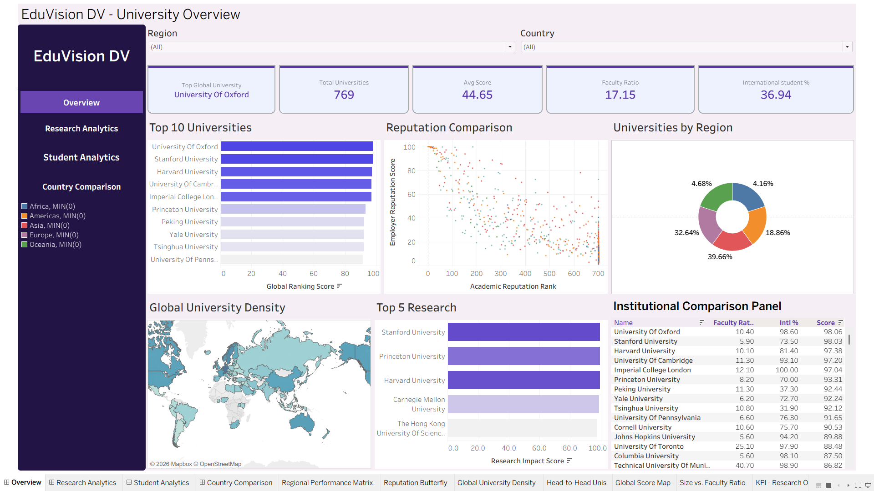
VIEW 1 OF 4
University Overview
Oxford leads the table at 98.06 GRS
Europe holds 39.7% of ranked universities
Global standing at a glance — top institutions, reputation spread, regional share and a searchable comparison panel.
Reputation and rank correlate, with clear outliers
8
Notes:
Walk through the University Overview dashboard: Global standing at a glance — top institutions, reputation spread, regional share and a searchable comparison panel.

Slide 9
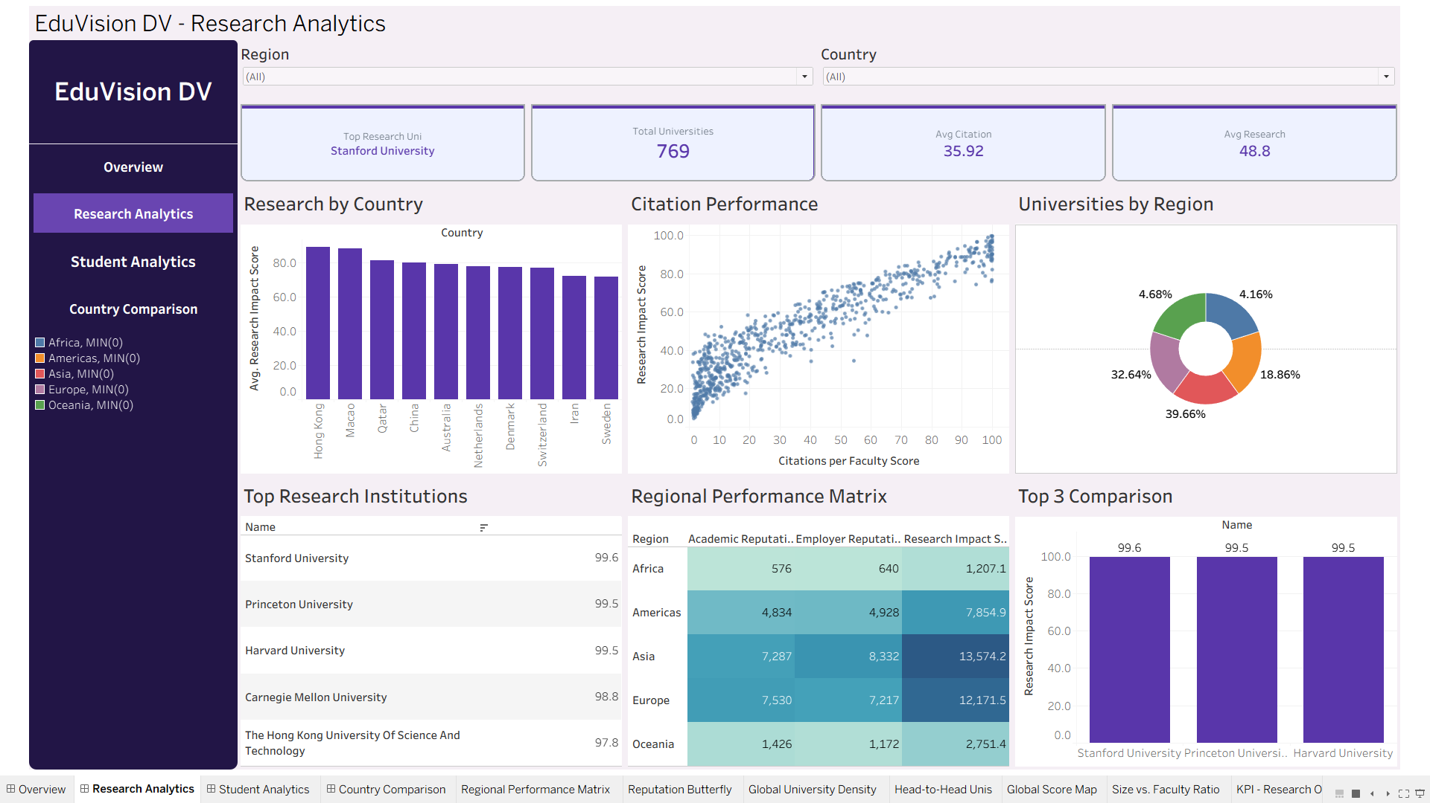
VIEW 2 OF 4
Research Analytics
Stanford tops research impact at 99.6
Hong Kong leads average research impact by country
Where research strength actually sits — by country, by citation performance and by region.
Citations per faculty track impact almost linearly
9
Notes:
Walk through the Research Analytics dashboard: Where research strength actually sits — by country, by citation performance and by region.

Slide 10
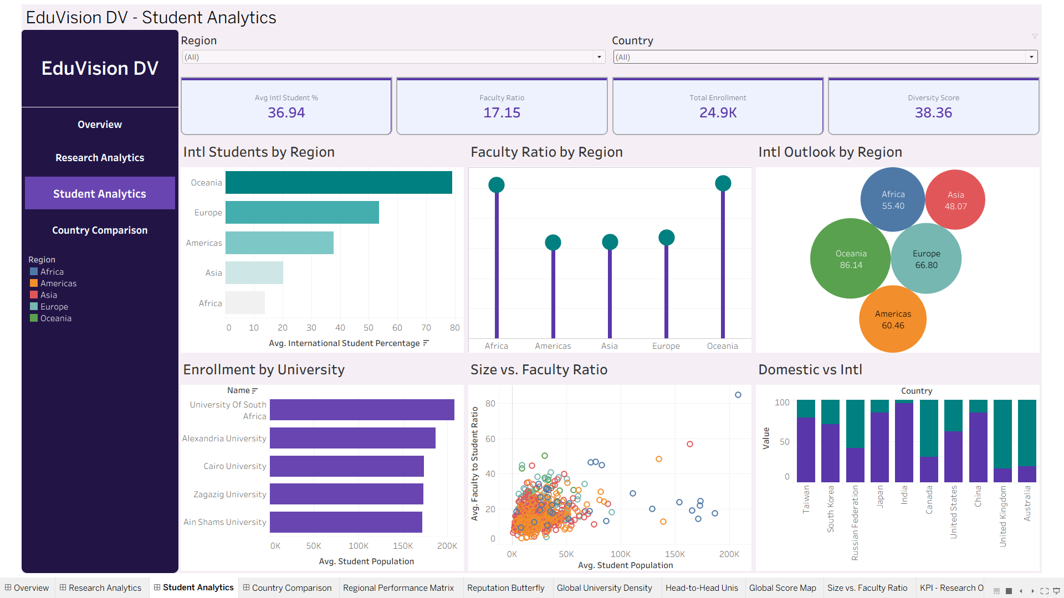
VIEW 3 OF 4
Student Analytics
Average international share is 36.94%
Oceania scores highest on international outlook at 86.14
Enrolment scale, teaching capacity and international mix read side by side.
Faculty ratio averages 17.15 students per staff member
10
Notes:
Walk through the Student Analytics dashboard: Enrolment scale, teaching capacity and international mix read side by side.

Slide 11
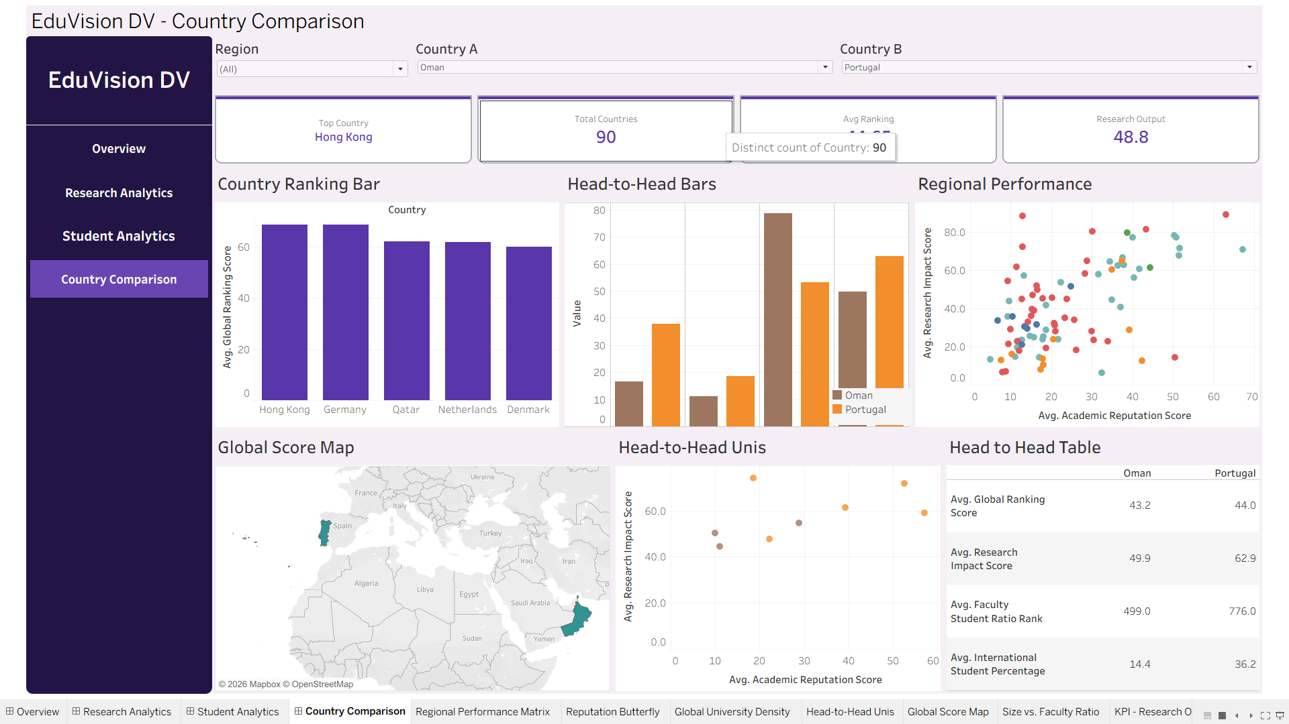
VIEW 4 OF 4
Country Comparison
90 countries covered end to end
Hong Kong is the top-scoring country overall
Pick any two countries and compare them across every KPI, with a global score map for context.
Head-to-head view spans ranking, research and diversity
11
Notes:
Walk through the Country Comparison dashboard: Pick any two countries and compare them across every KPI, with a global score map for context.

Slide 12
HOW IT CONNECTS
Not Four Slides — One Workbook
Every dashboard shares the same filter context, so a selection made in one view carries through the rest.
1
Sidebar navigation
2
Region & country filters
A persistent menu moves between the four dashboards without losing state.
Global parameters applied consistently across every sheet.
3
Interactive selections
4
Head-to-head comparison
Clicking a bar or mark highlights the same institution elsewhere.
Two-country parameters drive bars, scatter and a summary table.
5
Drill-down & highlighting
6
Reset control
Region to country to institution, in place.
Returns the whole workbook to its default unfiltered state.
EduVision — Higher Education Performance Dashboard
12
Notes:
Explain the shared filter context and navigation model.

Slide 13
WHAT STOOD OUT
A Few Things Worth Noting
98.06
39.66%
36.94%
17.15
Top global score
Europe's share
International mix
Faculty ratio
University of Oxford leads the combined ranking score.
Europe holds the largest slice of ranked institutions.
Average international student share across the dataset.
Mean students per faculty member worldwide.
Reading across the four views
Research impact tracks citations per faculty almost linearly — reputation follows output, not the reverse.
Smaller systems punch above their weight: Hong Kong and Macao lead average research impact, not the largest countries.
International openness is strongest in Oceania and Europe, while Asia's advantage sits in aggregate research volume.
EduVision — Higher Education Performance Dashboard
13
Notes:
Summarise the cross-dashboard findings rather than repeating individual charts.

Slide 14
WRAPPING UP
From Scattered Data to One Dashboard
4
interactive dashboards
EduVision turns QS and THE ranking data into an interactive Tableau suite for analysing university performance, research impact, student diversity and country-level education trends — in one place, on demand.
6
education KPIs
2
Thank you
global ranking sources
Questions welcome — the workbook is live and fully filterable.
Notes:
Close on the value delivered and invite questions.

