Slide 1
EduVision
Higher Education Performance Analytics Dashboard
Data Analytics & Business Intelligence • Python · Pandas · NumPy · Tableau
Infosys Springboard Virtual Internship Project
Presented by Varun

Slide 2
HOW EDUVISION IS BUILT
Technology Stack
Py
Pd
Tb
Gh
Python
Pandas & NumPy
Tableau
Jupyter & GitHub
Core scripting language driving the five-stage data pipeline.
Data profiling, cleaning, merging, and KPI computation.
Interactive BI dashboards, filters, and cross-dashboard actions.
Notebook-based EDA plus version-controlled delivery.
EduVision
1

Slide 3
CORE DELIVERABLE
A Four-Dashboard Analytics Suite
1
2
3
4
University Overview
Research Analytics
Student Analytics
Country Comparison
Global rankings, academic reputation, and institutional comparison.
Research impact, productivity, and its relationship to overall ranking.
International representation and faculty-to-student ratios.
Country-level benchmarking of universities and performance.
EduVision
2

Slide 4
WHY EDUVISION
Project Objectives
1
Unify Global Rankings
2
Clean & Standardize
Integrate QS World University Rankings and Times Higher Education datasets into one analytical structure.
Resolve duplicate, missing, and inconsistent university/country records across sources.
3
Engineer Education KPIs
4
Enable Interactive BI
Build ranking, research, reputation, and student metrics for consistent comparison.
Deliver a navigable Tableau suite for university-, research-, student-, and country-level insight.
EduVision
3

Slide 5
SYSTEM OVERVIEW
Data Pipeline & Architecture
Raw Ranking
Datasets (QS + THE)
→
Profiling &
Cleaning
→
Merging &
Standardization
→
KPI
Engineering
→
Tableau-Ready
Dataset
→
Dashboard
Suite
Five-script pipeline
Real data-quality fixes
Tableau-ready output
Dedicated scripts handle profiling, cleaning, merging, KPI engineering, and EDA visualization.
Duplicate institutions, inconsistent naming, and missing values were identified and resolved, not simulated.
The final dataset feeds directly into a four-dashboard, cross-filtered Tableau workbook.
EduVision
4

Slide 6
WORKING WITH REAL-WORLD DATA
Data Sources & Quality Challenges
Two Real-World Ranking Datasets
Inconsistent naming
University and country names differed between QS and THE — resolved through standardized merge keys.
QS World University Rankings
Global ranking positions, academic reputation, and institutional metadata.
Duplicates & missing values
Times Higher Education (THE) Rankings
Research impact, teaching, and international outlook indicators.
Profiling scripts surfaced real duplicate institutions and gaps, fixed before KPI engineering, not glossed over.
EduVision
5

Slide 7
LIVE DASHBOARD METRICS
Platform at a Glance
1,152
10
42.67
Universities Covered
Countries Represented
Avg. Overall Score
47.66
MIT
72.04
Avg. Global Ranking
Top-Ranked University
Avg. Faculty-to-Student Ratio
EduVision
6

Slide 8
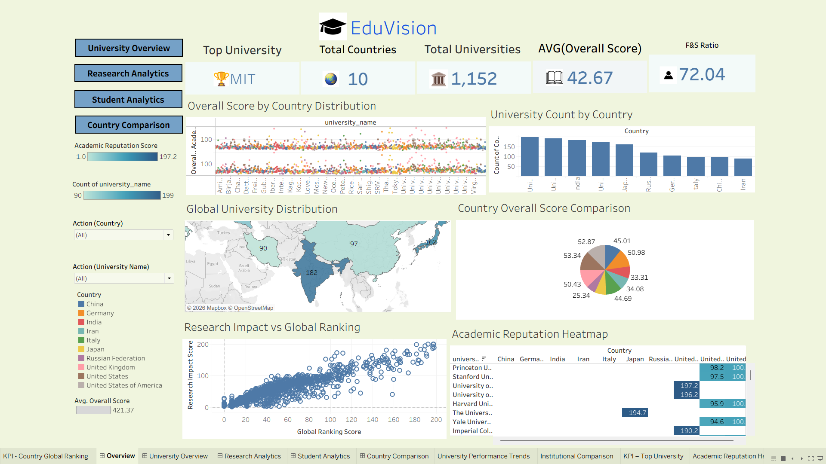
DASHBOARD SUITE · LANDING VIEW
Home Dashboard
Highlights
Top-level KPI bar: top university, countries, universities, avg. score, F&S ratio
Navigation buttons into all four analytical dashboards
Global distribution map and country-level score breakdown
Research Impact vs. Global Ranking scatter for a first-look correlation
Actual Tableau dashboard from the completed EduVision project.
EduVision
7

Slide 9
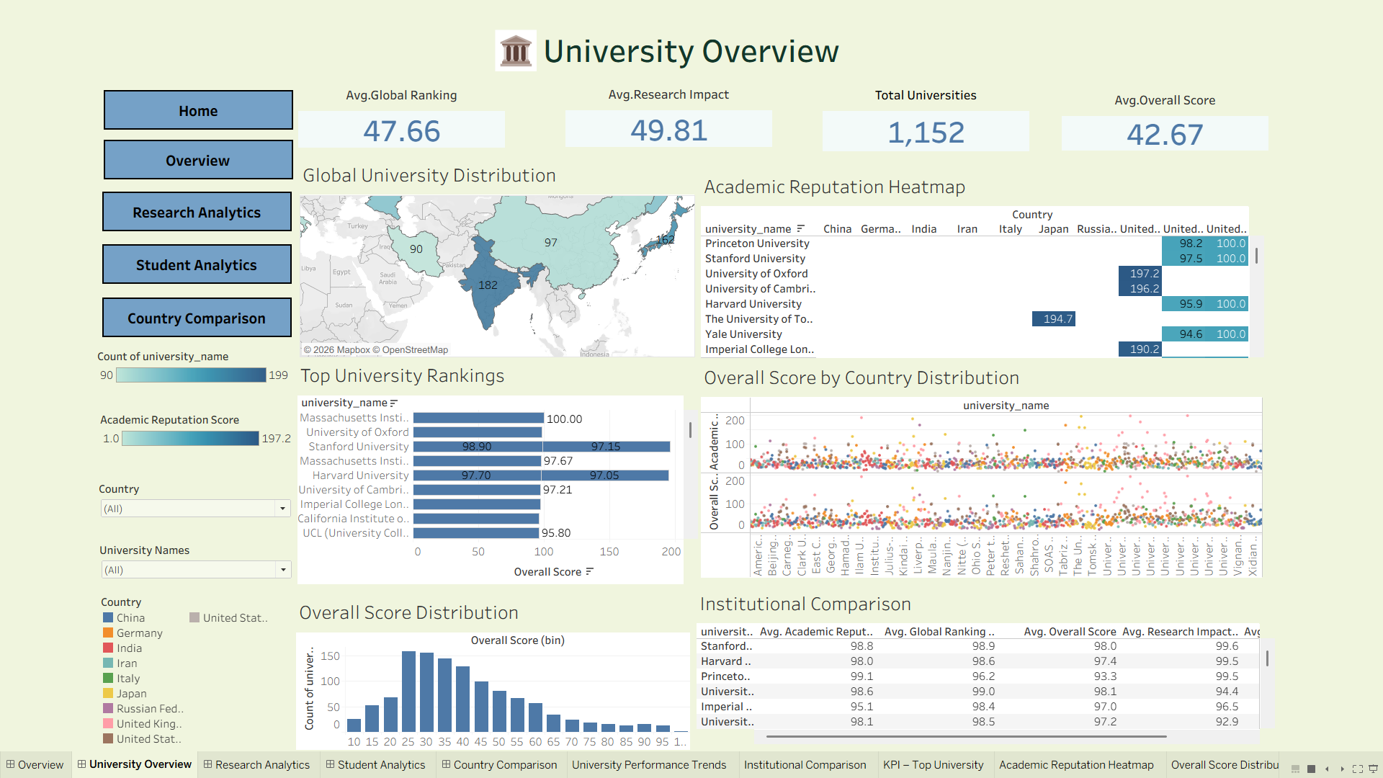
DASHBOARD 1 OF 4
University Overview Dashboard
Highlights
Top University Rankings ranked by overall score
Academic Reputation Heatmap across countries
Global University Distribution map
Institutional Comparison table across key metrics
Actual Tableau dashboard from the completed EduVision project.
EduVision
8

Slide 10
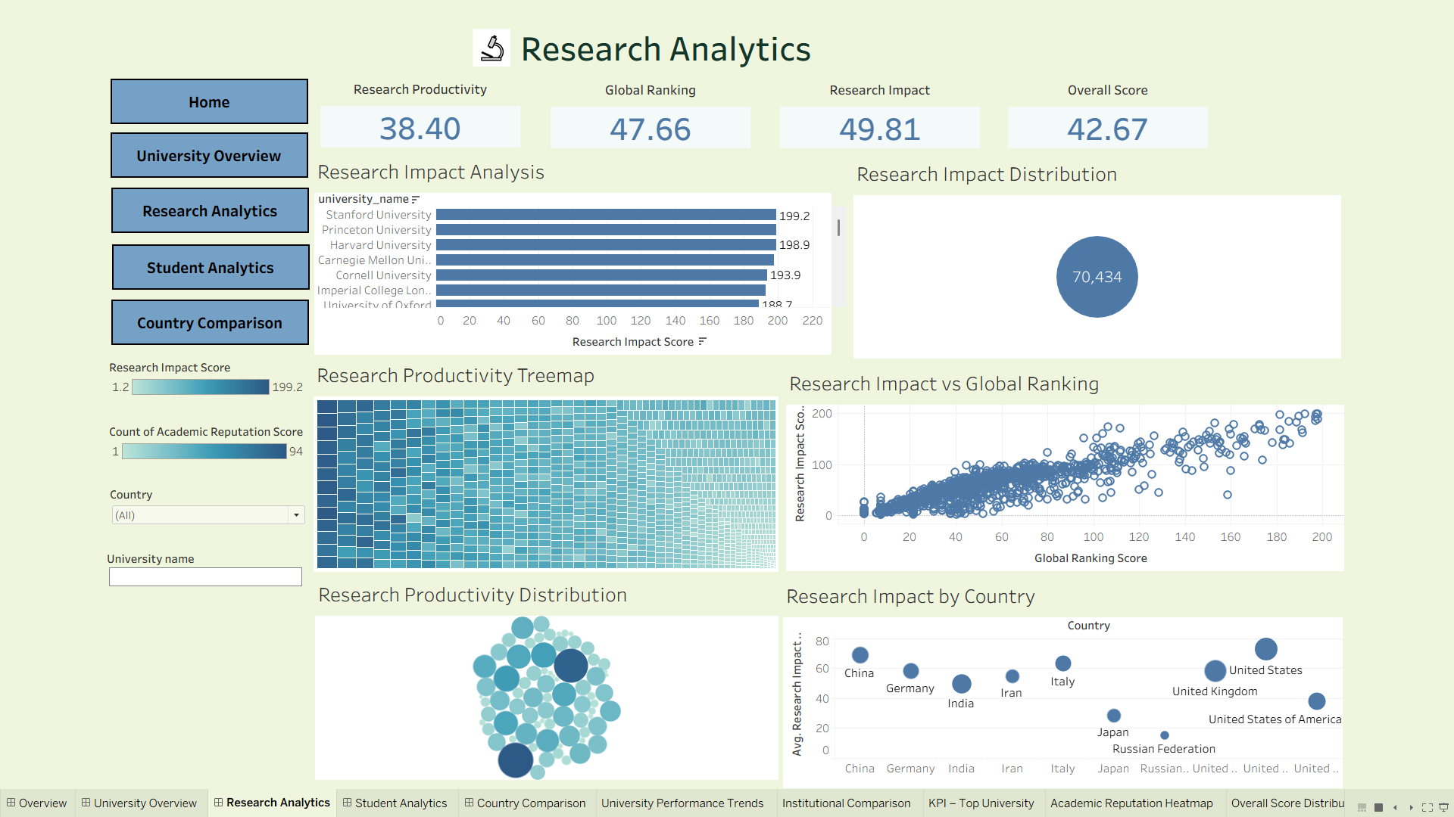
DASHBOARD 2 OF 4
Research Analytics Dashboard
Highlights
Research Impact Analysis ranked by top institutions
Research Productivity Treemap and distribution
Research Impact vs. Global Ranking correlation
Research Impact benchmarked by country
Actual Tableau dashboard from the completed EduVision project.
EduVision
9

Slide 11
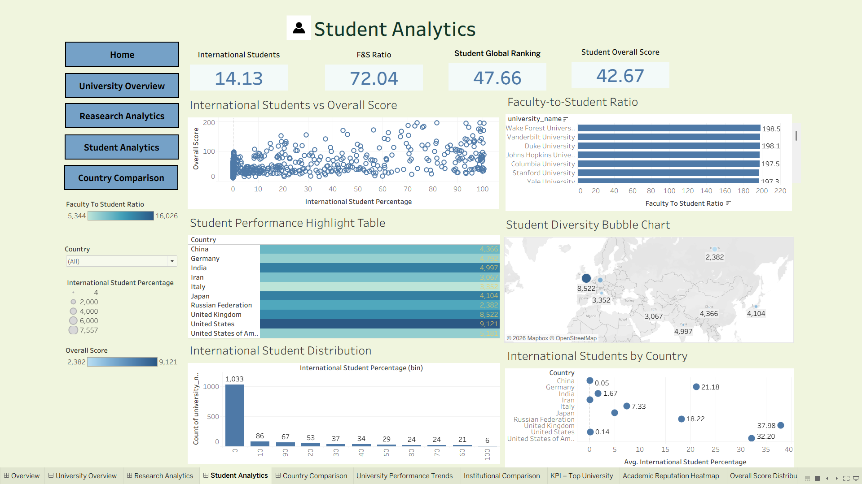
DASHBOARD 3 OF 4
Student Analytics Dashboard
Highlights
International Students vs. Overall Score relationship
Faculty-to-Student Ratio leaderboard
Student Diversity bubble map by country
International Student Distribution histogram
Actual Tableau dashboard from the completed EduVision project.
EduVision
10

Slide 12
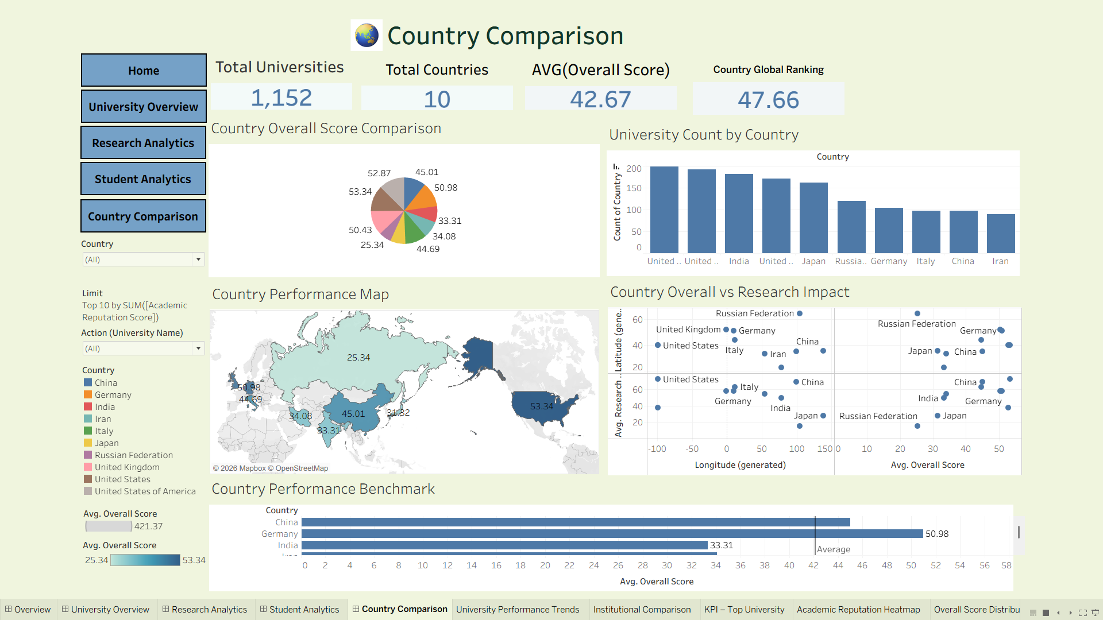
DASHBOARD 4 OF 4
Country Comparison Dashboard
Highlights
Country Overall Score Comparison and benchmark chart
University Count by Country
Country Performance Map
Country Overall Score vs. Research Impact scatter
Actual Tableau dashboard from the completed EduVision project.
EduVision
11

Slide 13
WHAT'S NEXT FOR EDUVISION
Future Enhancements
1
2
3
Automated Data Refresh
Predictive Ranking Models
Cloud-Based Pipelines
Scheduled pipelines to pull new ranking cycles without manual reprocessing.
ML-based forecasting of future university ranking movement.
Migrate processing to the cloud for scale and advanced geographic analytics.
EduVision
12

Slide 14
REPOSITORY & DOCUMENTATION
Project Delivery
8-Module Repository Structure
Delivered Assets
1. Data Collection
2. Data Cleaning & Transformation
3. Education KPI Engineering
4. Dashboard Planning & Prototyping
5. Dashboard Development
6. Dashboard Integration
7. Testing & Validation
8. Documentation & Delivery
Raw, cleaned, and final KPI datasets
Python scripts for collection & KPI generation
Jupyter notebook for cleaning & transformation
Prototype, development, and final Tableau workbooks
Dataset sources, KPI definitions & methodology docs
QA checklist and testing reports
GitHub Repository: <add repository URL here>
EduVision
13

Slide 15
Project Credits
Varun
B.Tech Student, CMR College of Engineering & Technology
Infosys Springboard Virtual Internship — Data Analytics & Visualization
EduVision
14

Slide 16
Q & A

Slide 17
Thank You
EduVision — Higher Education Performance Analytics Dashboard

