Slide 1


Slide 2
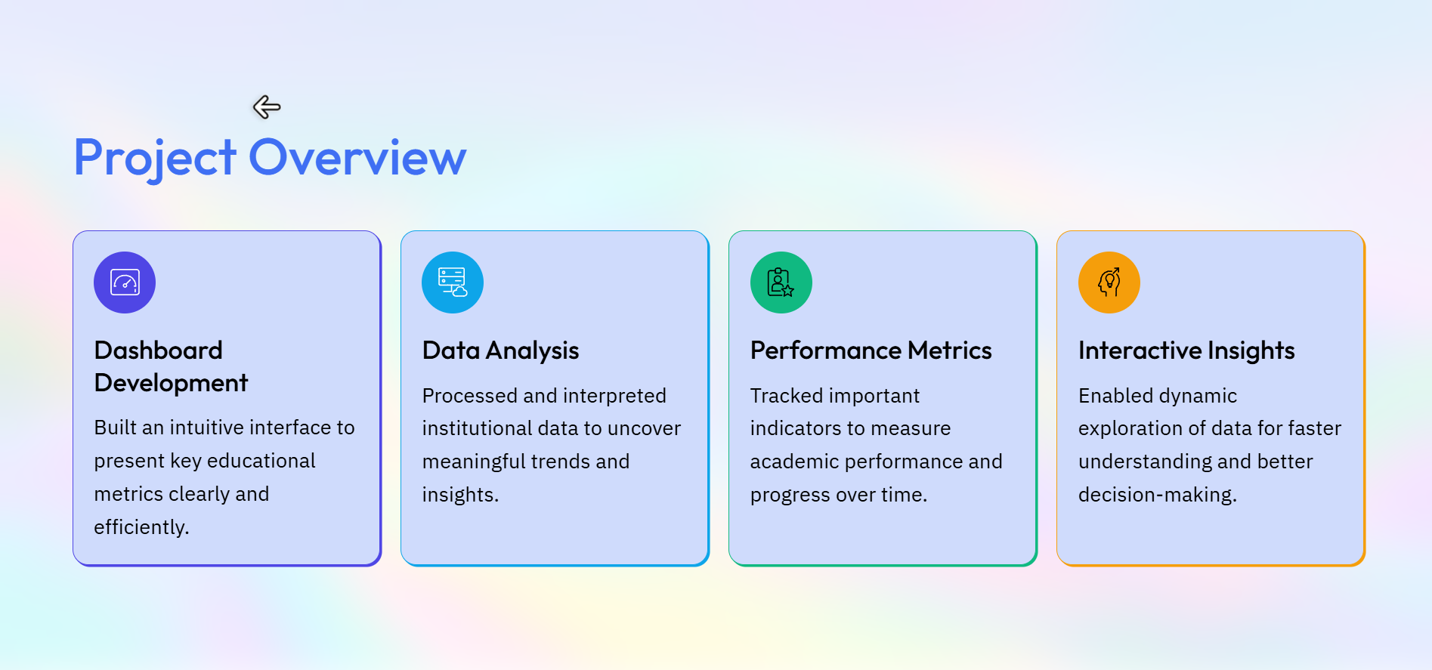

Slide 3
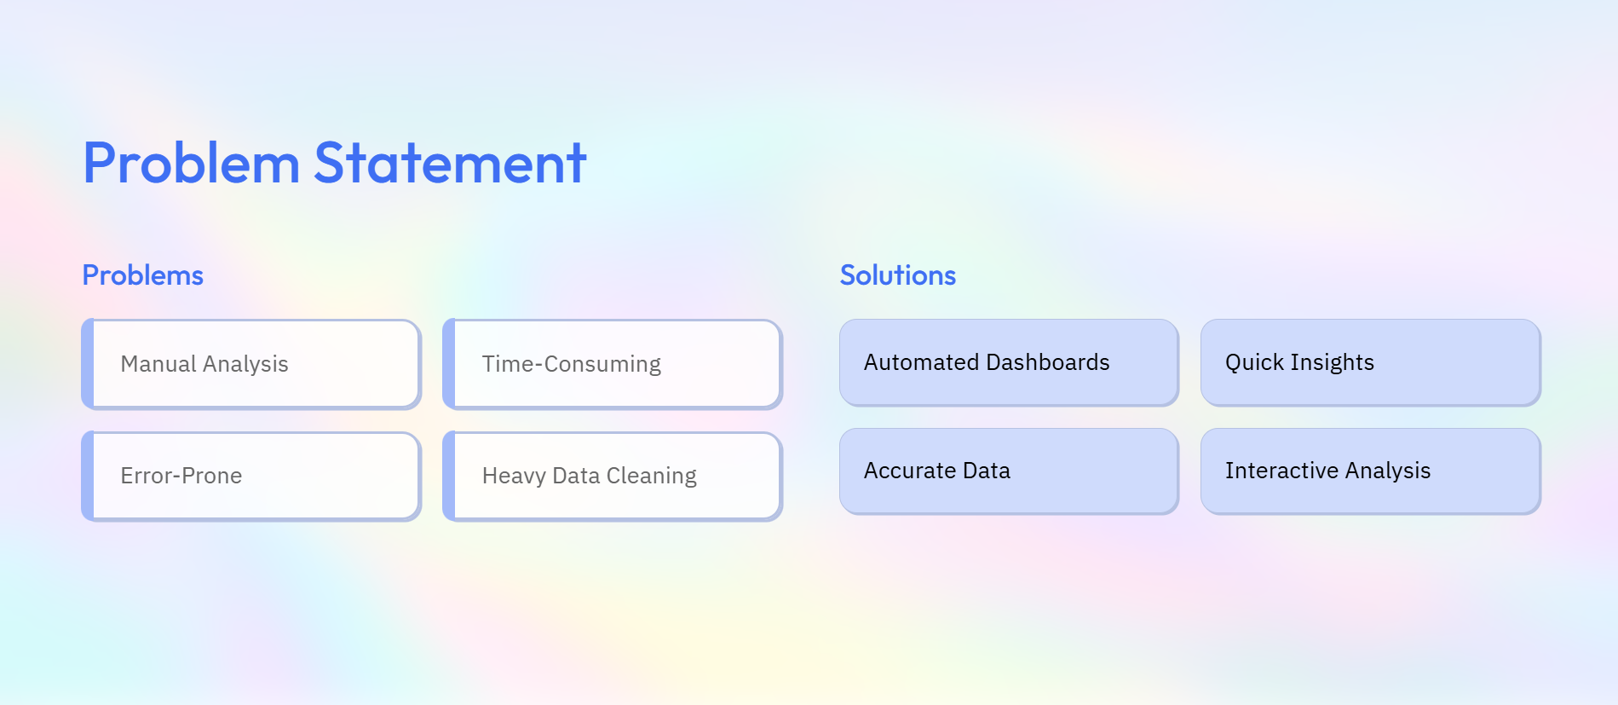

Slide 4
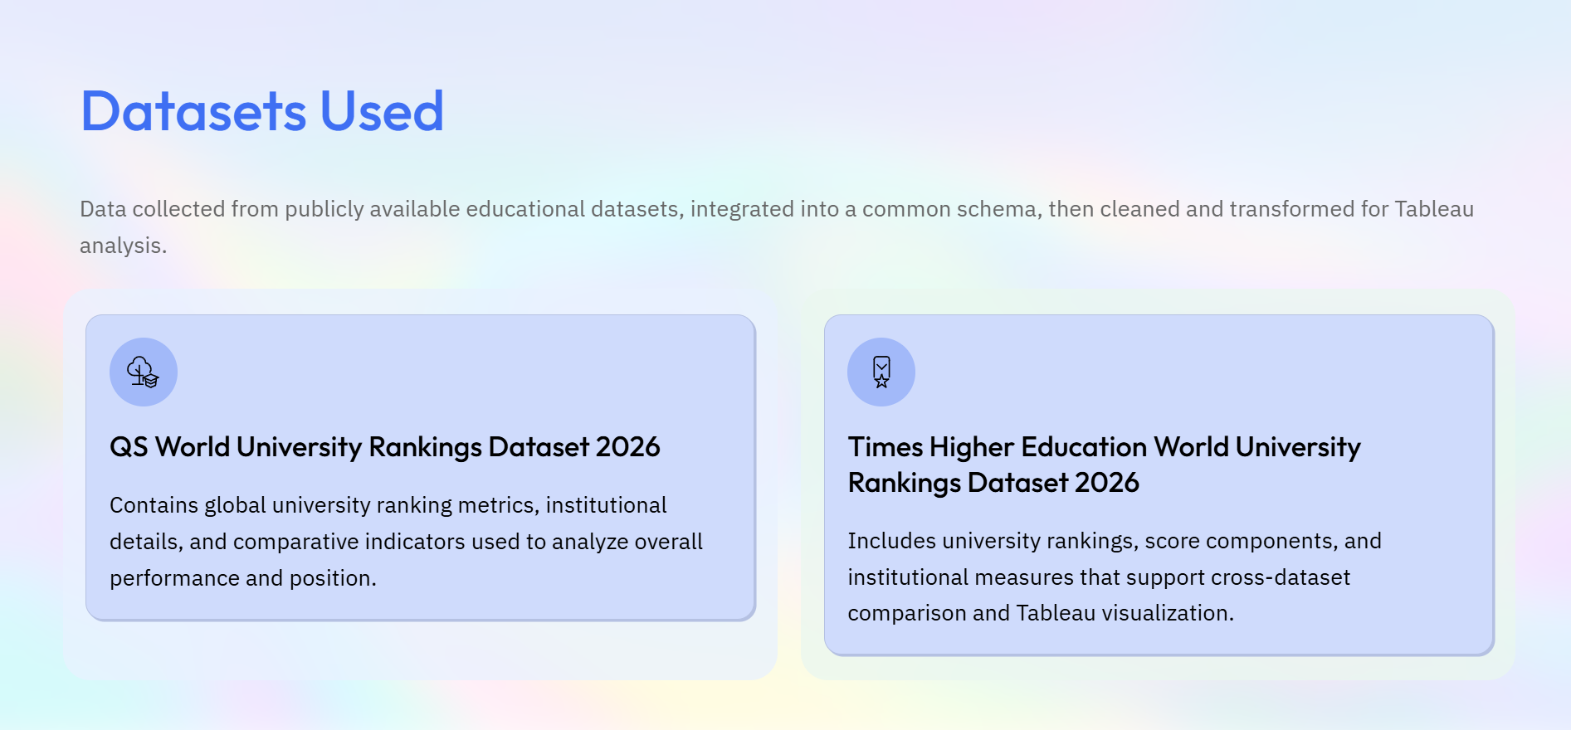

Slide 5
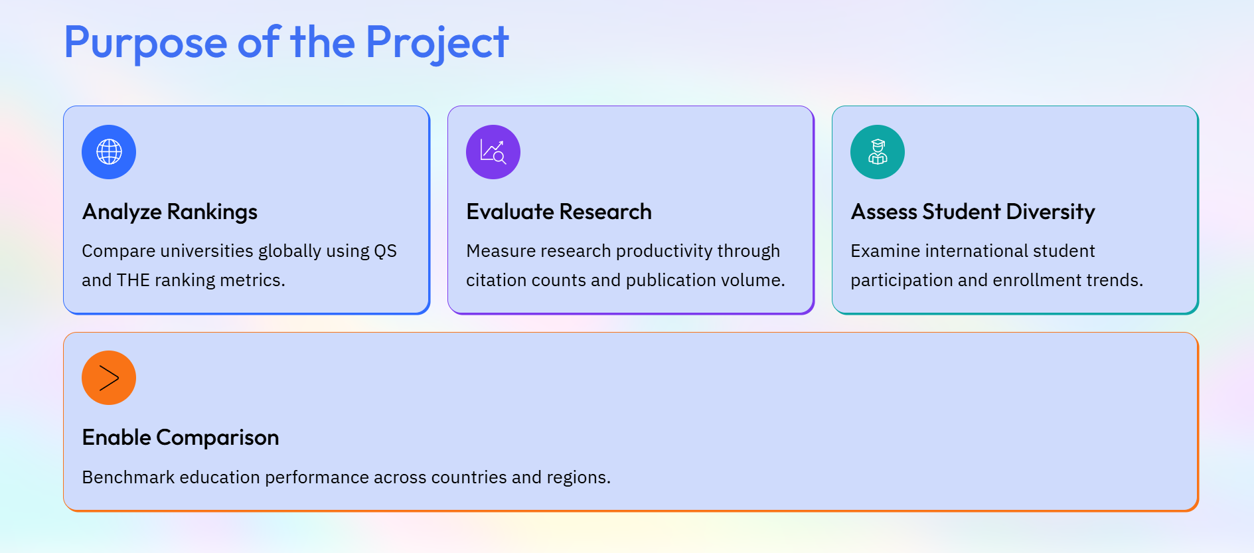

Slide 6
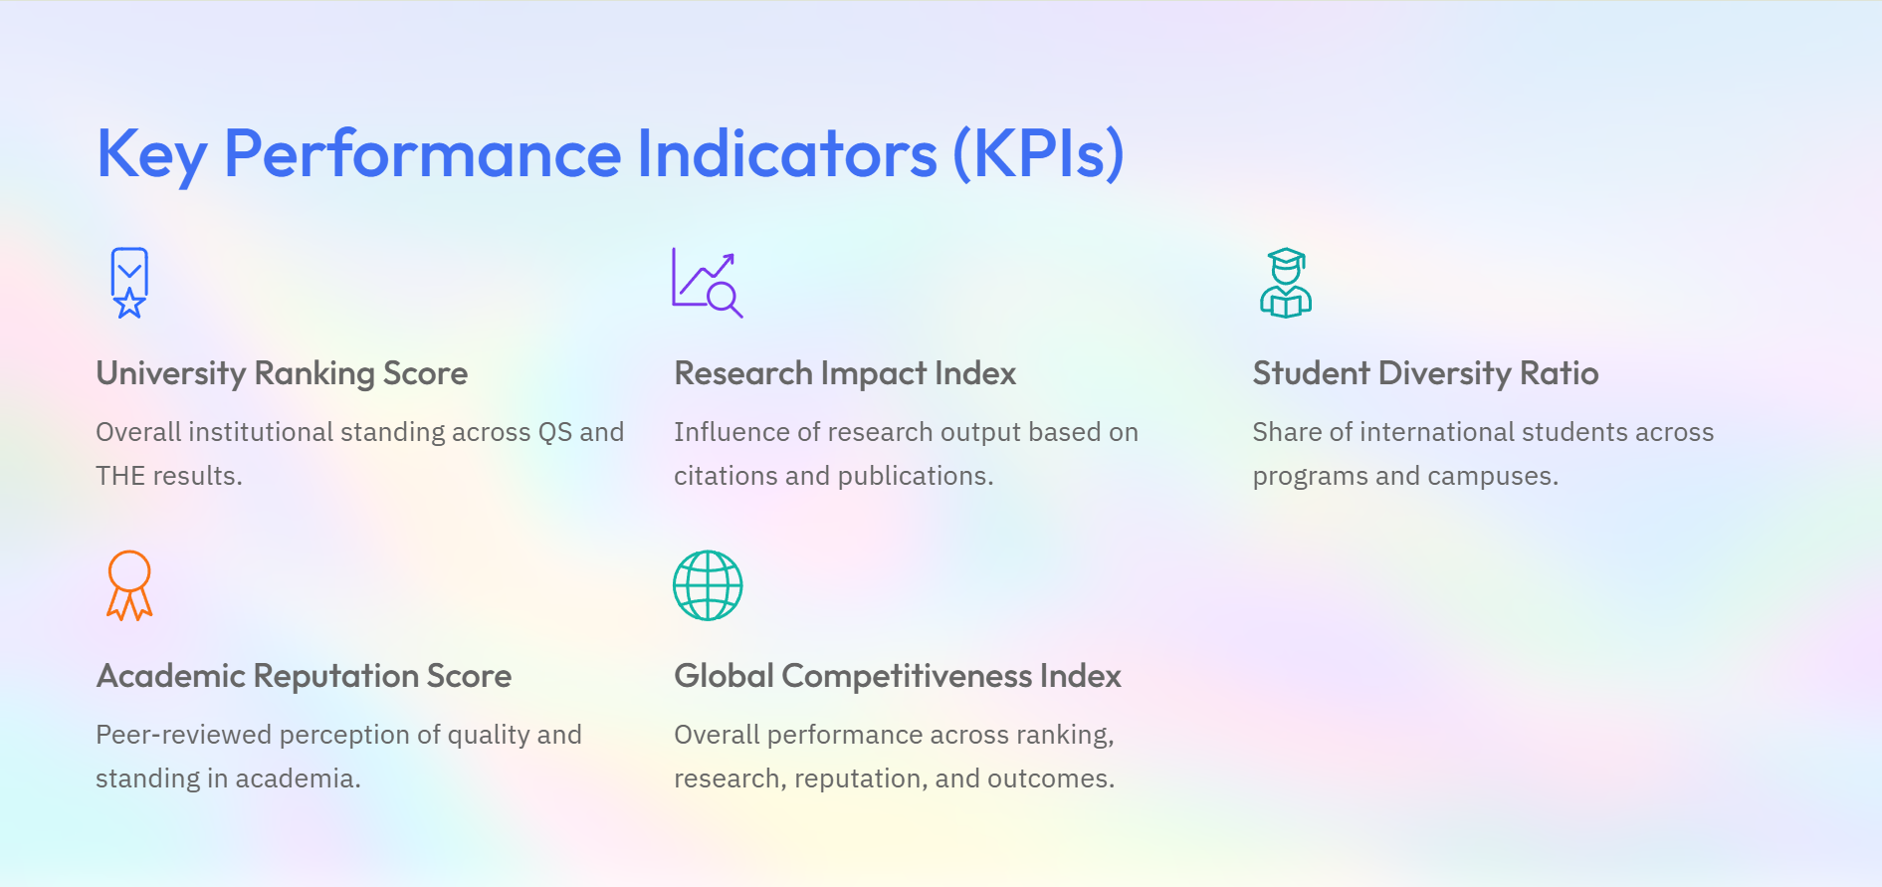

Slide 7
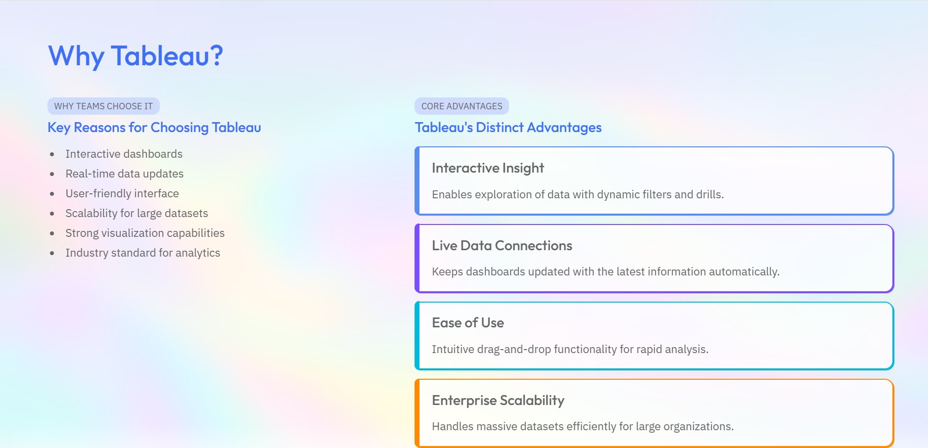


Slide 8
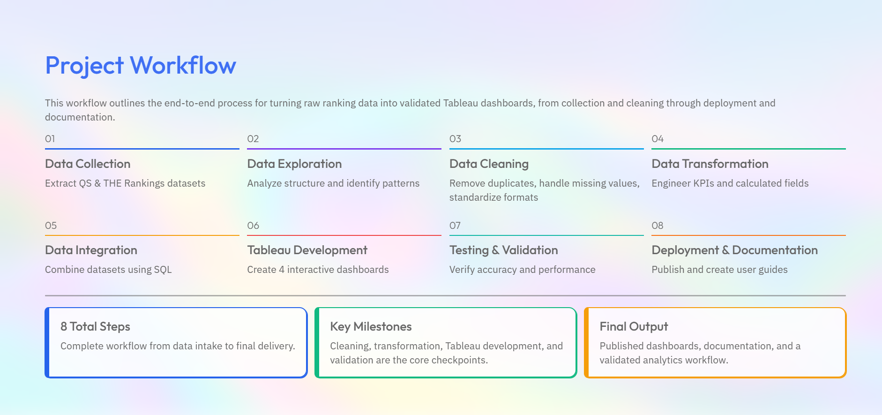

Slide 9

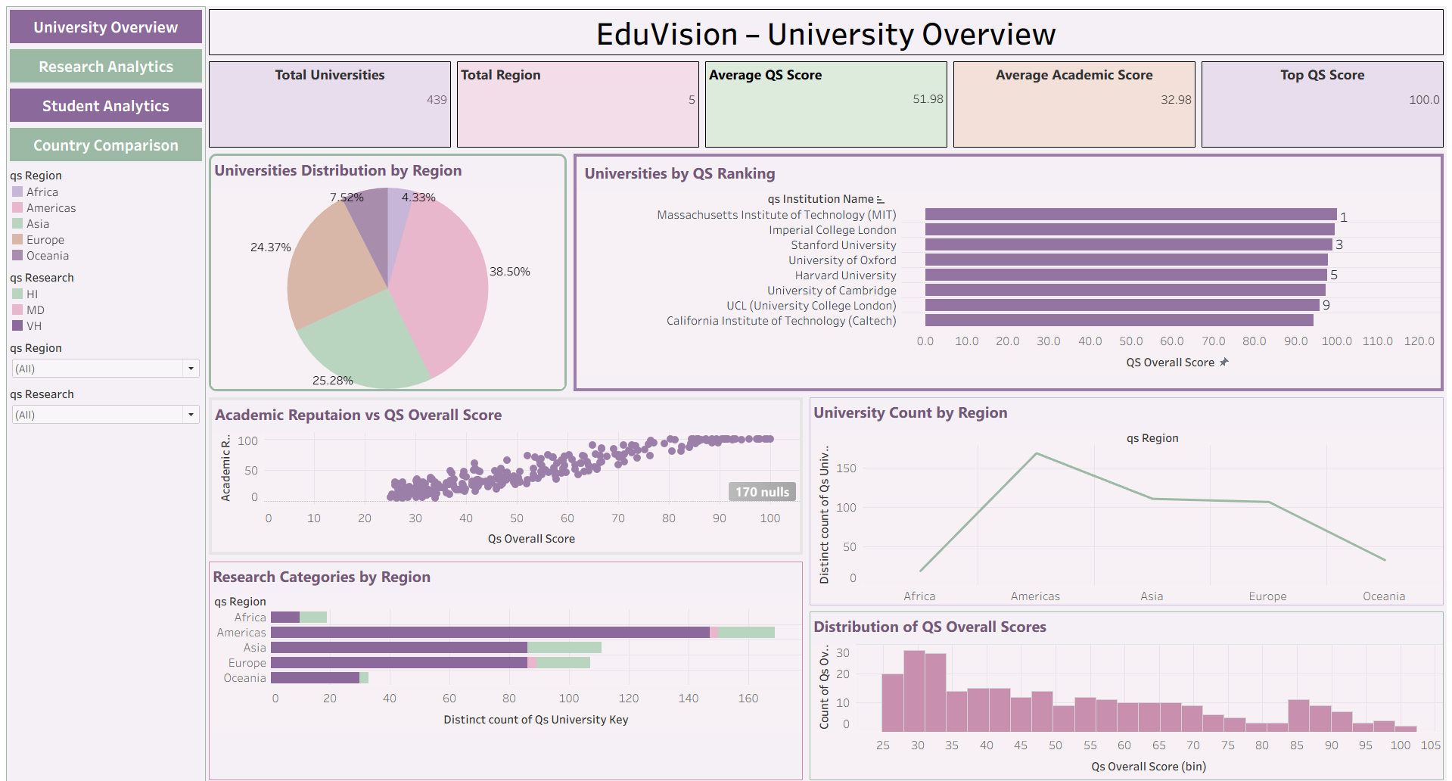
Dashboards Developed & Outcomes
Global rankings, geographic distribution, and academic reputation at a glance.

Slide 10
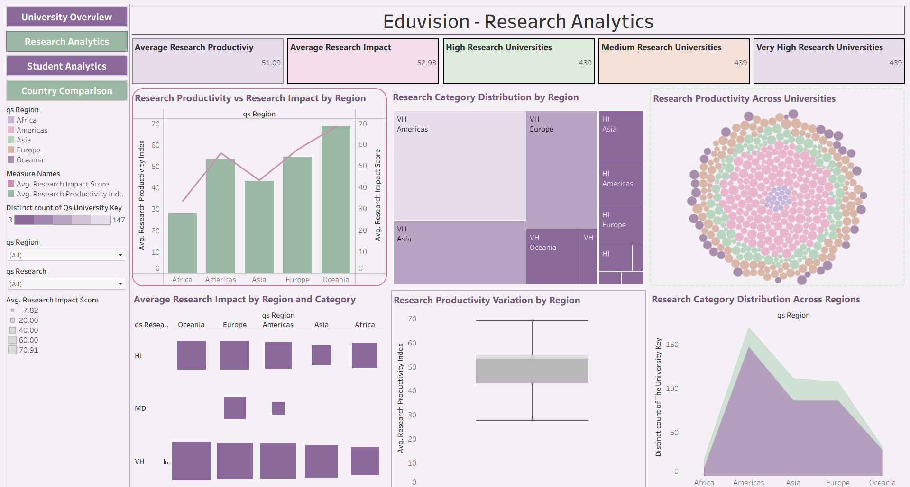
Dashboards Developed & Outcomes
Publication volume, citation performance, and productivity trends across research areas.

Slide 11
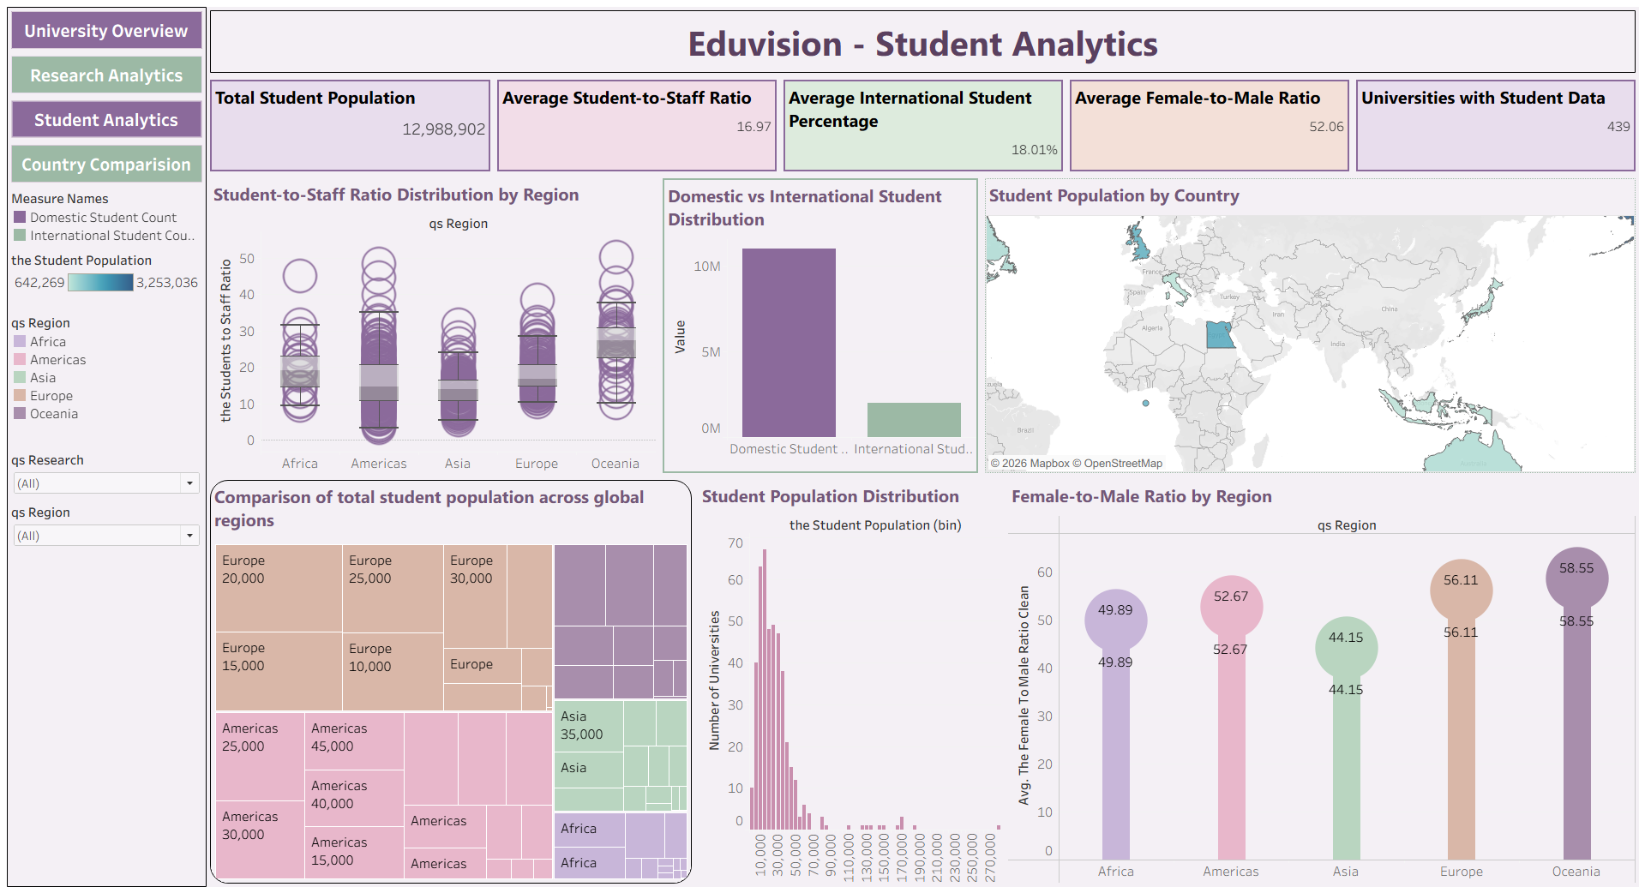
Dashboards Developed & Outcomes
Rankings, global distribution, academic reputation analysis.

Slide 12
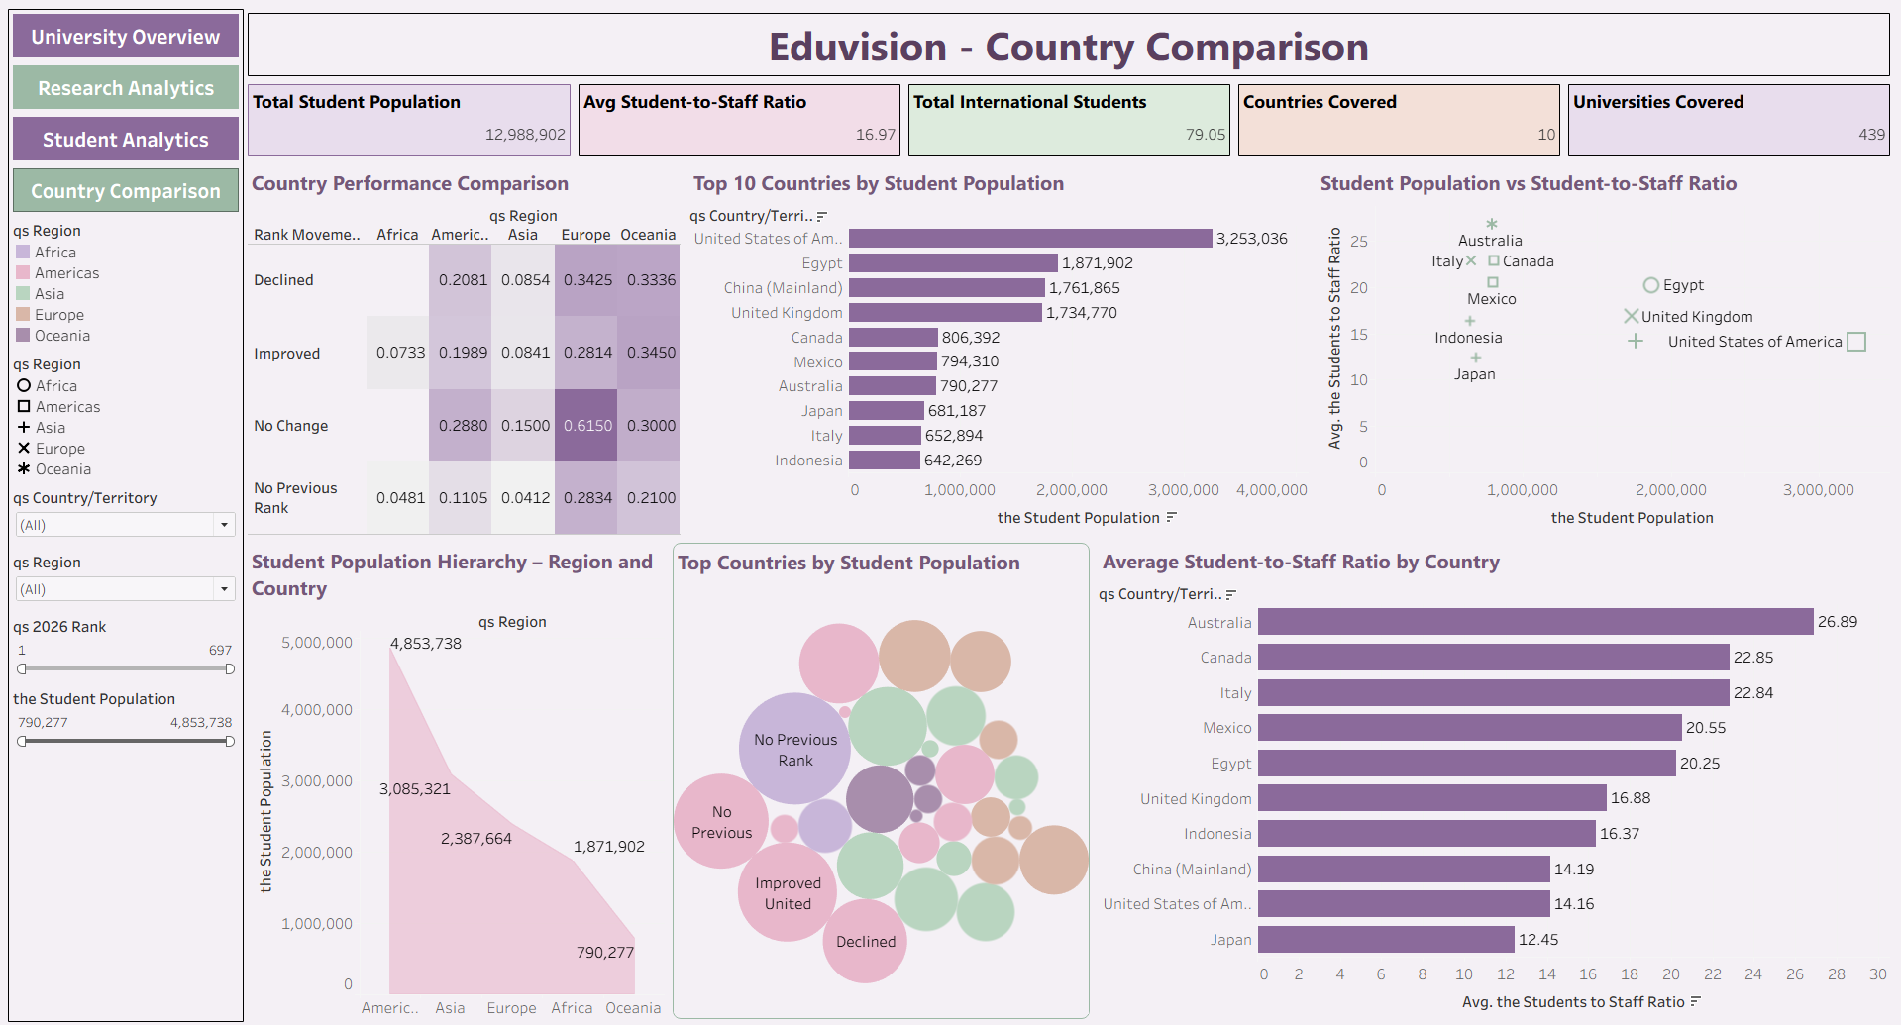
Dashboards Developed & Outcomes
Country benchmarking, regional education trends.

Slide 13
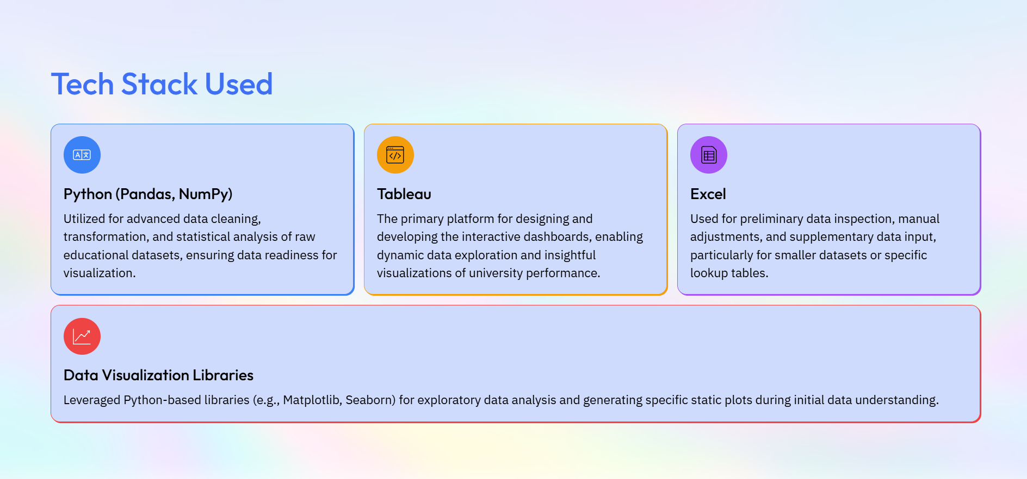

Slide 14
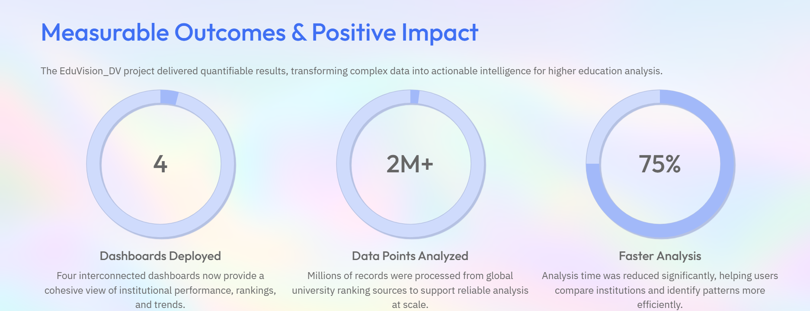


Slide 15


Slide 16


