Slide 1
Higher Education Performance Dashboard
EduVision_DV
Presented by
Amirthan Murugan

Slide 2
Problem Statement
Higher education stakeholders lack a single, unified view of global university performance, research output, and student diversity — data remains scattered across ranking bodies such as QS and Times Higher Education.
This project aims to:
Develop a comprehensive higher education analytics dashboard suite covering rankings, research performance, student diversity, and global education trends.
Transform raw educational data (QS World University Rankings, Times Higher Education Rankings) into actionable insights via interactive Tableau dashboards.
Enable students, researchers, administrators, policymakers, and consultants to evaluate institutions, compare universities globally, and identify trends.
Final Deliverable: A unified Tableau workbook (.twbx) with four interconnected dashboards — University Overview, Research Analytics, Student Analytics, and Country Comparison.
EduVision_DV | Higher Education Performance Dashboard
2

Slide 3
Work Methodology
The project follows a structured, milestone-driven workflow — from raw data collection through to a fully documented, portfolio-ready dashboard suite.
Collect University
Datasets
→
Data Cleaning &
Transformation
→
Education KPI
Engineering
→
Dashboard
Development
→
Dashboard
Integration
→
Testing &
Validation
→
Documentation &
Delivery
Milestones
Milestone | Weeks | Focus | Target
1 | 1–2 | Data Collection & Cleaning | >95% dataset completeness
2 | 3–4 | KPI Engineering & Planning | 6+ KPIs generated
3 | 5–6 | Dashboard Development | 4 dashboards integrated
4 | 7–8 | Testing & Delivery | Portfolio-ready suite
EduVision_DV | Higher Education Performance Dashboard
3

Slide 4
Module 1: University Data Collection
Why this module: To gather raw ranking data from multiple global and national sources into one common base for analysis.
Where the Data Comes From (Kaggle)
QS World University Rankings 2025 kaggle.com/datasets/melissamonfared/qs-world-university-rankings-2025
Times Higher Education World University Rankings 2024 kaggle.com/datasets/ddosad/timesworlduniversityrankings2024
NIRF India Rankings 2016–2025 (Govt. of India) kaggle.com/datasets/iitanshravan/nirf-rankings-dataset-20162025
Challenges Faced
Tools Used
Skills Learned
Inconsistent university and country naming across QS, THE, and NIRF sources.
Different scoring scales between ranking systems.
Merging three differently structured datasets into one schema.
Duplicate institution records across ranking years.
Python
Pandas
Kaggle datasets
Jupyter Notebook
Dataset sourcing & evaluation from Kaggle and official ranking bodies.
Python (Pandas) for merging multi-source data.
Schema design for heterogeneous datasets.
Data-quality validation & completeness testing.
Deliverables: university_raw_data.csv, data_collection.py | Evaluation: Dataset completeness above 95%
EduVision_DV | Higher Education Performance Dashboard
4

Slide 5
Module 2: Data Cleaning & Transformation
Why this module: To resolve inconsistencies across sources and produce one trustworthy, analysis-ready dataset.
Tasks
Tools Used
Skills Learned
Remove duplicate records across ranking sources.
Standardize university names for consistency.
Standardize country names across datasets.
Normalize ranking metrics to a common scale.
Create Tableau-ready, analysis-optimized datasets.
Python
Pandas
NumPy
Jupyter Notebook
Data deduplication techniques
String/fuzzy matching for name standardization
Handling missing values in Pandas
Data-type standardization & scaling
Deliverables: university_cleaned.csv • education_cleaning.ipynb Evaluation: Less than 2% missing values. • Consistent ranking indicators across sources.
EduVision_DV | Higher Education Performance Dashboard
5

Slide 6
Module 3: Education KPI Engineering
Why this module: To turn raw ranking data into meaningful, comparable performance indicators for every dashboard.
Tasks
Tools Used
Skills Learned
Calculate Global Ranking Score.
Calculate Research Impact Score.
Calculate Faculty-to-Student Ratio.
Calculate International Student Percentage.
Calculate Academic Reputation Score.
Calculate Research Productivity Index.
Python
Pandas
Microsoft Excel (formula validation)
KPI / metric design for education analytics
Weighted composite scoring formulas
Data normalization (min-max scaling)
Calculated fields in Python & Excel
Deliverables: university_final_dataset.xlsx • generate_education_kpis.py Evaluation: All KPIs correctly calculated. • Dataset fully optimized for Tableau.
EduVision_DV | Higher Education Performance Dashboard
6

Slide 7
KPI Calculation
Six core KPIs power every visualization in the dashboard suite. Each is derived directly from the cleaned QS, THE, and NIRF datasets.
KPI | Formula | Purpose
Global Ranking Score | (0.4 × Academic Rep. + 0.2 × Employer Rep. + 0.2 × Faculty/Student Ratio + 0.2 × Citations) × 100 | Composite overall university standing
Research Impact Score | (Total Citations ÷ Total Publications) × 100 (normalized 0–100) | Measures influence of published research
Faculty-to-Student Ratio | Total Faculty Count ÷ Total Student Count | Indicates teaching capacity & attention
International Student % | (International Students ÷ Total Students) × 100 | Reflects global diversity & outlook
Academic Reputation Score | Normalized Peer-Survey Score (scaled 0–100) | Captures academic peer perception
Research Productivity Index | Total Publications ÷ Total Faculty Count | Research output per faculty member
EduVision_DV | Higher Education Performance Dashboard
7

Slide 8
Module 4: Dashboard Planning & Prototyping
Why this module: To plan a clear, user-centered dashboard structure before development begins, reducing rework later.
Tasks
Tools Used
Skills Learned
Design layouts for University Overview, Research Analytics, Student Analytics, and Country Comparison dashboards.
Define global filters and navigation structure.
Define dashboard actions and interactive comparisons.
Storyboard the end-to-end user experience.
Tableau Desktop
Whiteboard / Figma (wireframes)
PDF (storyboard)
UX wireframing for analytics dashboards
Information architecture & navigation design
Rapid prototyping in Tableau
Storyboarding & stakeholder walkthroughs
Deliverables: dashboard_storyboard.pdf • eduvision_prototype.twbx Evaluation: Dashboard designs approved. • Prototype functionality verified.
EduVision_DV | Higher Education Performance Dashboard
8

Slide 9
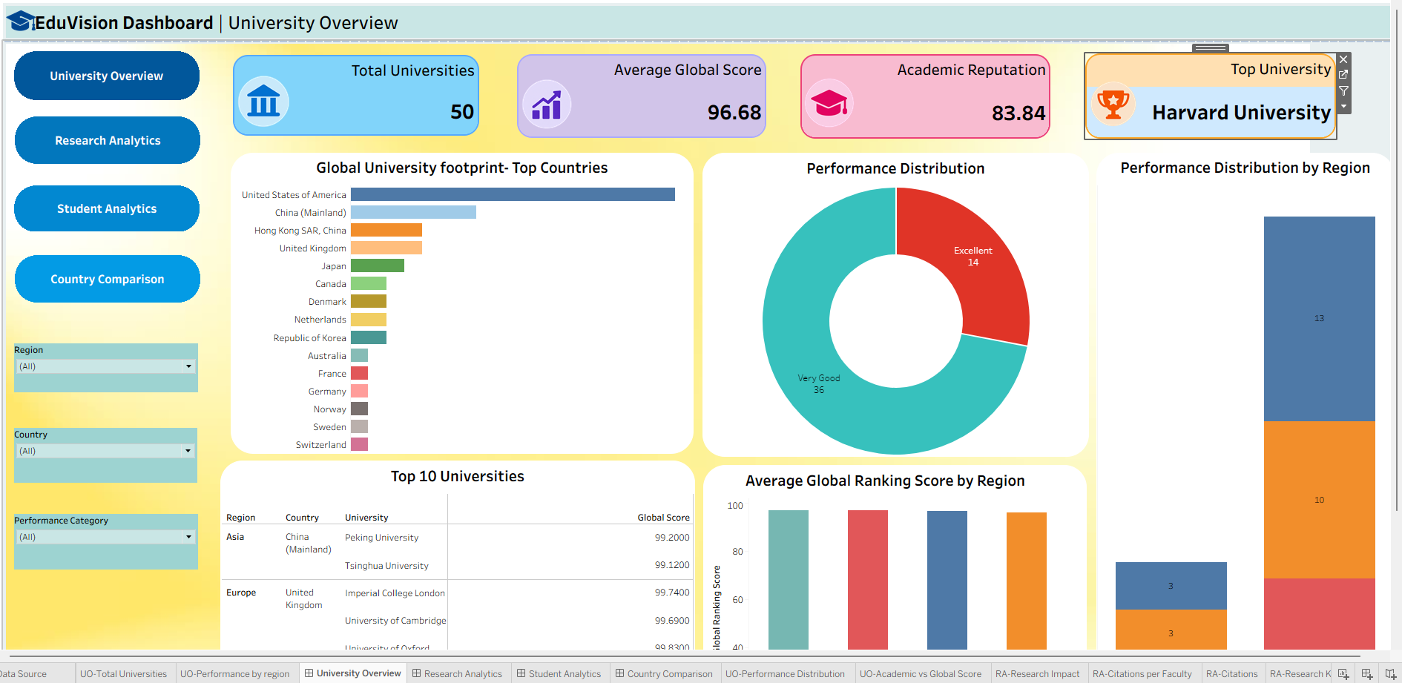
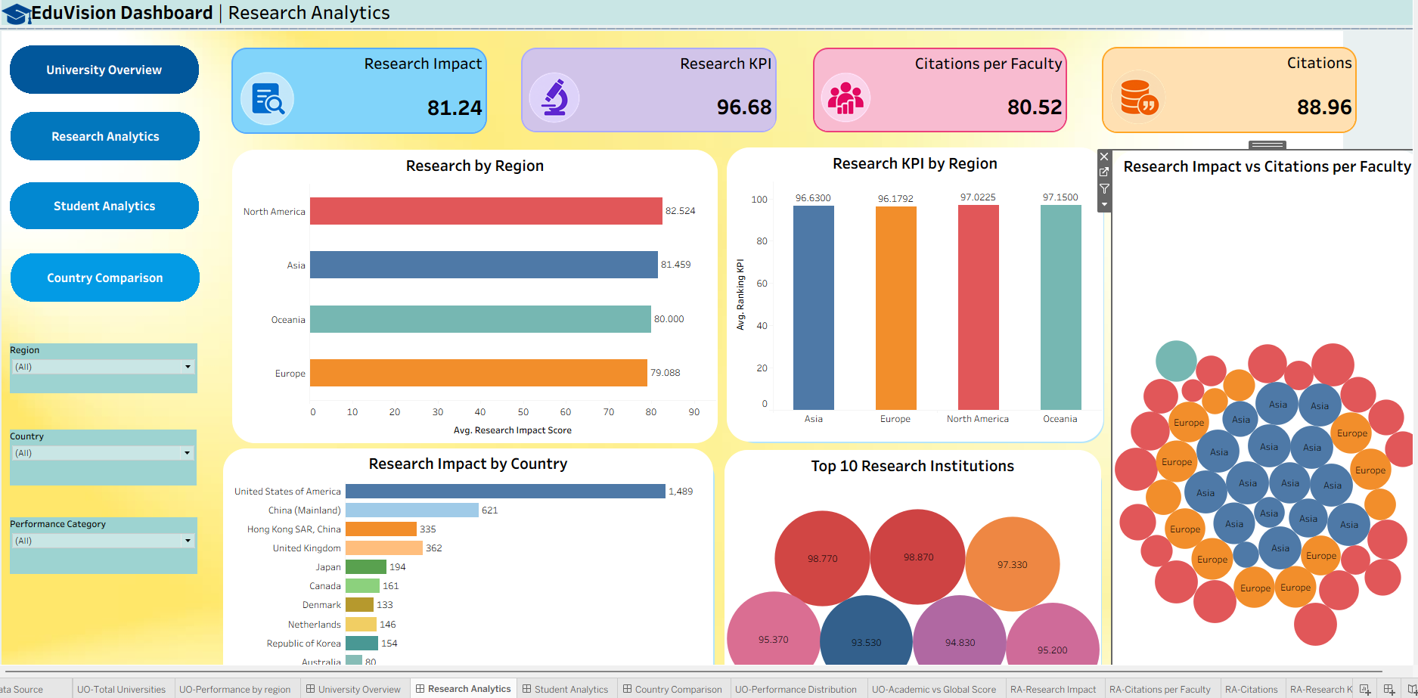
Module 5: Build University Overview & Research Analytics Dashboards
Why this module: To turn cleaned data and KPIs into visual, interactive dashboards for rankings and research performance.
University Overview
Research Analytics
Top university rankings
Global university distribution
Academic reputation analysis
University performance trends
Institutional comparison
Publications analysis
Citation performance
Research productivity trends
Top research institutions
Research impact comparison
Deliverable: eduvision_dashboard_v1.twbx • Interactive visualizations operational, ranking metrics validated.
Tools Used: Tableau Desktop, Tableau Public Skills Learned: Tableau calculated fields, chart design (bar/donut/map), KPI card design, dashboard color theory.
EduVision_DV | Higher Education Performance Dashboard
9

Slide 10
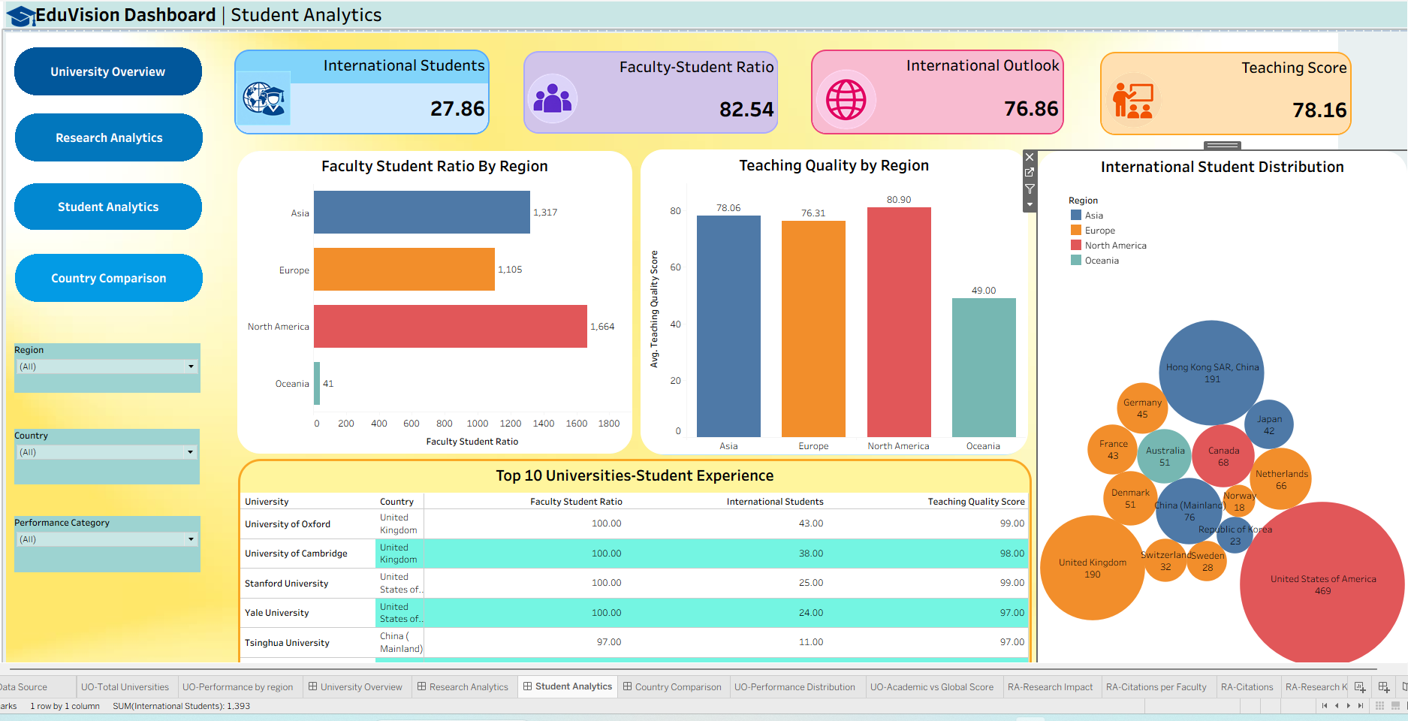
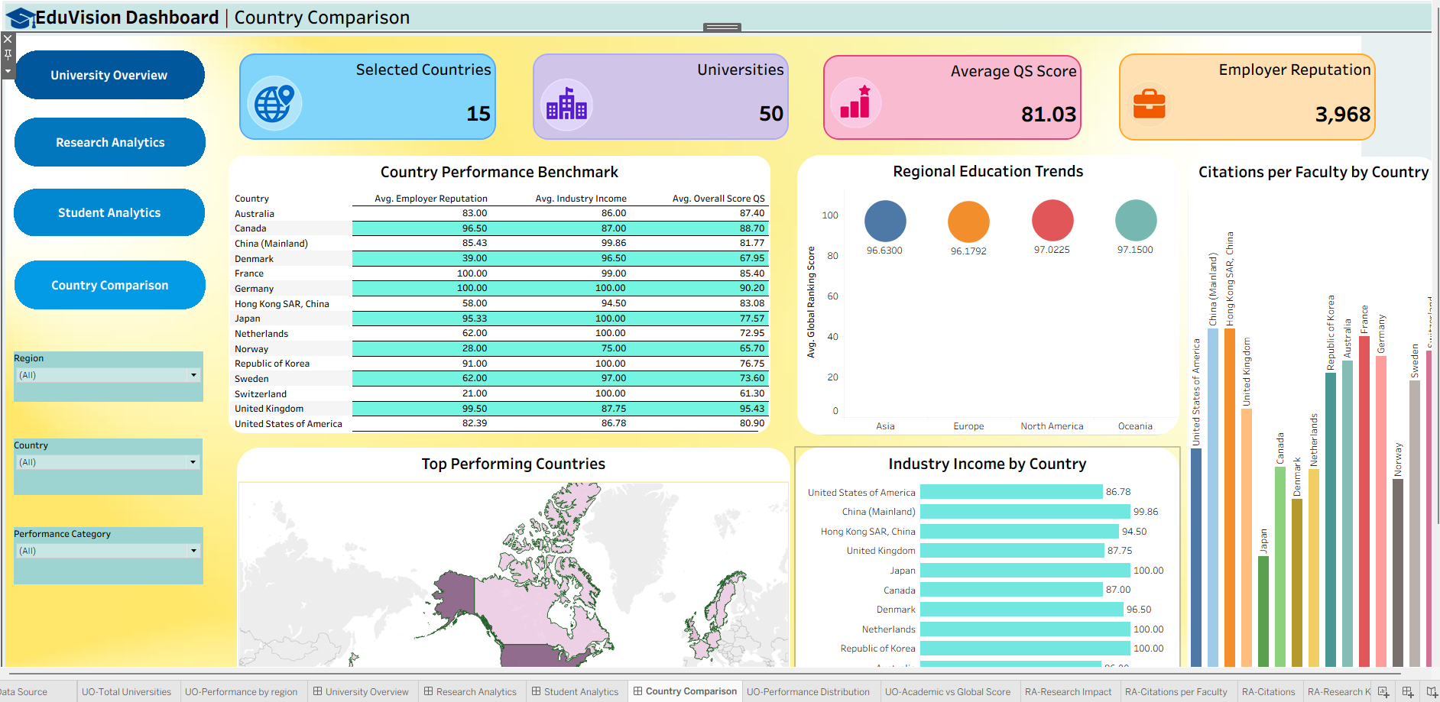
Module 6: Build Student Analytics & Country Comparison Dashboards
Why this module: To visualize student diversity and enable side-by-side country-level benchmarking.
Student Analytics
Country Comparison
International student analysis
Faculty-to-student ratio analysis
Student diversity trends
Enrollment comparisons
Student distribution analysis
Country ranking comparison
Education performance benchmarking
Regional education trends
Top performing countries
Deliverable: EduVision_DV.twbx • Global filters, navigation controls & parameter actions integrated across all dashboards.
Tools Used: Tableau Desktop, Filters / Actions / Parameters Skills Learned: Dashboard integration, cross-filtering, parameter actions, geographic (map) visualization.
EduVision_DV | Higher Education Performance Dashboard
10

Slide 11
Module 7: Testing and Validation
Why this module: To make sure every number on the dashboards is accurate and every interaction works before delivery.
Tasks
Tools Used
Skills Learned
Validate KPI calculations against source data.
Verify ranking calculations for accuracy.
Test dashboard interactions, filters, and actions.
Validate educational metrics across all four dashboards.
Tableau
Microsoft Excel (cross-checking)
Manual QA checklist
QA test-case design for dashboards
Data validation & cross-checking techniques
Regression testing of interactive visuals
Root-cause debugging of ranking discrepancies
Deliverables: QA Checklist • Dashboard Testing Report Evaluation: No major dashboard issues. • KPI accuracy above 95%.
EduVision_DV | Higher Education Performance Dashboard
11

Slide 12
Module 8: Documentation and Project Delivery
Why this module: To make the project reproducible, understandable, and ready to share as a portfolio piece.
Tasks
Tools Used
Skills Learned
Prepare documentation: dataset sources, KPI definitions, dashboard guide, and education analytics methodology.
Organize project structure: /scripts, /data, /dashboard, /docs.
Deploy to GitHub Repository.
Optionally publish to Tableau Public.
Markdown
GitHub
Tableau Public
Technical documentation writing
Git & GitHub version control
Project structuring & file organization
Portfolio presentation & publishing
Deliverables: GitHub Repository • Final Documentation • Tableau Workbook Evaluation: Fully documented project. • Portfolio-ready dashboard suite.
EduVision_DV | Higher Education Performance Dashboard
12

Slide 13
Conclusion
EduVision_DV successfully transforms scattered global ranking data into a single, interactive Tableau workbook that supports clear, data-driven decisions across higher education.
Key Outcomes
Delivered Capabilities
Collection and integration of global university datasets.
Data cleaning and transformation for educational analytics.
Development of six+ higher education KPIs.
Country-level education benchmarking.
Four interactive, fully-integrated Tableau dashboards.
Interactive filters and drill-down capabilities.
University ranking and performance analysis.
Single Tableau workbook (.twbx) as final deliverable.
Result: A portfolio-ready, fully documented dashboard suite enabling students, researchers, administrators, and policymakers to benchmark institutions globally.
EduVision_DV | Higher Education Performance Dashboard
13

Slide 14
Thank You
EduVision_DV | Higher Education Performance Dashboard
Amirthan Murugan

