Slide 1
🎓
EduVision
Higher Education Performance Dashboard
Gouthami Borkute
B.Tech – Data Science · Malla Reddy Engineering College for Women
Tools: Python · Pandas · Tableau

Slide 2
INTRODUCTION
Project Overview
Objective
Data Sources
📊
Analyze university performance
QS World University Rankings
using educational ranking data
🏆
🌍
Compare universities and countries
side by side, across key indicators
📘
Times Higher Education (THE)
World University Rankings
🔬
Analyze research & student indicators
to surface meaningful patterns
The project analyzes rankings, research performance, student diversity, academic excellence, and global education trends.
✨
Convert raw data into KPIs
and interactive dashboards
02

Slide 3
METHODOLOGY
Project Workflow
1
2
3
4
5
6
7
Data
Collection
Cleaning &
Transformation
KPI
Engineering
Dashboard
Development
Dashboard
Integration
Testing &
Validation
Final
Dashboard
This flow follows the workflow defined in the project document, from raw ranking data to a fully validated four-dashboard Tableau deliverable.
03

Slide 4
PREPROCESSING
Data Cleaning & Preparation
Performed using Python & Pandas
🧹
Removed duplicate records
🔍
Handled missing values
🏛️
Standardized university names
🌐
Standardized country names
🔢
Converted fields to numeric format
✅
Prepared a Tableau-ready dataset
OUTPUT
A cleaned and structured university dataset — with duplicates removed, names standardized, and ranking metrics normalized, exactly as specified in the project requirements.
04

Slide 5
METRICS
KPI Engineering
Six key KPIs required by the project specification
🌍
🔬
👨‍🏫
Global Ranking Score
Research Impact Score
Faculty-to-Student Ratio
Converts ranking into a comparable score
Measures impact using citation performance
Represents the faculty/student indicator
✈️
🏅
📈
International Student %
Academic Reputation Score
Research Productivity Index
Represents international student performance
Measures academic reputation
Combines research-related indicators
05

Slide 6
DASHBOARD 1 OF 4
🎓
University Overview
Provides an overall view of university performance.
KEY VISUALIZATIONS
🏆
Top University Rankings
🎓
🌍
Global University Distribution
🎓
Academic Reputation Analysis
One of four
interactive dashboards
in the EduVision suite
📊
University Performance Trends
🔍
Institutional Comparison
WHAT I CAN DEMONSTRATE
Country Filter → University Filter → Compare Performance
06

Slide 7
DASHBOARD 2 OF 4
🔬
Research Analytics
Analyzes research performance across universities.
KEY VISUALIZATIONS
KEY KPIS
📚
Publications Analysis
• Research Impact Score
📈
Citation Performance
• Research Productivity Index
• Citations per Faculty
🔬
Research Productivity Trends
• Research Quality
🏆
Top Research Institutions
• Research Environment
📊
Research Impact Comparison
07

Slide 8
DASHBOARD 3 OF 4
👩‍🎓
Student Analytics
Focuses on student-related indicators and international student performance.
KEY VISUALIZATIONS
INTERACTIVE FEATURES
🌍
International Student Analysis
• Country filter
👨‍🏫
Faculty-to-Student Ratio Analysis
• University filter
• Chart selection
🎓
Student Diversity Trends
📊
Enrollment Comparisons
🌎
Student Distribution Analysis
08

Slide 9
DASHBOARD 4 OF 4
🌍
Country Comparison
Compares higher-education performance across countries.
KEY VISUALIZATIONS
🗺️
University Distribution by Country
🌍
🏆
Global Ranking Score by Country
🔬
Research Impact by Country
Compare every
country and university
on equal footing
🎓
Academic Reputation vs Research Impact
✈️
International Student Performance
📊
Country KPI Comparison
MAIN GOAL
Identify differences in university, research, academic, and student performance between countries.
09

Slide 10
BRINGING IT TOGETHER
Dashboard Integration & Interactivity
INTERACTIVE FEATURES
NAVIGATION FLOW
🔎
Filters
🧭
Dashboard Navigation
University
Overview
↓
🔗
Dashboard Actions
📊
Interactive Comparisons
Research
Analytics
↓
🌍
Country-based Analysis
🎓
University-level Drill-down
Student
Analytics
↓
Country
Comparison
10

Slide 11
TECH STACK
Technologies Used
🐍
📊
🔗
📝
Data Processing
Visualization
Dashboard Integration
Documentation
Python
Tableau Desktop
Filters
Ppt
Pandas
Tableau Public
Parameters
GitHub
NumPy
Actions
11

Slide 12
PERSONAL CONTRIBUTION
My Contribution
“My main contribution was in data preprocessing, KPI engineering, and Tableau dashboard development.”
✓
Cleaned and transformed the data using Python
✓
Handled missing and duplicate values
✓
Prepared the final dataset
✓
Created the required KPIs
✓
Designed four Tableau dashboards
✓
Added filters and navigation
✓
Tested dashboard interactions
✓
Prepared the project for final presentation
12

Slide 13
PROBLEM SOLVING
Challenges & Solutions
CHALLENGE | SOLUTION
Different dataset structures | Standardized common fields
Missing values | Handled during preprocessing
Duplicate universities | Removed duplicates
Different indicators | Created common KPIs
Large dataset | Used Python / Pandas
Complex analysis | Used interactive Tableau dashboards
13

Slide 14
ROADMAP
Future Improvements
📅
Add multiple years of ranking data
🌍
Include more universities and countries
👥
Add actual student/faculty counts where available
📈
Improve year-wise trend analysis
🤖
Add predictive analytics
🖱️
Add more advanced Tableau interactions
☁️
Deploy the dashboard online
14

Slide 15
CONCLUSION
EduVision transforms raw university ranking data into meaningful insights.
Data
Cleaning
KPIs
Visualization
Insights
It helps users:
•
Compare universities
•
Analyze research performance
•
Understand student indicators
•
Benchmark countries
•
Explore higher-education trends
15

Slide 16
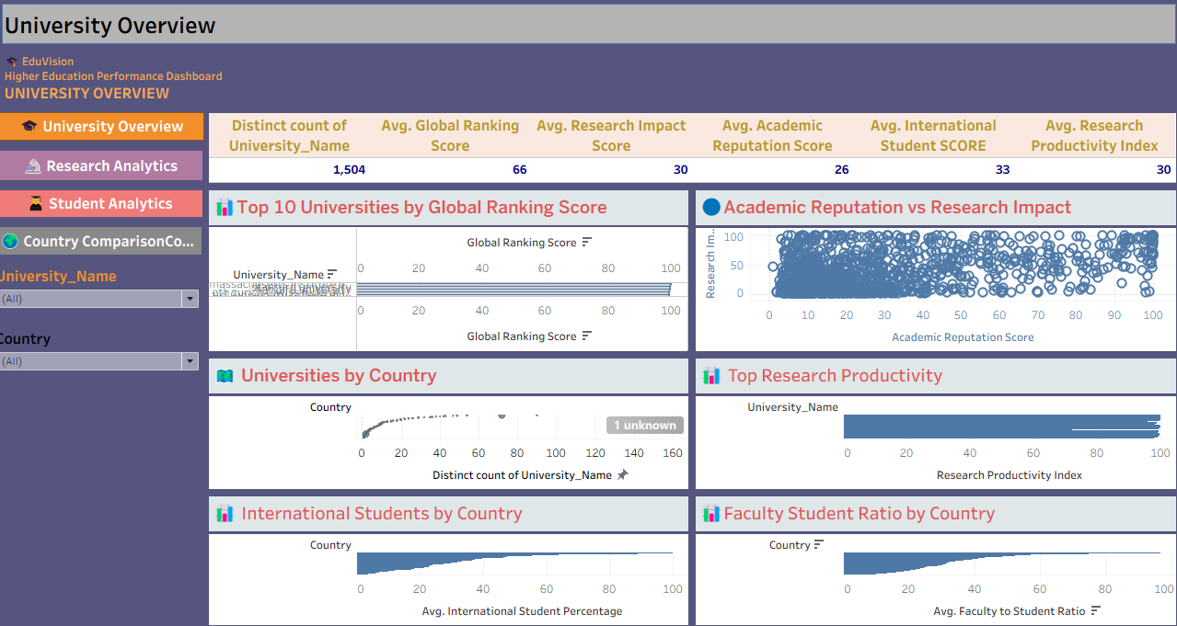

Slide 17
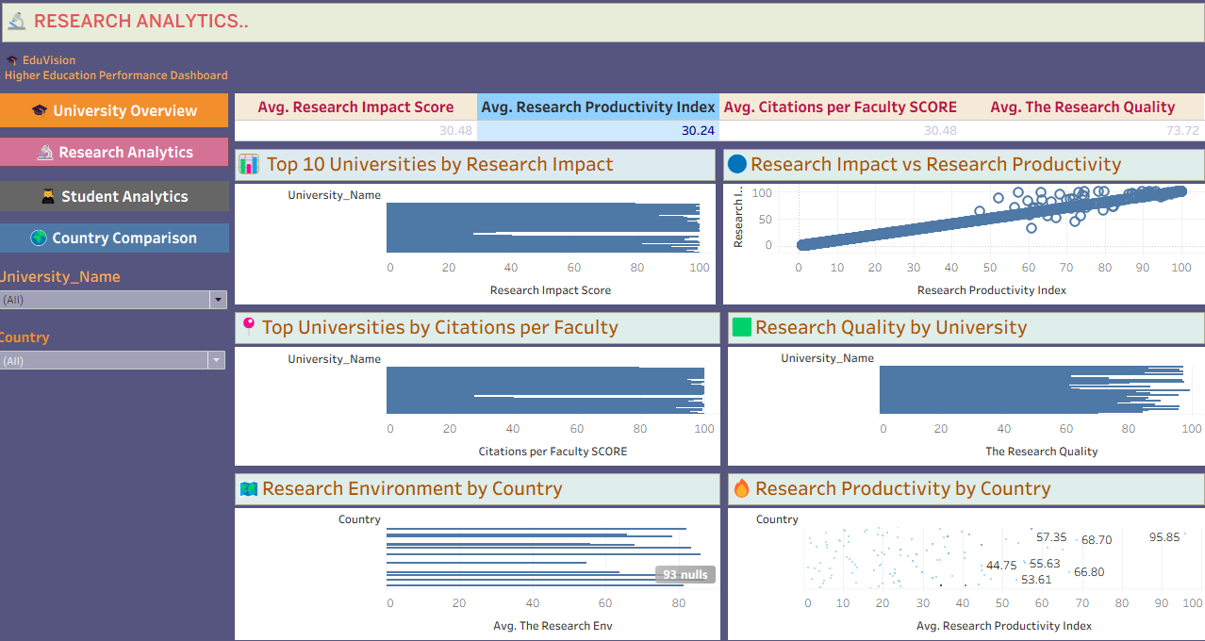

Slide 18
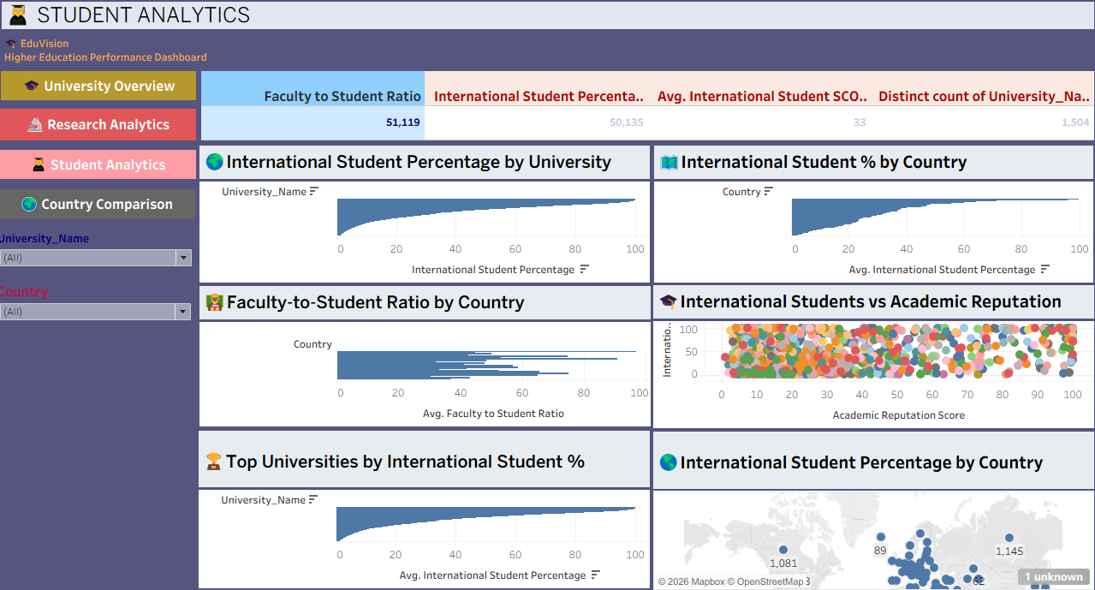

Slide 19
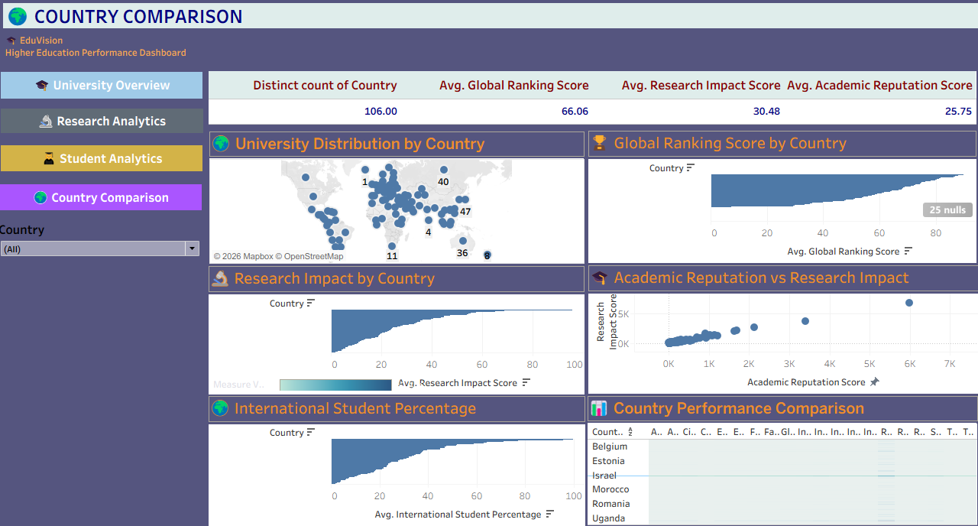

Slide 20
Thank You!

