Slide 1


Slide 2
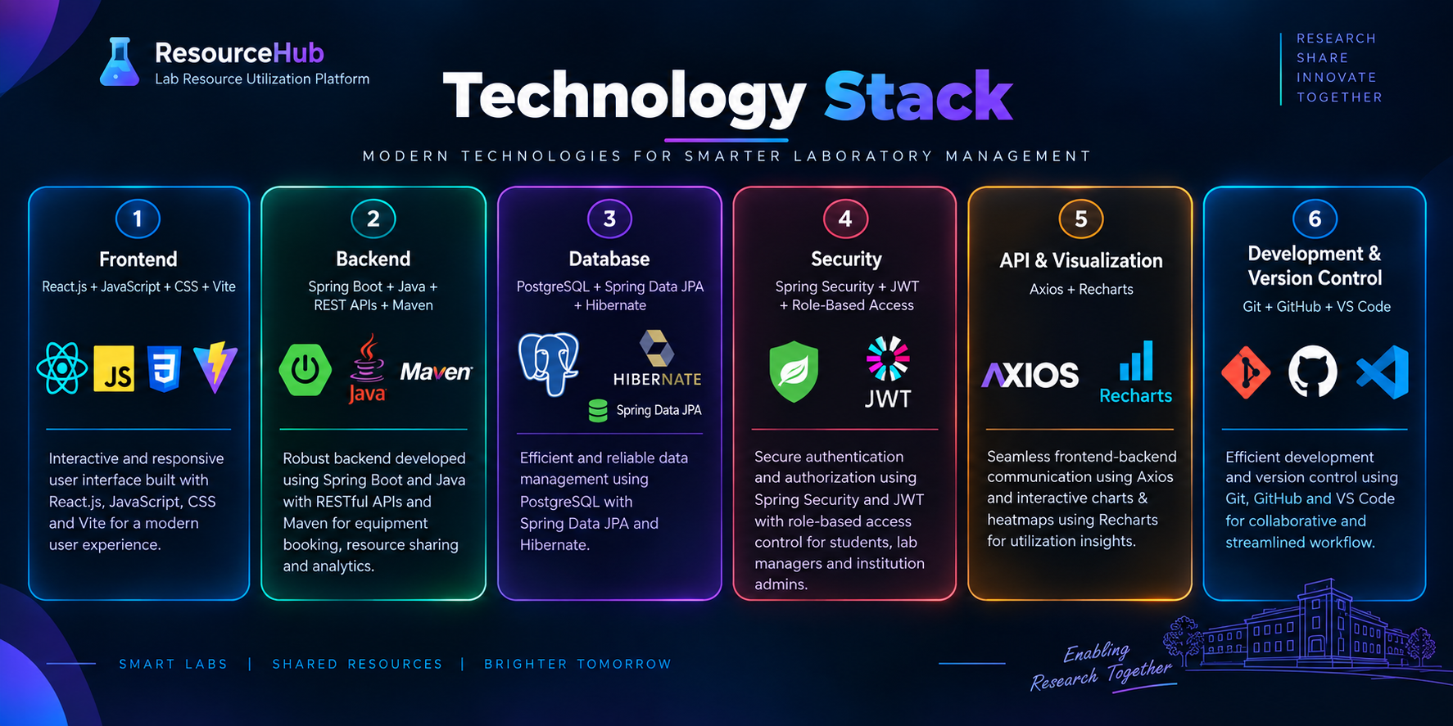

Slide 3
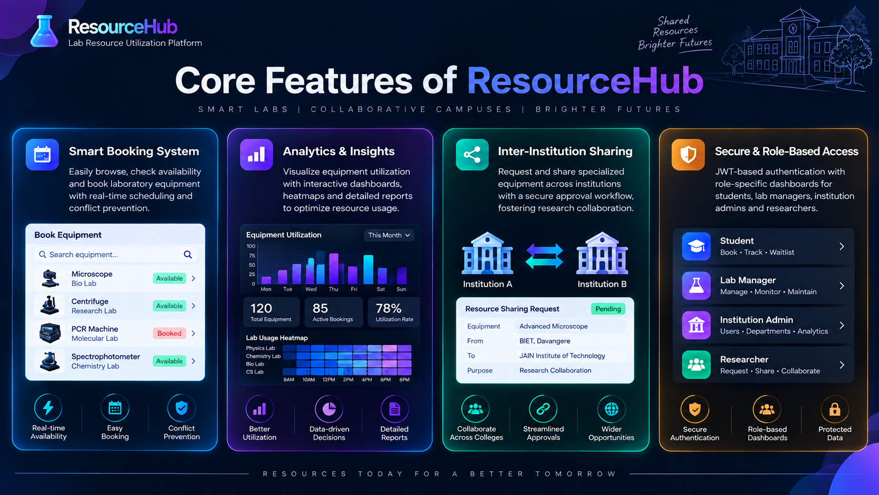

Slide 4
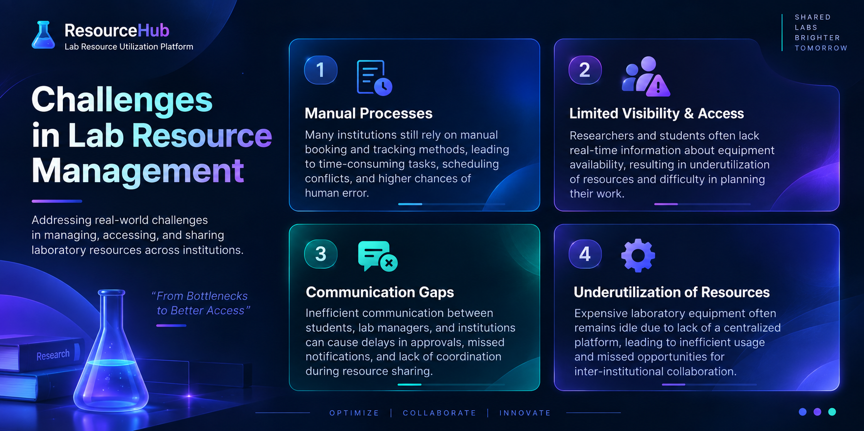

Slide 5
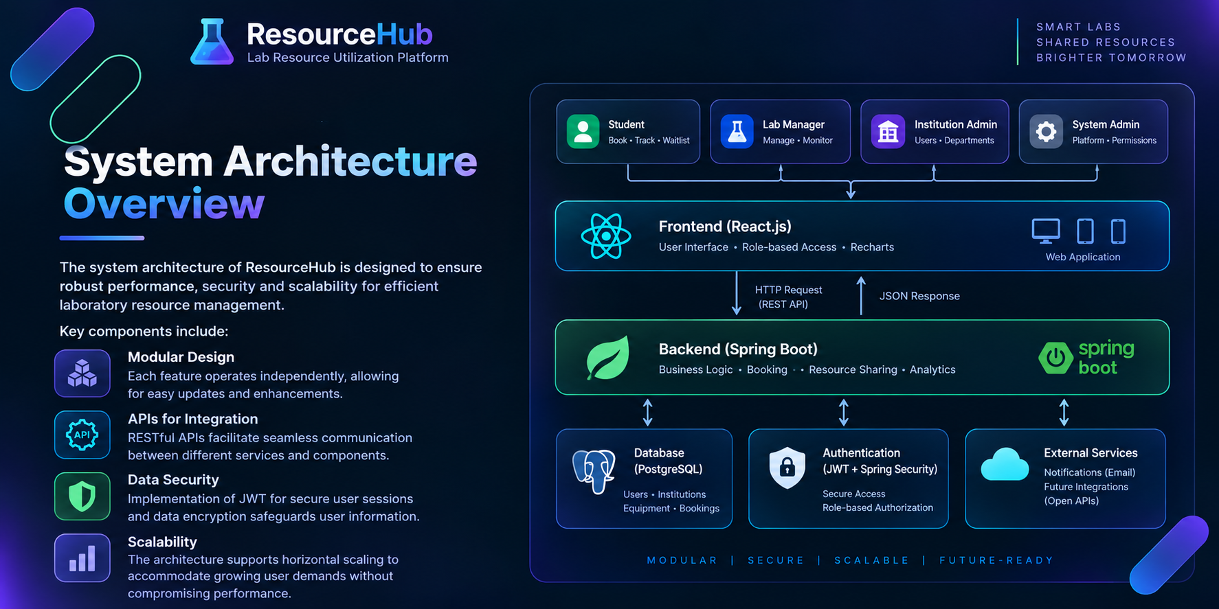
System Architecture Overview
The system architecture of CampusEventHub is designed to ensure robust performance and scalability. Key components include:
  Modular Design: Each feature operates independently, allowing for easy updates and enhancements.
  APIs for Integration: RESTful APIs facilitate seamless communication between different services and components.
  Data Security: Implementation of JWT for secure user sessions and data encryption safeguards user information.
  Scalability: The architecture supports horizontal scaling to accommodate growing user demands without compromising performance.

Slide 6
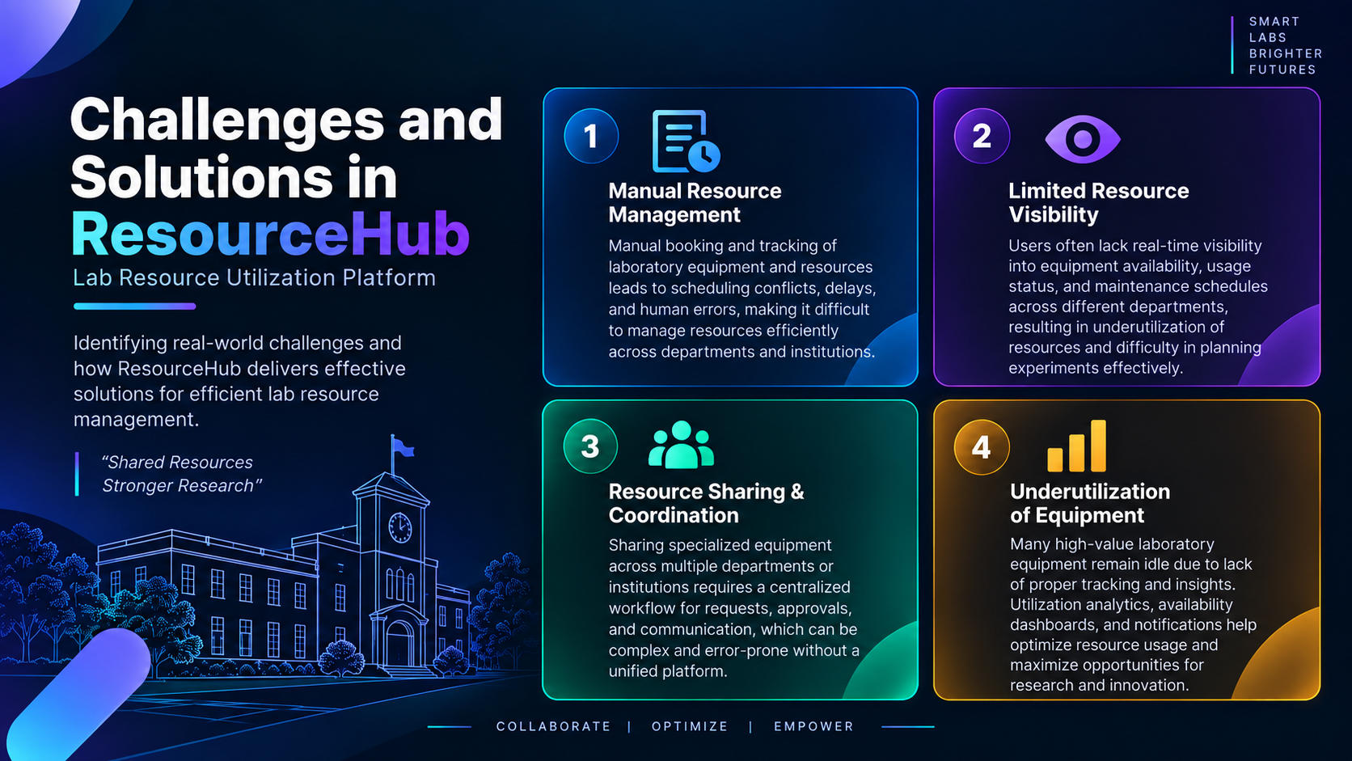

Slide 7
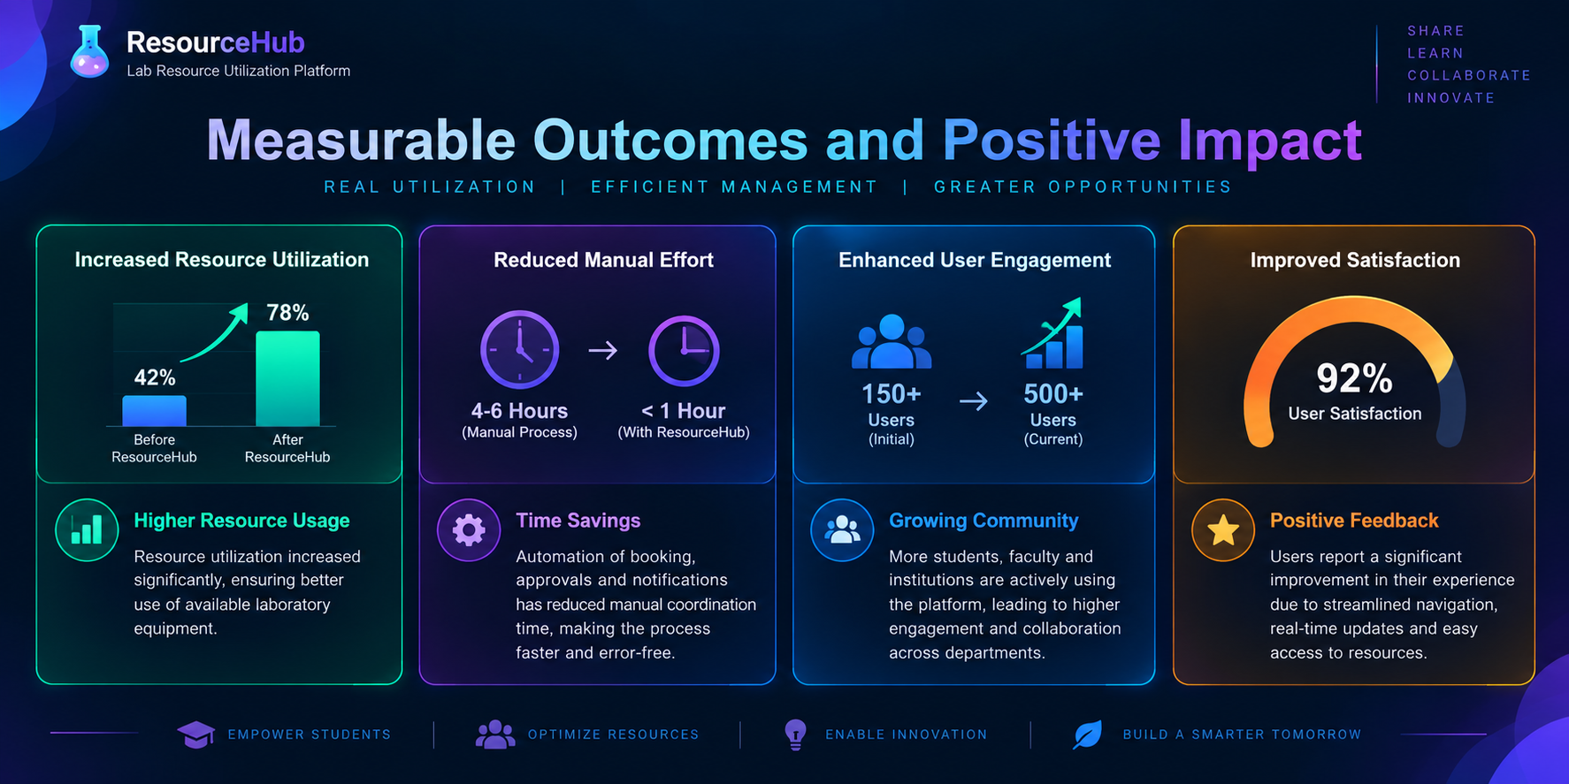

Slide 8
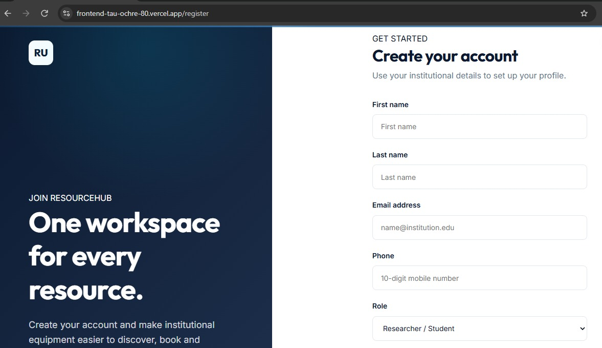
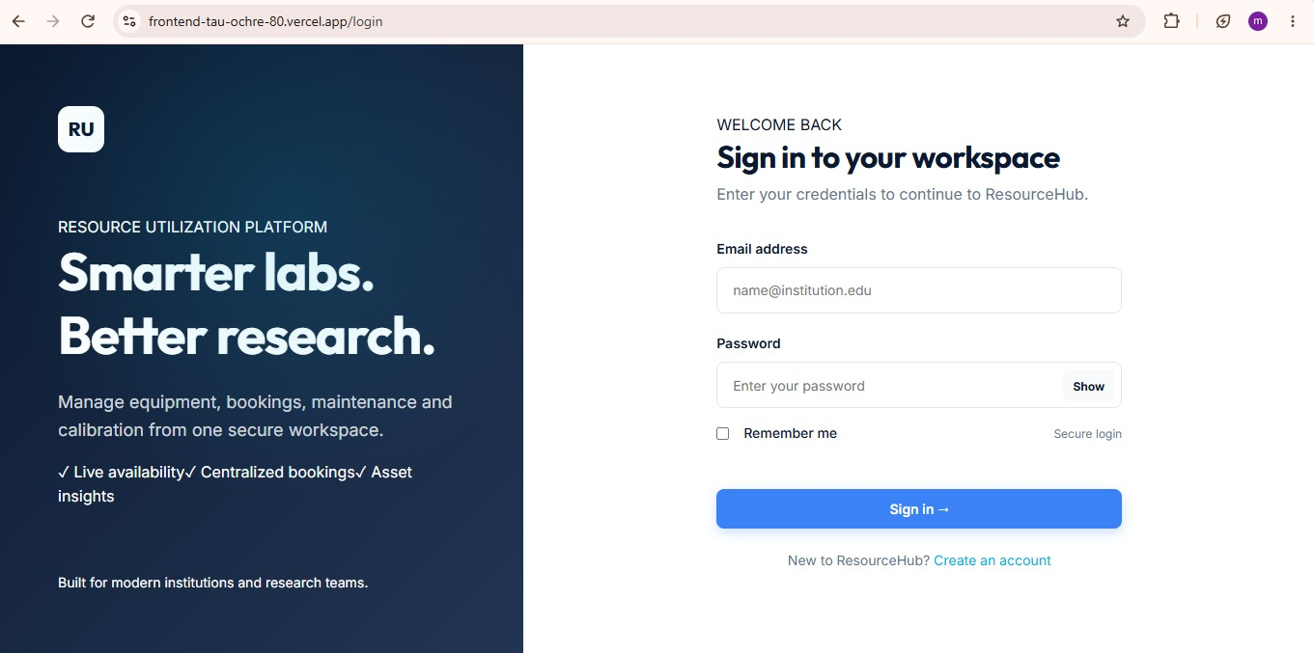
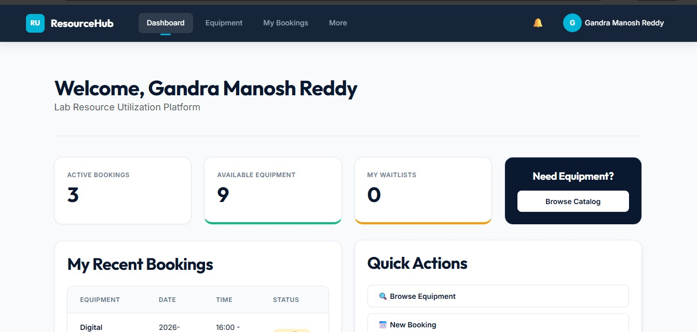
These mock-ups show a simple, user-friendly interface for easy equipment booking and resource management.

Slide 9
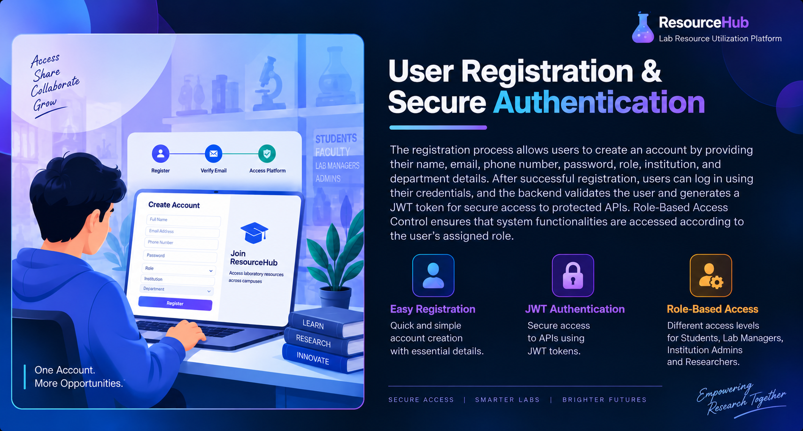

Slide 10
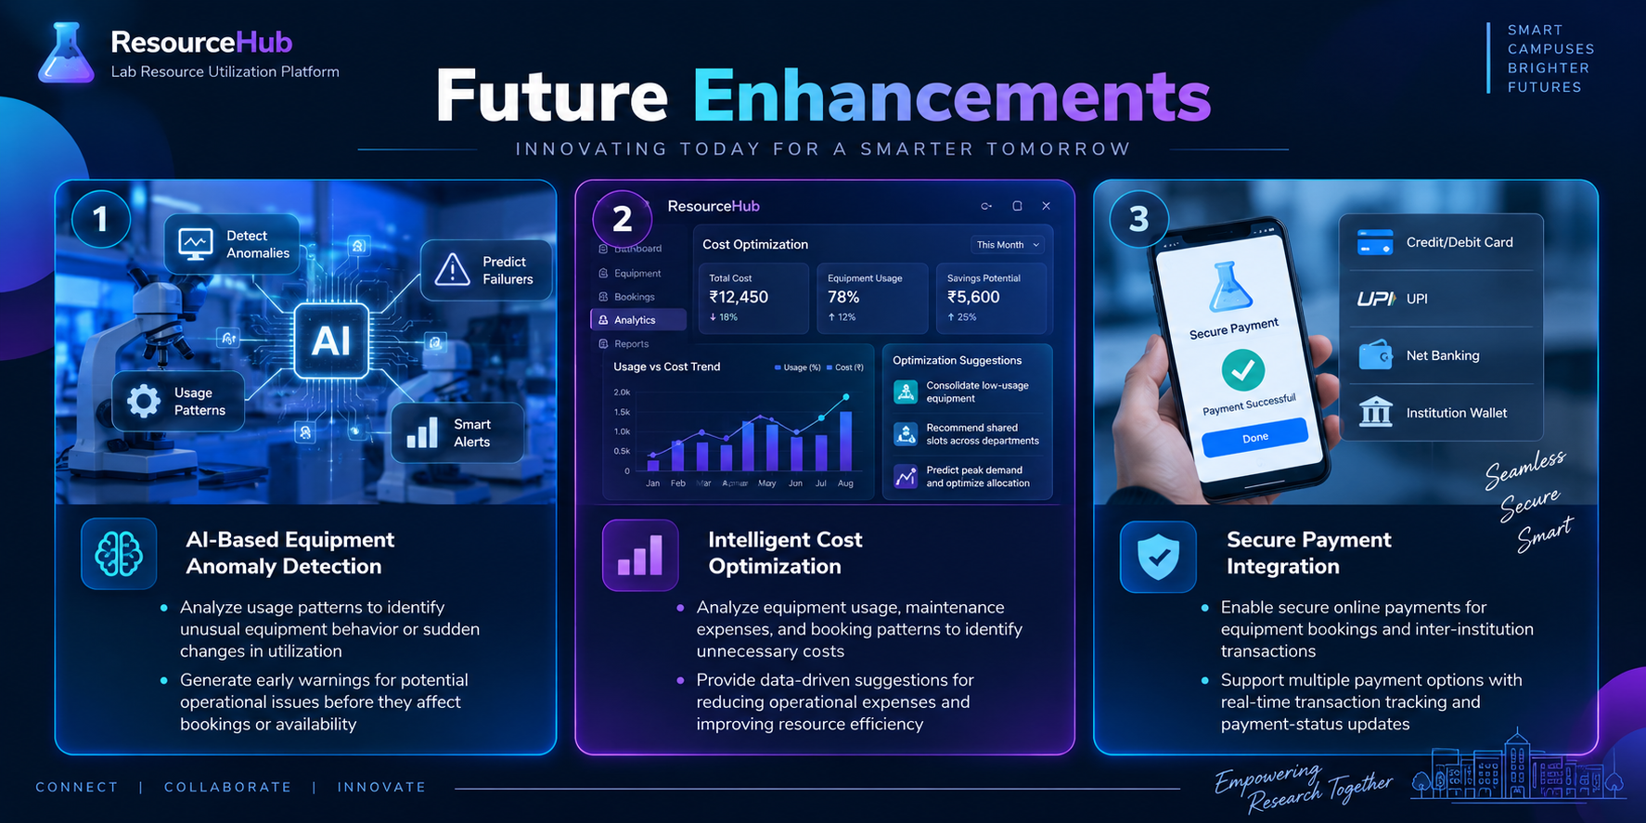

Slide 11
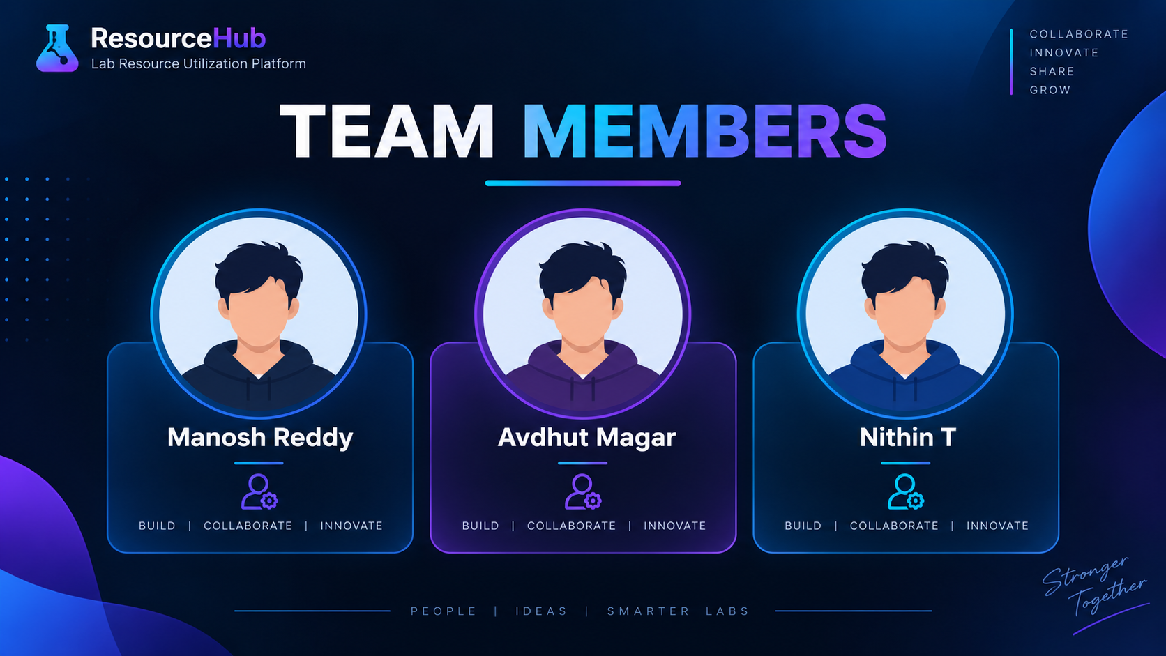

Slide 12


Slide 13


Slide 14


