Slide 1

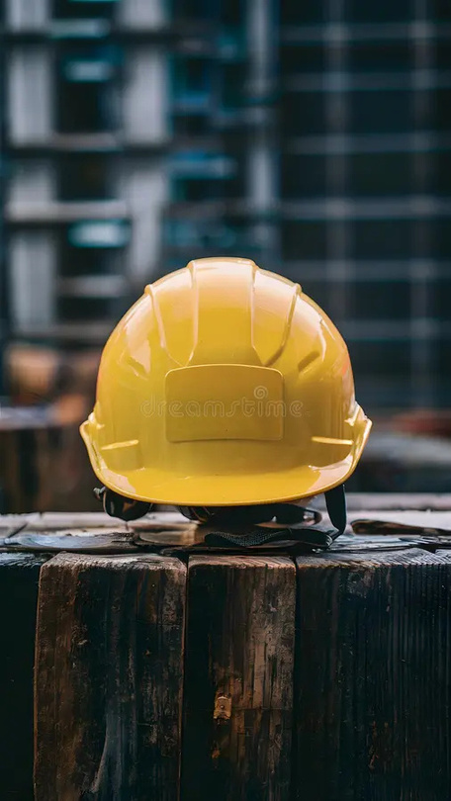
SAFETY AI-BASED PPE VIOLATION DETECTION SYSTEM
REAL-TIME HELMET, MASK & SAFETY VEST MONITORING USING YOLOV8
Presented by:
Ojaswi Ambare
5th Semester – Information Technology
G. H. Raisoni College of Engineering, Nagpur
Mentor:
Ankit Pathak
Infosys Springboard Virtual Internship

Slide 2
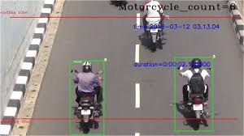

Home
About
Other
ABSTRACT
SafetyEye is an AI-powered Personal Protective Equipment (PPE) violation detection system designed to enhance safety compliance in industrial and construction environments.
The system automatically detects safety violations such as missing helmets, masks, and safety vests from live CCTV or webcam video streams using the YOLOv8 object detection model.
In addition to real-time detection, SafetyEye provides intelligent analytics such as violation heatmaps, occupancy count, and a compliance score to measure overall safety adherence.
The platform supports automatic violation logging, PDF challan generation, and interactive dashboards built using Streamlit. This project was developed as part of the Infosys Springboard Virtual Internship and demonstrates real-world application of computer vision and AI-driven safety monitoring.

Slide 3
PROBLEM STATEMENT
OBJECTIVES
Manual monitoring of PPE compliance is slow, inconsistent, and error-prone.
Existing systems lack:
• Real-time violation detection
• Automated evidence collection
• Historical safety analytics
• Occupancy awareness
• Compliance measurement
This leads to missed violations, delayed responses, and increased risk of workplace accidents.
• To detect PPE violations (Helmet, Mask, Safety Vest) in real time
• To automate violation logging and evidence storage
• To generate PDF challans and reports
• To analyze safety trends using heatmaps
• To count the number of people in monitored areas
• To calculate a compliance score for safety evaluation
• To provide an interactive and user-friendly dashboard

Slide 4
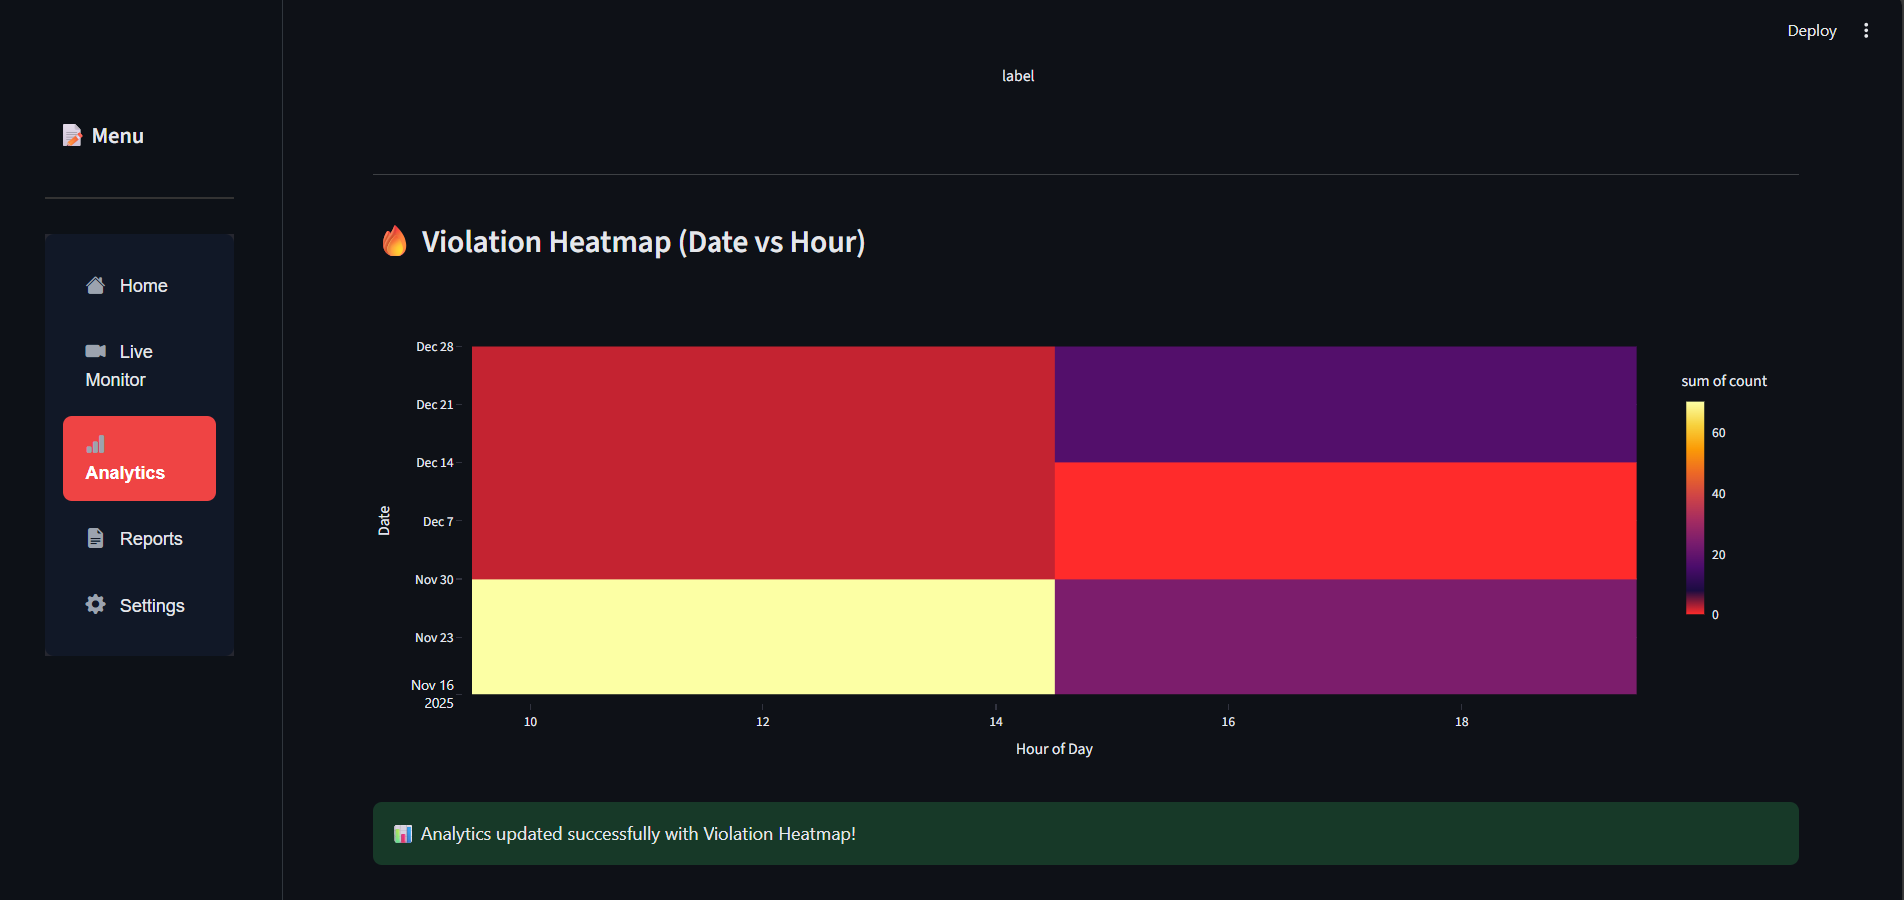

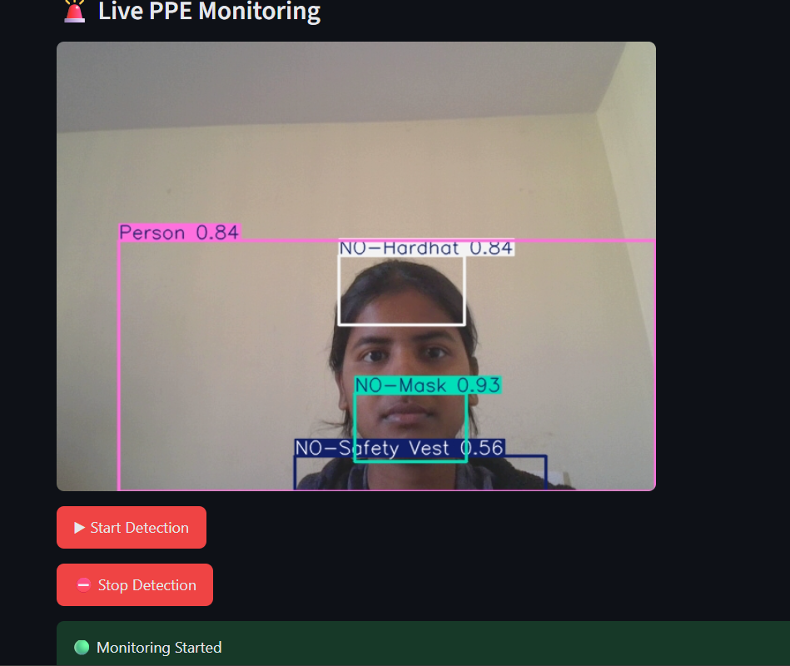
KEY FEATURES
• Real-Time PPE Violation Detection
• Automatic Violation Logging
• PDF Challan Generation
• Interactive Dashboard
• Heatmap Visualization of Violation Zones
• Occupancy Count (Number of People Detected)
• Compliance Score for Safety Evaluation
• Configurable Alerts and Thresholds
• Heatmap Visualization of Violation Zones
• COMPLIANCE SCORE FEATURE
• OCCUPANCY COUNT FEATURE

Slide 5
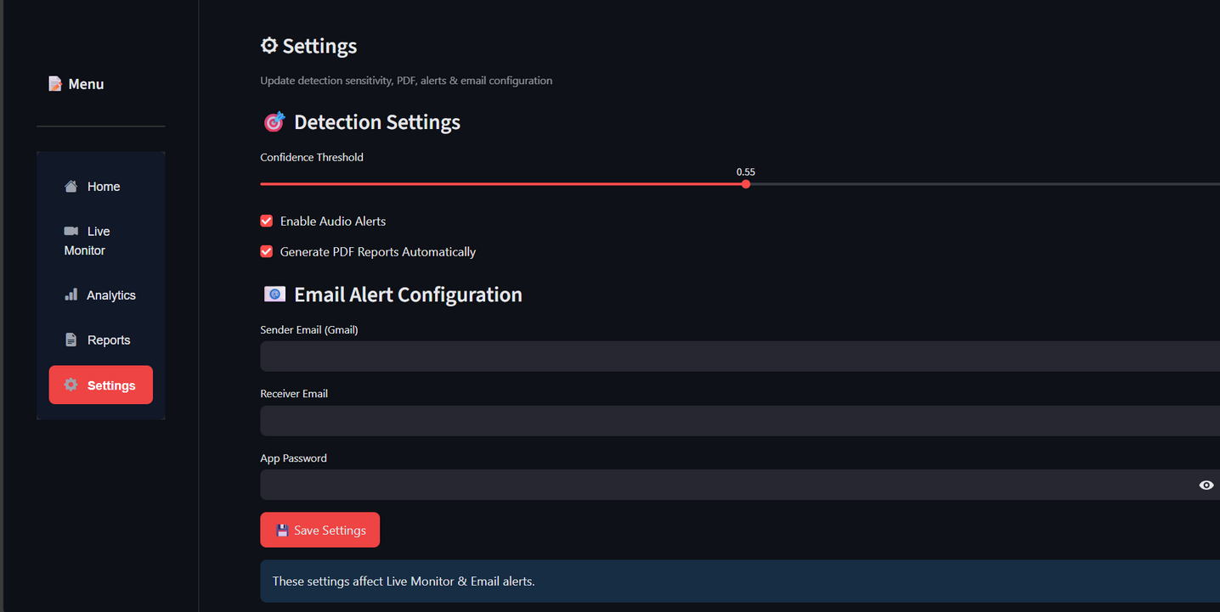
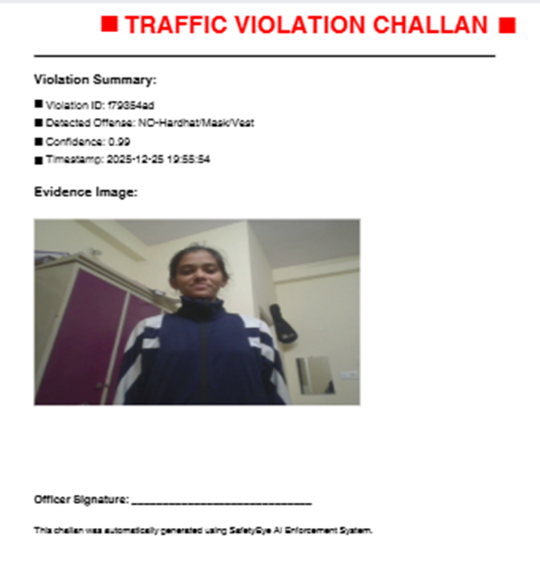
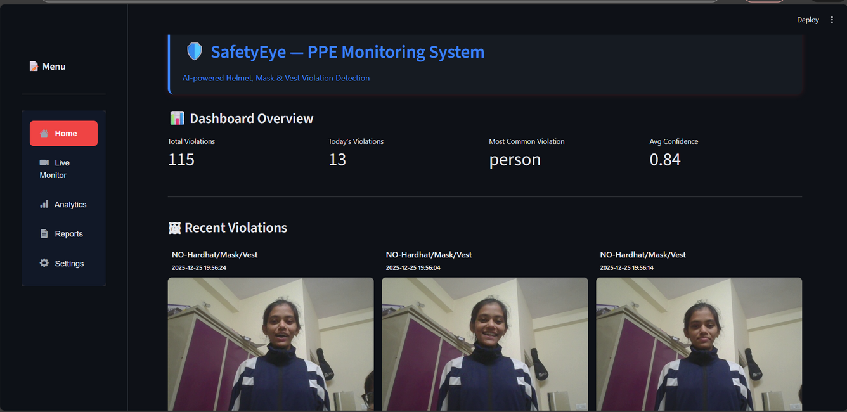
DASHBOARD PAGES
Home Page – Project overview and system status
• Live Monitor Page – Real-time detection view
• Analytics Page – Charts, heatmap, occupancy, compliance score
• Reports Page – Violation images and PDF challans
• Settings Page – Thresholds, alerts, email options
• Settings Page
• Home Page
• Challan PDF

Slide 6
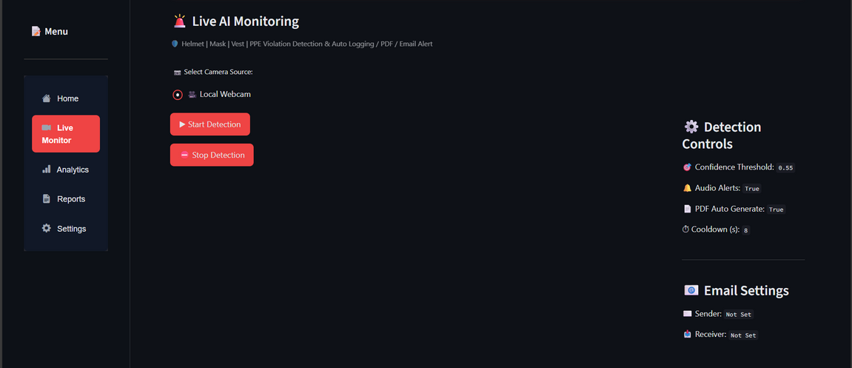
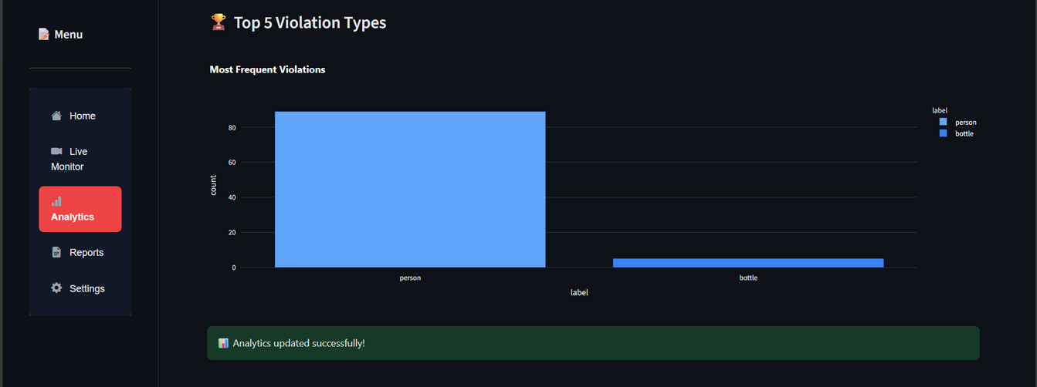
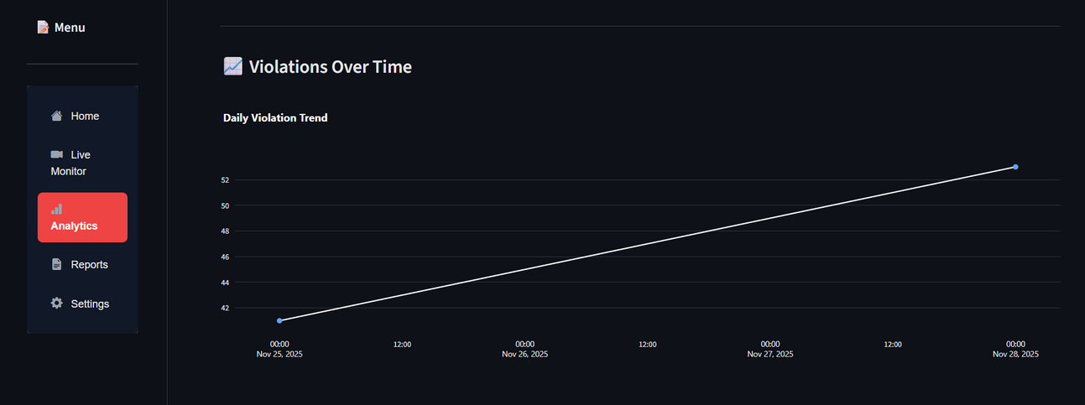
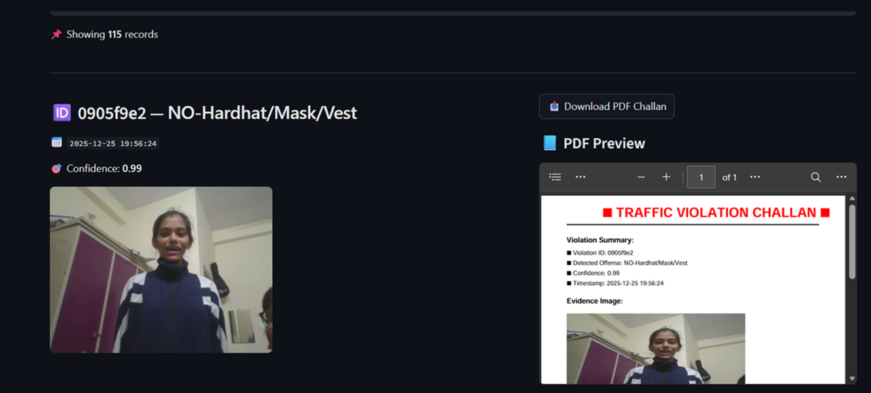
DASHBOARD PAGES
Live monitoring Page
Reports Pages

Slide 7

DATASET,TRAINING & PERFORMANCE OVERVIEW
• Dataset Combination of public PPE datasets and manually annotated samples (~3,000–5,000 images) covering Helmet, Mask, Safety Vest, No-PPE cases Includes varied lighting, camera angles, and real-world CCTV scenarios
• Classes Used Helmet / No Helmet, Mask / No Mask, Vest / No Vest, Person
• Model Training YOLOv8 pretrained model (COCO weights) Fine-tuned using transfer learning for PPE-specific detection Input size: 640 × 640
• Performance (Observed) Detection Accuracy: ~85–90% (varies with lighting & pose) Real-Time Speed: ~20–25 FPS on live webcam Optimized for real-time monitoring with balanced precision & recall
📌 Performance may vary based on camera quality and hardware configuration

Slide 8
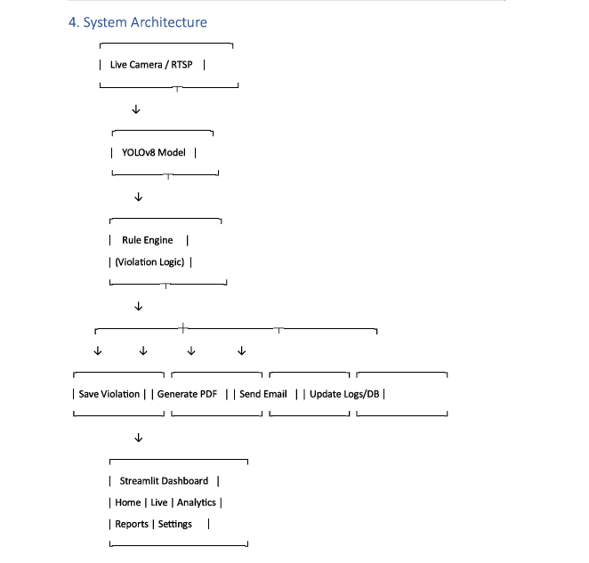

SYSTEM ARCITECTURE
SafetyEye follows a modular and scalable architecture:
1. Input Layer:
Live video feed from webcam, CCTV, or RTSP cameras.
2. AI Processing Layer:
YOLOv8 model detects PPE items and violations with bounding boxes and confidence scores.
3. Backend Layer:
Violation logging, image storage, PDF challan generation, and analytics computation.
4. Frontend Layer:
Streamlit-based dashboard displaying live feed, analytics, reports, and settings.

Slide 9

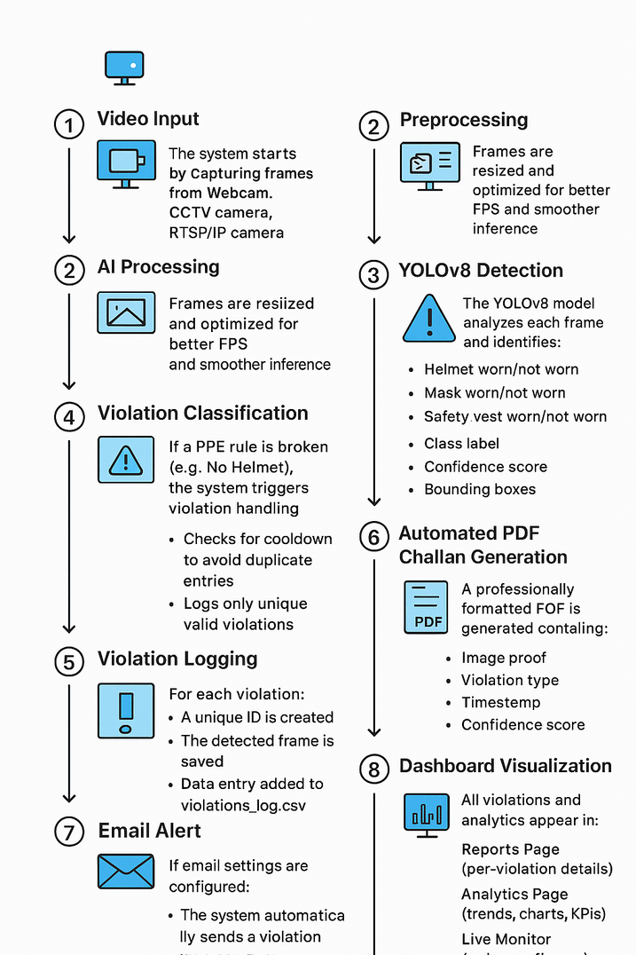
SYSTEM WORKFLOW
• Capture live video frames
• Preprocess frames and send to YOLOv8 model
• Detect PPE compliance or violations
• Log violations with timestamp and image
• Update analytics (heatmap, occupancy, compliance score)
• Display results on dashboard
• Generate PDF reports if enabled

Slide 10

• Real-time detection at 15–25 FPS
• High accuracy using YOLOv8 model
• Stable logging and PDF generation
• Effective visualization of safety data
• Reduced manual monitoring effort
PERFORMANCE & ACHIEVEMENTS
APPLICATIONS
• Construction Sites
• Manufacturing Industries
• Warehouses
• Industrial Plants
• Traffic & Public Safety

Slide 11
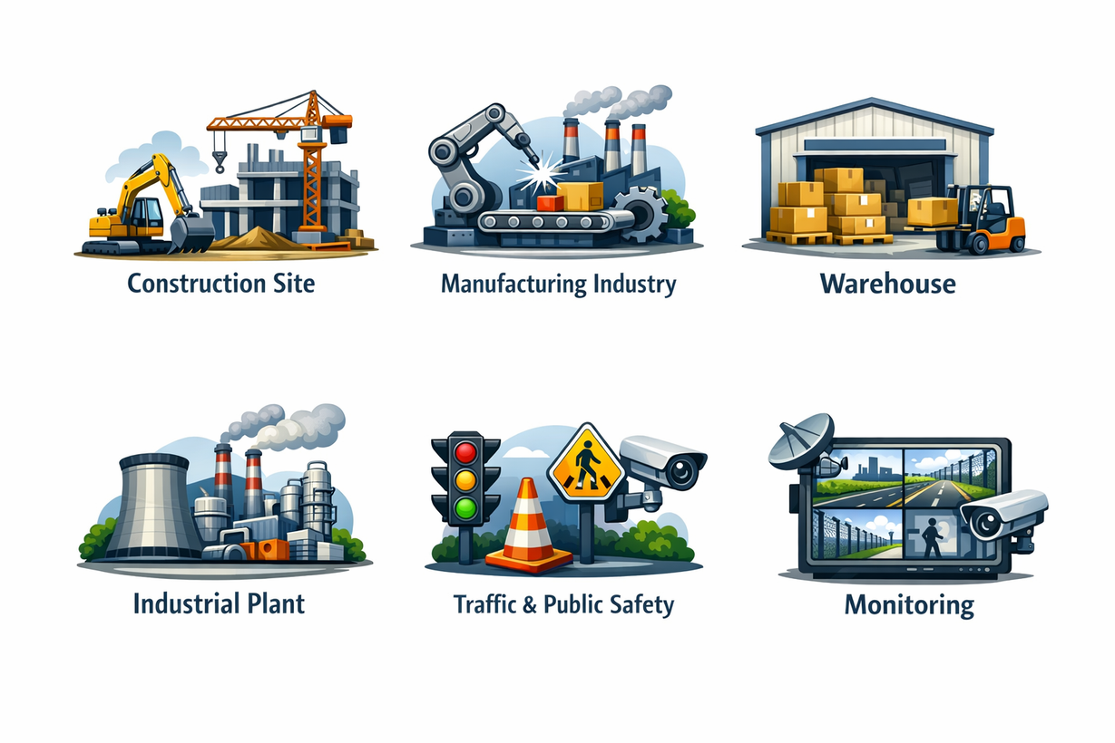
DETECTION LIMITATIONS & REAL WORLD CHALLENGES
• Occlusion & Partial Visibility Helmet, mask, or vest partially visible hone par detection miss ho sakta hai (side/back view, body overlap).
• Camera Angle & Human Pose Variation Head tilt, fast movement, or non-frontal poses reduce detection confidence.
• Lighting & Video Quality Issues Low light, shadows, glare, motion blur, or low-resolution CCTV feeds impact accuracy.
• Visual Similarity Confusion Cap vs helmet, scarf/beard vs mask, jacket vs safety vest can cause false violations.
• Confidence Threshold Trade-off Lower threshold → false positives Higher threshold → missed violations (System uses balanced thresholding)
• Single-Frame vs Real-World Decision Making Real deployments require trend-based analysis rather than decisions from a single frame.

Slide 12
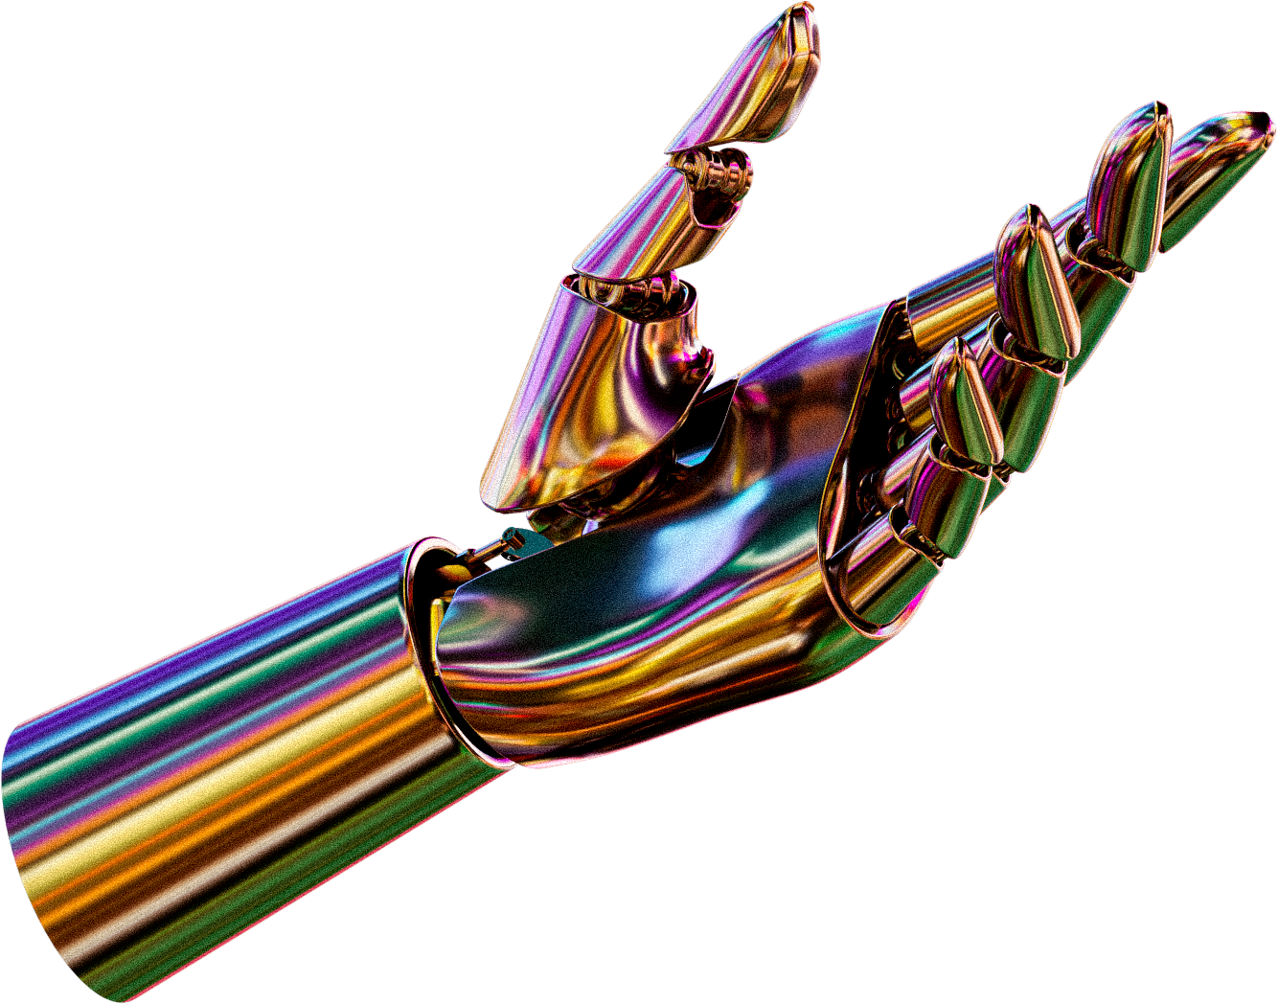
CONCLUSION & FUTURE SCOPE
SafetyEye successfully automates PPE compliance monitoring using AI and computer vision.
The system improves workplace safety, reduces manual effort, and provides real-time insights through analytics such as heatmaps, occupancy count, and compliance scores.
Future enhancements include multi-camera tracking, cloud deployment, IoT integration, predictive analytics, and advanced alert systems.

Slide 13
THANK YOU !
FOR YOUR ATTENTION

