Slide 1
Construction Site Safety – Full Project Report
Infosys Presentation • EDA • YOLOv8 Detection • Final Code & Outputs

Slide 2
introduction
Construction projects involve high-risk activities such as working at heights, operating heavy machines, and handling hazardous materials.
Many site accidents occur because workers fail to wear essential safety gear.
This project aims to build an automated system that identifies workers and checks whether they follow PPE guidelines.
The goal is to improve workplace safety and support real-time monitoring.

Slide 3
Data overview
Dataset consists of construction-site images with annotated PPE items.
Images include various lighting, angles, and real-world working conditions.
Target classes for detection include:
Helmet / Hardhat
Safety Vest
Face Mask
Missing Helmet
Missing Mask
Missing Vest
Person / Worker
Machinery and Equipment

Slide 4
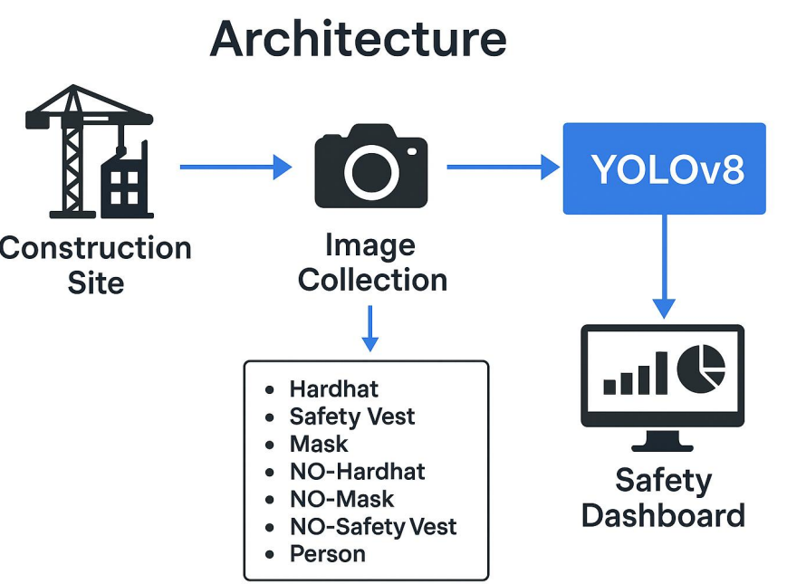

Slide 5
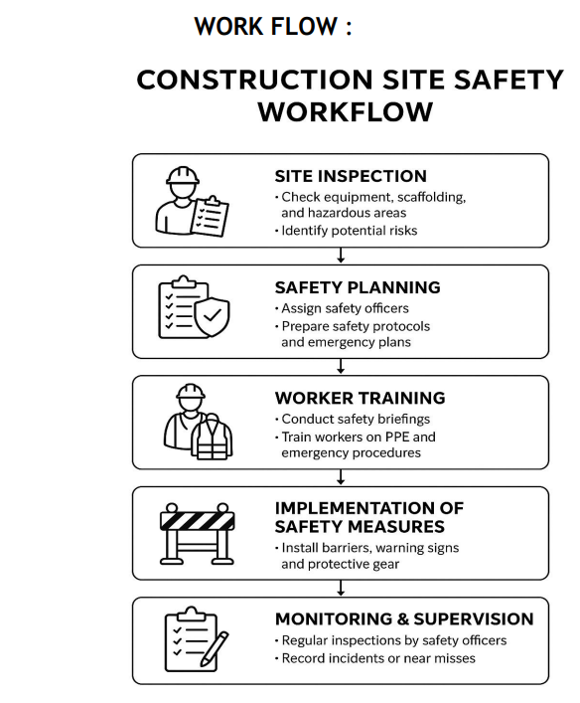

Slide 6
challenges
1. Detection Challenges :
Hard to detect PPE in dark or very bright areas
PPE and clothes sometimes look similar in color
Bad camera angles reduce accuracy
2. Construction Site Challenges :
Dust and smoke can block camera view
PPE may be partially covered or dirty
Weather changes affect visibility
3. Technical / System Challenges :
Real-time detection needs a strong system
Hard to connect detection system to existing CCTV
Need regular monitoring and updates

Slide 7
Final summary
Imported all required libraries
Loaded the construction safety dataset
Checked images and labels using basic EDA
Loaded the YOLOv8 model
Trained the model on PPE classes
Validated the model accuracy
Ran predictions on new images
Detected PPE and safety violations
Saved output images with labels
Used the model for safety monitoring

