Slide 1
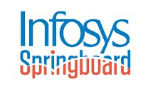
HOME
ABOUT
CONTENT
OTHERS
SafteyEye AI-Based PPE Violation Detection System
Real-time detection of helmet, mask, and safety-vest violations using YOLOv8”
NAME OF PRESENTER : OJASWI AMBARE
(G.H RAISONI COLLEGE OF ENGINEERING,NAGPUR,MAHARASHTRA [5TH SEM IT BRANCH])
MENTOR NAME : ANKIT PATHAK (INFOSYS INTERNSHIP PROGRAM)

Slide 2
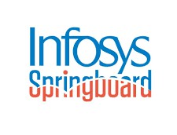
HOME
ABOUT
CONTENT
OTHERS
Abstract
SafetyEye is an AI-powered Personal Protective Equipment (PPE) violation detection system designed to improve safety compliance in industrial and construction environments. The system automatically identifies safety violations—such as missing helmets, masks, or safety vests—from live CCTV or webcam feeds using the YOLOv8 object detection model.
The platform provides real-time monitoring, automatic violation logging, PDF challan generation, analytics dashboards, and email alerts to supervisors. The system ensures rapid identification of unsafe behavior, helping organizations reduce workplace accidents and maintain regulatory compliance.
The project integrates Python, Streamlit, OpenCV, and YOLOv8, supported by a clean UI, database storage, and reporting features. The solution was developed as part of the Infosys Springboard Virtual Internship, demonstrating practical knowledge in deep learning, UI development, and full-stack project integration.

Slide 3

HOME
ABOUT
CONTENT
OTHERS
Introduction
Ensuring workplace safety is a critical responsibility in industrial, manufacturing, and construction environments. Workers are required to fo low strict Personal Protective Equipment (PPE) guidelines, such as wearing helmets, reflective safety vests, and face masks. However, manual monitoring of hundreds of workers through CCTV cameras is time-consuming, inefficient, and prone to human error.
THIS PROJECT INTRODUCES A COMPLETE, END-TO-END PIPELINE CONSISTING OF:
Live monitoring using webcam/RTSP camera feeds
Real-time object detection for PPE items Automatic violation logging
PDF challan generation Email alerts to supervisors
Interactive dashboards and analytics A clean UI built using Streamlit
SafetyEye is an AI-powered PPE violation detection system designed to automate this monitoring process using computer vision. By leveraging the YOLOv8 deep learning model, the system accurately detects safety-related violations in real time from live video streams.

Slide 4
HOME
ABOUT
CONTENT
OTHERS
Problem Statement
Challenges Faced
MANUAL MONITORING OF SAFETY VIOLATIONS IS SLOW, INCONSISTENT, AND ERROR-PRONE.
Noisy frames, lightning variation
SUPERVISORS CANNOT WATCH EVERY CAMERA FEED CONTINUOUSLY, LEADING TO MISSED VIOLATIONS
Real-time performance issue
AND SAFETY HAZARDS. TRADITIONAL SYSTEMS LACK:
Class imbalance in dataset
Instant detection
OCR/PDF accuracy issues
Automatic reporting
Model consistency
Evidence collection
Historical analytics
Multi-object cases
Real-time alerts

Slide 5
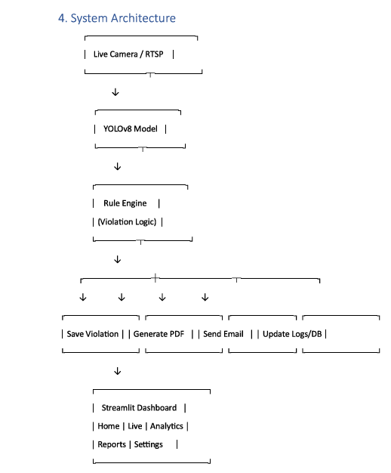
SafetyEye solves these challenges by providing:
System Architecture
HOME ABOUT CONTENT OTHERS
SafetyEye uses a modular and scalable AI pipeline to detect PPE violations in real time. The system works through four main layers:
🔹 1. Input Layer – Video Capture
Accepts Webcam, CCTV, RTSP/IP camera Captures continuous frames via OpenCV
Sends frames to the AI model for real-time processing
🔹 2. AI Processing Layer – YOLOv8 Engine
Detects: Helmet, Mask, Safety Vest, Violations (No Helmet/Mask/Vest) Outputs: labels, confidence, bounding boxes
Optimized with resizing, GPU/CPU tuning, and duplicate-avoidance
filtering
🔹 3. Backend Layer – Automation & Storage Logs violations in violations_log.csv Saves violation images in /database/ Auto-generates PDF challans/reports
Sends email alerts (optional)
🔹 4. Frontend Layer – Dashboard UI Built with Streamlit (dark theme)
Features:
Live Monitoring Analytics (charts, KPIs) Reports (images + PDFs)
Settings panel (thresholds, alerts, email)

Slide 6
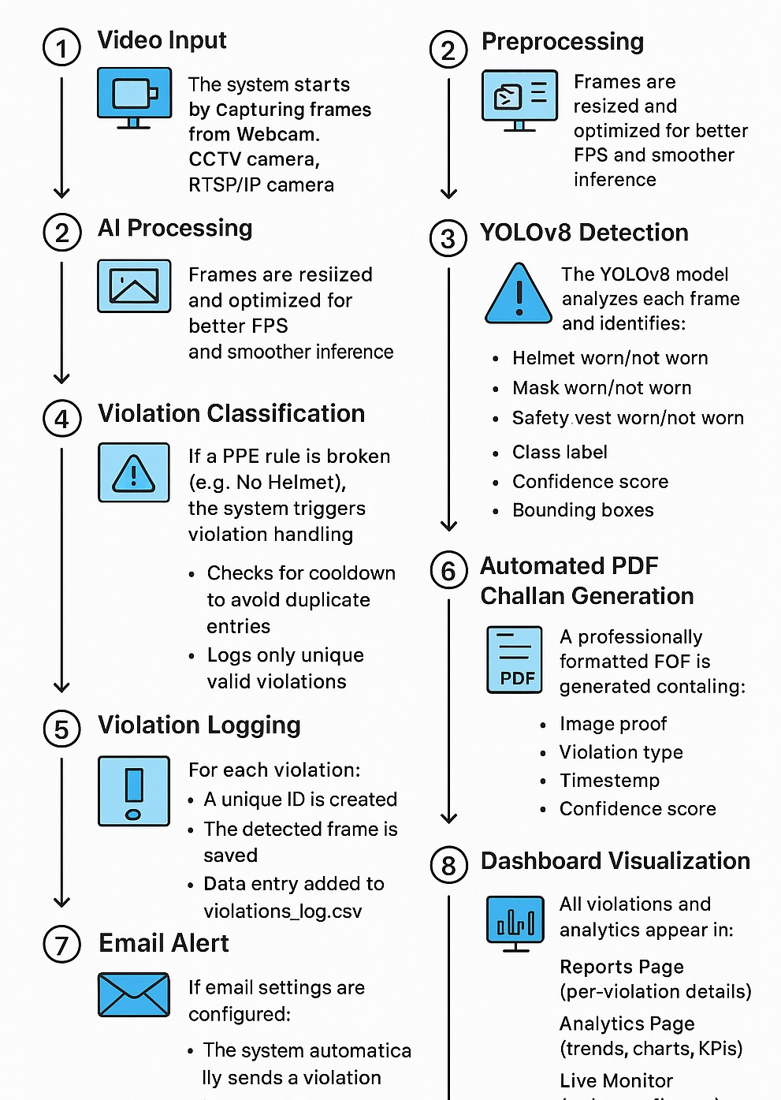
HOME
ABOUT
CONTENT
OTHERS
System Workflow

Slide 7
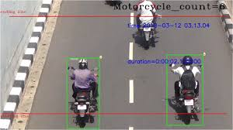
HOME
ABOUT
CONTENT
OTHERS
Methodology
violation image
Dataset Preparation
Kaggle dataset (helmet, mask, vest)
Folder structure auto-organized using Python script
Model Training
YOLOv8n (lightweight, fast) 50 epochs, 640×640 images Model Integration
YOLO model loaded once using @st.cache_resource for high performance
Real-Time Inference
Frames resized to 640×480 Bounding boxes + labels shown
Uses adjustable confidence threshold
Automation Layer
Cooldown system prevents duplicate violation logs Auto PDF generation
Optional email alerts
Dashboard Analytics
Pie chart, line chart, KPI cards Violation history + CSV export Supports images & training graphs

Slide 8
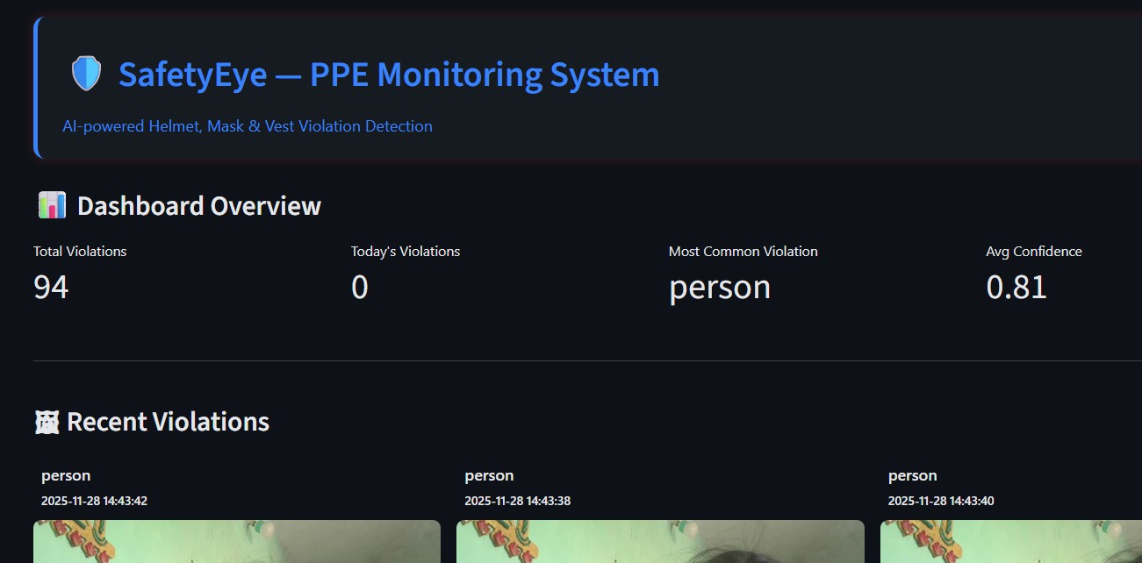
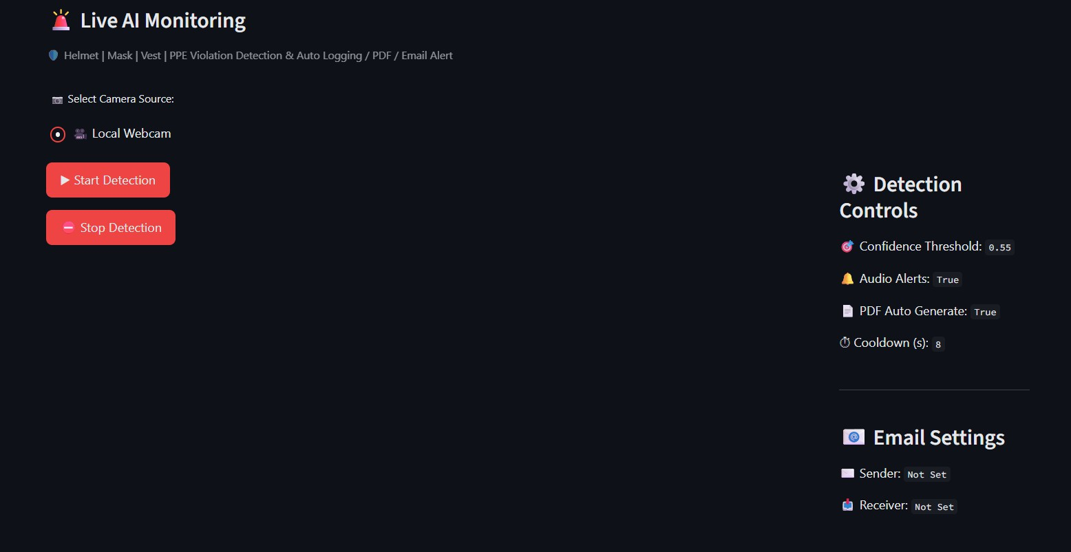
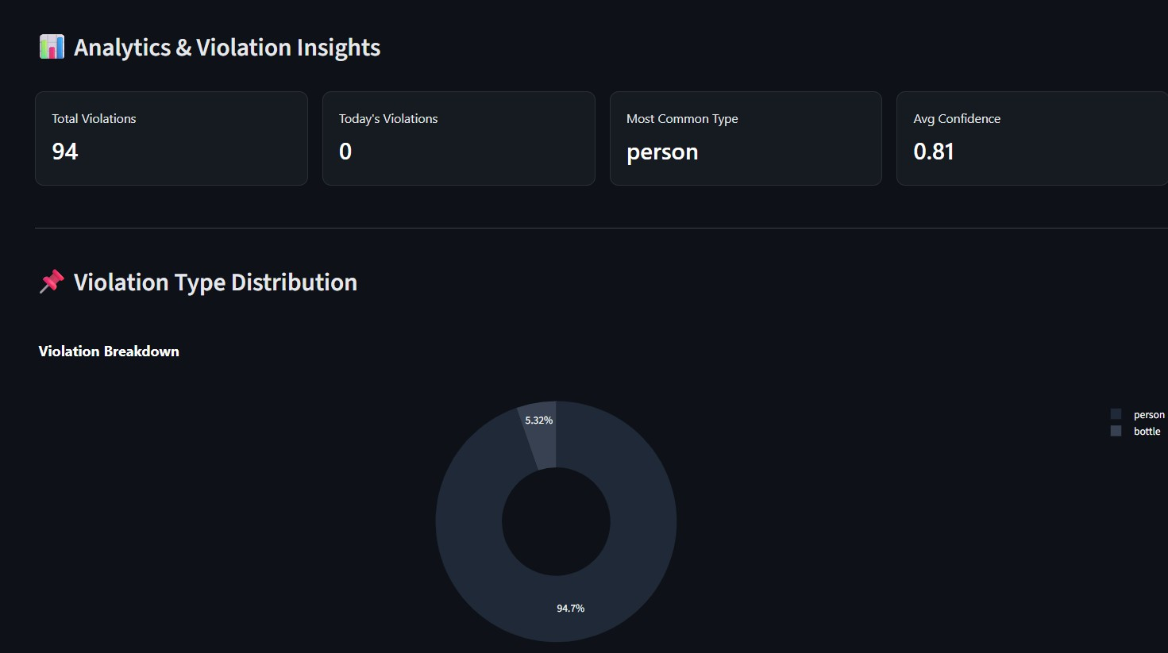
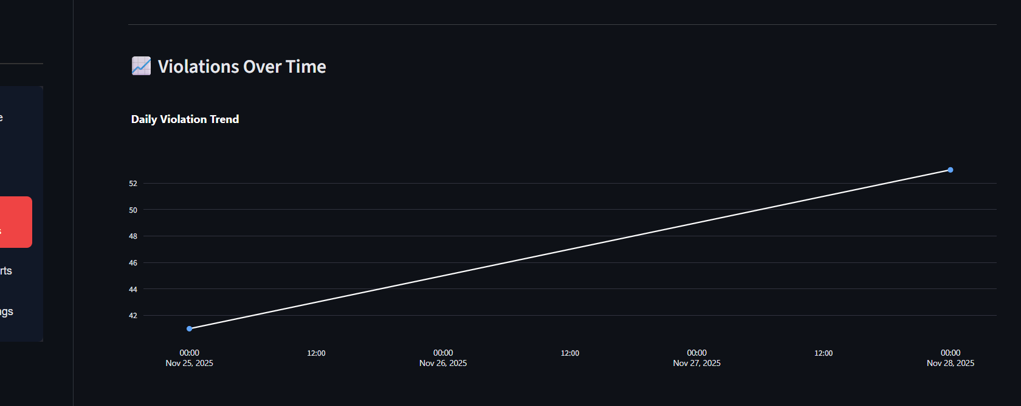
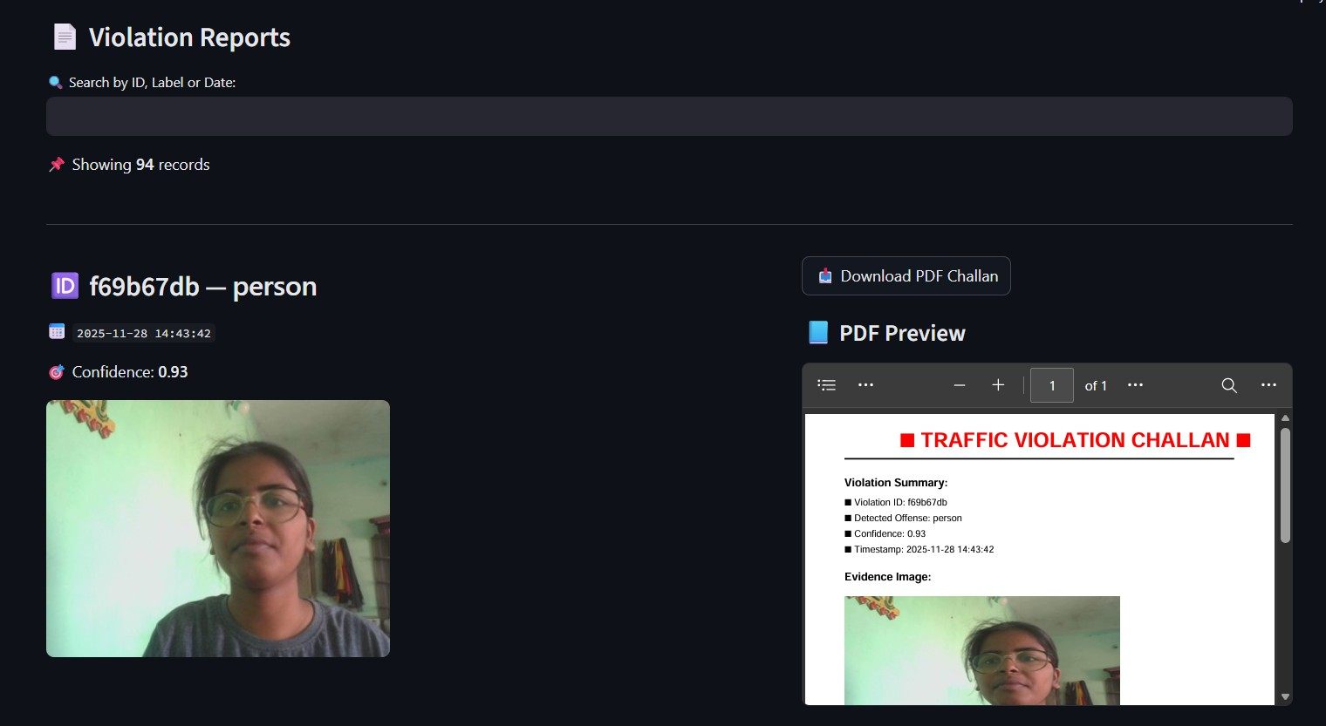
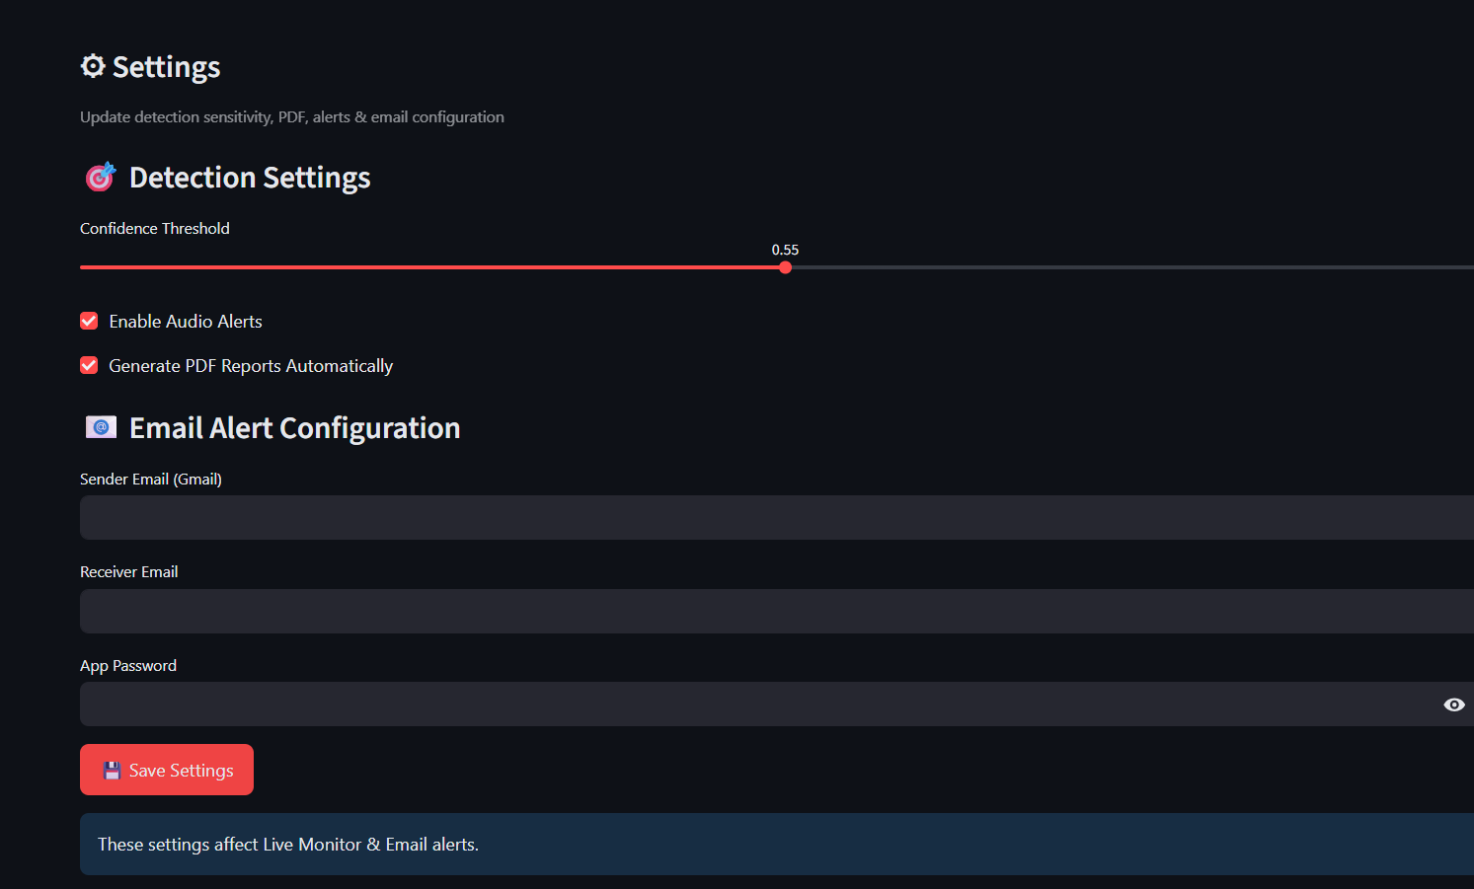
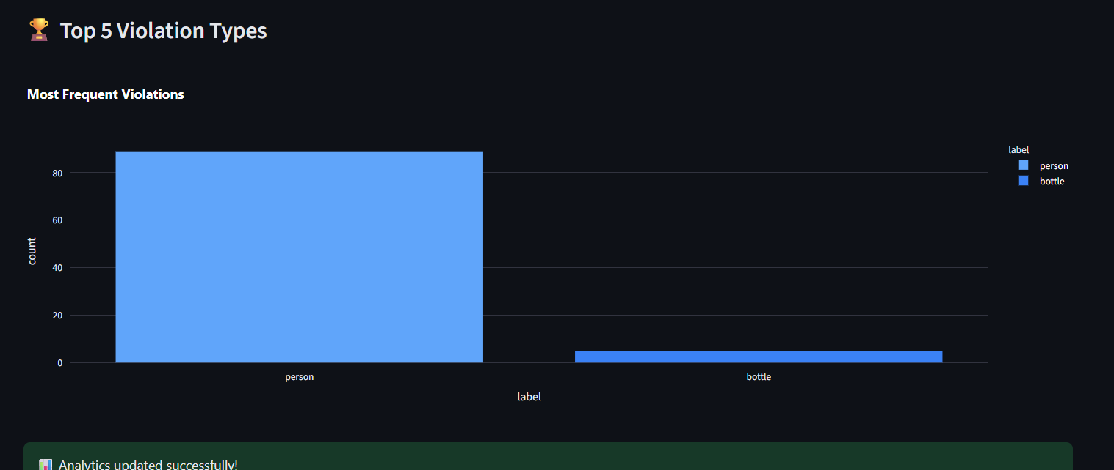
HOME
ABOUT
CONTENT
OTHERS
Implementation
ANALYTICS PAGE
HOME PAGE
LIVE MONITOR PAGE
REPORT PAGE
SETTINGS PAGE

Slide 9
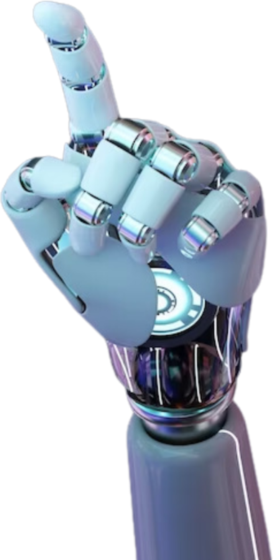
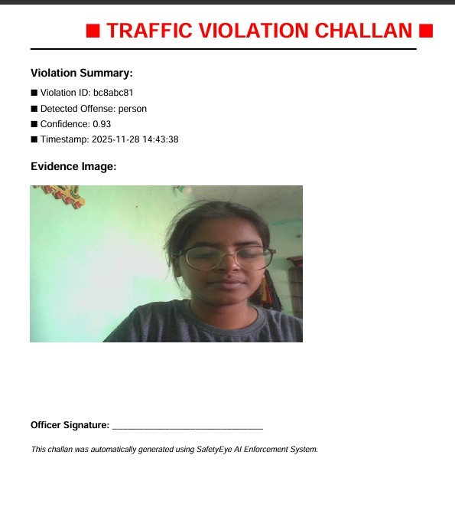
HOME
ABOUT
CONTENT
OTHERS
Performance Achievements:
Real-time detection achieved at 15–25 FPS (depending on camera).
CHALLAN PDF
High accuracy using the YOLOv8 model.
Stable violation logging & PDF generation.
Analytics dashboard provides actionable insights.
PLAN WISELY.
Key ObsEeXrvEaCtiUonTsE: SMARTLY.
Email alerts help reduce reporting delay. Cooldown logic avoids repeated spam logs.

Slide 10
HOME
ABOUT
CONTENT
OTHERS
Conclusion
The SafetyEye project automates PPE monitoring using advanced computer vision, reducing manual effort, improving safety compliance, and delivering real-time insights across factories, construction sites, warehouses, and industrial plants. Future enhancements include IoT integration,Multi-Camera Tracking, Dashboard Enhancements,predictive analytics, and smarter alerting systems to further strengthen workplace safety.
-

