Slide 1

🎙
AI Live Meeting Summarizer
Real-Time Speech-to-Text · Speaker Diarization · LLM Summarization

Slide 2
Problem Statement
📝
Manual Note-Taking
👥
Speaker Confusion
Meetings produce vast information; manual notes are slow, incomplete, and error-prone.
It's hard to track who said what in multi-speaker discussions without specialized tools.
⏳
Post-Meeting Delay
📧
No Easy Sharing
Summaries shared hours after a meeting reduce retention and follow-up effectiveness.
Distributing meeting notes requires manual effort — copying, formatting, and emailing.

Slide 3
Proposed Solution
A fully integrated Streamlit application that captures live audio, transcribes in real time, identifies speakers, and generates structured meeting summaries — all with one-click export.
🎙️
📝
👥
Live/Recorded Audio Capture
Speech-to-Text
Speaker Diarization
PyAudio + SoundDevice for real-time mic input
Vosk / Whisper offline STT engines
pyannote.audio for speaker identification
🤖
📊
📧
LLM Summarization
Streamlit UI
One-Click Export
Groq LLaMA 3.1 or HuggingFace BART/T5
Interactive Start/Stop with live transcript view
PDF, Markdown, and Email via smtplib

Slide 4
Tech Stack
🎤 STT
👥 Diarization
🤖 LLM / NLP
Vosk
Whisper
PyAudio
SoundDevice
pyannote.audio
LLaMA 3.1 (Groq)
🖥️ Frontend
⚙️ Backend
📦 Export / Eval
Streamlit
Python threading
asyncio
queue
jiwer
rouge_score

Slide 5
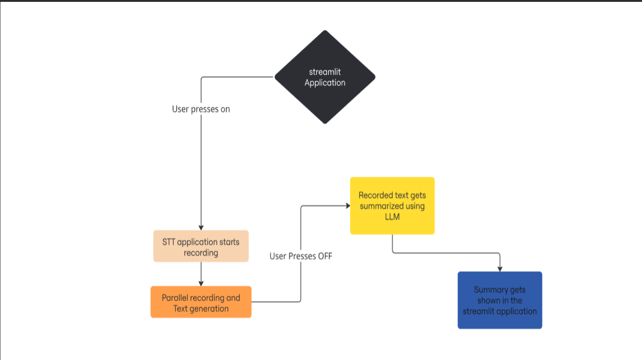
Workflow Diagram
Workflow Diagram

Slide 6
Feasibility & Viability
✅ Feasibility
🚀 Viability
Open-source STT (Whisper) run fully offline
pyannote.audio is mature & well-documented
Groq API provides fast LLM inference
Streamlit enables rapid UI prototyping
8-week timeline is achievable with phased milestones
Remote-work boom drives demand for meeting tools
Free-tier APIs keep infrastructure costs low
Offline STT avoids cloud data privacy concerns
Extensible: add Zoom/Teams integration later
GitHub release enables open-source community growth

Slide 7
Impact & Benefits
⚡
🎯
👥
📈
10x
< 15%
< 20%
0.4+
Faster Summaries
Word Error Rate
Diarization Error
ROUGE Score
Auto-generated in seconds vs. hours of manual work
High accuracy with Whisper STT benchmarked on AMI corpus
Precise speaker segmentation using pyannote.audio
High-quality summaries evaluated with NLP metrics

Slide 8
🎙
Conclusion
The AI Live Meeting Summarizer bridges the gap between spoken conversation and actionable knowledge — making every meeting count.
🌐 Live Demo:
https://shreya1811-live-meeting-summarizer.hf.space
Built with Python · Streamlit · Whisper · pyannote · Groq

