Slide 1
Unified Military Analytics & Comparison Dashboard
Task 4 – Dashboard Planning & KPI Mapping
Tool: Power BI

Slide 2
Dataset & KPI Foundation
Dataset: Global Military Data (140+ countries)
Indicators: Military, Economic, Geographic
Derived KPIs: Assets per Capita, Budget/GDP, Personnel Density
Helper Column: Total Assets

Slide 3
Dashboard Architecture
1. Quick Stats – Global overview
2. Nation Overview – Single country deep dive
3. Compare Powers – Two-country comparison
4. Coalition Builder – Multi-country analysis

Slide 4
Dashboard 1 – Quick Stats
KPIs: Power Index Rank, Assets per Capita, Military Burden
Charts: Bar chart (Top 10 countries), World map
Table: Country-wise summary
Filters: Region, Continent, Alliance

Slide 5
Dashboard 1: Quick Stats (Global Overview)
Filter Panel
• Region
• Continent
• Alliance
KPI Card
Avg Assets per Capita
KPI Card
Avg Budget / GDP
KPI Card
Avg Military Burden
Bar Chart
Top 10 Countries by Power Index
Map Chart
Global Military Distribution
Table
Country | Rank | Alliance | Assets per Capita
Go to Nation Overview →

Slide 6
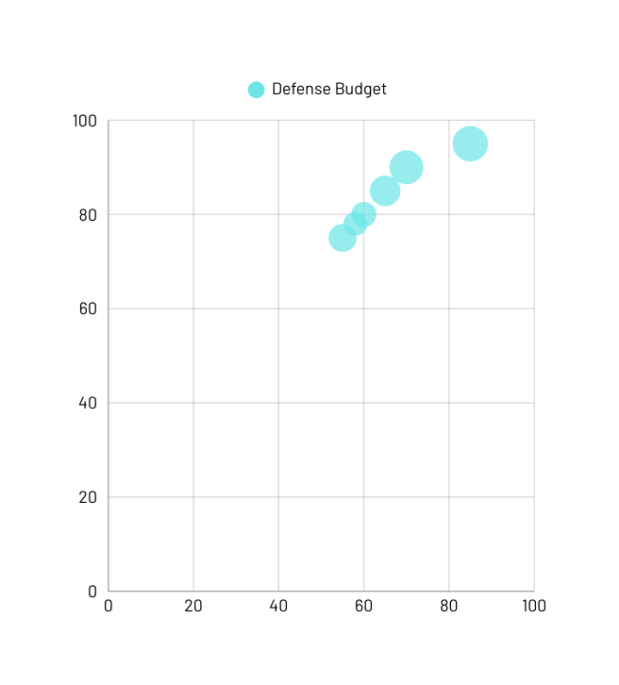
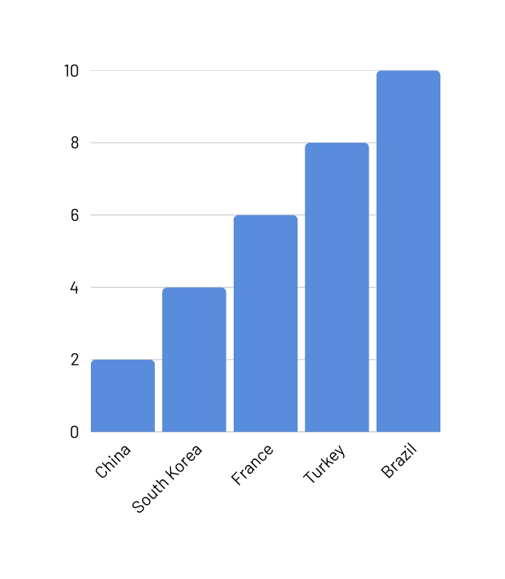
Bar Chart
Map Chart

Slide 7
Dashboard 2 – Nation Overview
KPIs: Power Index Rank, Budget per Soldier, Air Power Ratio
Charts: Bar chart (assets), Radar chart (capabilities)
Table: Detailed country metrics
Filter: Country selector

Slide 8
Dashboard 2: Nation Overview (Single Country)
Dropdown
Select Country
KPI
Power Rank
KPI
Assets per Capita
KPI
Budget / Soldier
Bar Chart
Aircraft | Armor | Navy | Manpower
Radar Chart
Air | Armor | Naval | Personnel
Table
Detailed Country Metrics
Compare Powers →

Slide 9
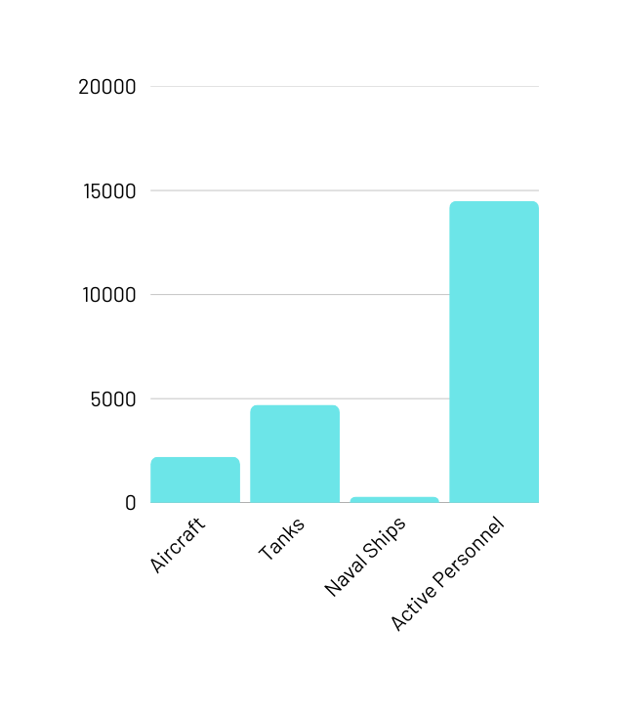
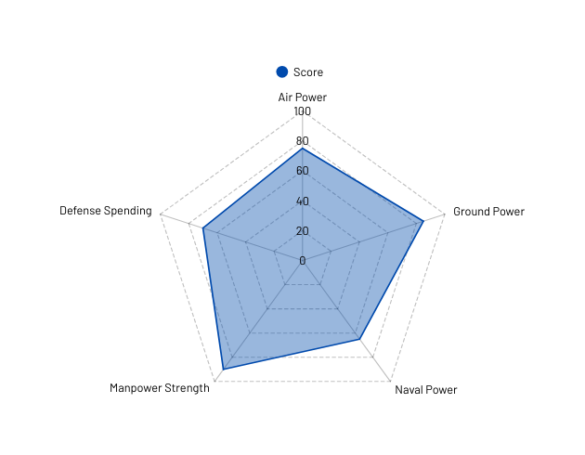
Bar Chart
Radar Chart

Slide 10
Dashboard 3 – Compare Powers
KPIs: Assets per Capita, Rank Gap, Total Assets
Charts: Side-by-side bars, Rank comparison chart
Table: Country A vs Country B
Filters: Country A, Country B

Slide 11
Dashboard 3: Compare Powers (2 Countries)
Dropdown
Country A
Dropdown
Country B
KPI
Assets per Capita (A vs B)
KPI
Budget per Soldier (A vs B)
KPI
Rank Gap
Side-by-Side Bar Chart
Aircraft | Armor | Navy | Manpower
Bar Chart
Rank Comparison
Comparison Table
Country A vs Country B

Slide 12
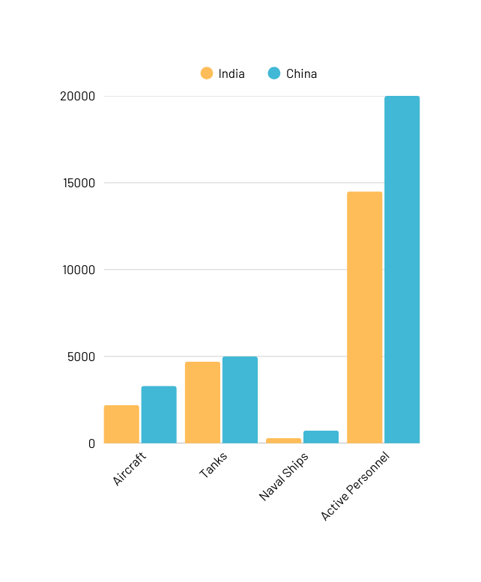
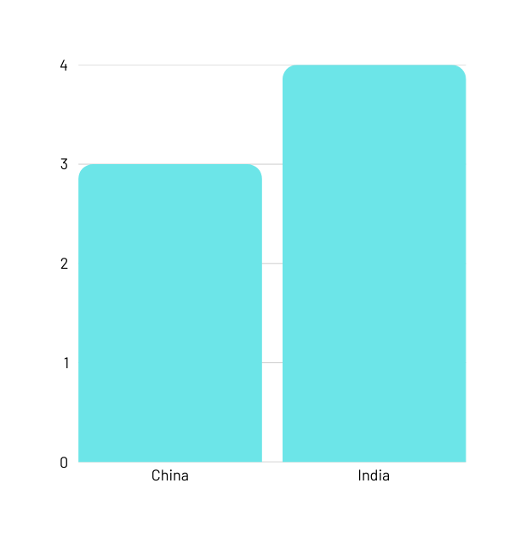
Grouped Bar Chart
Bar Chart

Slide 13
Dashboard 4 – Coalition Builder
KPIs: Coalition Total Assets, Manpower, Defense Spending
Charts: Stacked bar (contribution), Coalition vs reference
Table: Selected countries summary
Filter: Multi-select countries

Slide 14
Dashboard 4: Coalition Builder (Multi-Country)
Multi-Select Filter
Select Countries
KPI
Total Assets
KPI
Total Manpower
KPI
Total Budget
Stacked Bar Chart
Asset Contribution by Country
Bar Chart
Coalition vs Reference
Table
Selected Countries Summary
Clear Selection

Slide 15
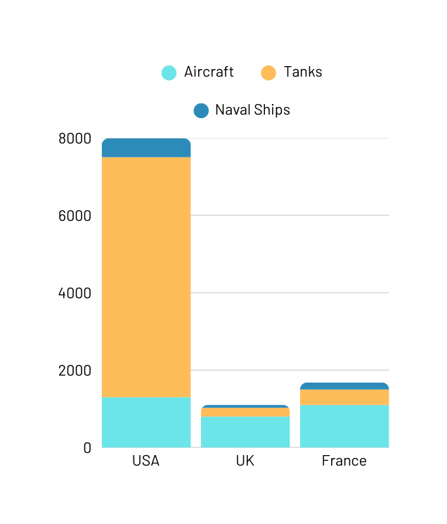
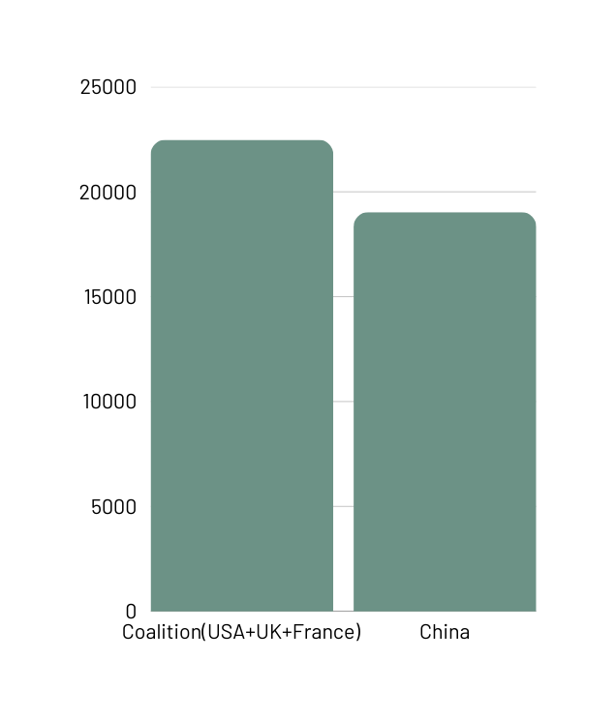
Stacked Bar Chart
Bar Chart

Slide 16
Dashboard Uniqueness & Flow
Quick Stats answers: Who are the strongest globally?
Nation Overview answers: How strong is one country?
Compare Powers answers: Who is stronger and why?
Coalition Builder answers: What if countries combine?

