Slide 1

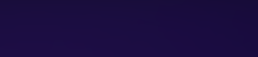
Face Recognition Based Attendance System
Intern: Sakshi Bisht
Organization: Infosys Springboard

Slide 2

The Challenge & Our Solution
Traditional Problems
Modern Solution
Manual attendance is time-consuming and error-prone
This project introduces an automated attendance system using face recognition technology. By leveraging computer vision and machine learning, the system provides a touchless, accurate, and efficient method for tracking attendance in real-time.
Proxy attendance remains a persistent issue
Paper-based records are difficult to maintain and analyze
Administrative overhead reduces productive time

Slide 3
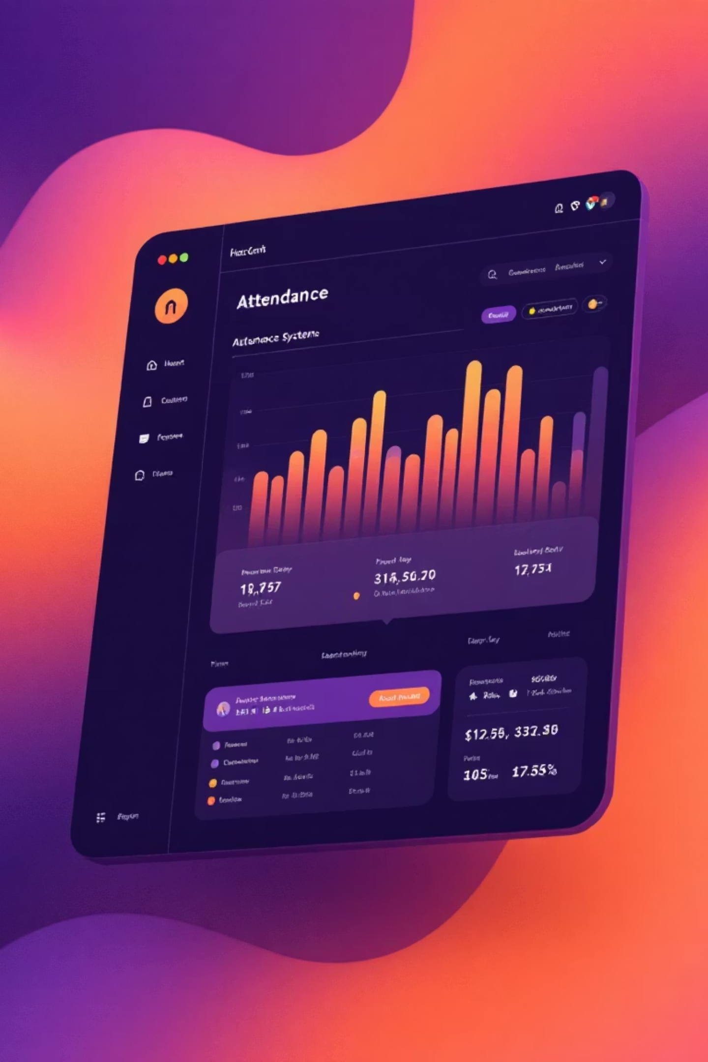
Project Objective
Automate Attendance
Ensure Accuracy
Replace manual roll calls with instant face recognition, saving time and reducing administrative burden
Eliminate proxy attendance through biometric verification and maintain reliable attendance records
User-Friendly Interface
Provide an intuitive web-based system accessible to both administrators and end-users

Slide 4
Why This Project?
01
02
Real-World Application
Technical Learning
Addresses a genuine need in educational institutions and corporate environments where attendance tracking is essential
Opportunity to work with cutting-edge technologies including computer vision, machine learning algorithms, and web frameworks
03
04
Industry Relevance
Measurable Impact
Biometric systems are increasingly adopted across industries, making this a valuable skill set for future career opportunities
Creates tangible efficiency improvements that can be demonstrated and quantified in real deployment scenarios

Slide 5





System Architecture Overview
The system operates through four integrated components working seamlessly together. The camera captures live video, OpenCV processes facial features, the LBPH algorithm performs recognition, and Streamlit provides the user interface. All attendance records are automatically logged with timestamps into CSV files for easy access and reporting.
Video Capture
Live camera feed
Face Detection
Haar Cascade
Recognition
LBPH Algorithm
Logging
CSV Records

Slide 6




System Workflow
Training Phase
Registration Phase
The LBPH algorithm processes collected images to create a recognition model that learns unique facial patterns for each registered user
New users register by entering their details and capturing multiple facial images from different angles to build a robust dataset
Attendance Logging
Recognition Phase
Recognized individuals are automatically marked present with precise timestamps, and data is instantly saved to CSV files for record-keeping
System continuously monitors the camera feed, detects faces using Haar Cascade, and matches them against the trained model in real-time

Slide 7






Core Technologies Powering the System
Python
OpenCV
Primary programming language providing the foundation for all system components with its extensive libraries and ease of implementation
Computer vision library handling face detection, image processing, and camera integration for real-time video analysis
Haar Cascade
LBPH Algorithm
Pre-trained classifier for rapid face detection in video streams, identifying facial regions with high accuracy and speed
Local Binary Pattern Histogram recognizer that identifies faces by analyzing texture patterns and comparing them to trained models
Streamlit
CSV Storage
Web framework creating an interactive and responsive user interface without requiring extensive front-end development knowledge
Lightweight data storage format for attendance records, enabling easy export and integration with other systems

Slide 8

Implementation Results & Challenges
Successful Outcomes
Achieved 92% recognition accuracy under optimal lighting conditions
Reduced attendance marking time from 10 minutes to under 30 seconds
Generated exportable CSV reports for attendance analysis
Challenges Overcome
Lighting variations affecting detection required parameter tuning
Multiple face detection needed filtering logic to identify primary subject
Dataset quality was improved through better image capture guidelines
Model retraining optimization reduced processing time significantly

Slide 9

Key Learnings & Future Scope
Skills Developed
Project Summary
Hands-on experience with OpenCV and computer vision techniques
This internship project successfully demonstrated the practical application of face recognition technology in solving real-world attendance challenges. The system combines computer vision, machine learning, and web development to create an efficient, accurate, and user-friendly solution.
Understanding of machine learning algorithms for face recognition
Web application development using modern Python frameworks
Problem-solving in real-world deployment scenarios
Impact: Significant time savings and improved accuracy in attendance management with strong potential for real-world deployment.
Future Enhancements
Integration with cloud storage for centralized data management
Mobile app development for extended accessibility
Deep learning models for improved accuracy and robustness
Multi-camera support for larger venues and spaces

Slide 10

Conclusion
What We Built
Real Impact
So, what did we achieve here? We built a face recognition system that makes checking in super fast and easy. No more manual sign-ups or long queues – it handles attendance efficiently, just by recognizing faces.
This isn't just a tech project; it's about real impact. Think about the time saved – potentially minutes per person each day – and how much more accurate attendance records become. This system is genuinely designed to simplify attendance for places like schools and offices, making things smoother and more reliable.
What's Next
The best part is, it's ready for what's next. Our system can easily integrate with your existing tools, and we're excited to keep adding smart features. We're even kicking off a pilot program at a local school next quarter to see it in action and make a real difference.

