Slide 1
Hospital Operations & Patient Analytics Dashboard
Dashboard Storyboard & Presentation
Patient overview • Hospital operations • Doctors & medical care • Insurance & financial overview

Slide 2
Project Overview
A single dashboard story for understanding patients, hospital operations, medical care and financial performance.
01
Patient Overview
02
Hospital Operations
Understand patient volume, age, gender, diagnosis, geography and billing.
Track admissions, emergency cases, discharge activity and length of stay.
03
Doctors & Medical Care
04
Insurance & Financial
Monitor doctors, diagnoses, laboratory tests and medication usage.
Analyze billing, insurance coverage, insurance type and department-level billing.
Hospital Operations & Patient Analytics | 2

Slide 3
Dashboard KPI Snapshot
Key figures visible across the reference dashboard.
TOTAL PATIENTS
984
Count of Patient_ID
TOTAL ADMISSIONS
984
Count of Admission_Date
AVG LENGTH OF STAY
7.95
Average Length_of_Stay_Days
TOTAL BILL AMOUNT
21M
Sum of Total_Bill_INR
EMERGENCY ADMISSIONS
323
Count of Patient_ID
TOTAL DOCTORS
10
Count of Doctor
TOTAL DIAGNOSIS
13
Count of Diagnosis
LAB TESTS
5K
Sum of Lab_Tests_Count
Hospital Operations & Patient Analytics | 3

Slide 4
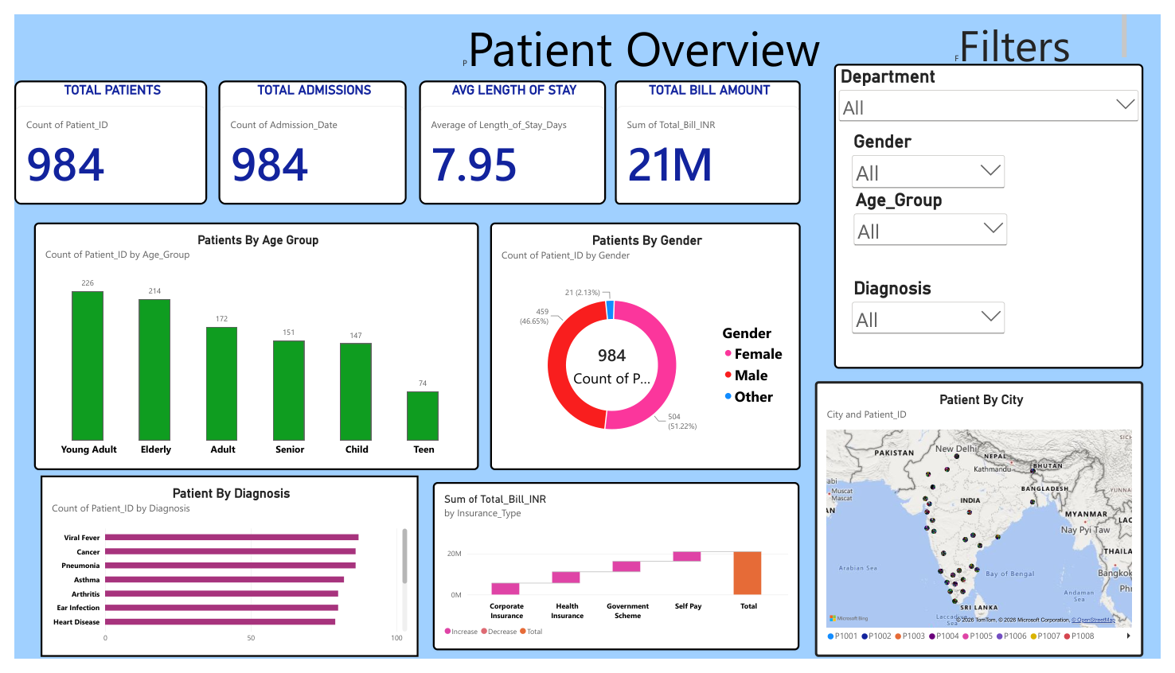
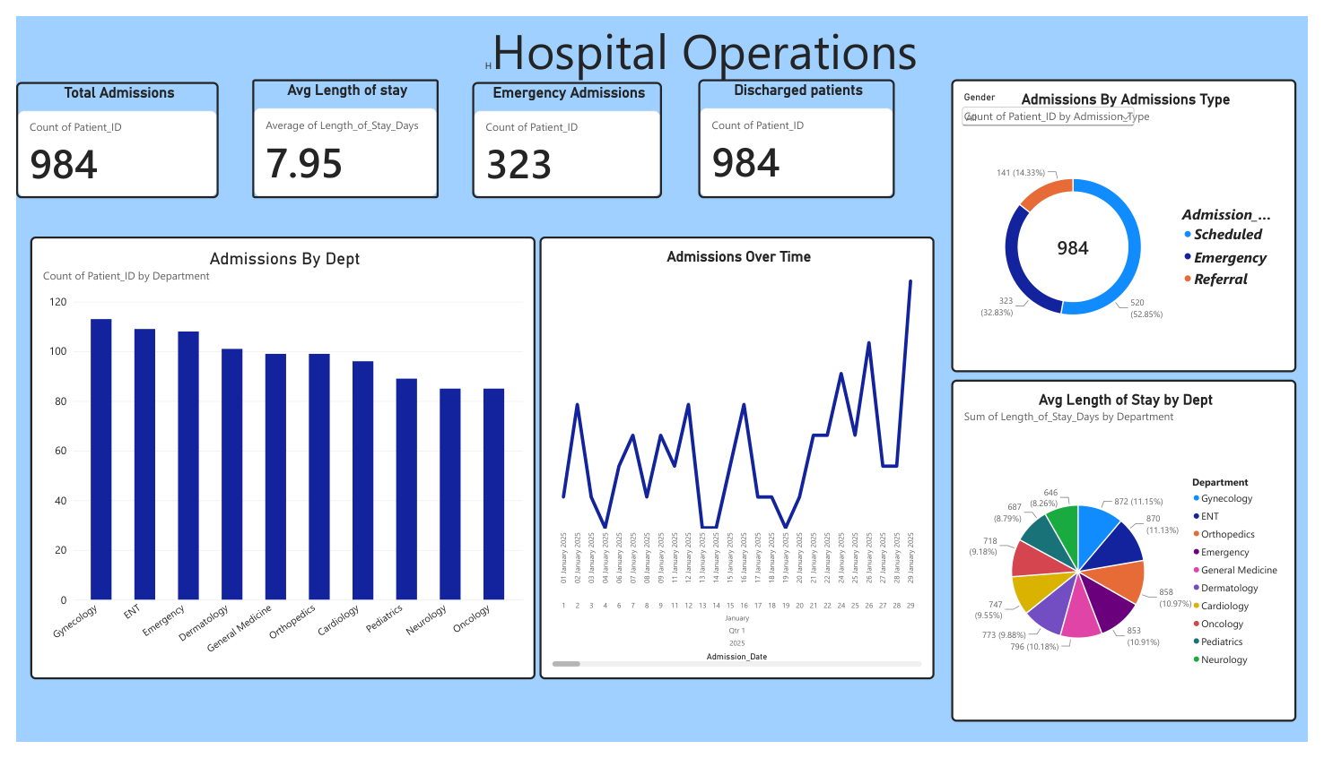
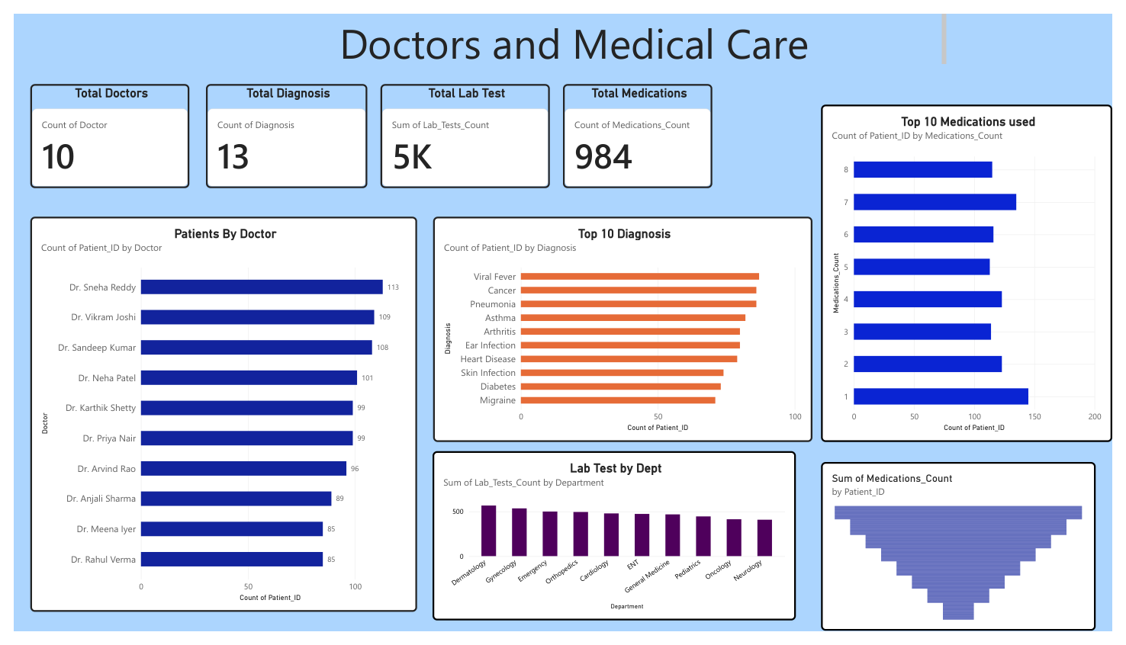
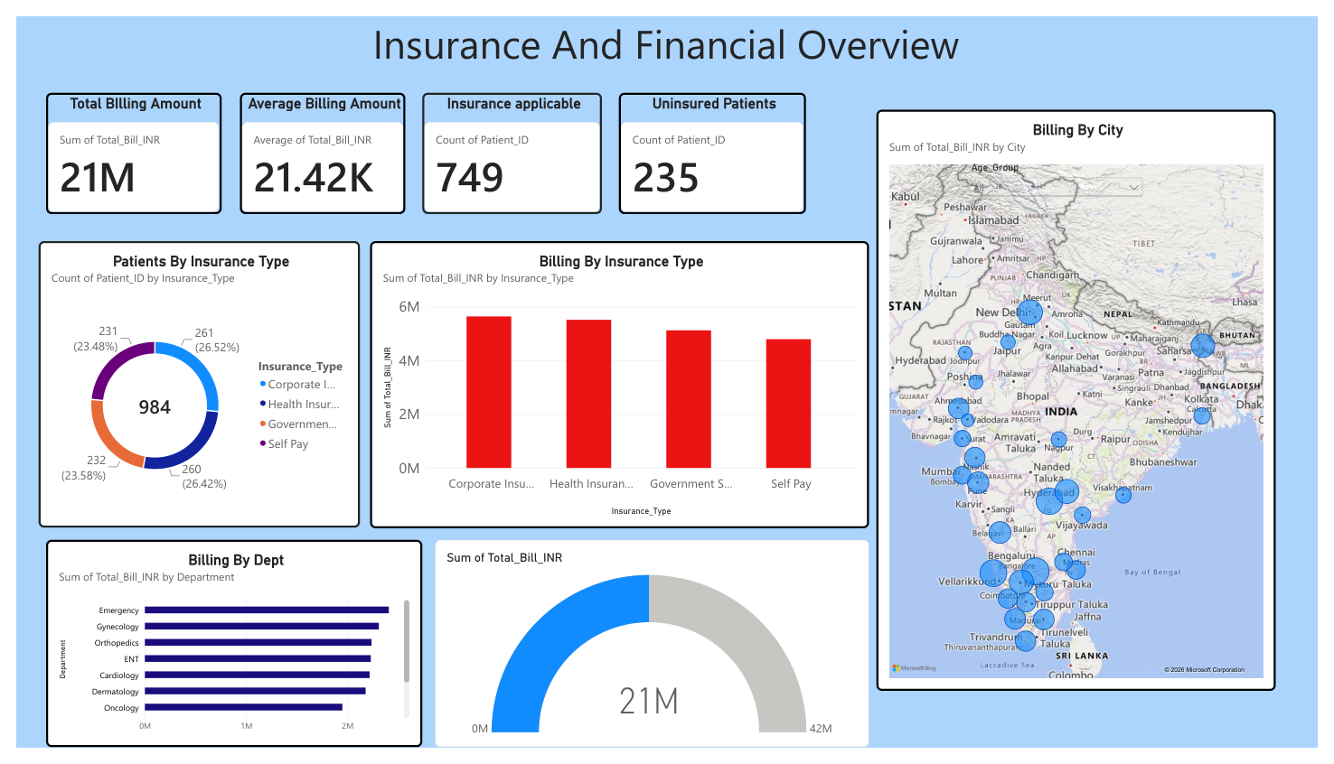
Dashboard Storyboard
Four dashboard pages used to tell the hospital analytics story.
Dashboard 1
Dashboard 2
Dashboard 3
Dashboard 4
Hospital Operations & Patient Analytics | 4

Slide 5
Dashboard 1 — Patient Overview
Focus: patient population, demographics, diagnosis, geography and insurance-related billing.
• 984 total patients and 984 total admissions are highlighted at the top.
• Average length of stay is 7.95 days and total bill amount is shown as 21M.
• Age-group and gender visuals summarize the patient population.
• Diagnosis and city views add clinical and geographic context.
• Filters include Department, Gender, Age Group and Diagnosis.
Hospital Operations & Patient Analytics | 5

Slide 6
Dashboard 2 — Hospital Operations
Focus: admissions, admission type, trends and length of stay by department.
• Total admissions: 984.
• Average length of stay: 7.95 days.
• Emergency admissions: 323.
• Admission type separates Scheduled, Emergency and Referral cases.
• Admissions over time and average length of stay by department support operational monitoring.
Hospital Operations & Patient Analytics | 6

Slide 7
Dashboard 3 — Doctors & Medical Care
Focus: medical workforce, diagnoses, laboratory testing and medication usage.
• 10 doctors and 13 diagnoses are shown as headline KPIs.
• Laboratory test activity is summarized at about 5K.
• Doctor-level patient counts compare workload across doctors.
• Top diagnosis and lab-test-by-department visuals support clinical analysis.
• Medication usage is also summarized for the patient population.
Hospital Operations & Patient Analytics | 7

Slide 8
Dashboard 4 — Insurance & Financial Overview
Focus: billing, coverage and financial distribution across insurance types and departments.
• Total billing amount: 21M.
• Average billing amount: 21.42K.
• 749 patients are shown as insurance applicable and 235 as uninsured.
• Insurance type distribution compares Corporate, Health Insurance, Government Scheme and Self Pay.
• Billing is further broken down by insurance type, department and city.
Hospital Operations & Patient Analytics | 8

Slide 9
Key Takeaways & Conclusion
Patient volume
Operations
984 patients and 984 admissions provide the overall activity baseline.
323 emergency admissions and 7.95-day average stay highlight operational workload.
Medical care
Financials
10 doctors, 13 diagnoses and ~5K lab tests provide a clinical activity view.
21M total billing with coverage and uninsured views supports financial monitoring.
The storyboard connects patient demographics → hospital operations → medical care → financial performance.
Hospital Operations & Patient Analytics | 9

