Slide 1
INDUSTRIAL INTERNSHIP PROJECT
14,734
Hospital Operations
& Patient Analytics
Patient records analysed
20
Analytical columns
End-to-end data cleaning, analysis and interactive dashboard development using Python, Tableau and Power BI.
8
Interactive dashboards
3
Submitted in partial fulfilment of the requirements for the
Bachelor of Computer Applications (BCA)
Tools: Python | Tableau | Power BI
Notes:
Introduce the project: hospital patient dataset cleaned in Python and visualised in Tableau and Power BI.

Slide 2
CONTENTS
Presentation Agenda
01
Project Overview & Objectives
02
Dataset Overview
Purpose, scope and expected outcomes
Structure, size and key attributes
03
Methodology & Tools
04
Data Quality Assessment
Workflow followed and technology stack
Missing values and data inconsistencies
05
Data Cleaning & Transformation
06
Feature Engineering
Corrective actions applied to the dataset
New analytical columns derived
07
Dashboard Development
08
Key Insights & Conclusion
Tableau and Power BI visualisations
Findings and learning outcomes
Hospital Operations & Patient Analytics
2

Slide 3
SECTION 01
Project Overview & Objectives
Objectives
About the Project
1
Assess data quality
The project analyses a hospital patient dataset covering admissions, departments, billing, insurance and patient satisfaction across multiple Indian cities.
Raw data was cleaned and transformed using Python and Pandas, and the resulting dataset was used to build interactive dashboards in Tableau and Power BI for hospital management decision support.
Examine structure, completeness and consistency of the raw dataset
2
Clean and standardise
Handle missing values, duplicates, invalid bills and inconsistent categories
3
Engineer new features
Derive length of stay, age group, bill category and time-based attributes
4
Visualise and report
Build four dashboard views each in Tableau and Power BI
Hospital Operations & Patient Analytics
3

Slide 4
SECTION 02
Dataset Overview
15,000
12
14,734
20
Raw records
Original columns
Cleaned records
Final columns
Key Attributes in the Dataset
Patient_ID / Patient_Name
Unique patient identity
Data Coverage
Age / Gender / City
Patient demographic profile
12 clinical departments
12+ cities across India
Admissions from 2020 to 2025
27 doctors across departments
10 insurance providers
Source format: CSV file
Department / Doctor_Name
Treating unit and consultant
Admission_Date / Discharge_Date
Hospitalisation period
Bill_Amount_INR
Billed treatment amount
Insurance_Provider
Insurance coverage of the patient
Patient_Satisfaction_Score
Feedback rating on a 1-5 scale
Hospital Operations & Patient Analytics
4

Slide 5
SECTION 03
Methodology & Tools
01
02
03
04
05
Data Collection
›
Data Exploration
›
Data Cleaning
›
Feature Engineering
›
Visualisation
Raw hospital CSV dataset imported into Jupyter Notebook
Structure, data types and value distributions reviewed
Missing values, duplicates and invalid entries treated
Eight derived analytical columns created
Dashboards built in Tableau and Power BI
Technology Stack
Python
Pandas & NumPy
Jupyter Notebook
Core programming language
Data cleaning and computation
Analysis environment
Tableau
Power BI
MS Excel / CSV
Interactive dashboards
Business intelligence reporting
Data storage and exchange
Hospital Operations & Patient Analytics
5

Slide 6
SECTION 04
Data Quality Assessment
Missing values were identified in five columns of the raw dataset, measured as a percentage of all 15,000 records.
Observations
Insurance_Provider had the highest share of missing data at 12.52%
Patient_Satisfaction_Score followed at 6.68%
Age, Discharge_Date and City showed minor gaps below 3%
Other Quality Issues
Gender recorded in 13 inconsistent formats such as M, m, MALE and Female
Negative values present in Bill_Amount_INR
Duplicate records found against the same Patient_ID
Hospital Operations & Patient Analytics
6

Slide 7
SECTION 05
Data Cleaning & Transformation
Issue Identified
Action Applied
Inconsistent gender labels
Standardised into Male, Female and Other
Negative billing amounts
Invalid records removed from the dataset
Duplicate patient entries
Dropped duplicates on Patient_ID
Missing Age and satisfaction scores
Imputed using the column median value
Missing City values
Imputed using the most frequent city (mode)
Missing insurance and discharge dates
Filled as "None"; discharge set to admission date
Date columns stored as text
Converted to proper datetime format
15,000 → 14,734
12 → 20
0
Valid records retained after cleaning
Columns after feature engineering
Missing values remaining
Hospital Operations & Patient Analytics
7

Slide 8
SECTION 06
Feature Engineering
Eight new analytical columns were derived from the cleaned dataset to support deeper operational and patient-level analysis.
1
2
3
4
Length_of_Stay
Stay_Category
Age_Group
Bill_Category
Days between admission and discharge date
Same Day, 1-3, 4-7 and more than 7 days
0-18, 19-35, 36-50, 51-65 and 65+ bands
Low, Medium, High and Very High billing
5
6
7
8
Admission_Year
Admission_Month
Admission_Quarter
Admission_Day
Year extracted from the admission date
Month name for seasonal trend analysis
Quarter of the year for period comparison
Weekday used for daily load analysis
Outcome
The final cleaned dataset contains 14,734 records and 20 columns with no remaining missing values, and was exported as hospital_operations_patient_analytics_cleaned.csv for dashboard development.
Hospital Operations & Patient Analytics
8

Slide 9
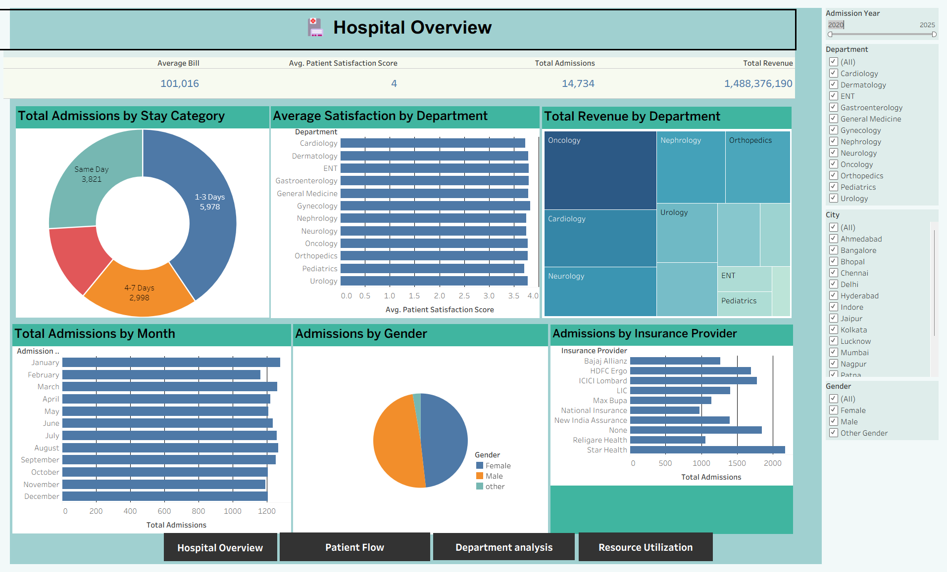
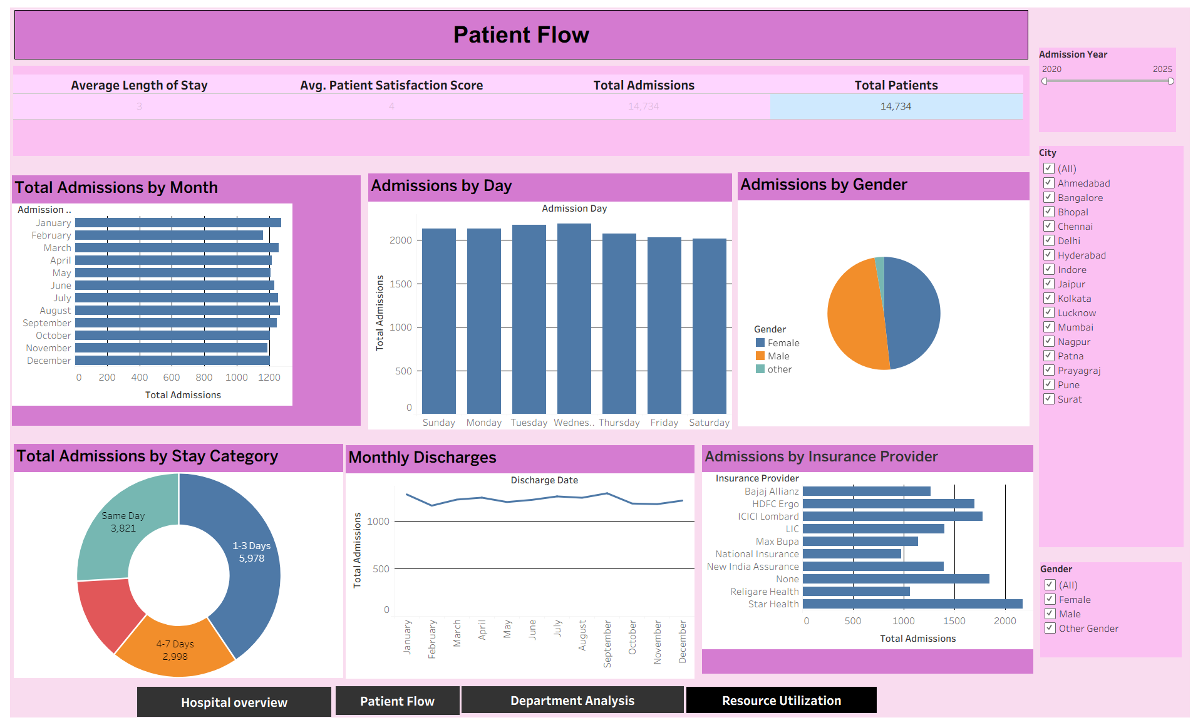
SECTION 07 · TABLEAU
Tableau Dashboards — Operations View
Two of the four interlinked Tableau dashboards, filtered by admission year, department, city and gender.
Dashboard 1 — Hospital Overview
Dashboard 2 — Patient Flow
Key Observations
14,734 total admissions generating ₹1.49 bn in revenue
Average bill of ₹1,01,016 per patient across departments
1-3 day stays form the largest category with 5,978 admissions
Admissions are evenly distributed across months and weekdays
Hospital Operations & Patient Analytics
9

Slide 10
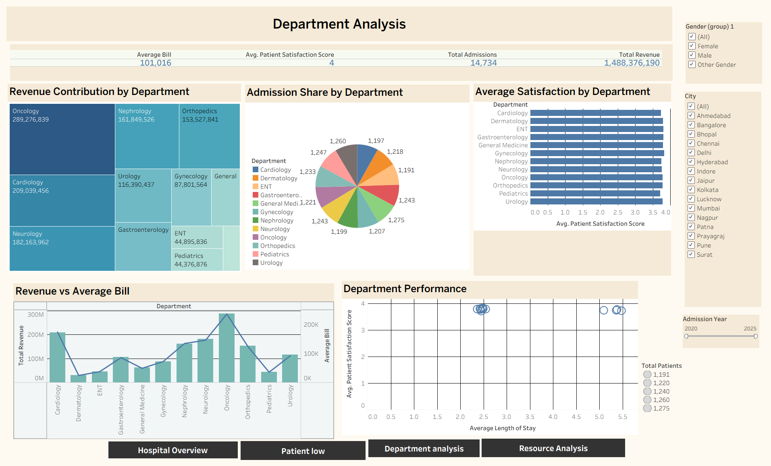
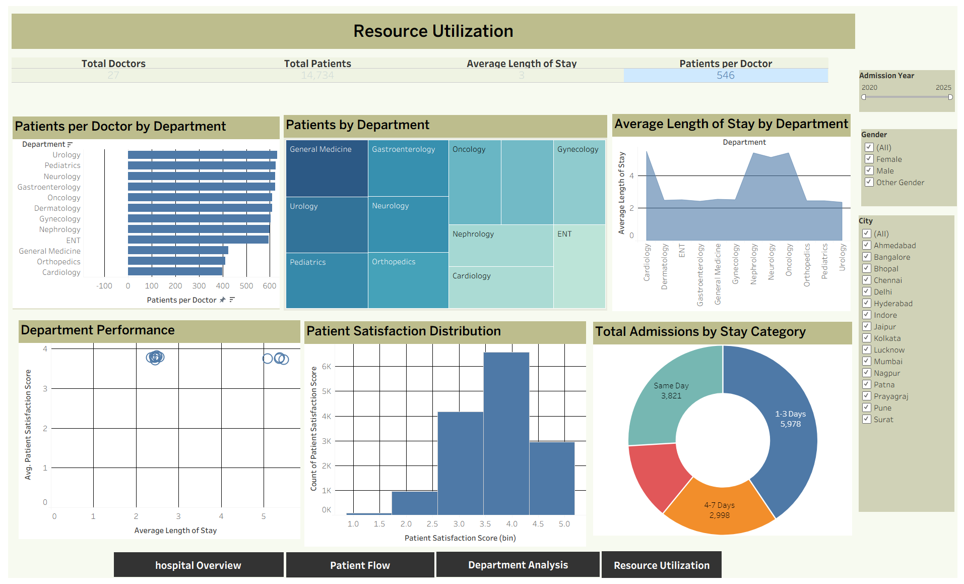
SECTION 07 · TABLEAU
Tableau Dashboards — Analytical View
Department-level performance and resource utilisation views built on the same cleaned dataset.
Dashboard 3 — Department Analysis
Dashboard 4 — Resource Utilization
Key Observations
Oncology leads revenue contribution at ₹289 million
Admissions are shared almost equally across the 12 departments
27 doctors serve the patient base, averaging 546 patients each
Most satisfaction scores fall between 3.0 and 4.5 out of 5
Hospital Operations & Patient Analytics
10

Slide 11
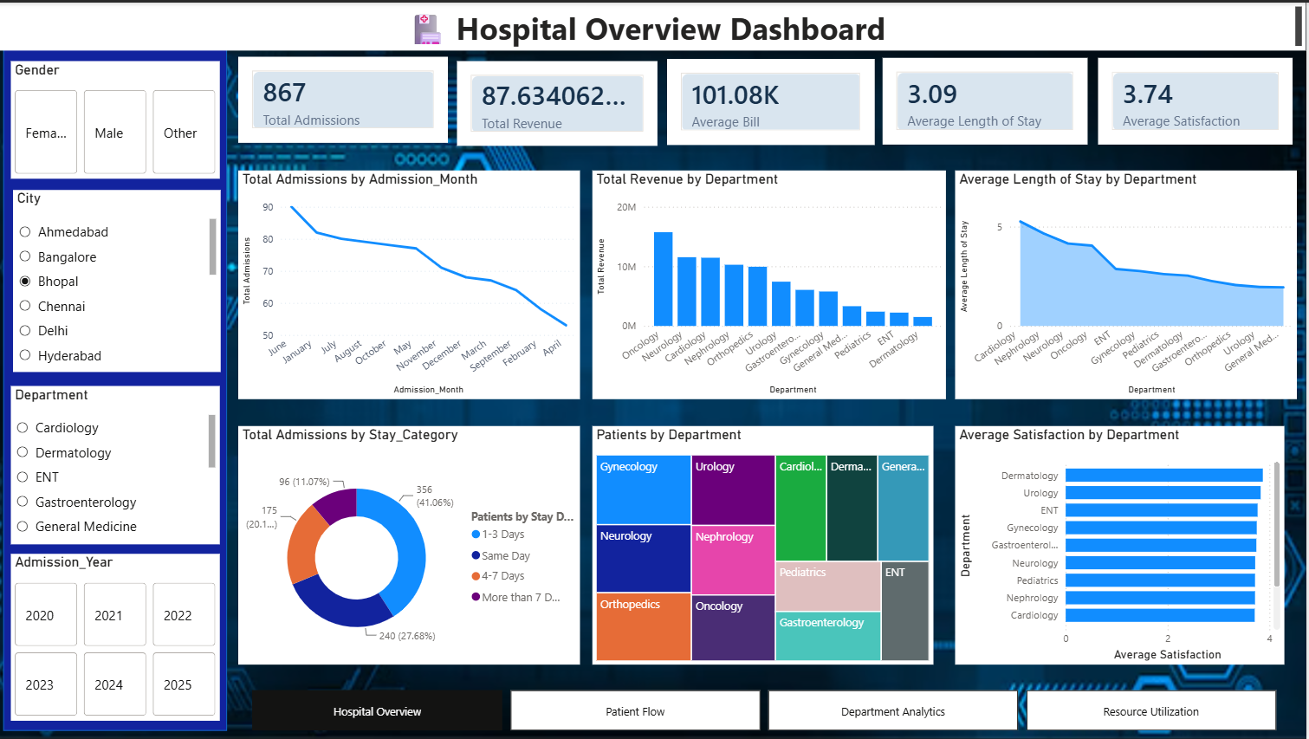
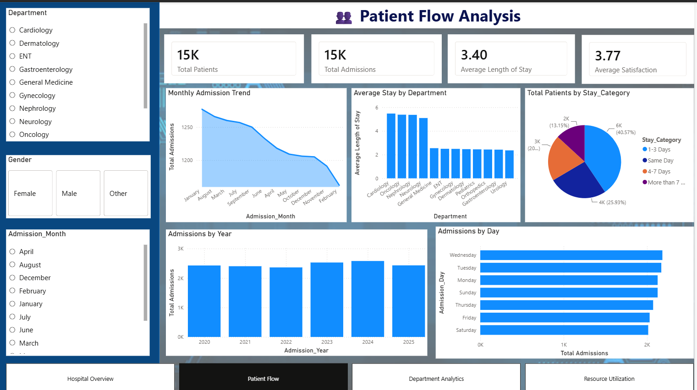
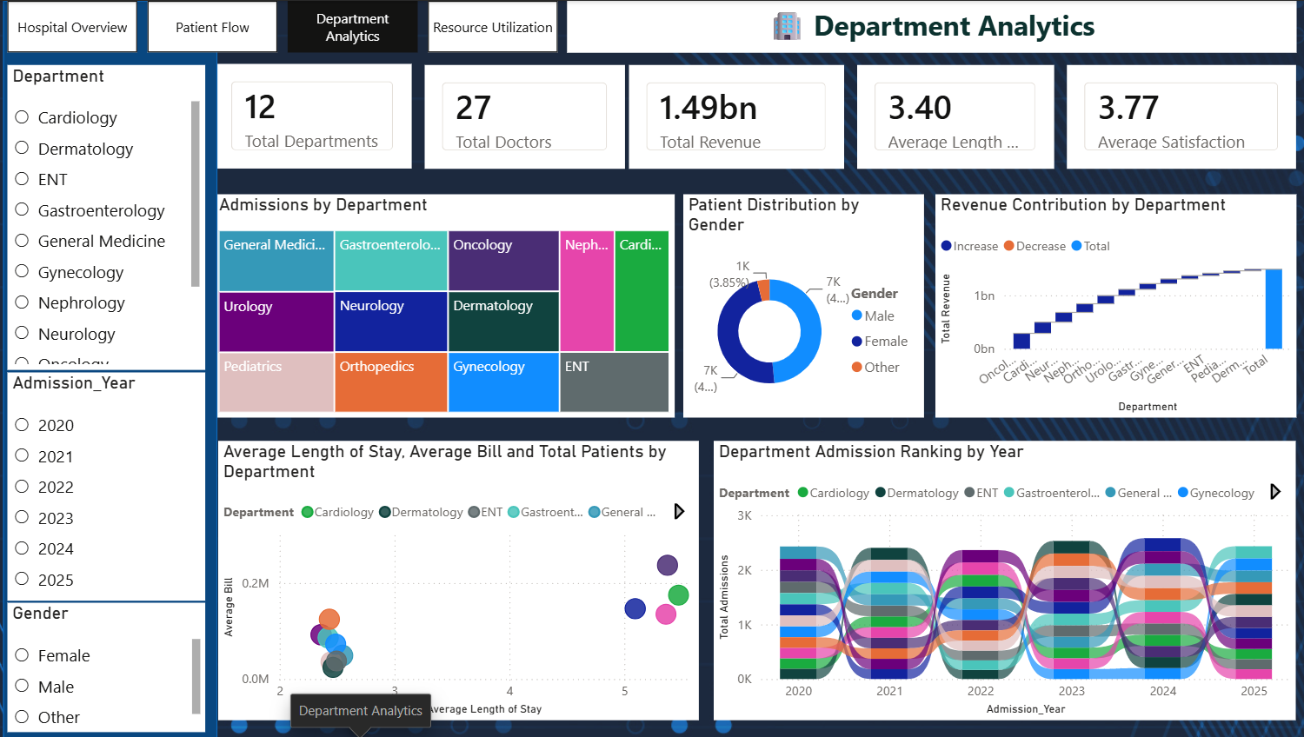
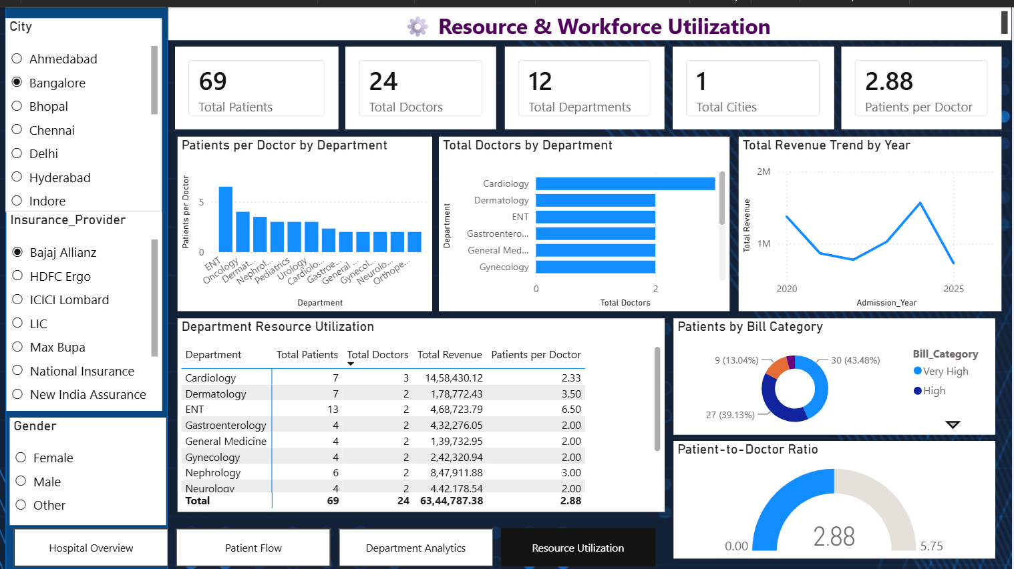
SECTION 07 · POWER BI
Power BI Dashboards
Hospital Overview
Patient Flow Analysis
Department Analytics
Resource & Workforce Utilization
Hospital Operations & Patient Analytics
11

Slide 12
SECTION 08
Key Insights & Conclusion
14,734
₹1.49 bn
3.4 days
3.77 / 5
Total admissions
Total revenue
Average length of stay
Average satisfaction
Key Insights
Conclusion
Oncology is the highest revenue-generating department, followed by Cardiology and Neurology.
General Medicine records the highest number of admissions, while ENT records the lowest.
Over 40% of patients are discharged within one to three days of admission.
Admissions remain stable across months and weekdays, showing steady hospital demand.
A high patient-to-doctor ratio indicates workforce pressure in specific departments.
The hospital patient dataset was successfully cleaned, transformed and enriched using Python and Pandas, resulting in a reliable analytical dataset of 14,734 records and 20 columns with no missing values.
The dataset was then visualised through eight interactive dashboards in Tableau and Power BI, covering hospital overview, patient flow, department performance and resource utilisation.
Learning Outcomes
Practical data cleaning and feature engineering with Pandas
Dashboard design and storytelling in Tableau and Power BI
Translating raw operational data into business insight
Hospital Operations & Patient Analytics
12

Slide 13
THANK YOU

