Slide 1

PROJECT DOCUMENTATION
MedTrack_DV
Hospital Operations & Patient Analytics Dashboard
Delivered as a completed four-dashboard analytics suite, implemented in both Power BI and Tableau.
Infosys Springboard 7.0 — Data Visualization (Batch 2)
Prepared by Pricilla G
B.Tech — Artificial Intelligence & Data Science, Arunachala College of Engineering for Women
GitHub Branch: Pricilla-G
MedTrack_DV — Hospital Operations & Patient Analytics Dashboard
1 / 15

Slide 2



PROJECT OVERVIEW
Hospital data, turned into four live dashboards
MedTrack_DV takes hospital operations data through preparation, KPI engineering and dashboard development, presenting hospital performance through Power BI and Tableau. The project is organized into eight modules, each with a clear input and output, ending in a completed four-dashboard analytics suite.
Hospital Overview
Patient Flow
Department Analytics
Resource Utilization
Overall hospital performance and major KPIs
Admissions, patient stay and readmission analysis
Department-level volume, performance and efficiency
Bed, ward and patient-load analysis
TOOLS & TECHNOLOGIES
Python
Pandas / NumPy
Jupyter Notebook
Excel
Power BI
Tableau
GitHub
Two platforms, one analytical story: the dashboard suite was built and validated in both Power BI (MedTrack_DV.pbix) and Tableau (MedTrack_DV.twbx), covering the same four dashboard areas.
MedTrack_DV — Hospital Operations & Patient Analytics Dashboard
2 / 15

Slide 3





WHY THIS PROJECT
Problem Statement & Objectives
Prepare a structured hospital dataset for analysis
THE PROBLEM
Hospitals generate information from patient admissions, department activity, bed status and other operational activities. Viewed separately, these measures make it difficult to understand the overall operational situation.
Clean and standardize the available data
Calculate important hospital performance KPIs
THE APPROACH
MedTrack_DV brings the available measures into a single analytical environment, so hospital information can be viewed through KPIs, charts, filters and dashboard interactions — for administrators, healthcare managers, medical staff and policymakers.
Plan the dashboard layout before development
Develop four dashboards covering hospital operations
Test calculations, filters and dashboard behavior
MedTrack_DV — Hospital Operations & Patient Analytics Dashboard
3 / 15

Slide 4
PROJECT ROADMAP
Eight modules, one connected workflow
1
2
3
4
5
6
7
8
Data Collection
&
Integration
Data Cleaning
&
Preparation
Hospital
KPI
Engineering
Dashboard Planning
& Storyboard
Hospital Overview
& Patient Flow
Department Analytics
& Resource Utilization
Testing
& Validation
Documentation
& Delivery
→
→
→
→
→
→
→
Each module has a clear input and output: raw hospital records flow through cleaning and KPI engineering, into a storyboard-planned set of four dashboards, which are then integrated, tested and documented for GitHub delivery in both Power BI and Tableau.
MedTrack_DV — Hospital Operations & Patient Analytics Dashboard
4 / 15

Slide 5
MODULE 1
Data Collection & Integration
DATA SOURCES MERGED
ENGINEERED FIELDS
Admission (base table)
Length_of_Stay_Days
discharge_date − admission_date
Patient
Patient_Age / Age_Group
Department
(admission_date − date_of_birth) ÷ 365.25, binned into 6 groups
Ward + Bed
Admission_Month / Year / Quarter
time dimensions parsed from admission_date
Disease
Bed_Occupied_Flag
Employee, Doctor & Staff Assignment
1 if bed_status is occupied, booked or assigned
QUALITY CHECKS RUN ON THE INTEGRATED FILE
Merged left-to-right on admission_id, patient_id, department_id, ward_id, bed_id and disease_id to build one integrated hospital record.
Duplicate-row and duplicate-admission-ID checks · missing-value report by column · overall dataset completeness percentage
MedTrack_DV — Hospital Operations & Patient Analytics Dashboard
5 / 15

Slide 6
MODULE 2
Data Cleaning — key formulas & logic
The exact rules applied in hospital_cleaning.ipynb to take raw records to a clean, analysis-ready dataset.
1. Missing Value %
2. Duplicate Removal
3. Length of Stay (days)
(Missing Values ÷ Total Values) × 100
df.drop_duplicates()
Discharge Date − Admission Date
Target: below 2% overall
Drop rows where all columns match
Negative results → NaN
4. Patient Age (years)
5. Numeric Imputation
6. Categorical Imputation
(Admission Date − Date of Birth) ÷ 365.25
Missing Value → Column Median
Missing Value → "Unknown"
Invalid if < 0 or > 120 → NaN
Applied per numeric column
Applied per text / category column
MedTrack_DV — Hospital Operations & Patient Analytics Dashboard
6 / 15

Slide 7
MODULE 3
Hospital KPI Engineering
Six KPIs are calculated from the cleaned dataset in generate_hospital_kpis.py.
Total Admissions
Average Length of Stay
Readmission Rate
COUNT(DISTINCT admission_id)
AVG(length_of_stay_days), days ≥ 0
(Patients with >1 admission ÷ Total Unique Patients) × 100
Bed Utilization Rate
Occupancy Rate
Department Efficiency Score
(Occupied Bed Records ÷ Total Admission Records) × 100
(Occupied Bed Records ÷ Total Bed Records) × 100
0.40 × Admission Efficiency + 0.30 × Bed Utilization + 0.30 × LOS Efficiency
The dataset does not specify a fixed efficiency formula, so a transparent, explainable composite score is used for Department Efficiency — higher score means better relative departmental efficiency (weights: 40% admissions scaled against the busiest department, 30% share of records linked to an occupied bed, 30% inverse of average length of stay).
MedTrack_DV — Hospital Operations & Patient Analytics Dashboard
7 / 15

Slide 8
MODULE 4
Dashboard Planning & Storyboard
Before development, the storyboard defined structure, information placement and analytical flow for all four dashboards. Deliverable: dashboard_Storyboard.pdf.
Hospital Overview
Patient Flow
Department Analytics
Resource Utilization
Hospital KPIs, admissions and overall performance
Admissions, stay-related measures and readmission
Department volume, LOS and efficiency comparison
Beds, ward types, patient load and resource analysis
Planned interactions carried into every dashboard: date range, hospital, department and region filters; cross-dashboard navigation and linking; parameter-driven comparisons.
MedTrack_DV — Hospital Operations & Patient Analytics Dashboard
8 / 15

Slide 9
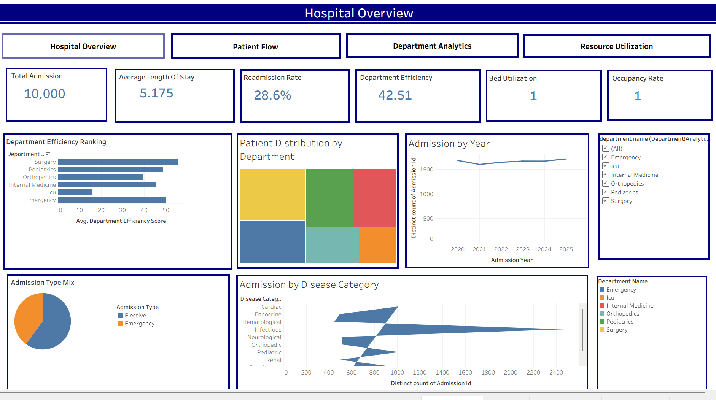
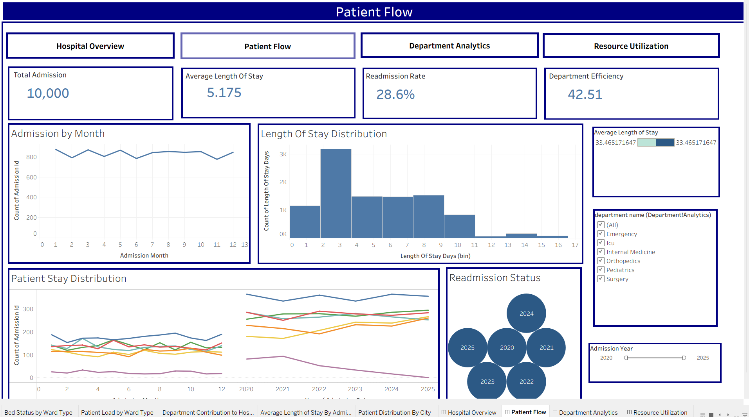
MODULE 5 · FINAL IMPLEMENTATION (POWER BI)
Hospital Overview & Patient Flow
Hospital Overview — landing dashboard, carries filters & navigation to the other three
Patient Flow — admission trends, length-of-stay distribution & readmission status
Deliverable: MedTrack_DV.pbix / medtrack_dashboard_v1.pbix · mirrored in Tableau (MedTrack_DV.twbx)
MedTrack_DV — Hospital Operations & Patient Analytics Dashboard
9 / 15

Slide 10
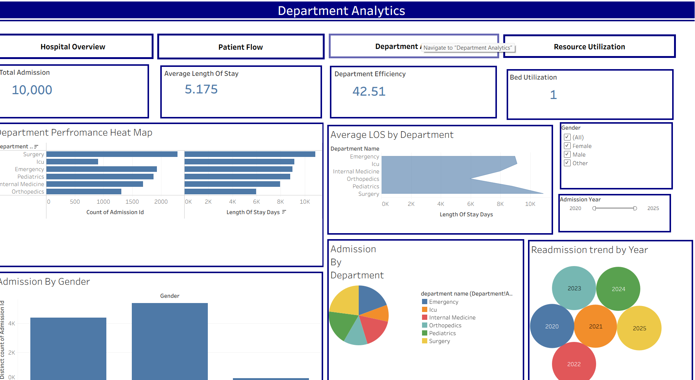
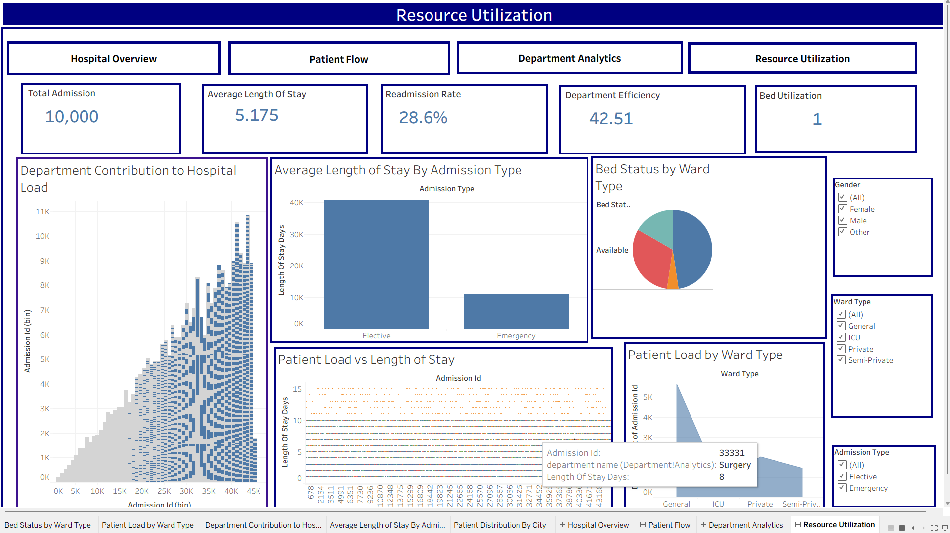
MODULE 6 · FINAL IMPLEMENTATION (POWER BI)
Department Analytics & Resource Utilization
Department Analytics — efficiency, admissions & LOS by department
Resource Utilization — bed status, patient load & capacity by ward type
All four dashboards share global filters and one-click navigation, unified into a single connected workbook.
MedTrack_DV — Hospital Operations & Patient Analytics Dashboard
10 / 15

Slide 11
MODULE 7
Testing & Validation
QA CHECKLIST STATUS
TEST AREAS COVERED
KPI Calculations
14
Values checked against the final analytical dataset for the selected filters
Healthcare Metrics
of 16 QA checks verified
Admission and discharge metrics verified across filter combinations
Dashboard Interactions
Pending at time of writing:
Date range, hospital, department and region filters tested
• Department Efficiency Score validation
• Navigation between dashboards
Navigation & Actions
Cross-dashboard navigation and parameter-driven actions tested
Patient-Flow Analytics
Target KPI accuracy: above 95%
Admission trends, discharge tracking, stay and peak-load analysis
Power BI & Tableau
Final PBIX and TWBX files open with visuals and interactions working
Sources: QA_Checklist.md & Dashboard_Testing_Report.md
MedTrack_DV — Hospital Operations & Patient Analytics Dashboard
11 / 15

Slide 12
MODULE 8
Documentation & Project Delivery
Project organized for final submission and GitHub delivery, so the work can be understood without opening every file.
MODULE 1
data_collection.py, hospital_raw_data.csv
MODULE 2
hospital_cleaning.ipynb, hospital_cleaned.csv
MODULE 3
generate_hospital_kpis.py, hospital_final_dataset.xlsx
RECOMMENDED MODULE 8 CONTENTS
• README.md
• Final project documentation
• Milestone documentation
• Final submission notes, if required
MODULE 4
dashboard_Storyboard.pdf
MODULE 5
medtrack_dashboard_v1.pbix
MODULE 6
Module 6 dashboard files / screenshots
MODULE 7
MedTrack_DV.pbix, MedTrack_DV.twbx
MODULE 8
Final & milestone documentation
ROOT
README.md
MedTrack_DV — Hospital Operations & Patient Analytics Dashboard
12 / 15

Slide 13
RESULTS
Final KPI Outputs
Headline figures from the final analytical workbook (hospital_final_dataset.xlsx), covering 10,000 hospital records.
10,000
5.175 days
28.6%
42.51
Total Admissions
Average Length of Stay
Readmission Rate
Department Efficiency Score
WORKBOOK SHEETS
Final_Dataset
KPI_Summary
KPI_Definitions
Department_Analytics
Monthly_KPIs
MedTrack_DV — Hospital Operations & Patient Analytics Dashboard
13 / 15

Slide 14
RESULTS
Key Observations & Insights
Selected observations from the submitted data.
Surgery leads admissions
ICU has the longest stays
Orthopedics readmits most
Surgery has the highest number of admissions, with 2,291 admissions recorded.
ICU has the highest average length of stay, at approximately 10.08 days.
Orthopedics has the highest department readmission rate, at approximately 30.05%.
Project Result Summary
10,000 cleaned records · 6 KPIs generated · 4 dashboards · Power BI + Tableau delivered
Admissions peaked in Mar 2025
Readmissions peaked in Mar 2023
The highest monthly admission count in the submitted data is 162, in March 2025.
The highest monthly readmission rate in the submitted data is 36.36%, in March 2023.
MedTrack_DV — Hospital Operations & Patient Analytics Dashboard
14 / 15

Slide 15
CONCLUSION
Thank You
MedTrack_DV carries hospital operations data through collection, cleaning, KPI engineering and storyboarding, into four fully interactive dashboards — delivered in both Power BI and Tableau, tested against the final analytical dataset and documented for GitHub delivery.
FINAL DELIVERABLES
GITHUB
PREPARED BY
MedTrack_DV.pbix & MedTrack_DV.twbx
pricillaabi905-cmyk · Branch: Pricilla-G
Pricilla G — B.Tech AI & Data Science
A portfolio-ready analytics suite, built module by module, milestone by milestone.
MedTrack_DV — Hospital Operations & Patient Analytics Dashboard
15 / 15

