Slide 1
Operating Systems
- Jayashree Prasad

Slide 2
OS: Learning Outcomes
Processes
Threads
System Calls
Schedulers (Scheduling algorithms)
Inter Process Communication (IPC)

Slide 3
Synchronization
Deadlocks
Main Memory Management (Paging)
Virtual Memory

Slide 4
Lab Topics:
Files
Process system calls
Threads
IPC

Slide 5
Semaphores/ Mutexes
Critical Sections
Synchronisation (process and threads)
Scheduler Simulations

Slide 6
Lectures & Labs
Classroom hours : 18 Hours
Lab Sessions : 9 Sessions (3 hrs each)

Slide 7
Evaluation (Weightage)
Test1 : 25%
Lab-test1 : 20%
Test2 : 25%
Lab-test2 : 20%
Assignment : 10%
Total : 100%
(8 weeks)

Slide 8
Evaluation
Lab Work 40%
First Test 25%
Second Test 25%
Assignments 10%

Slide 9
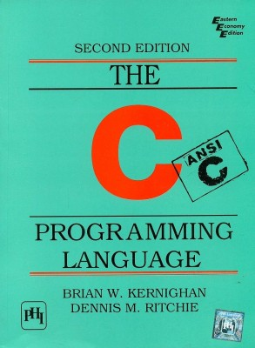

Slide 10
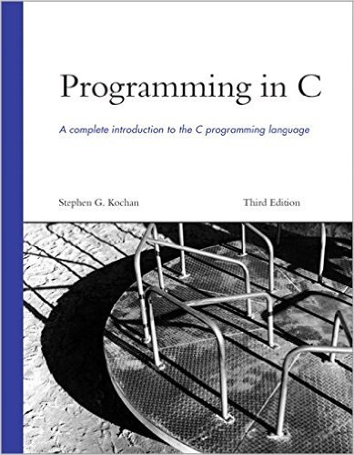

Slide 11
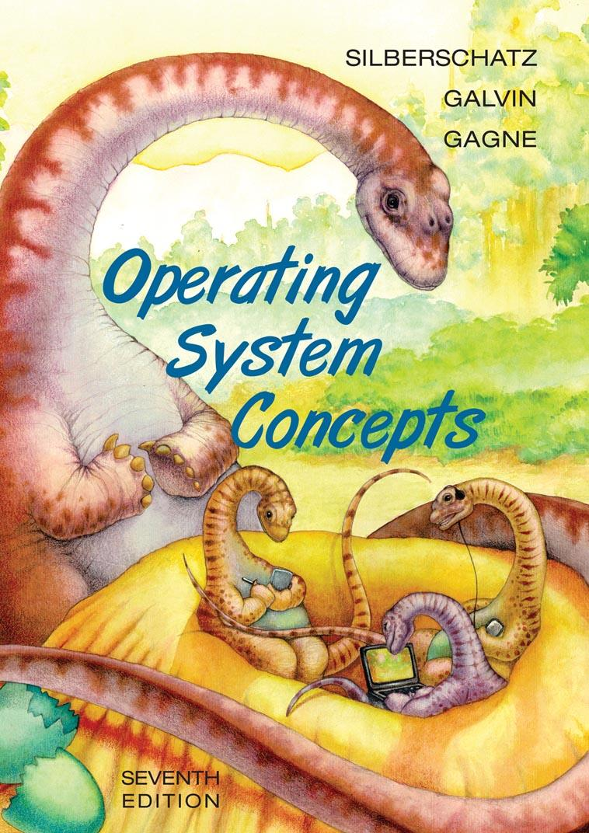

Slide 12
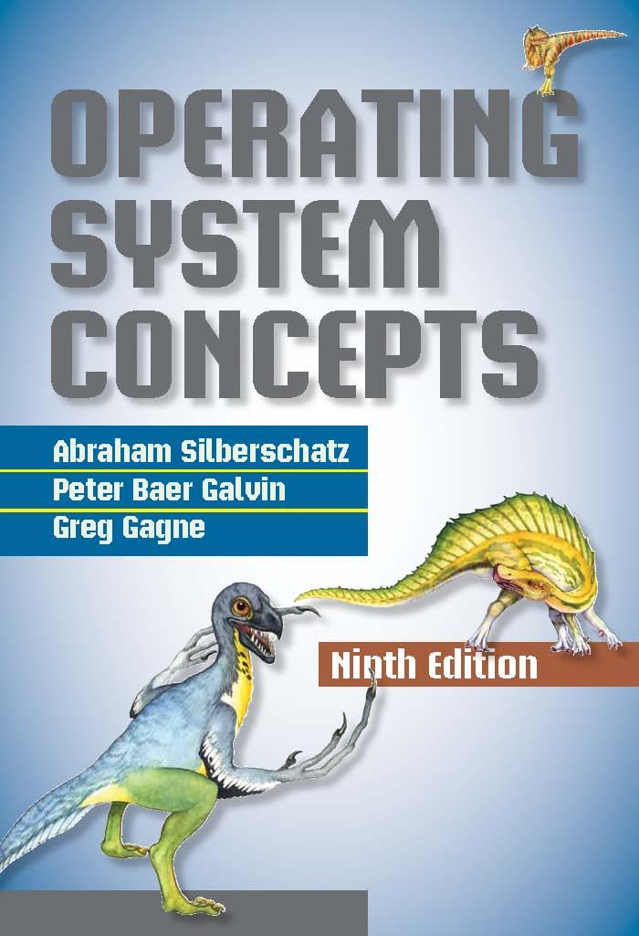

Slide 13
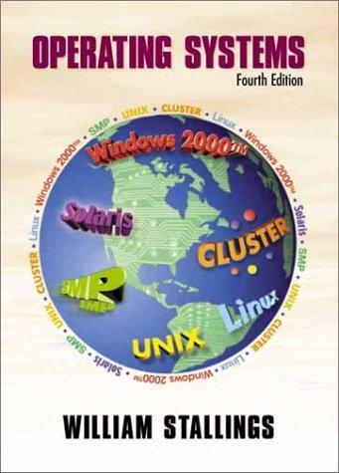

Slide 14
