Slide 1
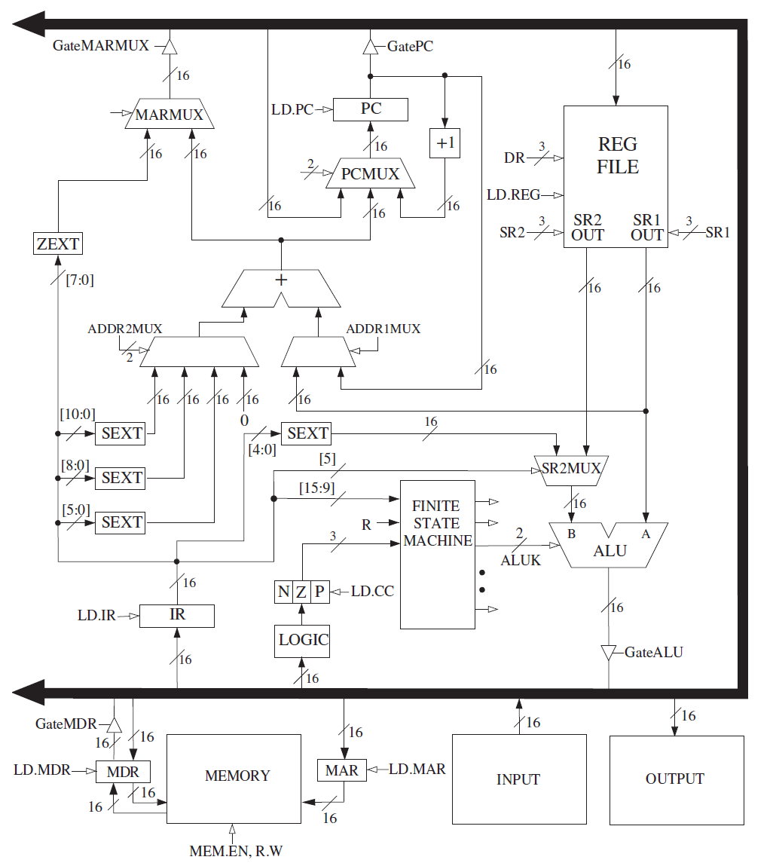

same
part
1 of 3

Slide 2
same
part
2 of 3
more than one clock

Slide 3
same
part
3 of 3

Slide 4



ADD
AND
NOT

Slide 5

ADDI
ANDI

Slide 6

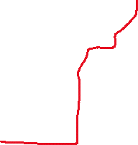


LEA

Slide 7

LD
1 of 3

Slide 8
LD
2 of 3
more than one clock

Slide 9

LD
3 of 3

Slide 10
LDI
1 of 5

Slide 11
LDI
2 of 5
more than one clock

Slide 12
LDI
3 of 5

Slide 13
LDI
4 of 5
more than one clock

Slide 14
LDI
5 of 5

Slide 15



LDR
1 of 3

Slide 16
LDR
2 of 3
more than one clock

Slide 17
LDR
3 of 3

Slide 18
ST
1 of 3

Slide 19
ST
2 of 3
ALUK=
passA

Slide 20
ST
3 of 3
more than one clock

Slide 21
STI
1 of 5

Slide 22
STI
2 of 5
more than one clock

Slide 23
STI
3 of 5

Slide 24
STI
4 of 5
ALUK=
passA

Slide 25
STI
5 of 5
more than one clock

Slide 26
STR
1 of 3

Slide 27
STR
2 of 3
ALUK=
passA

Slide 28
STR
3 of 3
more than one clock

Slide 29





BR

Slide 30



JMP
RET

Slide 31



JSR

Slide 32


JSRR

Slide 33

TRAP
部分

