Slide 1
玩转容器之docker实战
2018.12

Slide 2
三个实例来熟悉docker命令
坦克大战 -p
分布式selenium测试 -link
3D相册 -v

Slide 3
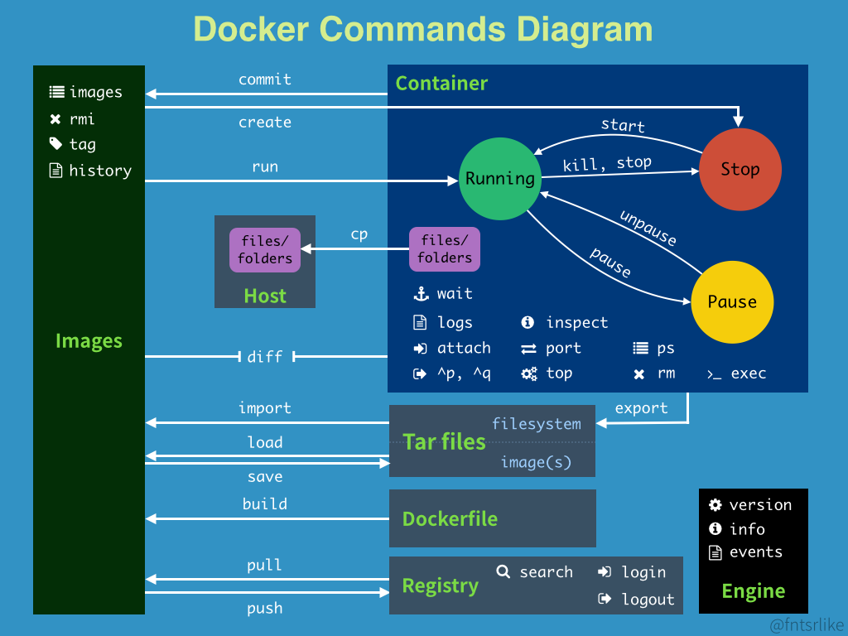
Docker 命 令
Notes:
docker ps
Docker images
Docker start/stop
Docker run

Slide 4


连接服务器
132.232.147.75
45.40.240.198
ssh root@132.232.147.75

Slide 5

坦克大战
docker run –name spring -d -p 8081:80 docker.io/springsoft/tank
http://132.232.147.75:8081/
http://45.40.240.198:8081/

Slide 6
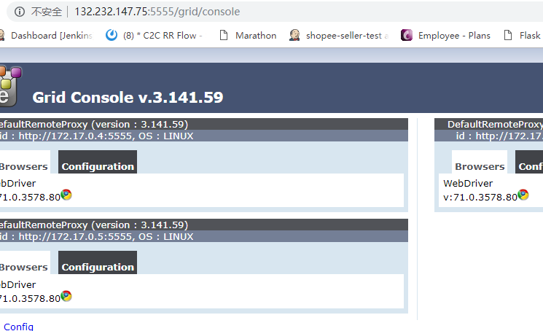
分布式selenium测试
容器：
docker run -d -p 5555:4444 --name selenium-hub-spring selenium/hub
docker run -d --link selenium-hub-spring:hub --name node1-spring selenium/node-chrome
http://XX.XX.XX.XX:5555/grid/console
Python:
Notes:
#coding=utf-8 from selenium import webdriver from time import sleep driver = webdriver.Remote( command_executor='http://132.232.147.75:5555/wd/hub', desired_capabilities={'browserName': 'chrome'} ) driver.get('http://www.baidu.com') print("get baidu") sleep(1) driver.find_element_by_id("kw").send_keys("hello world") print("click baidu") sleep(2) driver.find_element_by_id("su").click() sleep(2) print("picture baidu") driver.get_screenshot_as_file("./baidu_img.png") driver.quit() print("end...")

Slide 7

3D相册
改为自己的目录，以免重复
scp html1 root@132.232.147.75/root
docker run -p 81:80 -d -v /root/html1:/usr/share/nginx/html docker.io/nginx
http://xx.xx.xx.xx.:81/index.html

