Slide 1


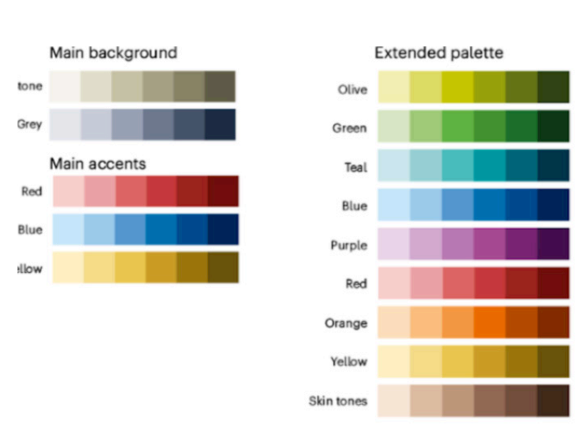







$$,…$$
$$N_{M}$$
$$G_{M}$$
$${G′}_{M}$$
Latent
Generator
Latent
Generator
Encode
Decode
Encode
Decode
$$N_{N}$$
$${G′}_{N}$$
$$G_{N}$$

Slide 2








$$ℳ_{1}$$
$$ℳ_{2},…$$
$$N_{M}$$
$$G_{M}$$
$${G′}_{M}$$
$$G_{N}$$
$${G′}_{N}$$
$$N_{N}$$

