Slide 1

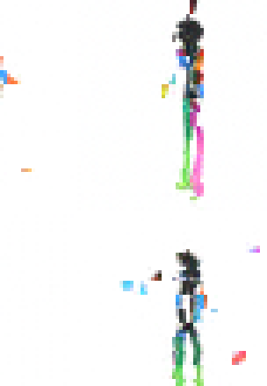
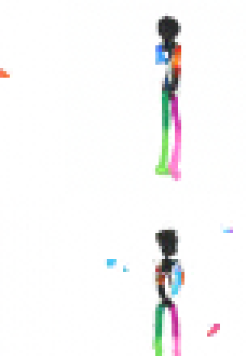
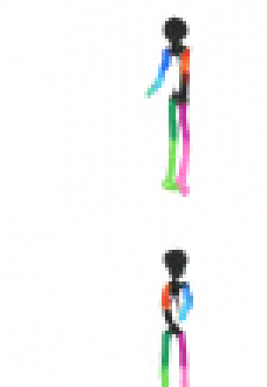
AN OPEN DATASET FOR LEARNING VIDEO DIFFUSION
DANCING STICK FIGURES
From noise to motion — four real checkpoints from the same model
1,000
2,000
3,000
4,000
TRAINING STEP
TRAINING STEP
TRAINING STEP
TRAINING STEP
ACTUAL CHECKPOINT SAMPLES · NO GENERATED COVER ART
Notes:
[Sources]
- /Users/jin/dev/dancing-stick-figure/paper/figs/img64_early_1k-4k.png — project-owned training checkpoint samples; cropped without generative modification.
[/Sources]

