Slide 1
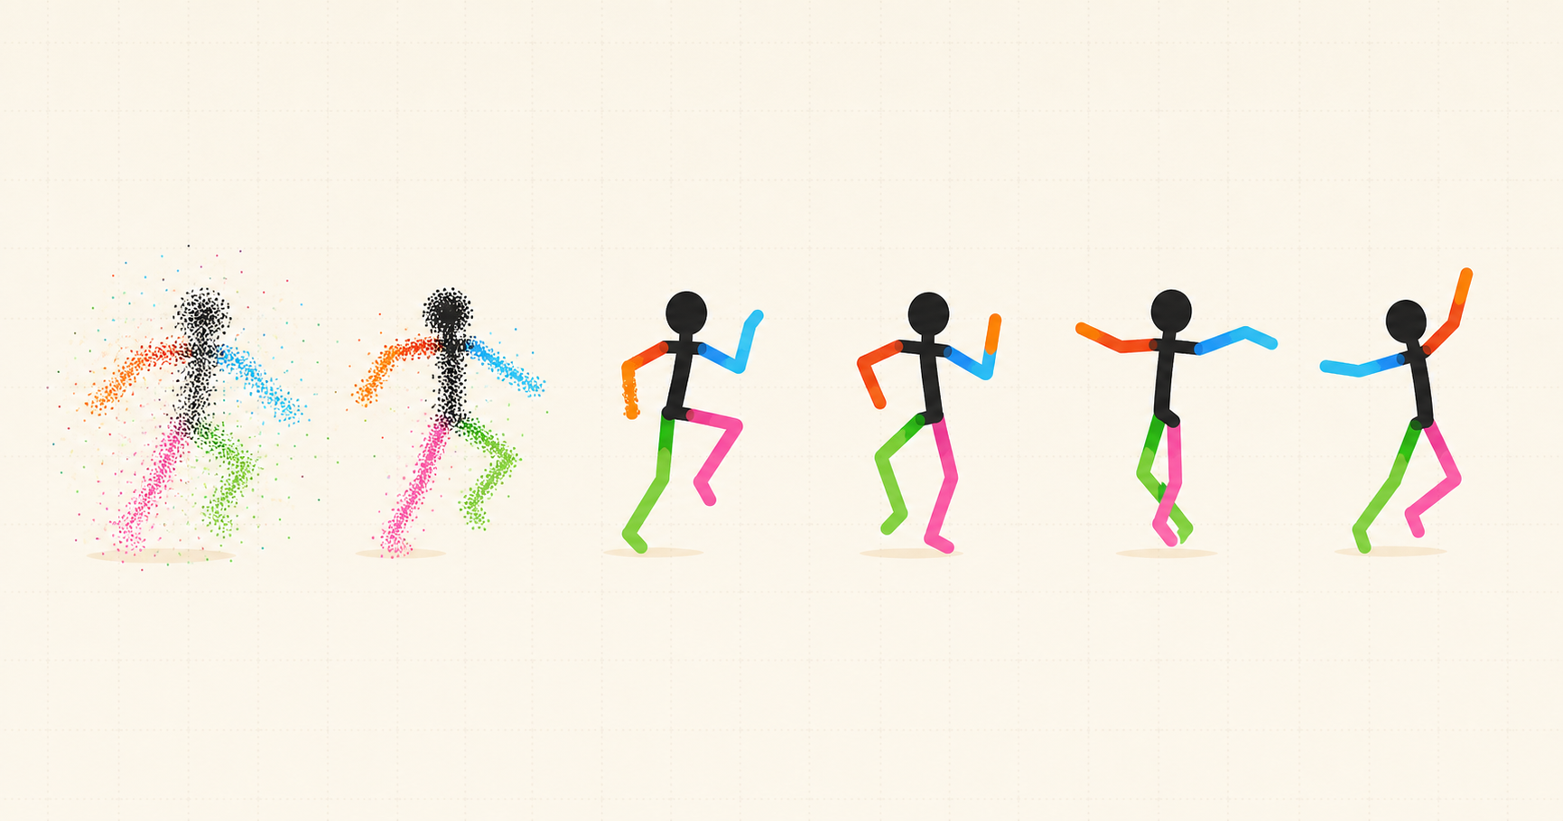
DANCING STICK FIGURES
Notes:
[Sources]
- AI-generated base illustration created earlier in this Codex task from the project's dataset contact sheet as a visual reference.
- Title text added as an editable PowerPoint element; no further image generation was used.
[/Sources]

