Slide 1
Numerical Linear Algebra & Parallel Computing
Sparse Matrices: PageRank Algorithm

Slide 2
Introduction
Motivation
Internet has become a ubiquitous source of information
Billions of web pages
Not all web pages are equally relevant or trustworthy
=> Need for ranking algorithms

Slide 3
Introduction
Ranking Algorithms
Need to rank items based on their importance
Used in various application:
Search Engines
Social Networks
E-commerce website
Recommender Systems
Not so easy task

Slide 4
Basic PageRank Algorithm
Ranking Algorithms
Need to rank items based on their importance
Used in various application:
Search Engines
Social Networks
E-commerce website
Recommender Systems
Not so easy task

Slide 5
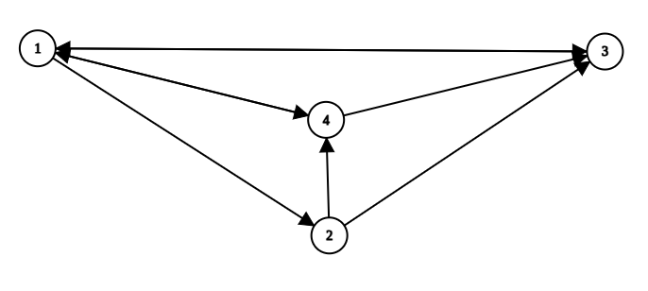
Basic PageRank Algorithm
PageRank vector
Example:

Slide 6
Basic PageRank Algorithm
PageRank vector
Linear Algebraic Interpretation:
THE $25,000,000,000 EIGENVECTOR THE LINEAR ALGEBRA BEHIND GOOGLE
Meaning:
represents the probability of a user visiting a particular web page randomly by clicking links on other web pages

Slide 7
Basic PageRank Algorithm
The Random Surfer Model
Describes the probability of a random user visiting a web page
Limitations

Slide 8
Basic PageRank Algorithm
The Random Surfer Model
Describes the probability of a random user visiting a web page
Limitations

Slide 9
Basic PageRank Algorithm
Markov chains
A mathematical model that describes a system that transitions between different states probabilistically.
the random surfer model can be represented as a Markov chain.

Slide 10
Basic PageRank Algorithm
Derivation of the Algorithm
Stationary distribution of a Markov chain.
the random surfer model can be represented as a Markov chain.
Derivation of the algorithm:
Exercise
Interpretation of the PageRank scores

Slide 11
Basic PageRank Algorithm
Analysis of the properties of the algorithm
the damping factor
the impact of the damping factor on the convergence of the PageRank algorithm
The impact of sparsity on the computation and accuracy of the PageRank algorithm for large web graphs
Spider traps
Dead ends

Slide 12

Basic PageRank Algorithm
New Reformulation

Slide 13
Basic PageRank Algorithm
The Disjoint-set data structure
Intuition
A tool to choose the damping factor.
The impact of sparsity on the computation and accuracy of the PageRank algorithm for large web graphs

Slide 14
Improving The PageRank Algorithm
The Personalized PageRank
Takes into account a user's preferences and browsing history when calculating PageRank scores.
The algorithm weights the links based on the user's interests and previous behavior
This improves the relevance of search results and recommendations for individual users

Slide 15
Improving The PageRank Algorithm
The Topic-Sensitive PageRank
takes into account the relevance of the content on the pages
introduces a topical vector that specifies the user's topic of interest

Slide 16
Implementation
Expected Format
Preprocessing and Parsing
Mapping to numbers
List of directed edges

Slide 17
Implementation
Storage
Sparse Matrices
Scipy Module

Slide 18
Implementation
Storage
Sparse Matrices
Scipy Module

Slide 19
Implementation
Implementation
Naïve Implementation
See pagerank.py

Slide 20
Implementation
Implementation
Naïve Implementation
See pagerank.py

