Slide 1
Project summary

Slide 2
JavaScript Learning
JavaScript Training
Overview
Studied JavaScript fundamentals to build a strong foundation for frontend web development.
Learned the core programming concepts required for developing dynamic and interactive web applications.
Gained an understanding of how JavaScript interacts with HTML, CSS, and browser elements to create responsive user interfaces.
Topics Covered
JavaScript Fundamentals
JavaScript Introduction
JavaScript Syntax
Variables and Data Types
JavaScript Output
JavaScript Operators

Slide 3
Programming Concepts
Conditional Statements (If, Else, Switch)
Loops and Iterations
Functions
Scope
Objects
Arrays
Strings
Numbers
Sets
Maps
Advanced JavaScript
Regular Expressions
Error Handling
Modern JavaScript (ES6)

Slide 4
React.js Learning
Overview
Learned React.js to understand modern frontend application development.
Studied component-based architecture for building scalable and reusable user interfaces.
Gained practical knowledge of React fundamentals required for enterprise web applications.
Topics Covered
React Fundamentals
React Introduction
Project Setup
First React Application
Rendering HTML
React Upgrade
ES6 Features

Slide 5
JSX
JSX Introduction
JSX Expressions
JSX Attributes
Conditional Rendering
Component Architecture
React Components
Class Components
Functional Components
Component Reusability
Props
Props
Props Destructuring
Props Children

Slide 6
React Hooks
useState
useEffect
useContext
useRef
useReducer
use Callback
useMemo
Custom Hooks

Slide 7
Overall Learning Outcome
Frontend Development Skills
Built a foundation in React.js.
Learned reusable component development.
Understood state and props management.
Learned modern UI development practices.
Technical Understanding
JavaScript Programming
React.js Framework
Component-Based Architecture
JSX
React Hooks
State Management
Event Handling
Dynamic UI Rendering
Outcome
Developed a strong foundation in JavaScript and React.js required for working on frontend web applications.
Gained the necessary knowledge to understand, modify, and contribute to React-based enterprise projects.

Slide 8
Industry 4.0 (NIRMAN)
Project Overview:
NIRMAN (Next-gen Intelligent Realtime Manufacturing Automation Network) is a centralized web-based Manufacturing automation system for managing and monitoring the complete product development lifecycle.
Eliminates manual process tracking by maintaining structured digital records and workflow management.
Provides role-based access to ensure controlled system usage based on user responsibilities.
Assigns a unique Product ID to every product for complete lifecycle tracking and traceability.
Enables centralized monitoring of product progress, task allocation, documentation, and quality verification.
Improves accountability, process consistency, visibility, and operational efficiency across the entire workflow.
Problem Statement:
Modern product development involves multiple stages, users, approvals, and documentation, making manual process management increasingly difficult. As the complexity of the development process grows, organizations face challenges in maintaining workflow consistency, tracking product progress, coordinating multiple users, and ensuring proper documentation at every stage.
Objective:
Automate and simplify the complete product development process.
Manage products through predefined sequential stages.
Ensure every stage is completed and validated before moving to the next stage.

Slide 9
Maintain centralized digital documentation throughout the product lifecycle.
Support secure role-based operations and controlled user access.
Improve product traceability and progress monitoring.
Strengthen quality assurance through qualification and verification mechanisms. Pasted markdown
User Roles & Responsibilities:
Administrator
Manages the overall workflow and initial project setup.
Creates and allocates products for processing.
Organizes work distribution across different stages.
Assigns resources and coordinates the overall development process.
Internal Supervisor
Assigns stage-specific tasks to operators.
Coordinates task distribution among multiple users.
Monitors task allocation and stage completion.
Ensures smooth workflow progression between stages.

Slide 10
Operator
Executes assigned stage-specific tasks.
Accesses only authorized tasks through role-based login.
Updates task status and submits required digital forms.
Records completion details before progressing to the next stage.
Quality Manager
Monitors operator qualifications and certification validity.
Verifies operator eligibility before task assignment.
Ensures compliance with quality and competency requirements.
Supports quality assurance throughout the development process.
External Supervisor
Performs final verification of completed products.
Reviews completed work against defined standards.
Approves products or recommends corrective actions.
Provides an additional level of quality validation before completion.

Slide 11
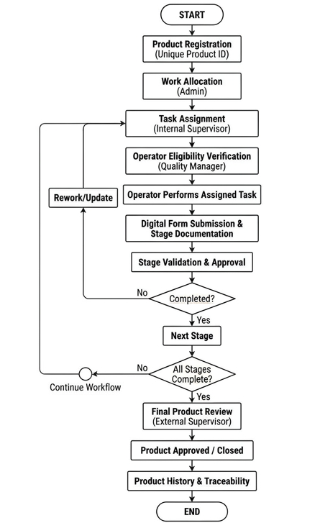
WORKFLOW:

Slide 12
Conclusion:
The project provides a centralized platform for managing the complete product development lifecycle through a structured, stage-wise workflow.
It improves process organization by integrating role-based access, task allocation, digital documentation, and product traceability into a single system.
The application ensures controlled workflow execution, enhances accountability, and supports quality assurance through systematic validation and monitoring.
Overall, the system simplifies the management of complex multi-stage development processes while improving efficiency, transparency, and record maintenance.
Learning:
Role-Based Access Control (RBAC) and permission hierarchy.
Stage-wise workflow management and sequential processing.
Product lifecycle management and traceability using unique Product IDs.
Task allocation, progress monitoring, and digital documentation.
How multiple user roles collaborate within a centralized application.
Technologies Used:
Frontend: React.js
Backend: Node.js, FastAPI
Database: PostgreSQL
Core Concepts: Workflow Management, Product Traceability, Digital Documentation, Quality Monitoring

Slide 13
Industry 4.0 (GR TO UD)
Overview:
Aim: Automate GR to UD cycle by eliminating manual interventions such as PDF, inspection data, rejection tracking.
Problems:
Manual PDF upload.
Paper-based verification.
Manual GR & UD.
Lengthy inspection cycles.
Manual tracking of rejected materials.
Objectives:
Reduce manual effort.
Improve operational accuracy & reduce data errors.
Enable real-time tracking.
Introduce end-to-end traceability.
Accelerate approval, info & decision boosting in SAP.

Slide 14
Scope:
Automate PDF.
Validate extracted PO.
Generate unique QR and barcode.
Automate GR posting using QR and barcode.
Capture inspection acceptance/rejection through the system.
Auto post UD decision in SAP.
Provide dashboard for monitoring & reports.
Users/Stakeholders:
IG Store
Responsibilities
Receives incoming products from the Security Department.
Generates the Goods Receipt (GR) for every received product.
Records essential product information such as Product ID, Serial Number, and other identification details.
Generates and attaches QR Code and Barcode labels for product identification and traceability.
Forwards the product to the appropriate Inspector for quality inspection.

Slide 15
Material Inspector
Responsibilities
Inspects products assigned based on the product's serial number.
Performs inspection according to predefined inspection guidelines.
Records inspection details in a digital inspection datasheet.
Verifies product measurements using appropriate measuring instruments.
Ensures all measurements fall within the specified tolerance limits.
Approves the product for further processing if inspection is successful if doubtful forwards to Indenter.
Subcontract Inspector
Responsibilities
Inspects products received from subcontract vendors.
Performs inspection using the same quality guidelines and inspection standards.
Records inspection observations and measurement values.
Validates whether the product satisfies the required tolerance specifications.
Approves products that satisfy inspection criteria or forwards doubtful cases to Indenter for further review.

Slide 16
Indenter
Responsibilities
Acts as the person who originally placed the purchase order.
Reviews products that require clarification after inspection.
Examines the inspector's report and inspection findings.
Decides whether the product should continue for approval or be rejected.
Places products in a Waiting state until the final usage decision is made.
Approver
Responsibilities
Performs the final evaluation of the product.
Reviews inspection reports and the Indentor's recommendation.
Makes the final Usage Decision (UD).
Approves products for further departmental use or rejects them based on the inspection outcome.
Completes the GR to UD process.

Slide 17
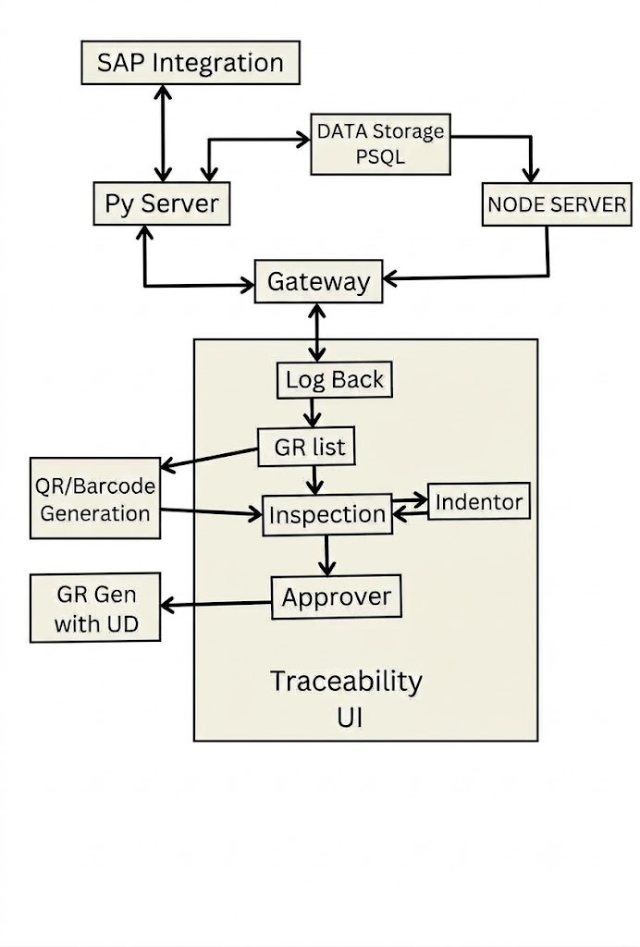
Workflow:

Slide 18
PDM(Predictive maintenance)
Project Overview:
Predictive Maintenance (PdM) is an intelligent monitoring system designed to continuously collect, store, visualize, and analyze sensor data from industrial components.
The project focuses on monitoring the health and operational status of multiple equipment components using real-time sensor data.
It enables early identification of abnormal operating conditions before equipment failure occurs.
Data is collected continuously through UDP communication, processed using a real-time data pipeline, and stored in specialized databases for monitoring and prediction.
Machine Learning models analyze historical sensor readings to predict potential failures and support maintenance planning.
The system combines real-time monitoring, historical data analysis, visualization dashboards, and AI-based prediction into a single platform.
Problem Statement:
Industrial equipment often operates continuously, making manual monitoring difficult and inefficient. Traditional maintenance approaches either perform maintenance after equipment failure or follow fixed maintenance schedules, resulting in unnecessary downtime, increased maintenance costs, and unexpected equipment failures.

Slide 19
Objective
Continuously acquire sensor data from industrial equipment using UDP communication.
Store real-time sensor readings efficiently for monitoring and analysis.
Visualize live and historical sensor data through interactive dashboards.
Detect abnormal operating conditions using sensor thresholds.
Predict equipment health using Machine Learning models.
Reduce unexpected equipment failures through predictive maintenance.
Support data-driven maintenance planning and decision making.
Components Monitored:
CWCM76/A190
CPU/Board-based component.
Monitored using temperature sensor readings.
Operating Levels:
  Low : ≤ 40°C
  Medium : 45–60°C
  High : ≥ 100°C

Slide 20
CWCMP&SP
CPU/Board-based component.
Temperature-based health monitoring.
Uses predefined threshold values to determine operating condition.
Temperature Ranges:
  Low : ≤ 40°C
  Medium : 45–60°C
  High : ≥ 100°C
RADAR
Industrial electronic component.
Continuously monitored through sensor readings.
Health status determined using collected operational parameters.
SERVO
Industrial electronic component.
Included in continuous condition monitoring.
Sensor values contribute to predictive analysis.

Slide 21
MOTOR
Motor component.
Monitored using Three-Phase Current measurements.
Current imbalance or abnormal current patterns may indicate overload, electrical faults, or motor degradation.
Sensor data is used to assess motor health and support predictive maintenance.
Technology Stack:
Frontend
Dash Framework
React.js
Backend
Dash Framework
Node.js
Databases
InfluxDB (Time-Series Database)
PostgreSQL

Slide 22
Data Handling
UDP Sender & Receiver
Redis
CSV Files
Machine Learning
LSTM
Random Forest
Conclusion:
The Predictive Maintenance system integrates real-time data acquisition, visualization, database management, and Machine Learning into a unified monitoring platform.
It enables continuous equipment health monitoring through live sensor data and historical trend analysis.
By combining intelligent prediction models with real-time dashboards, the system supports proactive maintenance planning, reduces unexpected failures, and improves equipment reliability.
The project demonstrates how modern industrial applications leverage IoT communication, time-series databases, and AI to enhance maintenance efficiency.

Slide 23
Learning:
Through studying this project, I gained an understanding of:
Predictive Maintenance concepts and industrial monitoring systems.
Application development using React.js and Node.js.
Database integration using PostgreSQL.
Machine Learning-based prediction using LSTM and Random Forest.
Industrial equipment health monitoring using temperature and motor current analysis.
End-to-end data flow from sensor acquisition to predictive analytics.

Slide 24
MROT (Maintenance Repair Operation Training)
Project Overview:
Centralized web-based system for maintenance, repair, operation and training support of naval equipment.
Four modules: Repair, Training, Operation and Maintenance.
Defect logs, periodic tasks, spares and equipment data are stored in the MROT_EON database.
Role-based access for maintainers, operators, supervisors, officers and administrators.
Ship-wise data (e.g. NGOPV) is loaded by bulk upload; MROT is connected to the PMS (cabinet).
Problem Statement:
Supporting complex naval systems means tracking defects, scheduling periodic maintenance, managing spares and keeping crews trained, across many users and ships. Defect records are scattered, weekly and monthly tasks can be missed, and manuals, PDFs and videos are hard to find.
Objective:
Bring repair, training, operation and maintenance into one platform.
Log defects and guide troubleshooting.
Schedule weekly and monthly maintenance tasks.
Search manuals, PDFs and videos with advanced search.
Test operators with MCQ-based training.
Control access by role, with admin privileges.

Slide 25
System Modules:
Repair
Defect logs and troubleshooting.
BIT reported defects (BD).
Functional defects (PD).
Training
MCQ assessments.
Operator learning (O&T).
Operation
How the system works.
Block diagrams, PDFs and videos.
Maintenance
Weekly and monthly periodic tasks.
SSB (System Structure Breakdown), SI (External system interface) and PM (Periodic maintenance).
Spares and equipment; advanced search.

Slide 26
User Roles & Responsibilities:
Maintainer (Access: MROT)
Performs weekly and monthly maintenance tasks.
Logs and troubleshoots defects.
Checks spares and equipment details.
Operator (Access: O&T)
Learns how the system works.
Takes MCQ-based training.
Uses the Operation module day to day.
Supervisor (Access: MROT)
Monitors maintenance tasks.
Tracks defect status.
Reviews work done by maintainers.

Slide 27
Officer (Access: MROT + admin privileges)
Oversees maintenance and repair status.
Reviews defect logs and reports.
Has admin privileges on top of MROT access.
Administrator (Access: MROT + admin privileges)
Manages users and their roles.
Configures the database and ship data.
Has full control of the system.
Each login in the Users table (e.g. Navy Officer) is mapped to a system role (System Officer). MROT is connected to the PMS (cabinet).

Slide 28
System Architecture:
Python Server
Advanced search, annotation and feedback
Client (Frontend)
React build file
Node Server
PDFs, videos and database linking
PostgreSQL
MROT_EON
Third-party Server
Block diagrams and defects
Frontend ships as a build file only. Backend = Node, Python and third-party servers.

Slide 29
Setup and Data Workflow:
Install software: Node.js, PostgreSQL (pgAdmin), VS Code, Python 3.12.
Configure database: Point db.config.js to the MROT_EON database.
Upload data: Bulk upload ship data (NGOPV); F6 saves to DB tables.
Link the client: Link the React build to EON-51, INS-NGOPV via data config.
Run servers: Start the Node and Python servers, then open the web client.

Slide 30
Conclusion:
MROT gives one centralized platform for repair, training, operation and maintenance.
Role-based access gives each user the right tools and level of control.
Defect logs, periodic tasks, spares and documents in one database improve traceability.
Overall, it speeds up troubleshooting, simplifies maintenance and keeps crews trained.
Technologies Used:
Frontend: React.js (build file)
Backend: Node.js, Python
Database: PostgreSQL (pgAdmin)
Tools: VS Code, Python 3.12
Core Concepts: RBAC, defect logs, periodic maintenance, advanced search

Slide 31
Marketing Portal
Project Overview:
Web-based portal to manage marketing leads through six stages, from lead enquiry to order received.
Every lead is stored as one row in the leads table, identified by lead_reference_no.
6 forms for data entry and 8 dashboards for marketing analysis.
Every module has three tabs: form submission, view / table and bulk upload.
Three actors use the portal: Admin, Executive and Operator.
Problem Statement:
Marketing teams handle many leads at once, each moving through quotations, tenders, bids and orders, with many details at every stage. Lead details are scattered, the current stage of a lead is not always clear, updating records is error-prone, and management lacks a single view of the pipeline.
Objective:
Capture every lead and check whether it is valid.
Track each lead through six defined stages and keep its stage history.
Support form entry and bulk upload for fast data loading.
Update records safely using a unique key.
Give management dashboards for pipeline and analysis.

Slide 32
Lead Lifecycle (6 Stages):
1. Lead Enquiry
2. Budgetary Quotation
3. Tender
4. Bidding
5. Order Acquisition
6. Order Received
Start with a new lead: capture the enquiry and lead information.
Check: is the lead valid?
If valid, prepare a price estimate as a budgetary quotation.
Then continue through tender, bidding, order acquisition and order received.

Slide 33
Module Structure:
Every module has 3 tabs: form submission, view / table and bulk upload.
Form submission has multiple sections, with 4 major ones.
A unique key is used to update existing data; the first table uses the primary key (PK).
Dashboards (8):
Domestic, Export, Overview, Analysis, Pipeline, Monthly, Yearly and Radar.
Forms (6):
Leads, Budgetary Quotation, Tender, Bid, Order Acquisition and Order Received.

Slide 34
User Roles & Responsibilities:
Admin (Access: All)
Full access to every dashboard, form and tool.
Manages the portal overall.
Executive (Access: Dashboards)
Views dashboards in the lead tabs.
Monitors pipeline and analysis.
Operator (Access: All 6 forms)
Enters data through all 6 forms.
Uses bulk upload tools.

Slide 35
Data Model:
leads (one row per lead)
lead_reference_no (PK)
Quotation details
Tender details
Bidding details
Order acquisition details
Order received details
Stage history
Supporting data:
Partners, competitors, corrigenda and milestones.

Slide 36
Conclusion:
The Marketing Portal manages every lead in one place, from enquiry to order received.
Three tabs per module make data entry, viewing and bulk upload simple.
Eight dashboards give management a clear view of the pipeline.
Role-based access and a unique key keep the data controlled and consistent.

