Slide 1




Project
Project Guide
Mr. Sunil Kumar
Cricket WC -
Team Selection.
Presented by Group 5 (PG-DBDA)
Dhawal Dattani
Mohd Yusuf
Sudhanshu Prajapati

Slide 2
TABLE OF CONTENTS
Introduction
Data Flow Diagram
Problem Statement
Activity Flow
Scope of Project
Final Output
Technology Used
Conclusion
Future Application
References

Slide 3
INTRODUCTION
In the dynamic world of international cricket, team selection for major events like the Cricket World Cup is crucial. It's akin to assembling a puzzle, requiring strategic planning, player analysis, and understanding team dynamics. The World Cup is cricket's pinnacle tournament, making team composition vital. Evaluating players' batting and bowling skills is essential, aiming for a well-rounded team. The goal is to create a cohesive unit, like a finely-tuned machine, for peak performance on the global stage. This task begins with selecting the right players, a process of utmost importance in achieving success

Slide 4
PROBLEM STATEMENT
The problem entails selecting the optimal Cricket World Cup playing eleven using data from ESPNCricinfo. Employing web scraping, Pandas for data cleaning, Power BI for visualization, and emphasizing Cricket Development, the objective is to strategically compose the team, accounting for athlete performance and conducting comparative analysis for competitive advantage.

Slide 5

SCOPE OF WORK
The Cricket World Cup team selection process is greatly aided by technology, including Python for web scraping, Pandas and MS Excel for data cleaning, and Power BI for visualization.
Python efficiently gathers extensive player performance data from various sources, which is then meticulously cleaned and organized with Pandas and MS Excel for reliable insights.
Power BI helps visualize data trends, allowing informed decisions on player selection, ensuring a strategically tailored squad for effective game plans and contingencies.
These technological tools enhance the selection process, leading to a competitive team vying for the World Cup title.

Slide 6

TECHNOLOGY USED
Web Scraping – Python & Bright Data
Data Manipulation - Python Pandas & MS Excel
Data Visualization - Power BI

Slide 7
APPLICATION
Sports Analytics Advancement:
The methodology can be extended to analyze player performance in various sports, aiding team selection, talent identification, and strategic decision-making using data-driven insights.
Player Development Strategies:
Implement findings to design personalized training regimens, address weaknesses, and enhance athletes' skills, promoting data-backed development and maximizing potential.
Tournament Performance Optimization:
Apply the approach to analyze opponents' strengths and weaknesses, enabling tailored strategies for upcoming tournaments, leading to better team performance and success.

Slide 8
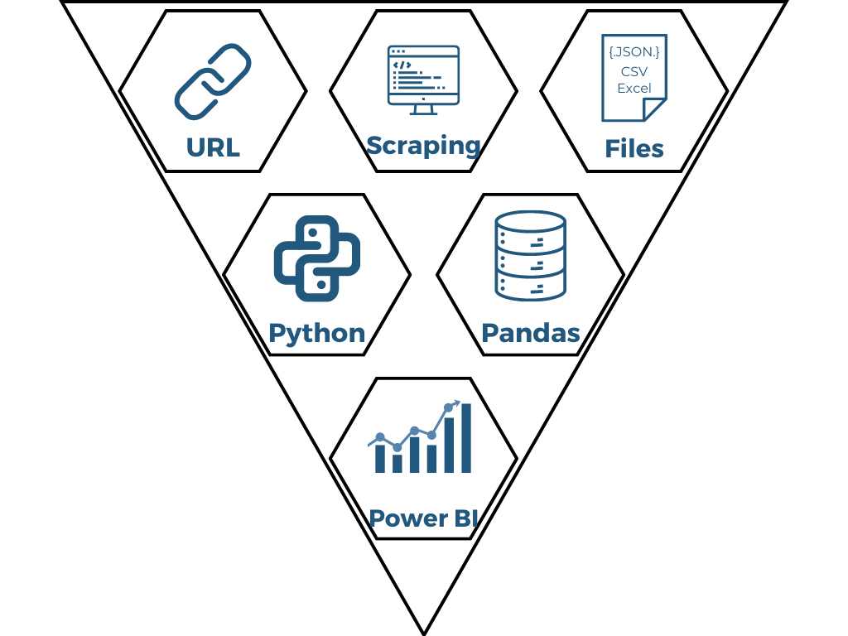
DATA FLOW DIAGRAM

Slide 9
1
Data Exploration
ESPNCricinfo
2
Web Scraping
Python
3
Data Cleaning
Python Pandas
Bright Data
MS Excel
4
Dashboard/Visualization
Power BI
ACTIVITY
FLOW

Slide 10
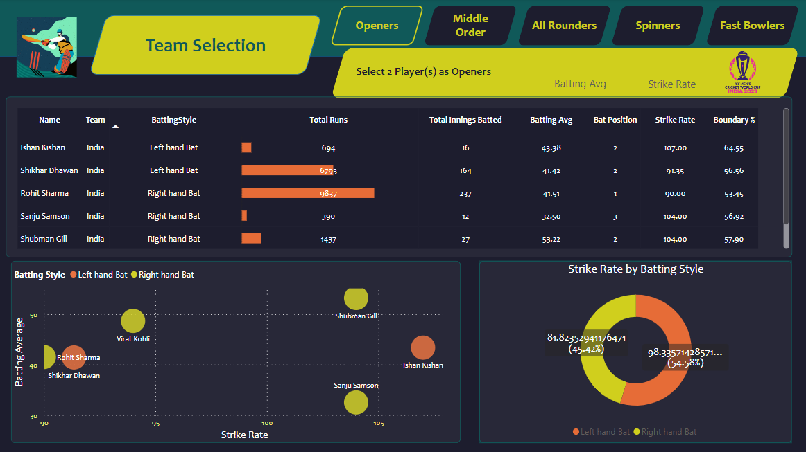
FINAL OUTPUT

Slide 11
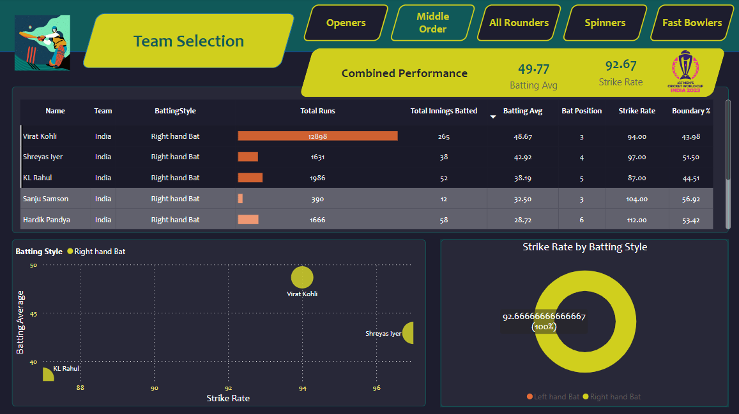
FINAL OUTPUT

Slide 12
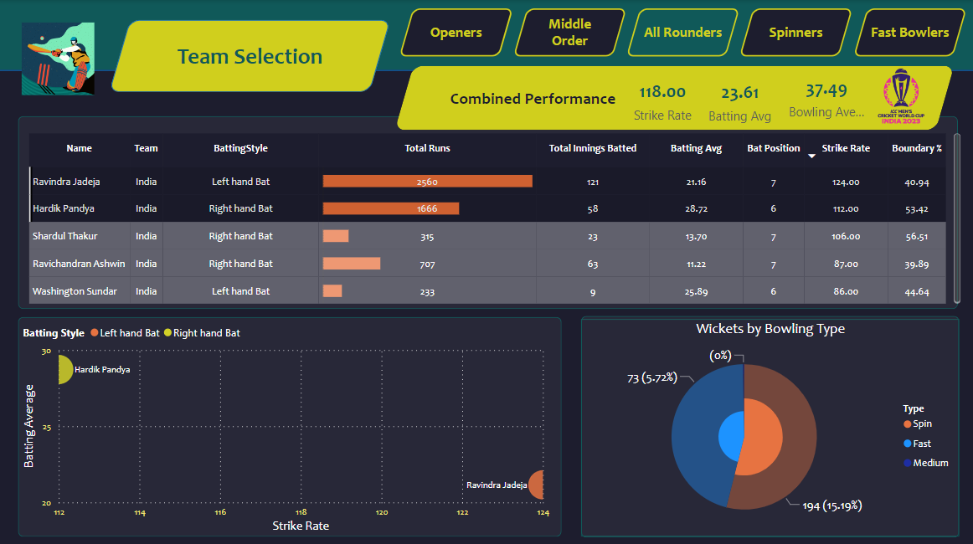
FINAL OUTPUT

Slide 13
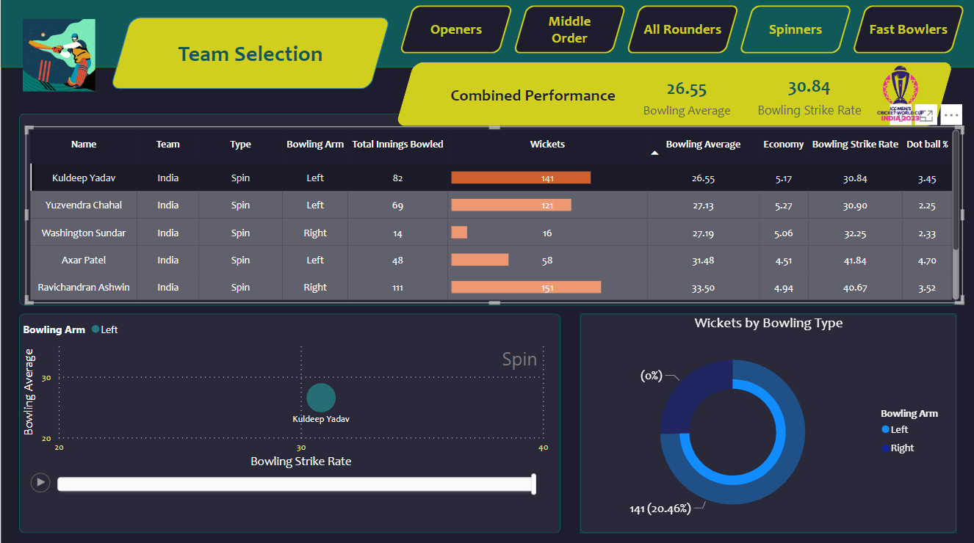
FINAL OUTPUT

Slide 14
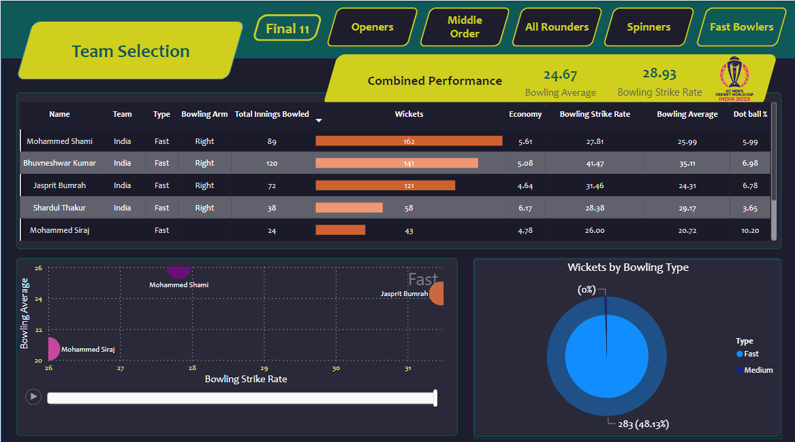
FINAL OUTPUT

Slide 15
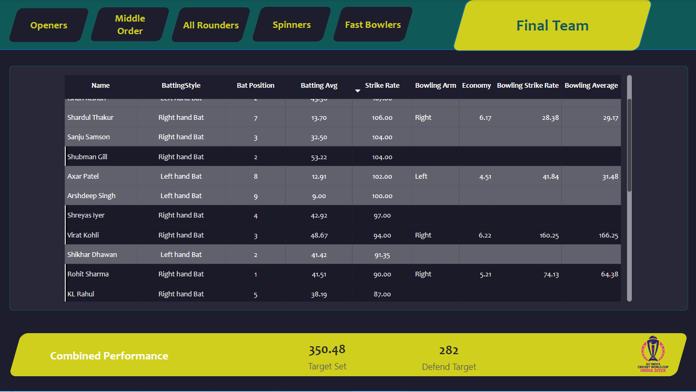
FINAL OUTPUT

Slide 16
CONCLUSION
The "Cricket WC – Team Selection" combines data and cricket expertise to create strong teams. It looks at player stats and past performances to balance batting and bowling skills. Hence get clear insights for smart selections, aiming to increase the chance of winning the World Cup. This tool introduces a fresh approach to team formation that could reshape cricket strategies.

Slide 17
REFERENCES
ESPNCricinfo
Google Images
Python - Data Wrangling with Python – Tips and Tools to Make Your Life Easier by Jacqueline Kazil, Katharine Jarmul
Web Scraping –GeekforGeeks
Power BI - YouTube
Pandas - TowardsDataScience
Literature Research -
Player selection in cricket based on similarity of playing conditions by Walid Mohammad, Sadia Sharmin (May 2020)
Intelligent Cricket Team Selection by Predicting Individual Players’ Performance using Efficient Machine Learning Technique by Chetan Kapadiya, Ankit Shah, Kinjal Adhvaryu, Pratik Barot (February 2020)
Selection of Indian Cricket Team in ODI using Integer Optimization by Prachi Agrawal, Talari Ganesh (December 2019)

Slide 18
THANK YOU

