Slide 1
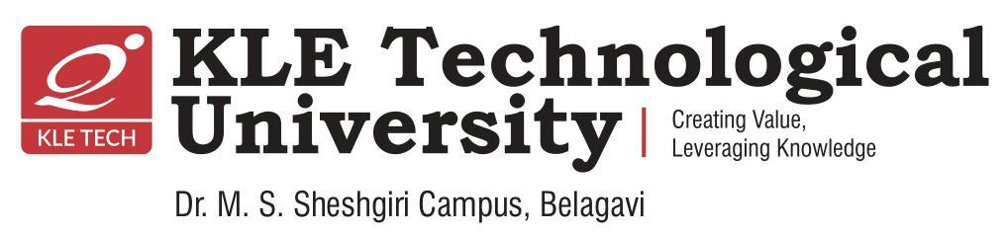
  AI-Based Surgical Suturing Assessment Using Deep Learning
NAME | ROLL NO | USN
ADITYA DESHPANDE | 34 | 02FE23BCI035
SHRUSTI HULBUTTE | 33 | 02FE23BCI034
BHAGYAVATHI SHETTY | 22 | 02FE23BCI023
KRISHNA PATEL | 07 | 02FE23BCI006
Under the guidance of : Prof. Salma Shahapur
DEPARTMENT OF COMPUTER SCIENCE & ARTIFICAL INTELLIGENCE ENGINEERING
Course Code : 25ECAC306 Academic year 2025 - 26
Department of Computer Science and Engineering (Artificial Intelligence)
KLE Technological University’s Dr. M. S. Sheshgiri College of Engineering and Technology, Belagavi
1/14

Slide 2
Table of content
Introduction
Problem Statement
Objectives
Literature Survey
Methodology
Method Used
Training Details
Results
Performance Analysis
Application
Conclusion
Future Scope
References
Department of Computer Science and Engineering (Artificial Intelligence)
KLE Technological University’s Dr. M. S. Sheshgiri College of Engineering and Technology, Belagavi
2/14

Slide 3
Introduction
Suturing quality directly impacts wound healing and tissue approximation.
Traditional assessment relies on expert observation.
Manual evaluation is subjective and time-consuming.
AI and Computer Vision enable objective assessment.
YOLOv8 is used to detect surgical landmarks.
Detected landmarks are analyzed for bite size and consistency.
Department of Computer Science and Engineering (Artificial Intelligence)
KLE Technological University’s Dr. M. S. Sheshgiri College of Engineering and Technology, Belagavi
2/14

Slide 4
Problem Statement
Manual suturing assessment lacks consistency.
Expert evaluation is time-intensive.
Measuring stitch quality is difficult in practice.
Surgical videos contain varying lighting and viewpoints.
Automated assessment is needed for objective evaluation.
AI can provide repeatable and quantitative feedback.

Slide 5
Objective
To design an AI-based system for automated surgical suturing assessment.
To implement frame extraction and annotation techniques for surgical video
analysis.
To build a YOLOv8-based deep learning model for detecting suturing regions.
To develop an objective and efficient framework for assisting surgical skill
evaluation.

Slide 6
Literature Survey
Paper Title | Methodology / Implementation | Dataset Description | Performance Parameters | Gap Identified
Mansour et al. – Deep Learning-Based Evaluation of Suture Images | CNN-based framework for automated suture assessment | Surgical suture image dataset | ~95% Accuracy | Focused only on image classification; no quantitative suturing metrics
Tao et al. – Sparse Hidden Markov Models for Surgical Skill Classification | Hidden Markov Models (HMM) for gesture recognition | Surgical gesture datasets | High classification performance | No landmark detection or spacing analysis
Hu et al. – Real-Time Surgical Skill Assessment | Temporal ML and Deep Learning models | JIGSAWS dataset | Real-time skill prediction | Requires temporal data; no suturing parameter estimation
Zia et al. – Robotic Surgery Skill Assessment | Machine Learning-based assessment framework | Robotic MIS dataset | Accurate skill classification | Focused on robotic surgery only

Slide 7
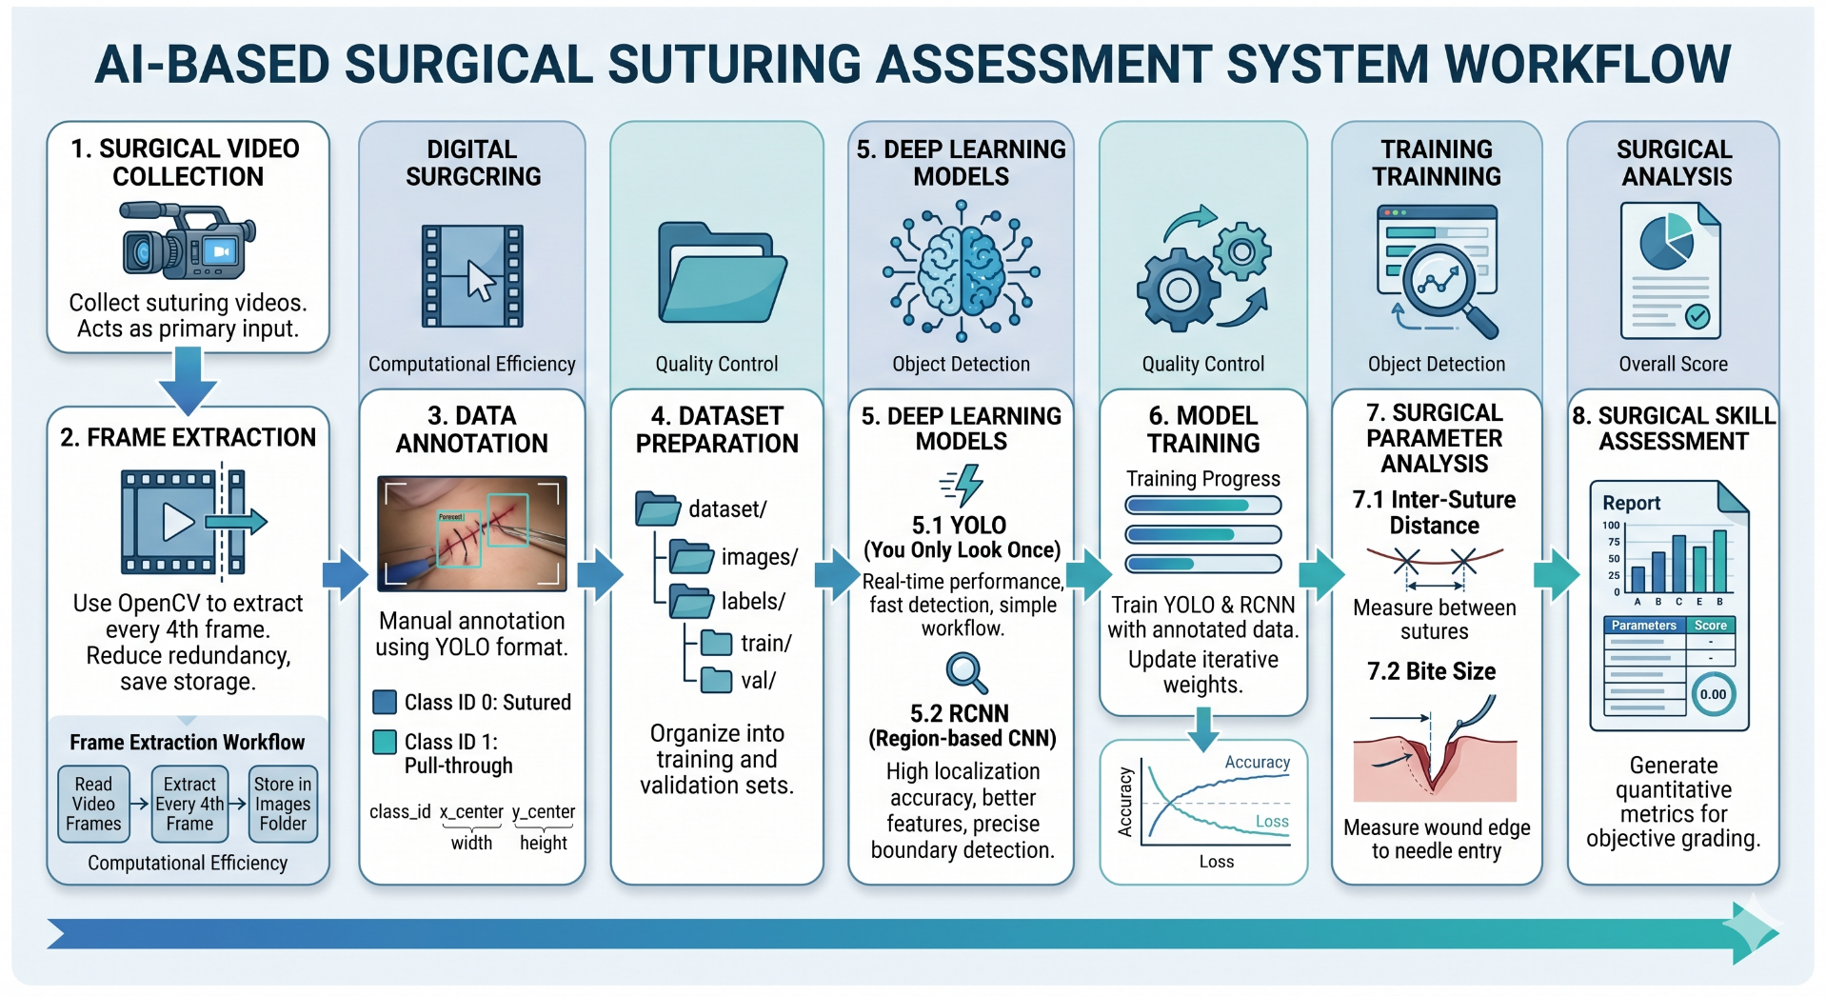
Methodology

Slide 8
Models Used
YOLOv8n selected for lightweight deployment.
Single-stage object detector.
High accuracy and fast inference.
Detects Sutured and Pull-Through landmarks.
Generates bounding box coordinates.
Coordinates used for metric computation.

Slide 9
Training Details
Model: YOLOv8n
Framework: PyTorch + Ultralytics
Classes: 2
Image Size: 640 × 640
Epochs: 50
Platform: Kaggle GPU
Metrics Used
Precision
Recall
F1 Score
mAP@0.5

Slide 10
Results
Successfully detected surgical landmarks using YOLOv8n.
Achieved 98.3% mAP@0.5 and 97% F1 Score.
Performed automated bite-size measurement from detected landmarks.
Enabled objective and quantitative assessment of suturing performance.
Reduced dependence on manual observation and evaluation.

Slide 11
Performance Analysis
Training and validation losses decreased steadily.
Model achieved stable convergence.
High precision and recall observed.
Very few false detections.
Strong generalization across surgical videos.
Suitable for automated skill assessment.

Slide 12
Applications
Automated surgical skill assessment in medical training institutes.
Real-time analysis of surgical suturing performance from videos.
Intelligent feedback systems for surgical trainees and students.
Computer-assisted evaluation in robotic and minimally invasive surgery.
Healthcare research and development using AI-based surgical analysis systems.

Slide 13
Conclusion
Developed an AI-based suturing assessment framework.
YOLOv8 successfully detected surgical landmarks.
Achieved 98.3% mAP@0.5 and 97% F1 Score.
Automated bite-size estimation performed.
Reduced dependence on manual evaluation.
Supports objective surgical training.

Slide 14
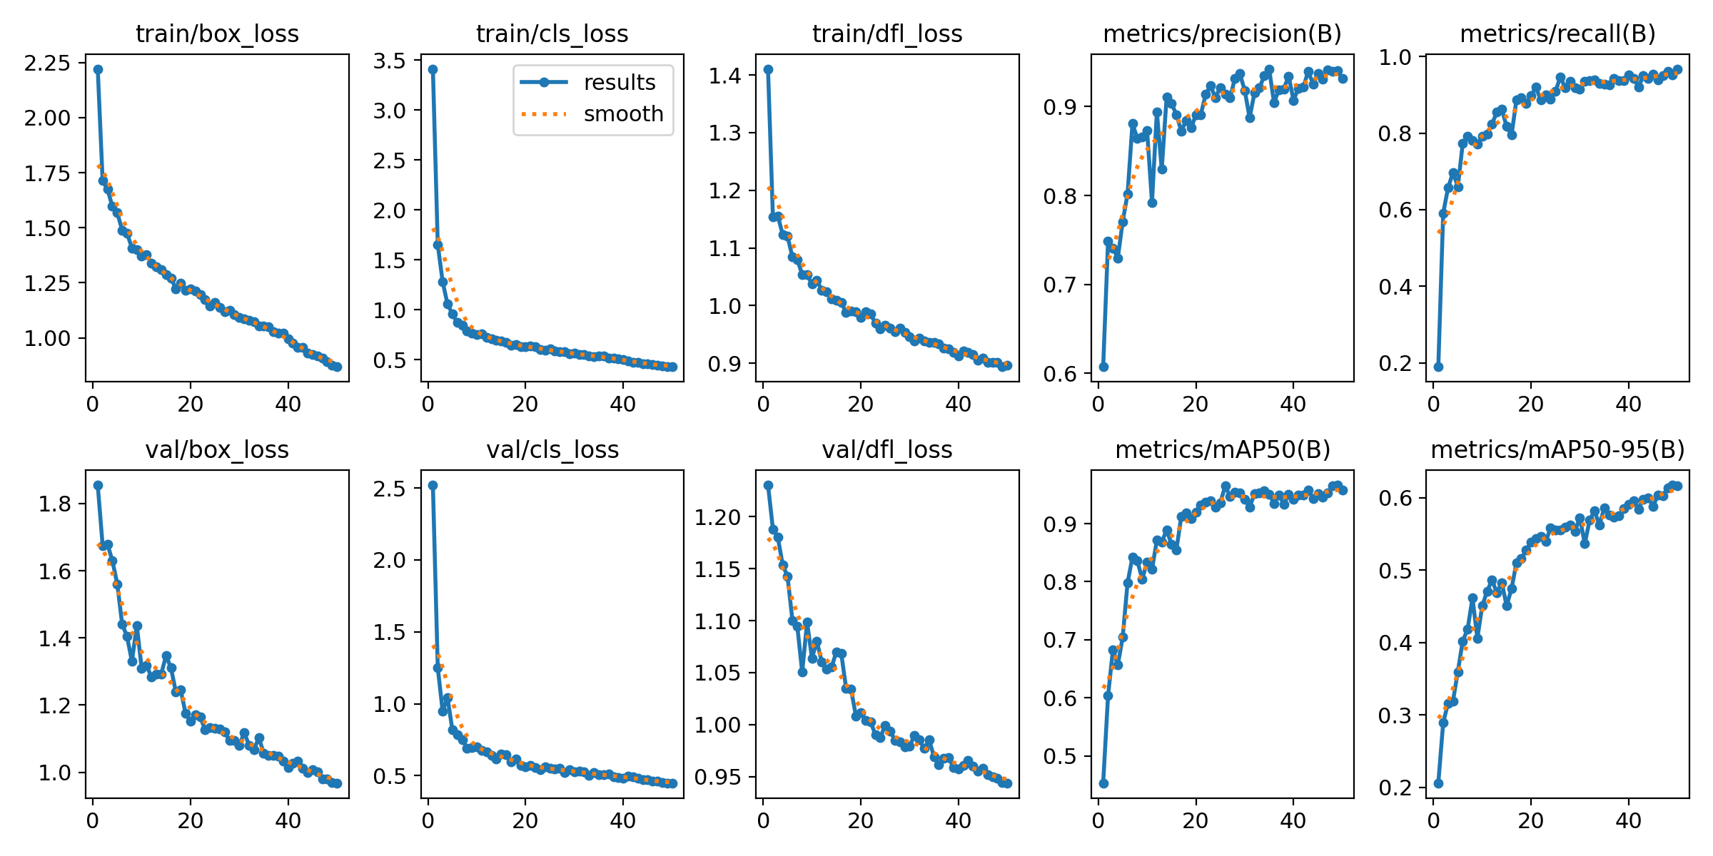
Conclusion

Slide 15
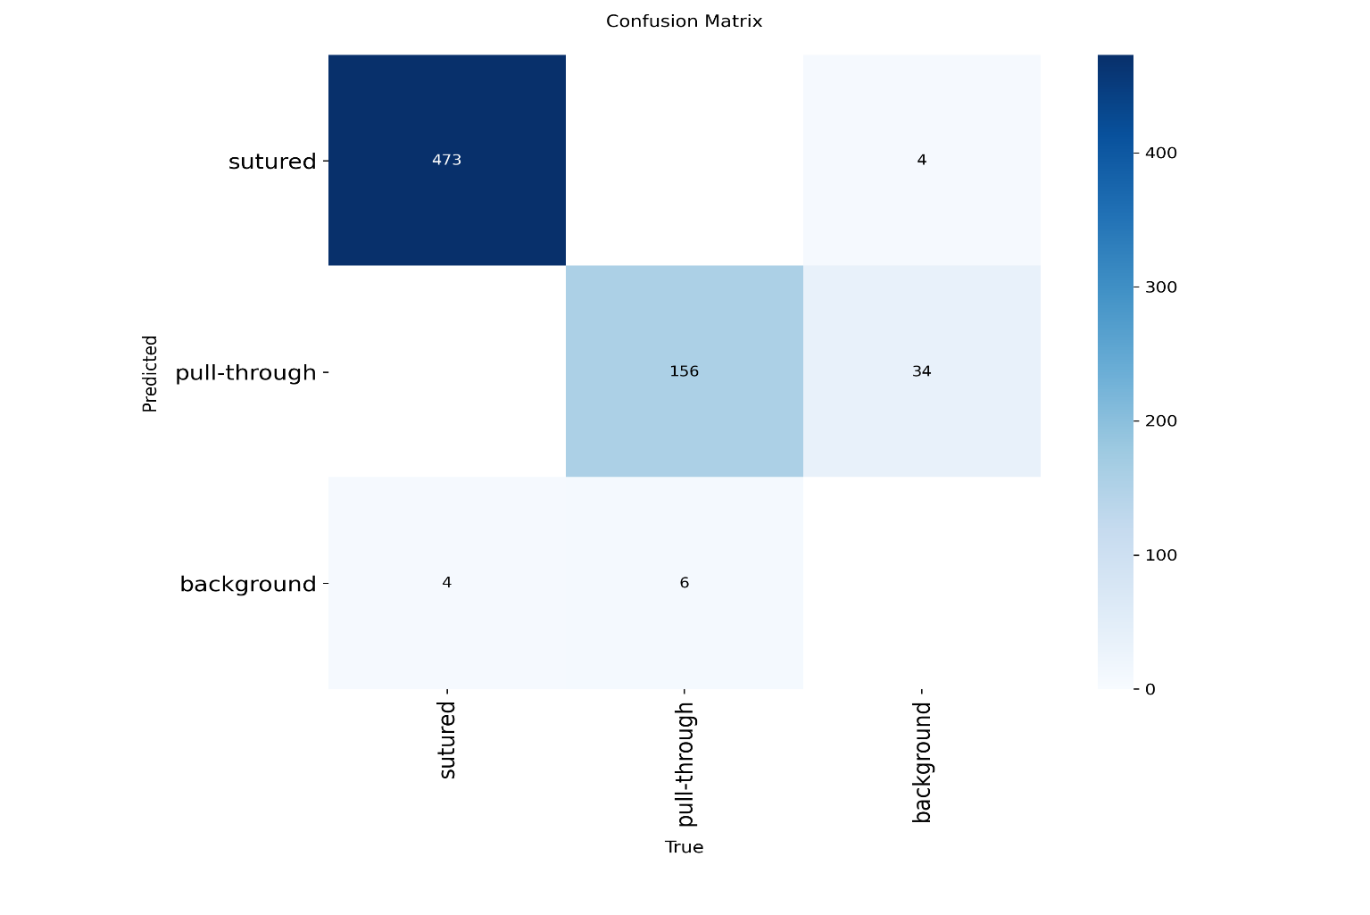
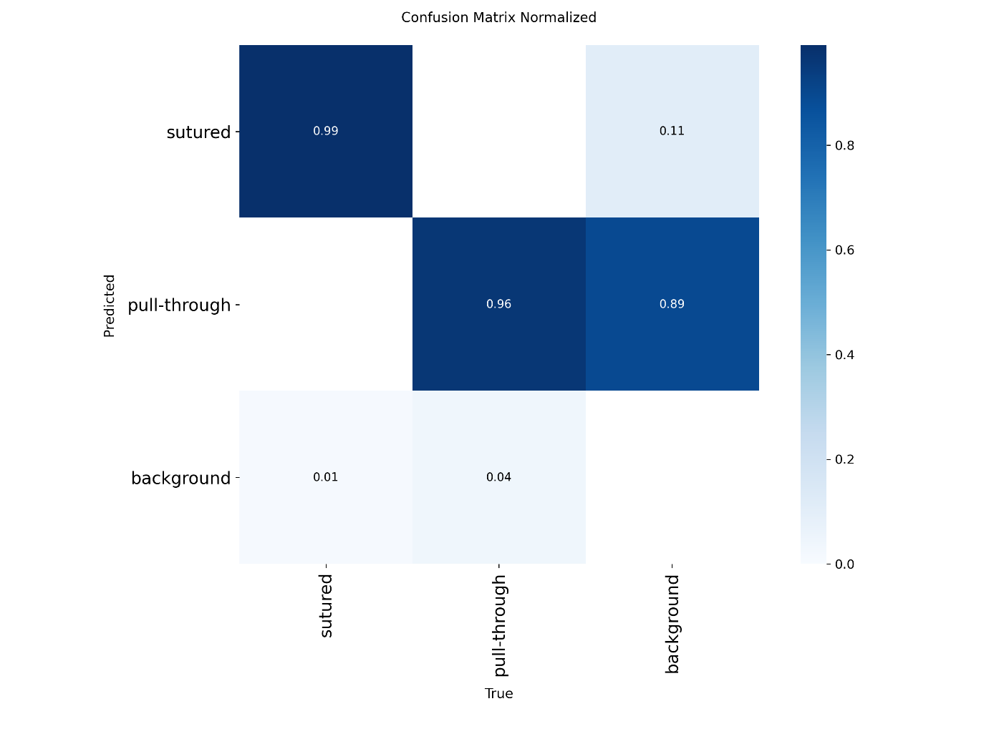
Conclusion

Slide 16
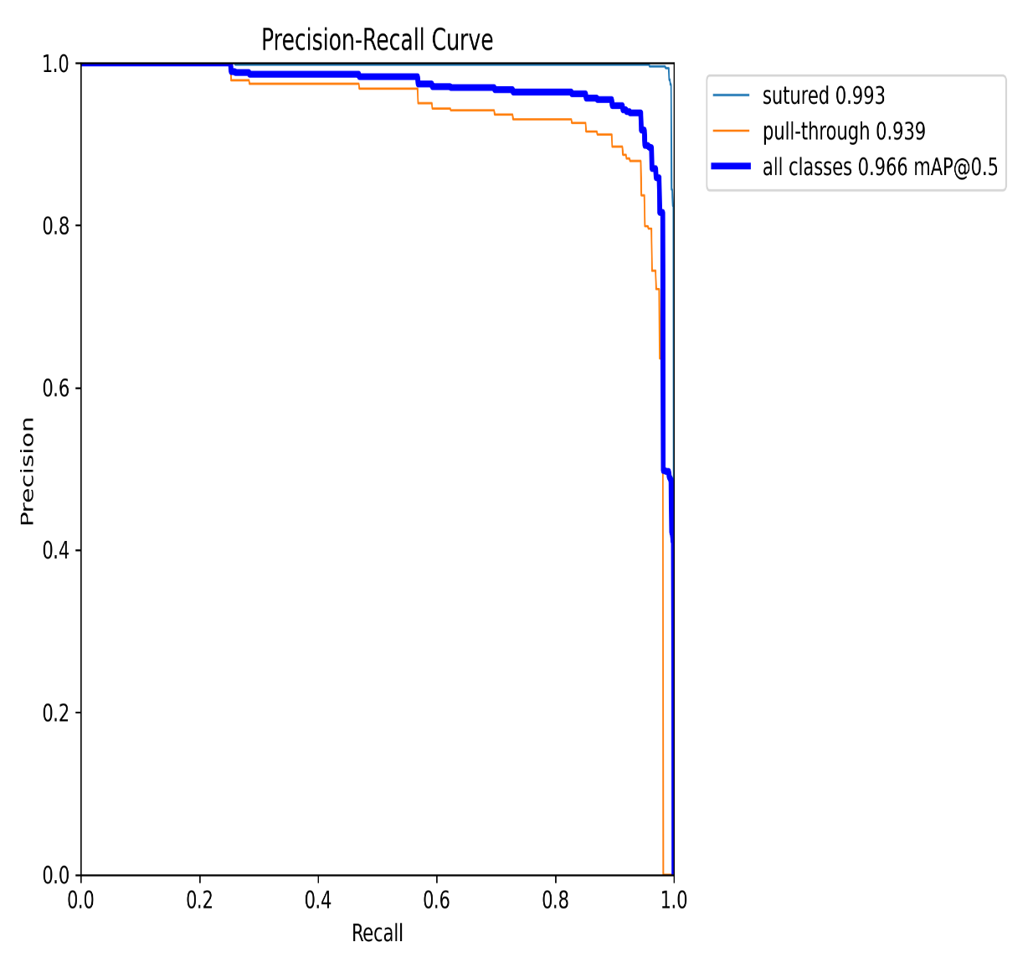
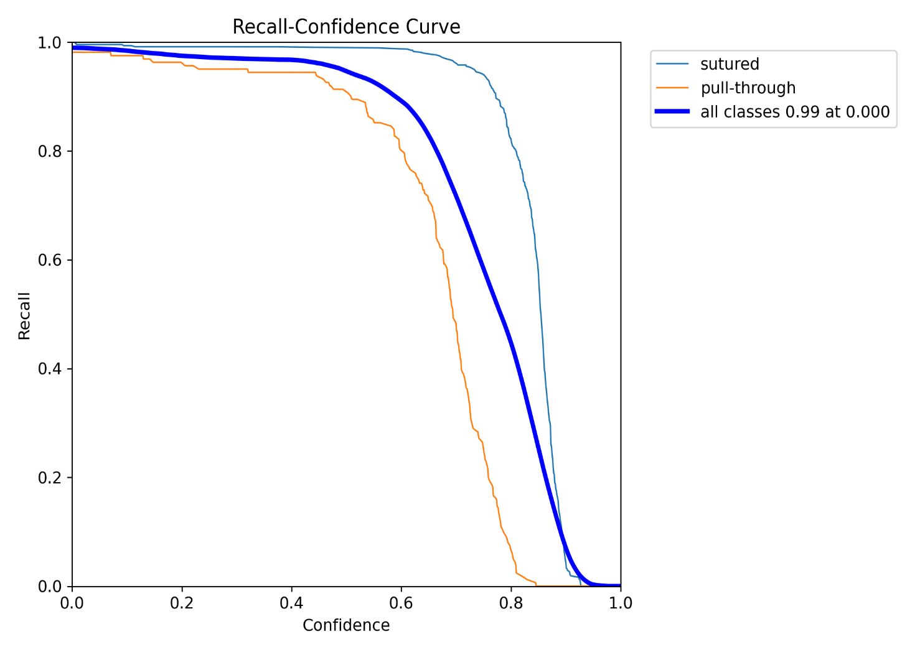
Conclusion

Slide 17
Future Scope
Integration of additional surgical parameters such as wound approximation and needle entry angle analysis.
Development of real-time surgical skill assessment and feedback systems.
Use of larger and more diverse surgical datasets for improved model accuracy.
Development of a complete automated surgical training and evaluation platform using advanced AI techniques.

Slide 18
References
[1] Mansour et al.: Deep Learning-Based Evaluation of Suture Images for Surgical Training. CNN-based framework for
automated surgical suture assessment.
[2] Tao et al.: Sparse Hidden Markov Models for Surgical Skill Classification. HMM-based surgical gesture classification
approach.
[3] Hu, et al.: Real-Time Surgical Skill Assessment Using Temporal Models. Real-time surgical performance prediction
using ML/DL models.
[4] Zia, et al.: Automated Assessment of Surgical Skills in Robotic Minimally Invasive Surgery. Machine learning-based robotic surgical skill evaluation.
[5] Wang, et al.: Deep Learning-Based Surgical Skill Assessment. CNN-based assessment framework using the JIGSAWS dataset.
[6] Khalid, et al.: Encoder–Decoder Skill Assessment Framework. Encoder–decoder deep learning framework for surgicalskill analysis.
[7] Liu, et al.: Multi-Path Deep Learning Framework for Surgical Skill Assessment. Multi-path architecture for surgical video analysis.
[8] Baby, et al.: Rank-Based Skill Evaluation. Deep learning with ranking loss for surgical skill evaluation.
[9] Dhanakshirur, et al.: Micro-Suturing Skill Assessment. MT-CNN-based microsuturing skill scoring framework.
[10] Handelman, et al.: Morphological Skill Evaluation. Image processing techniques for evaluating surgical morphology.

Slide 19
References
[11] Kil, et al.: Image-Based Suturing Skill Assessment. Computer vision-based suturing skill evaluation using
image datasets.
[12] Sirajudeen, et al.: Skill and Error Prediction in Robotic Surgery. Deep learning-based surgical error and skill
prediction.
[13] Khairnar, et al.: ML-Based Laparoscopic Skill Assessment. Machine learning approaches including RF, SVM,
and CNN for laparoscopic assessment.
[14] Hu, et al.: Multimodal Skill Assessment. Multimodal deep learning framework for surgical performance
evaluation.
[15] Wang, et al.: Time-Series Skill Evaluation. CNN-based time-series surgical skill analysis using JIGSAWS.
[16] Dhanakshirur, et al.: Automated Micro-Suturing Evaluation. CNN-based automated microsuturing scoring
system.
[17] Kil, et al.: CV-Based Skill Metrics. Computer vision-based metrics for differentiating surgical skill levels.
[18] Sirajudeen, et al.: Error Detection in Surgery. MS-TCN framework for surgical error detection and analysis.
[19] Khairnar, et al.: Tool Tracking for Skill Assessment. YOLOv8 and deep learning-based surgical tool tracking
framework.
[20] Hu, et al.: Window-Based Real-Time Assessment. Real-time surgical skill assessment using window-based
ML/DL methods.

