Slide 1
Continuum AI
Group 13

Slide 2
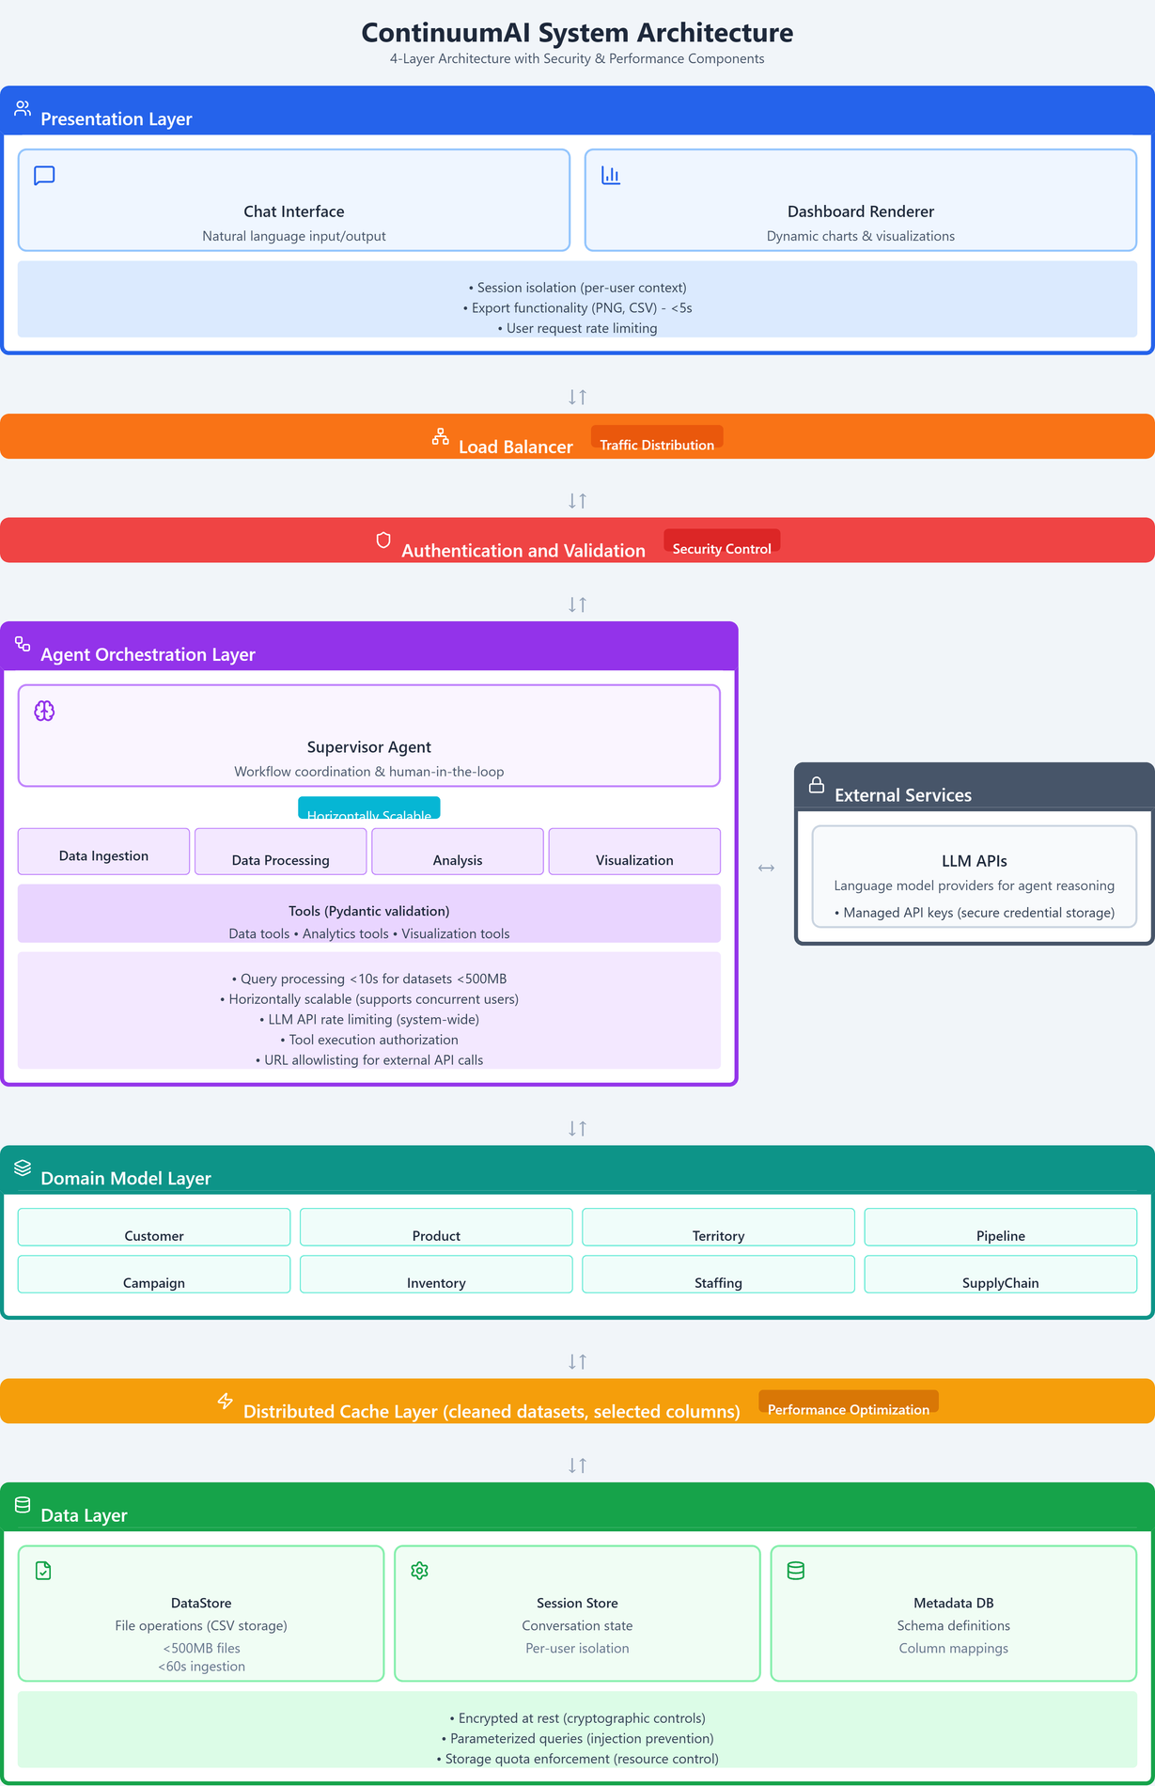
Architecture Diagram
2

Slide 3
Non-Functional Requirements
Data Ingestion Performance
Query Performance
Usability
Requirement:
A 100MB CSV file will be ingested, processed, and made ready for analysis in under 60 seconds.
Architecture Support
Data Ingestion Agent handles file uploads and schema validation in parallel.
Data Processing Agent cleans and transforms data (missing values, types, outliers).
Distributed Cache Layer stores cleaned datasets for immediate reuse.
Metadata DB registers schema definitions, speeding up later queries.
Requirement:
The system will process and display visualizations for 90% of natural language queries on datasets under 500MB within 10 seconds
Architecture Support
Cache Layer stores cleaned data, eliminating repeated reads.
Supervisor Agent routes queries to the right specialized agent.
Asynchronous execution reduces waiting time.
Requirement:
After a 15-minute tutorial, new users must achieve an 80% first-attempt success rate when generating a sales-trend visualization.
Architecture Support
Chat Interface allows plain-English queries.
Supervisor Agent provides clarifying prompts (human-in-the-loop).
Dashboard Renderer gives instant visual feedback.
3

Slide 4
Security Risks and Justifications
Injection Attacks
Broken Access Control
Cryptographic Failures
Malicious input execution via queries or uploads (e.g., SQL/CSV injection).
Validation Middleware scans all user inputs. (Security Middleware)
Strict Pydantic Schemas enforce typed, safe input. (Agent Orchestration)
Parameterized SQL Queries block injection even if earlier layers are bypassed. (Data Layer)
Unauthorized access to data or functionality beyond user permissions.
Session Isolation ensures user-specific data contexts. (Presentation Layer)
Security Middleware authenticates & blocks unauthorized requests. (Auth and Validation)
Per-User Data Isolation keeps user data strictly separated in all layers. (Data Layer)
Exposure of sensitive data due to weak encryption or poor key handling.
Encryption at Rest for all stored data. (Data Layer)
Secure Credential Management via runtime key retrieval & no logging. (External services)
Encrypted Communication ensures all data in transit is protected, even between internal layers. (Cross Layer)
4

Slide 5
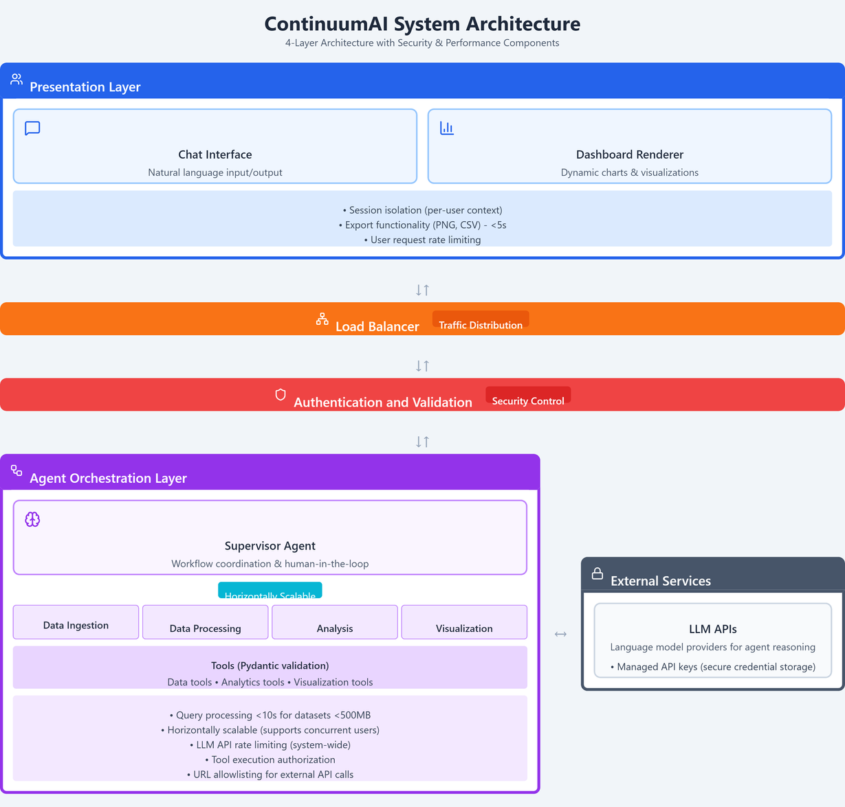
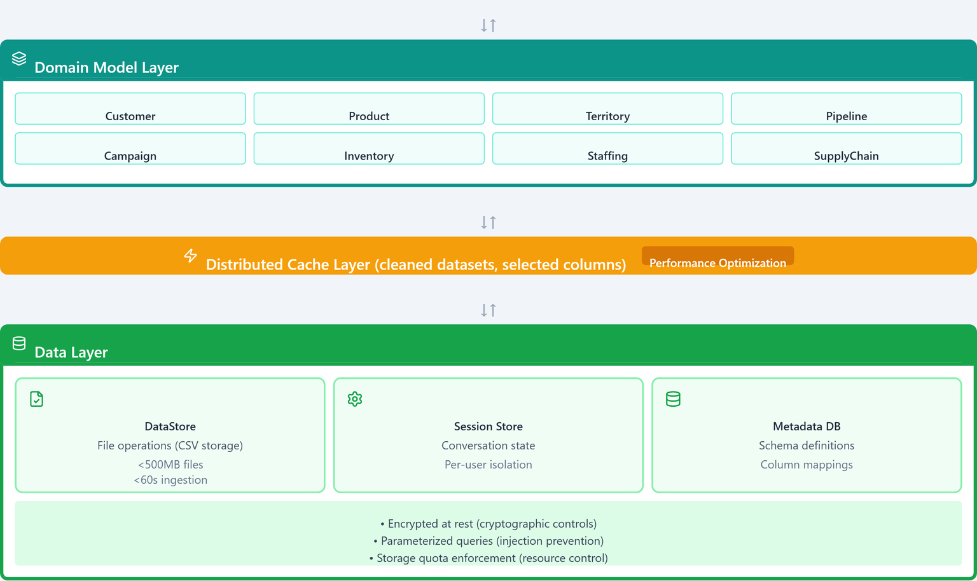
5

