Slide 1

Retail Analytics - Shelf Space Optimization
Shreya Surana, Spyros Protoulis, Sonic Prabhudesai

Slide 2
Problem Statement
What is the optimum strategy to allot self space and prices to the 3 types of jeans in order to maximise Profit and Sales for the store?

Slide 3
Data Manipulations
Derived variables:
Profit/ Sale
Profit/ Shelf
Price Reduction
profit as a % of sale
price*shelfspace of each jeans type : to experiment and check effect of both on dependent (sales)
Assumptions
The data provided to us is representative of how the trends might continue in the future.

Slide 4
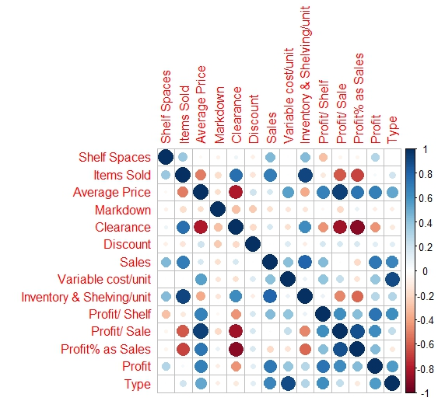
Correlation Analysis
We found interesting correlations between Shelving Cost per Unit and Shelf Spaces.
Also between Shelf Space and Profit/ Shelf
These 2 correlations seem to suggest that if we go to extremes assigning a lot of shelves for one type of jeans, our shelving costs may increase and profits may suffer.
Profit per Shelf is a very important metric for this problem, as the shelves are our finite resource that we need to decide on.
Profit per shelf has the highest positive correlation with Average Price. That may suggest we need to allocate more shelves to our more expensive, non discounted items.
We ran a correlation heatmap
We now utilised this result to conduct EDA to check the trend of sales with respect to the variables.

Slide 5
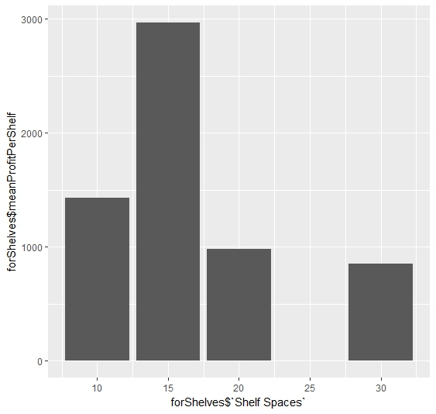
Exploratory Data Analysis
Keep in mind “15” has very few observations in our data, so that is by no means reliable. However, there is a clear downward trend. That is reasonable, since there is probably a cap of how many pieces will be sold regardless of number of shelves this type of jeans is allocated (there is only so much demand).

Slide 6
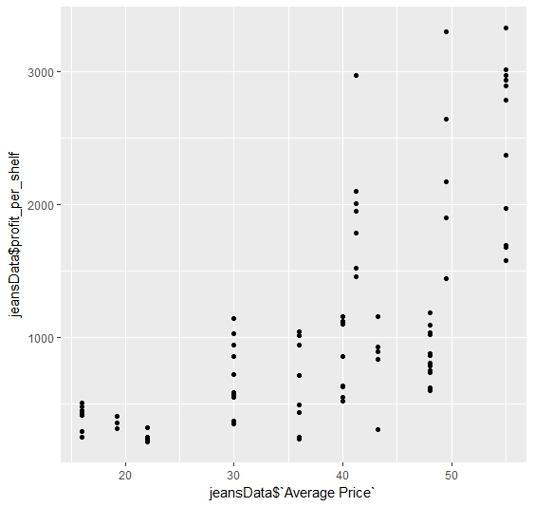
Exploratory Data Analysis
Profit per shelf is greater as the average price increases. This is a phenomenon that was expected

Slide 7
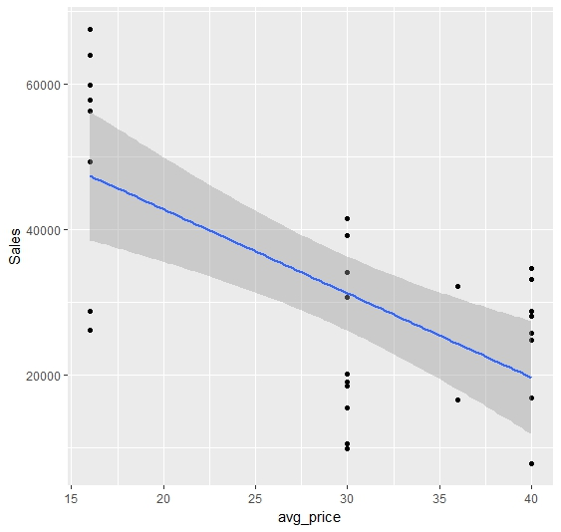
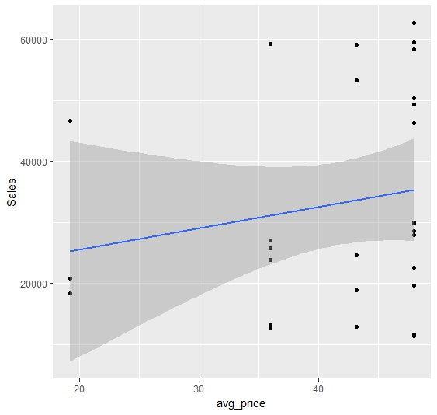
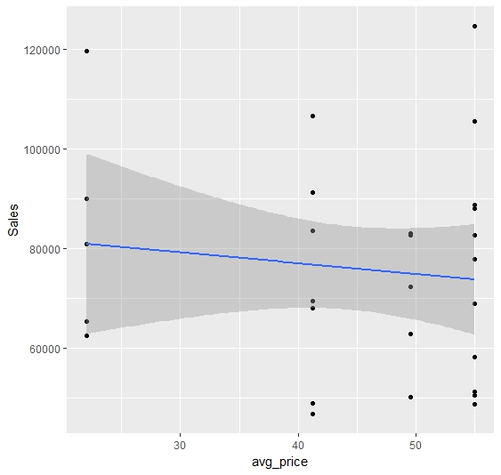
Exploratory Data Analysis
Sensitivity Analysis
Type 1
Type 2
Type 3

Slide 8
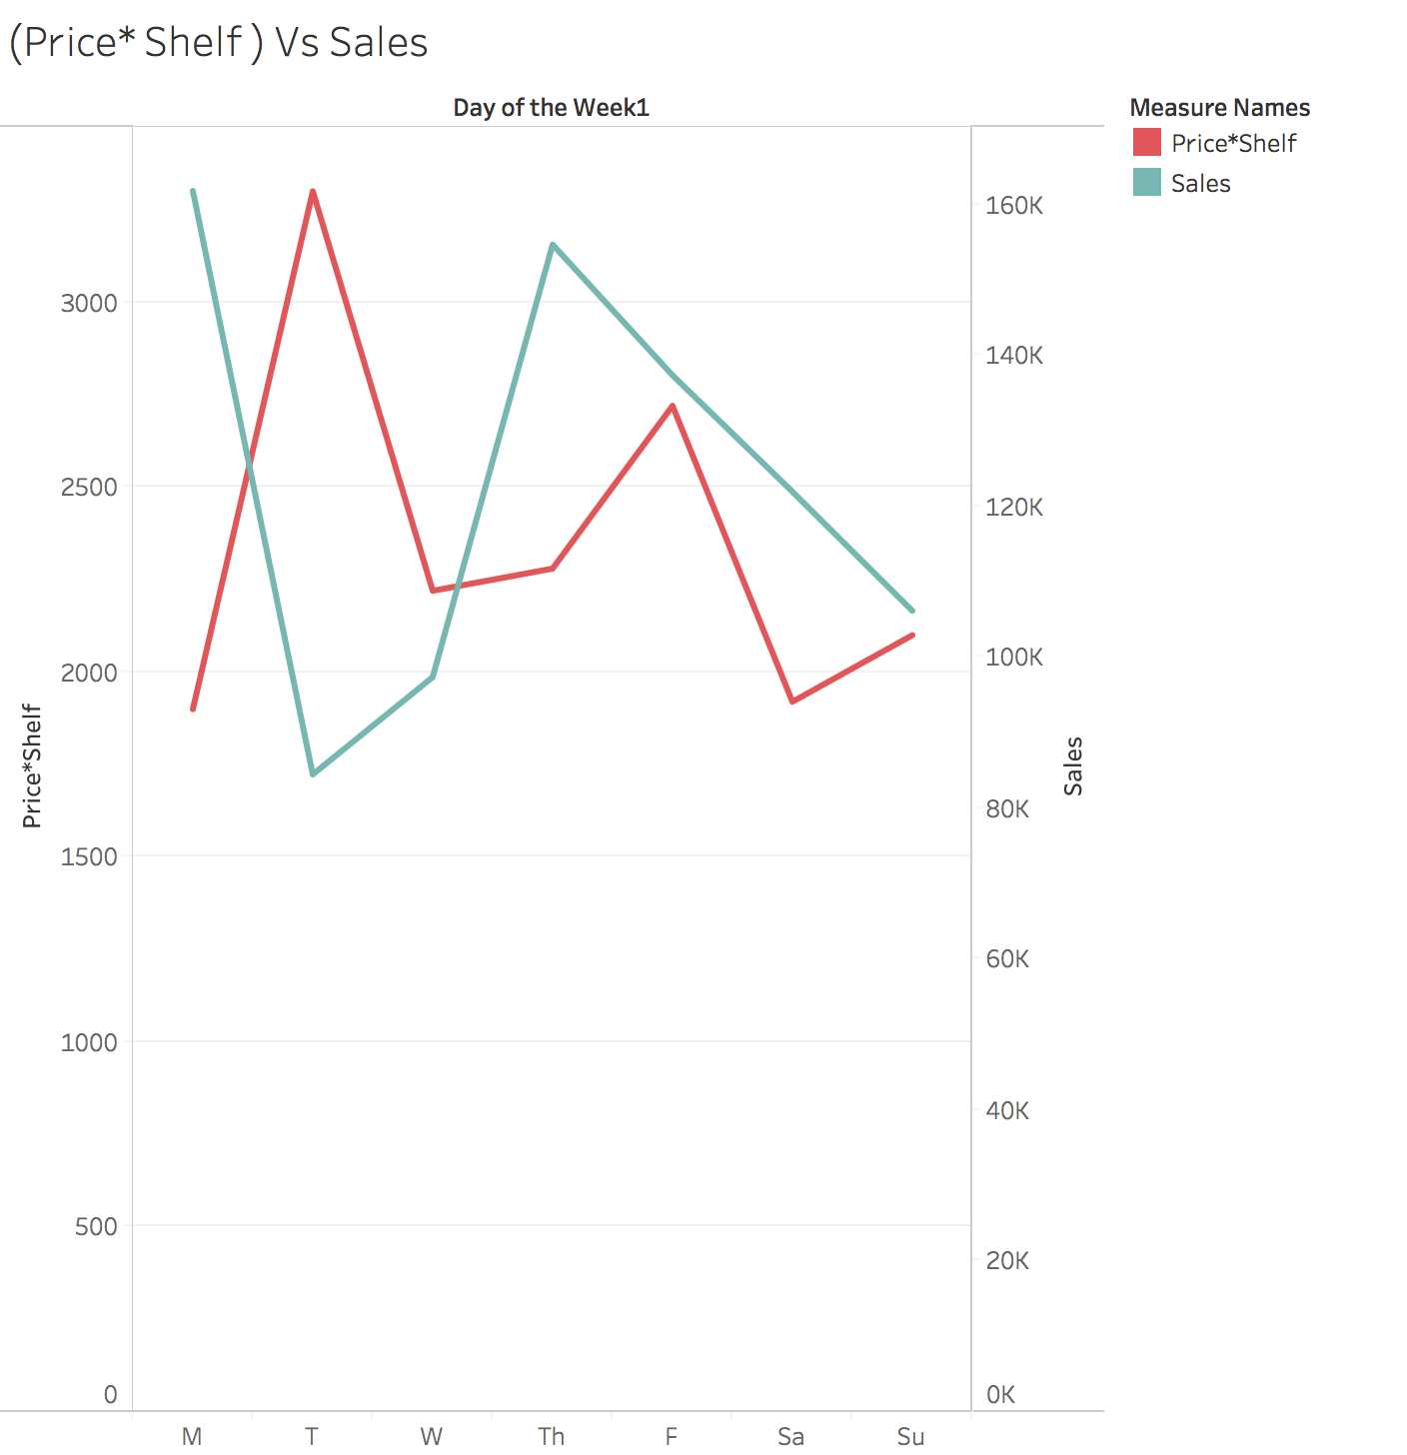
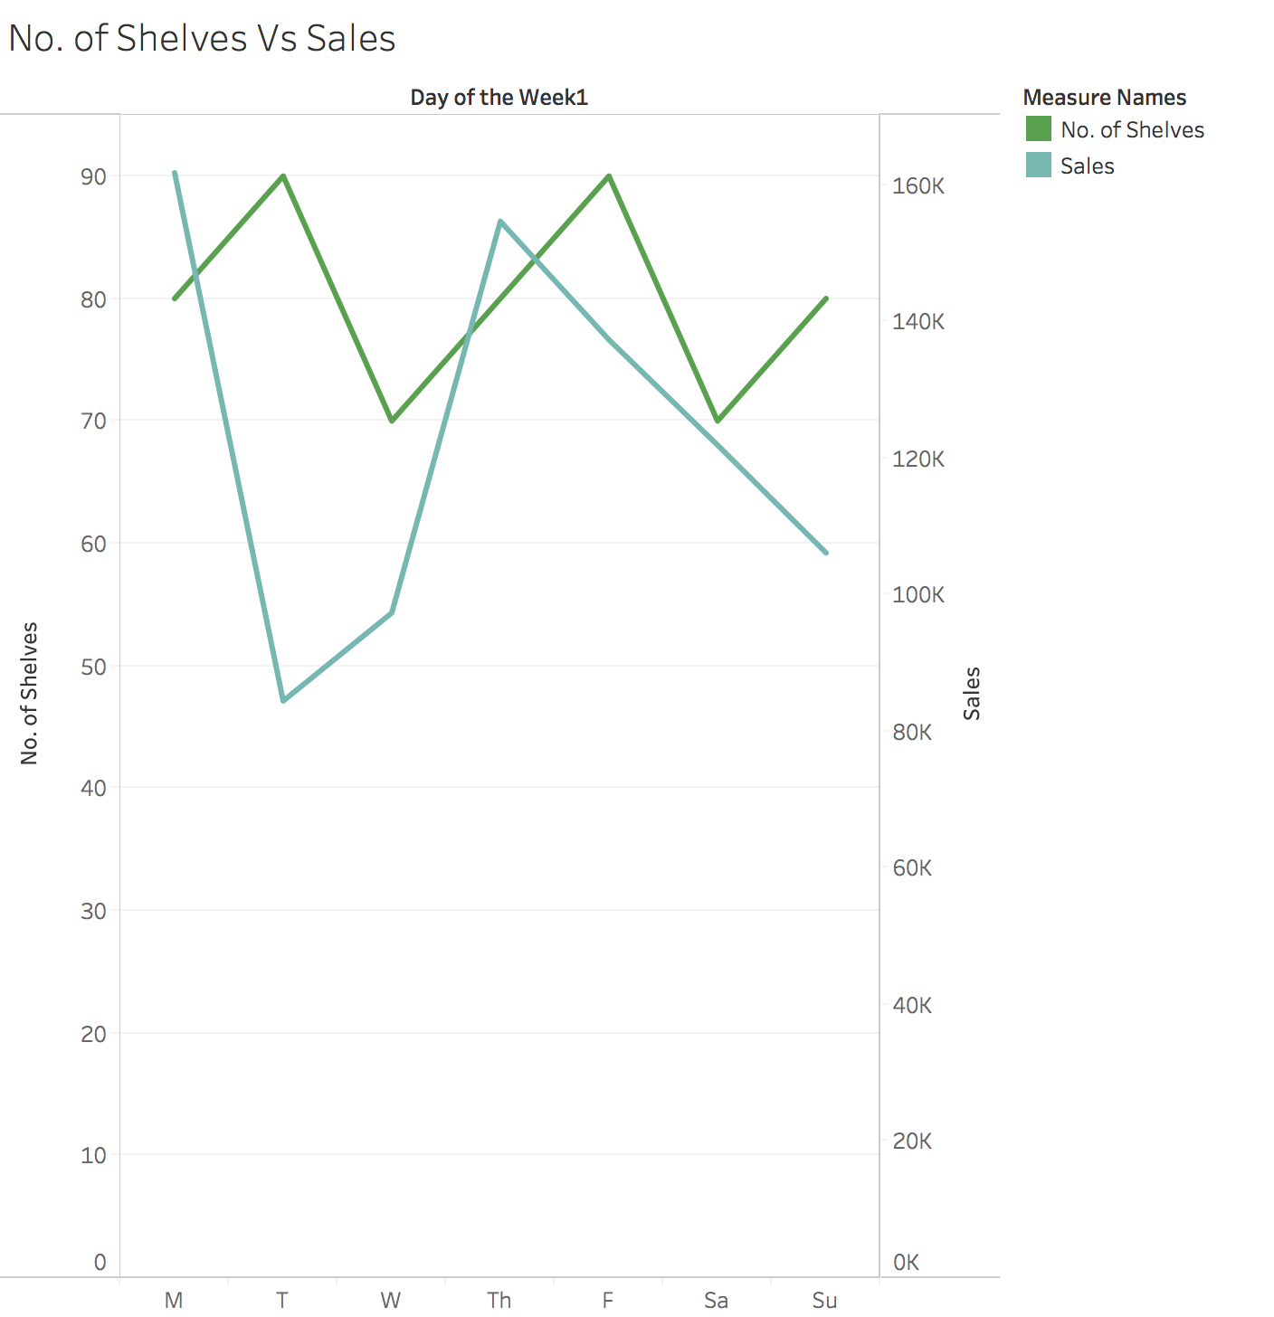
Exploratory Data Analysis
Sales Vs Key Metrics

Slide 9
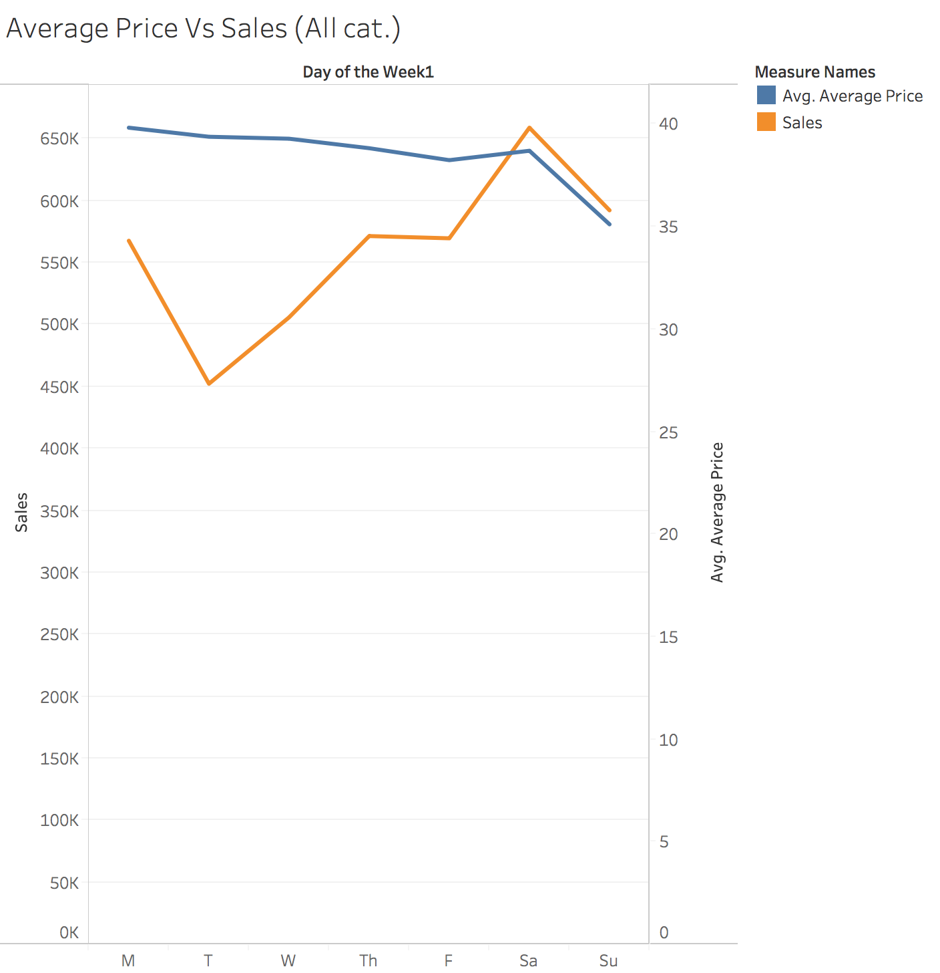
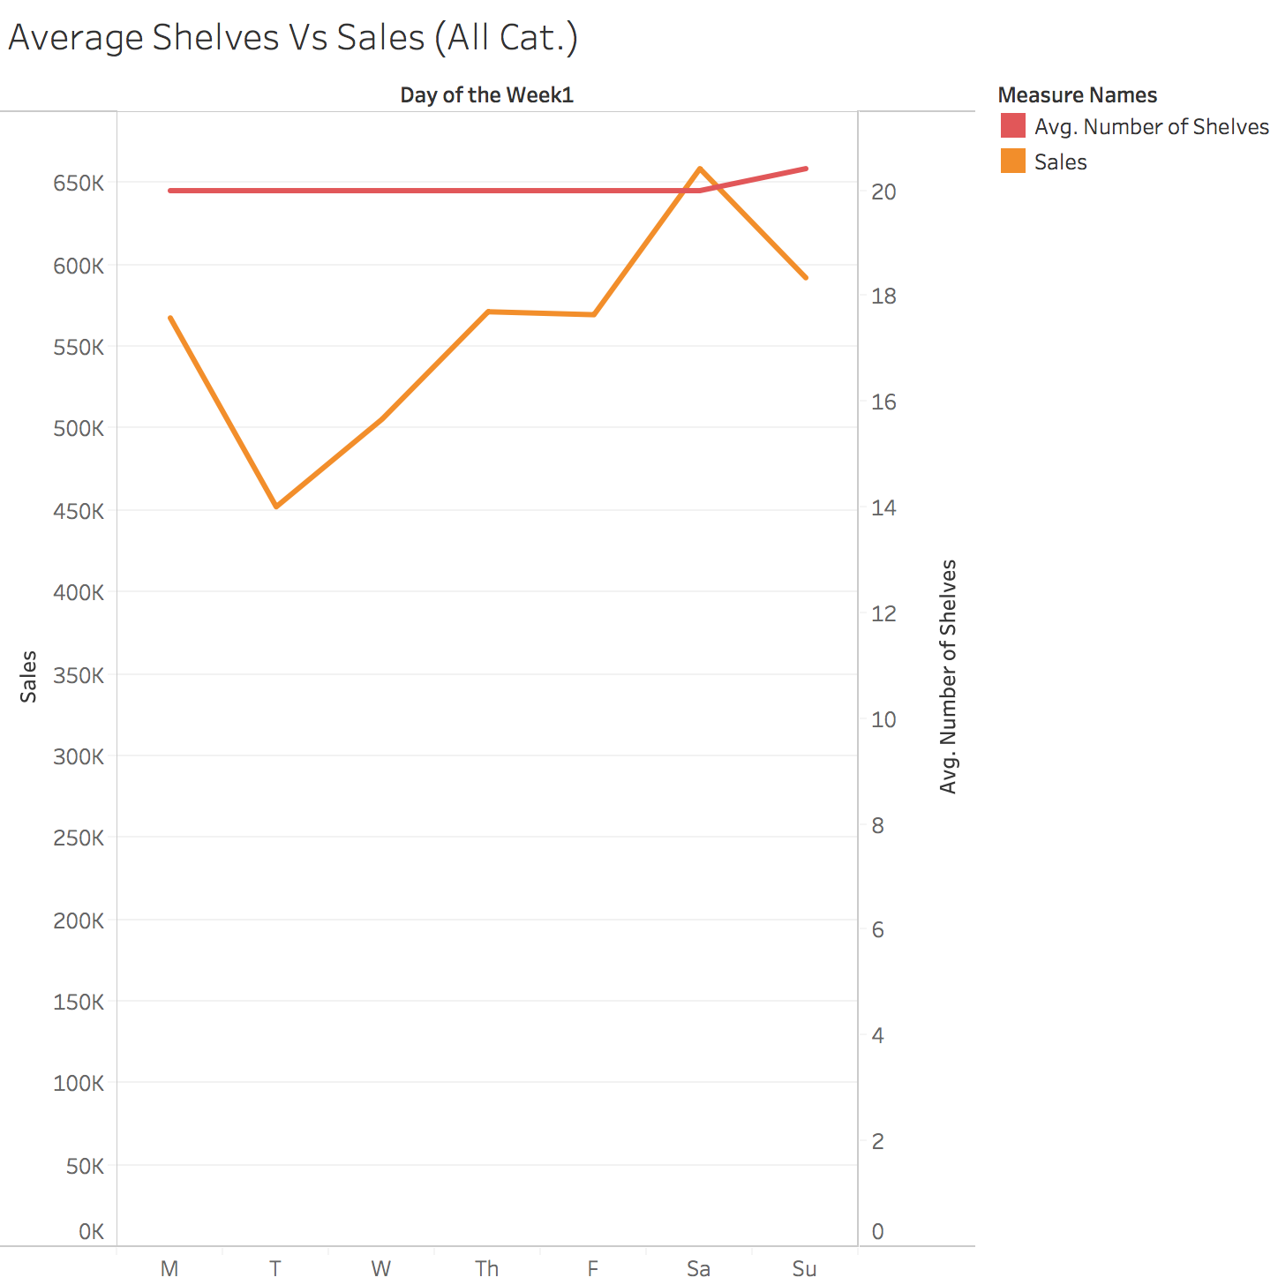
Exploratory Data Analysis
Profit/ Shelf Vs Key Metrics
Notice how there is a very little correlation between Sales and Price and Sales and Shelves.

Slide 10
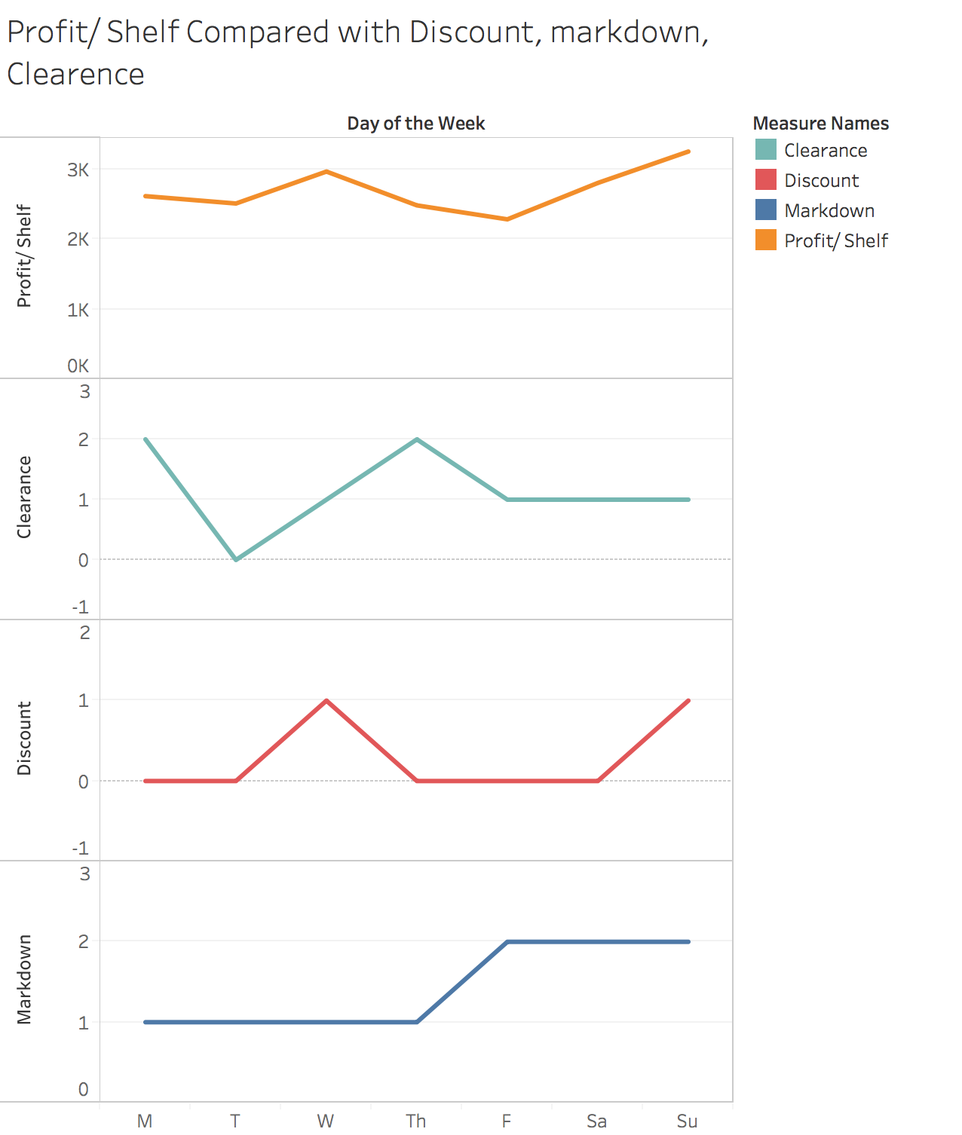
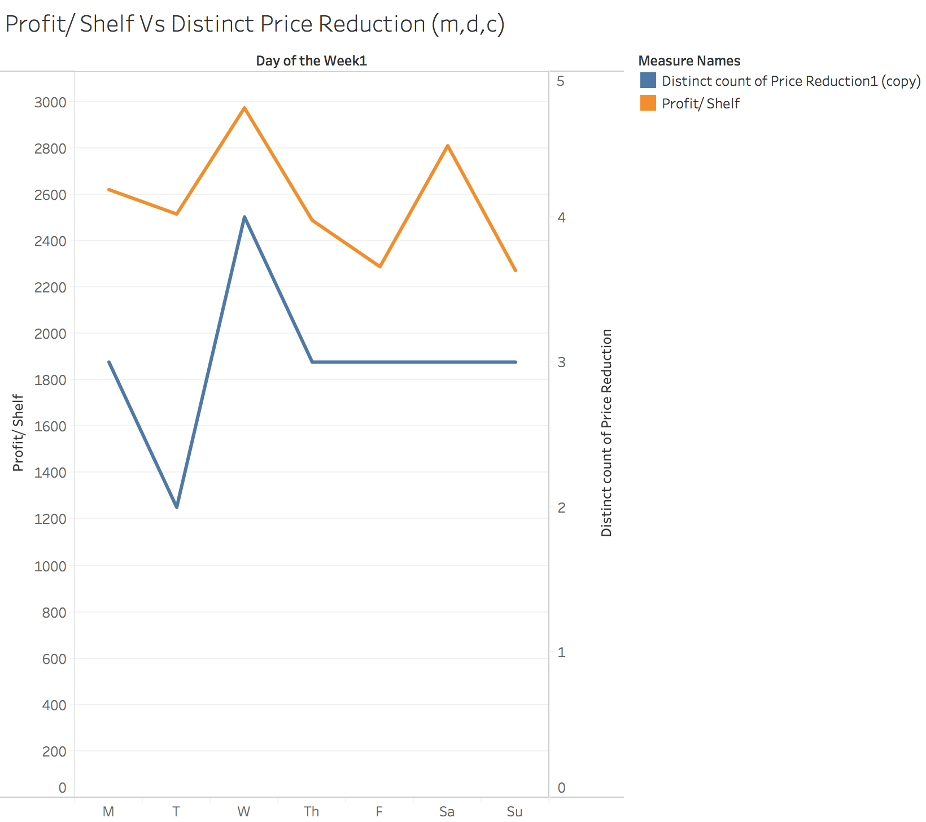
Exploratory Data Analysis
Profit/ Shelf Vs Key Metrics

Slide 11
What Model did we use?
The first step is to understand the objective of this problem. The two objectives for this optimization problems are (will be summarized later):
Maximizing total units sold
Maximizing total profit
To find optimal values of variables that affect our dependent variables (total units sold and total profit), we need to estimate their effects (betas, sensitivities) on these dependent variables.
For simplicity, we take one objective: maximization of total units sold. For maximization of total profit, additional variables of costs will need to be included.
Units sold for jeans x is affected by multiple attributes including: selling price of x (price sensitivity), shelf space of x (space sensitivity), promotions on x, prices and or units sold of other jeans (cross elasticities with jeans y and z), day of the week
So we create and iterate models for units sold for each type of jeans: sales_x, sales_y and sales_z

Slide 12
Models
Assumptions:
As can be seen in the sample data, we assume that price always represents the promotions (the price for jeans x on clearance is always the same)
Sales of jeans x will be affected by price of jean y and z, but it will also be affected by the shelf space of y and z. We assume that units sold of jeans y and z captures both these effects and can be used to estimate cross product elasticities for x with y and z.
As elasticities are estimated using multiplicative models, we have created log log models for the units sold of the three pairs of jeans.
Where,
β1 = shelf space elasticity, β2 = price elasticity, β3 = cross prod elasticty with y, β4 = cross prod elasticity with z, βi = effect of day of the week i (i =1 to 6 days of the week)
s = shelf space, p = price, sales_y is units sold of y, sales_z is units sold of z, dummy_DOW_i = 6 dummy variables for days of the week
The same estimation model is used appropriately for jeans y and z

Slide 13
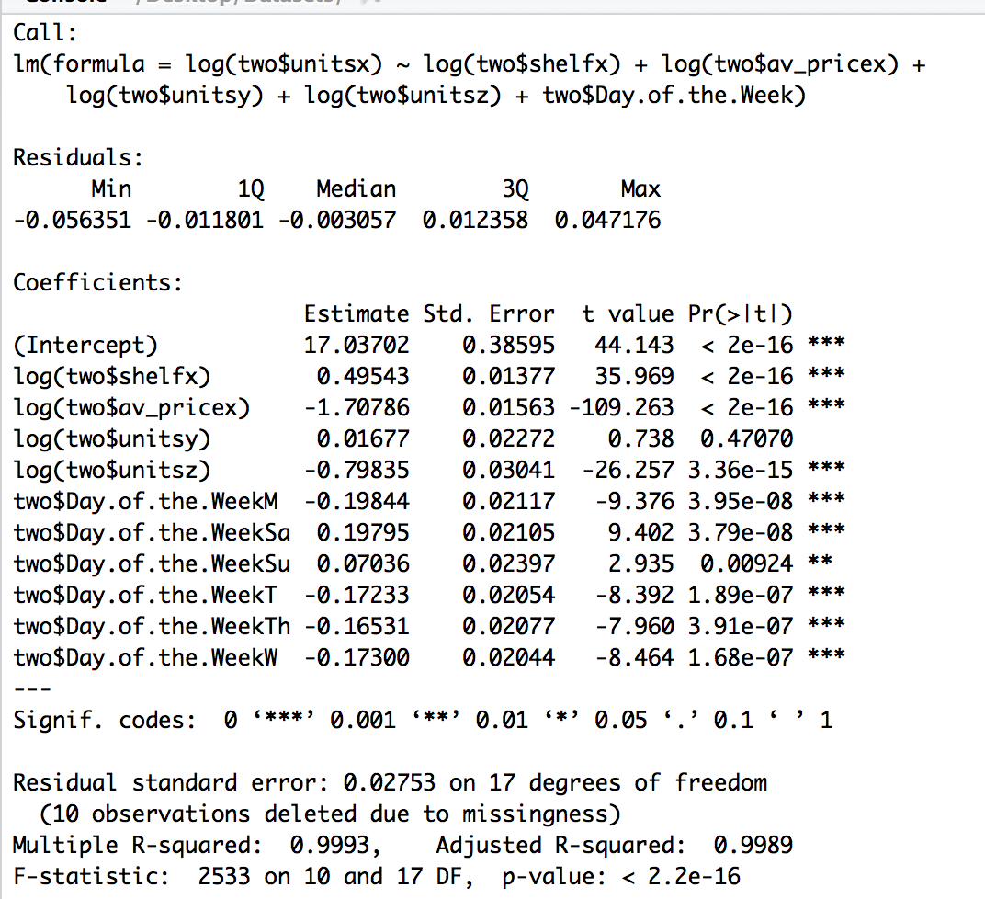
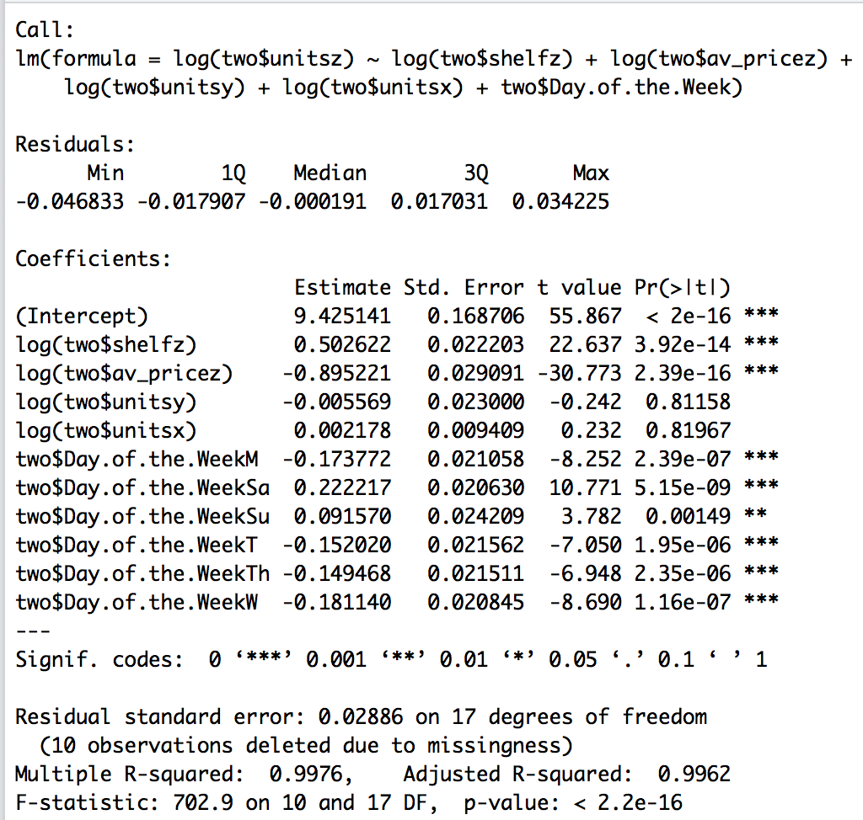
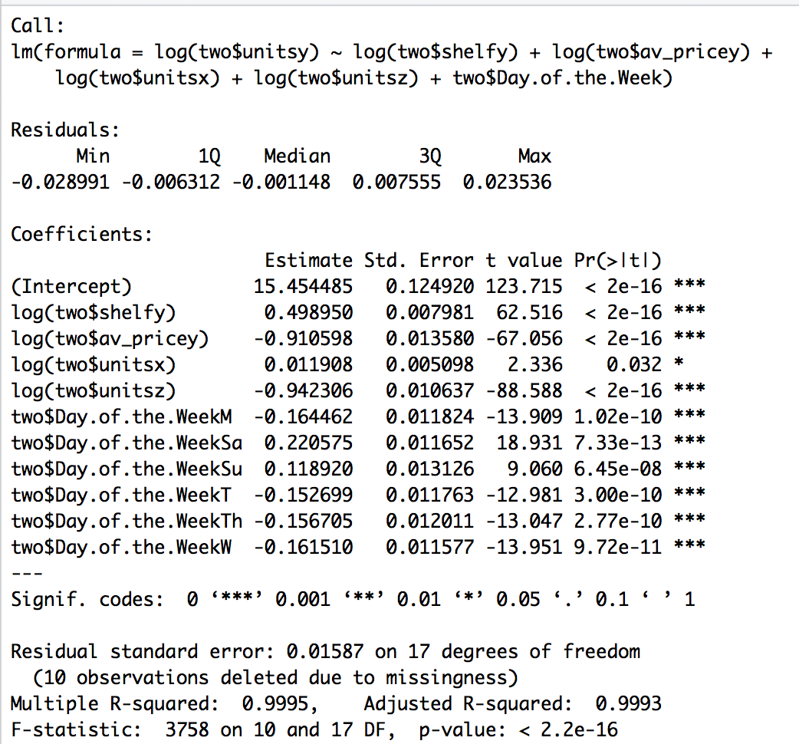
Models (for jeans x, y and z respectively):

Slide 14
Final Objective Function
Some findings
Finally we want to maximize total sales, that is sales of x + sales of y + sales of z
High R-squared
Jeans z always sell more
Jeans z are not significantly (statistical) affected by sales of other jeans
If we remove the intercept, the R-squared become 1, might be over fitting
Looking at the trends over days of the week, we can categorize them in smaller buckets of days of high sale and says of low sale

Slide 15
Decision Variables
Constraints
Number of shelves allocated for each type of jeans in a given day : s_x, s_y, s_z
Promotions: discount, markdown, clearance or none (reflected in prices) or each type of jeans in a given day
Each type of jeans is allotted a minimum of 5 shelf spaces:
s_x >= 5
s_y >= 5
s_z >= 5
Total shelf spaces available for all three types of jeans: s_x + s_y + s_z <= 60
We have no information about price constraints but an obvious one (at minimum) would be: price > cost

Slide 16
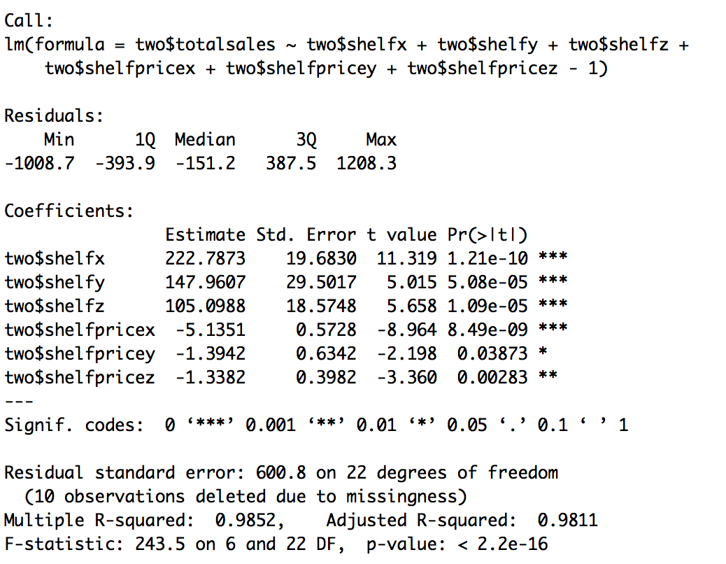
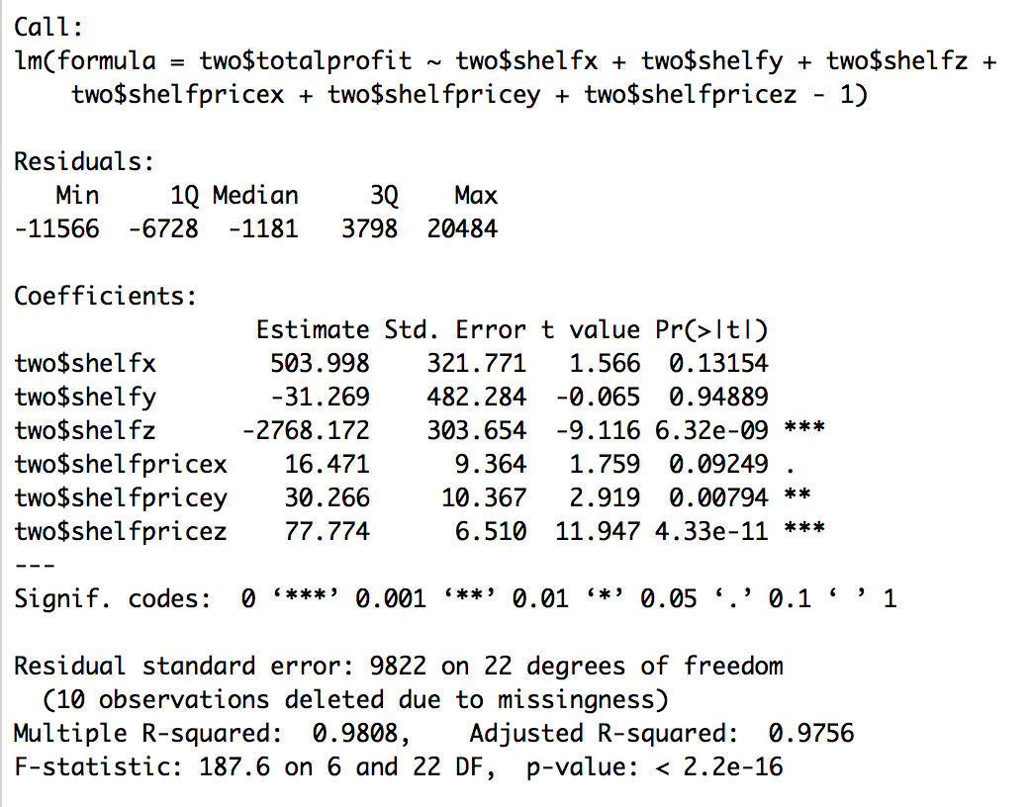
What we tried and failed at
We started with trying to build a model for total sales (which is our final objective to maximize)
We tried using price*shelfspace variables for each jeans type to explain their combined effect on total sales.
SInce there would be high correlation between shelf and price*shelfspace of each jeans type, we tried the second model with shelf spaces and prices as separate variables- but this would not explained combined effect
We were not able to understand how either of these could be optimized and hence did not go forward with them.
Similar approach for profit would fail as promotions for each type of jeans differ on each day

Slide 17
Alternative Objective Function
The objective is to maximize total profit.
Total profit (Π) is calculated as following:
With: n1 n2 n3 the number of jeans sold for each type correspondingly,
p1 p2 p3 the profit per unit for each type, (given the prices and costs):
Π = p1*n1 + p2*n2 + p3*n3
Also:
p = Average unit Sales price - (variable cost per unit + shelving cost per unit)
pi = SPi - (VCi + SCi)
So:
Π = [SP1 - (VC1 + SC1)]*n1 + [SP2 - (VC2 + SC2)]*n2 + [SP3 - (VC3 + SC3)]*n3

Slide 18
THANK YOU

