Slide 1

Visual studio and OpenGL setup
How to setup and get open GL to run in VS2017

Slide 2
Authors
Brandon Rickman brandon.rickman.@snhu.edu
Eddie Richards e.richards3@snhu.edu
Created for use with Southern New Hampshire University course CS330 – Computer Graphics and Visualization
NOTE – this setup was done on a Windows 10 OS with Visual Studio 2017

Slide 3
Visual Studio
Download and Set-Up

Slide 4
Download Link
https://visualstudio.microsoft.com/downloads/
The link provided is for Visual Studio 2019 (latest as of 7/3/2019)
Download the community version for free
Follow the install instruction on your PC

Slide 5
Open Gl
Download and Set-Up

Slide 6
Download LInk
Follow this link to the SNHU CS330 zip files required
https://github.com/sproutecks2125/VS-and-OpenGL-SetUp
Use these links if any updated version of the software are needed directly from the makers
FreeGLUT
https://www.transmissionzero.co.uk/software/freeglut-devel/
GLEW
https://sourceforge.net/projects/glew/files/glew/1.13.0/
SOIL2
https://bitbucket.org/SpartanJ/soil2/src/default/
GLM
https://github.com/g-truc/glm

Slide 7
Download Dependencies Continued
Once you have downloaded all of the dependencies, either independently or by using the provided zip file), save to a convenient and easy to locate place.
C:\ProgramFiles\... (or similar)

Slide 8
Setting up OpenGL
Inside Visual Studio and your Computer

Slide 9
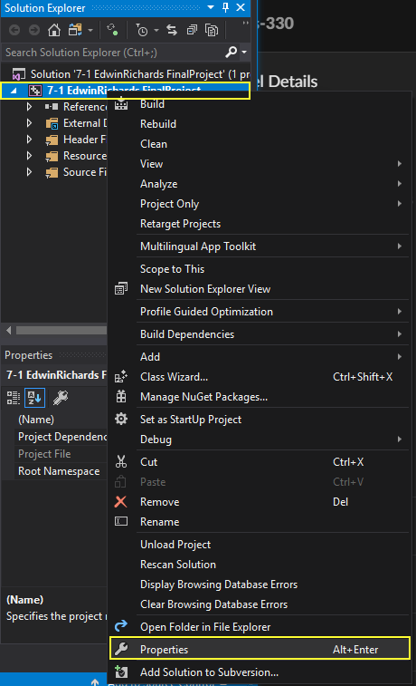
Open Visual Studio (#1)
Inside VS – Create a project and give it a name like Test-OpenGL
Create a blank .cpp file named OpenGL
Right-click the project, then choose Properties
In the properties, navigate to the C++ section (NOTE: for this to be present, you must first have a .cpp file in your project. You can add a blank one if you like).
Photo: Eddie

Slide 10
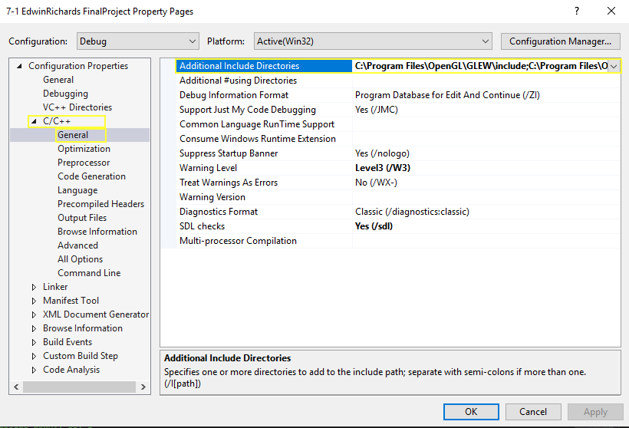
Project Properties Config (#2)
Then under General, put in the paths to the additional include directories

Slide 11
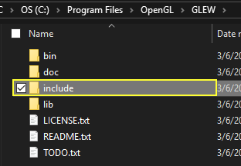
General << include (#2A)
The paths will be to the `include` directory inside the GLEW and GLUT directories where you saved the libraries

Slide 12
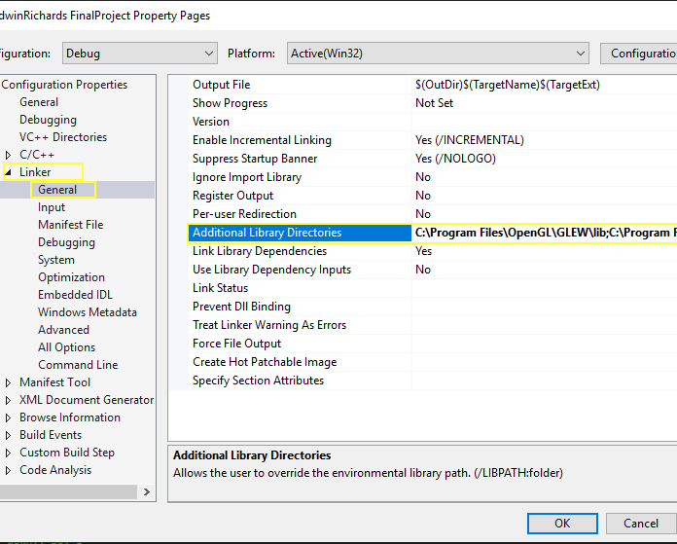
Project Properties continued (#3)
After you point to the include directories, go to the Linker section in the Properties and under General, add the paths to the additional library directories. These paths will be in the same location where you saved the libraries, but it will be the `lib` directory instead of `include`

Slide 13
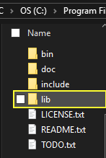
Linker << lib (#3A)
Makes both GLUT and GLEW `lib` folders are linked to the Linker Properties section.

Slide 14
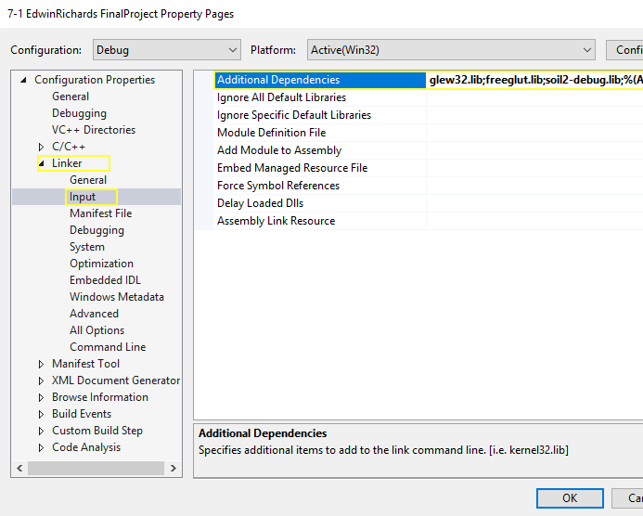
Linker input (#4)
Then, still in the Linker Properties, go to the Input section and add the additional dependencies. These will be the names of the `.dll` files for the libraries.
Three (3) .dll files needed
Glew32.lib
Freeglut.lib
Soil2-debug.lib

Slide 15
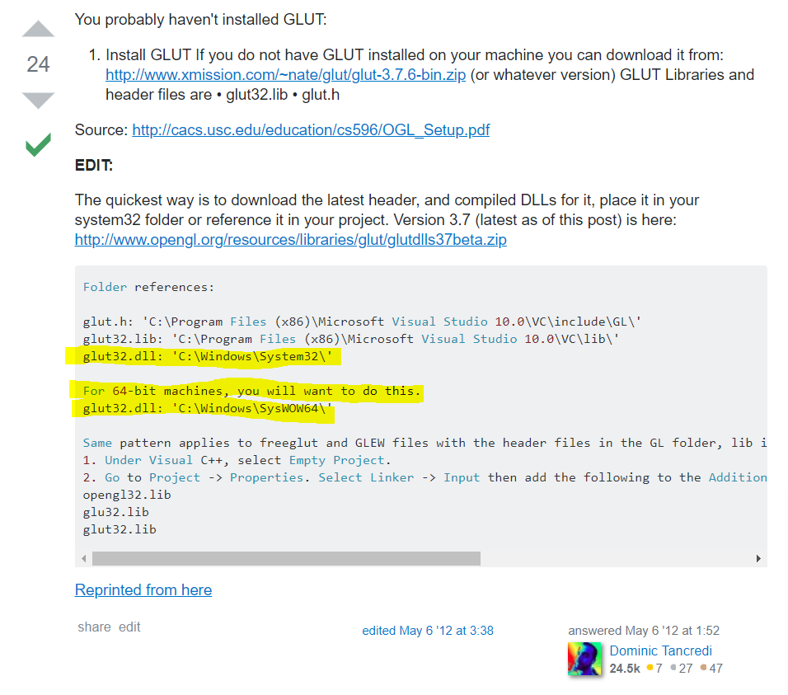
DLL << SYstem32 folder (#5)
To complete this last file setup we look at the provided instructions in the course.
First we need to add some .dll files to C:\windows\system32 folder
Second we look at this Stackoverflow correction solution:
https://stackoverflow.com/questions/10467473/how-to-fix-this-error-include-gl-glut-h-cannot-open-source-file-gl-glut-h
Add the `glut32.dll` file to the C:\windows\sysWOW64\ folder

Slide 16
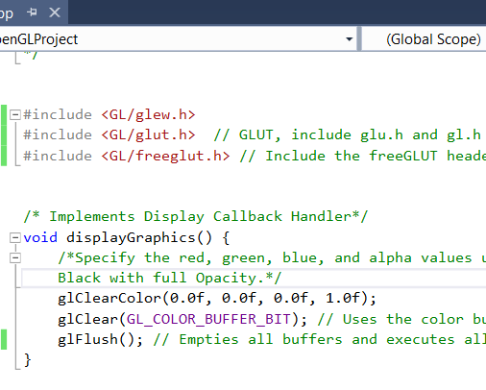
Source CPP File (#6)
The empty file we created needs to have the test source code copied into it. You can copy from the tutorial 1-2 instructions or (RECOMMENDED) retype the code yourself.
Be sure to add the `#include <GL/filename> as shown in the image.

Slide 17
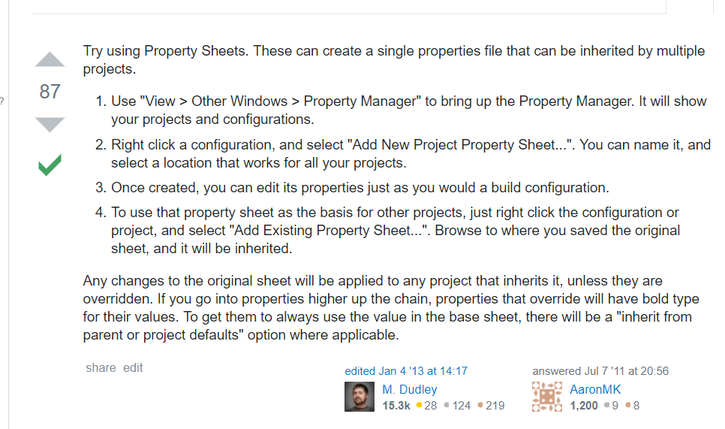
Setting up a property page
Visual Studio allows you to create a property page that can be used in each new project.
Once you get the project working you can save the property page to then be added to new projects without having to go through these steps each time.
Reference:
https://stackoverflow.com/questions/6386098/visual-studio-can-i-copy-a-projects-properties-to-use-in-another-project

Slide 18
NoTice
This has worked for setting up Visual Studio 2017 using the provided OpenGL.zip file at:
https://github.com/sproutecks2125/VS-and-OpenGL-SetUp
This has not been tested using the SOIL2 library but does not show any errors for the SOIL2 library.
If you come across any correction please lets us know by email or for quicker response use the GitHub page.
Hope this helps! Happy Coding and good luck on your course.

