Slide 1
Printing for the Intellectually Curious

Slide 2
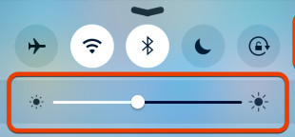
1) Open Educreations APP on iPads:
“New lesson”, ignore microphone prompt
In large font, type: Name
School
2) Turn brightness down on iPad
3) Stand near wall mural

Slide 3


Slide 4
Session participants will:
Understand history of 3d printing
Understand the general implications of 3d printing in classrooms
Know 3d printing platform options
Manipulate and create 3d objects in tinkercad

Slide 5
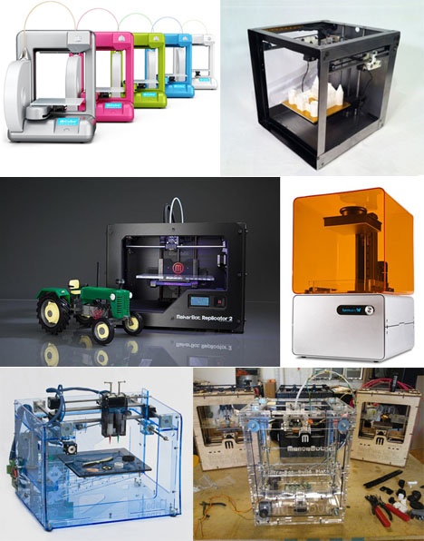

Slide 6

www.kahoot.it
305781

Slide 7
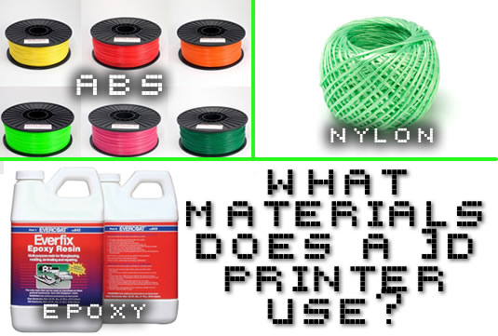
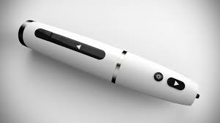
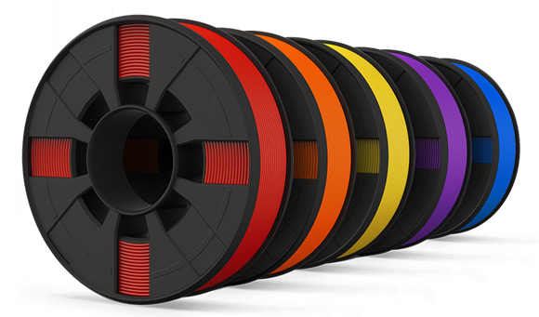

Slide 8
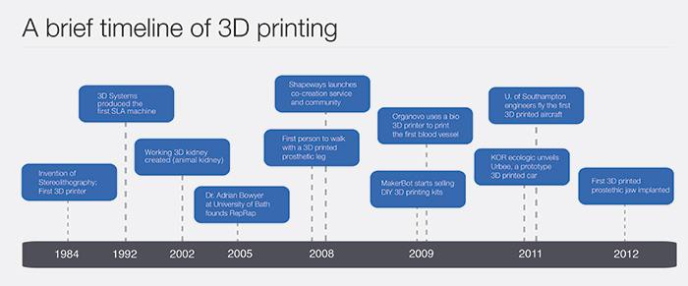
Notes:
M3D, Staples, Conductive filament, etc

Slide 9
https://www.youtube.com/watch?v=SObzNdyRTBs

Slide 10
IDEA
Design Software
Printer Software
Product

Slide 11


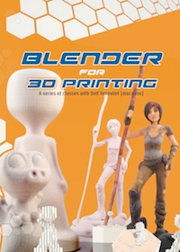
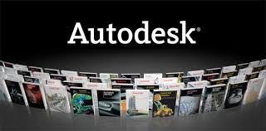

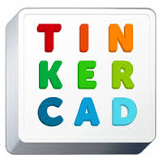

Design Software

Slide 13
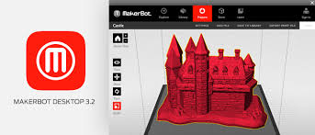
Printer Software

Slide 14
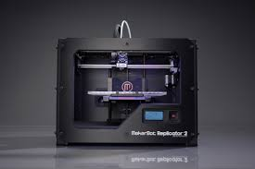
Product

Slide 15

Video
https://www.youtube.com/watch?v=_OBlgSz8sSM

Slide 16
Lt’s Try It!
Tinkercad.com
Create Account

Slide 17
http://bit.ly/transformEDsessions

