Slide 1
This Power Point highlights the structure of
sessions in transformED.
While sessions may be individualized based on
presenters’ needs, the following template and
general format are followed.
Slide descriptions are included in red font on each slide for presenter use.
Please delete red font upon finalization of
presentation.

Slide 2
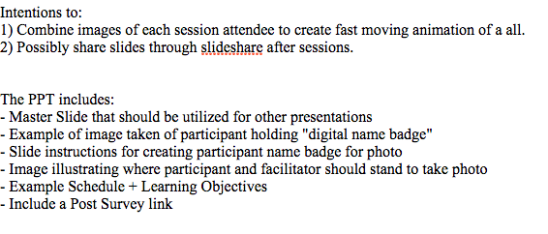
Items included in this Power Point template:

Slide 3
PRINT THAT POPS
AND REACTS 1.22.15
Afternoon Session Heather Mallak, Public Studio
Title page

Slide 4
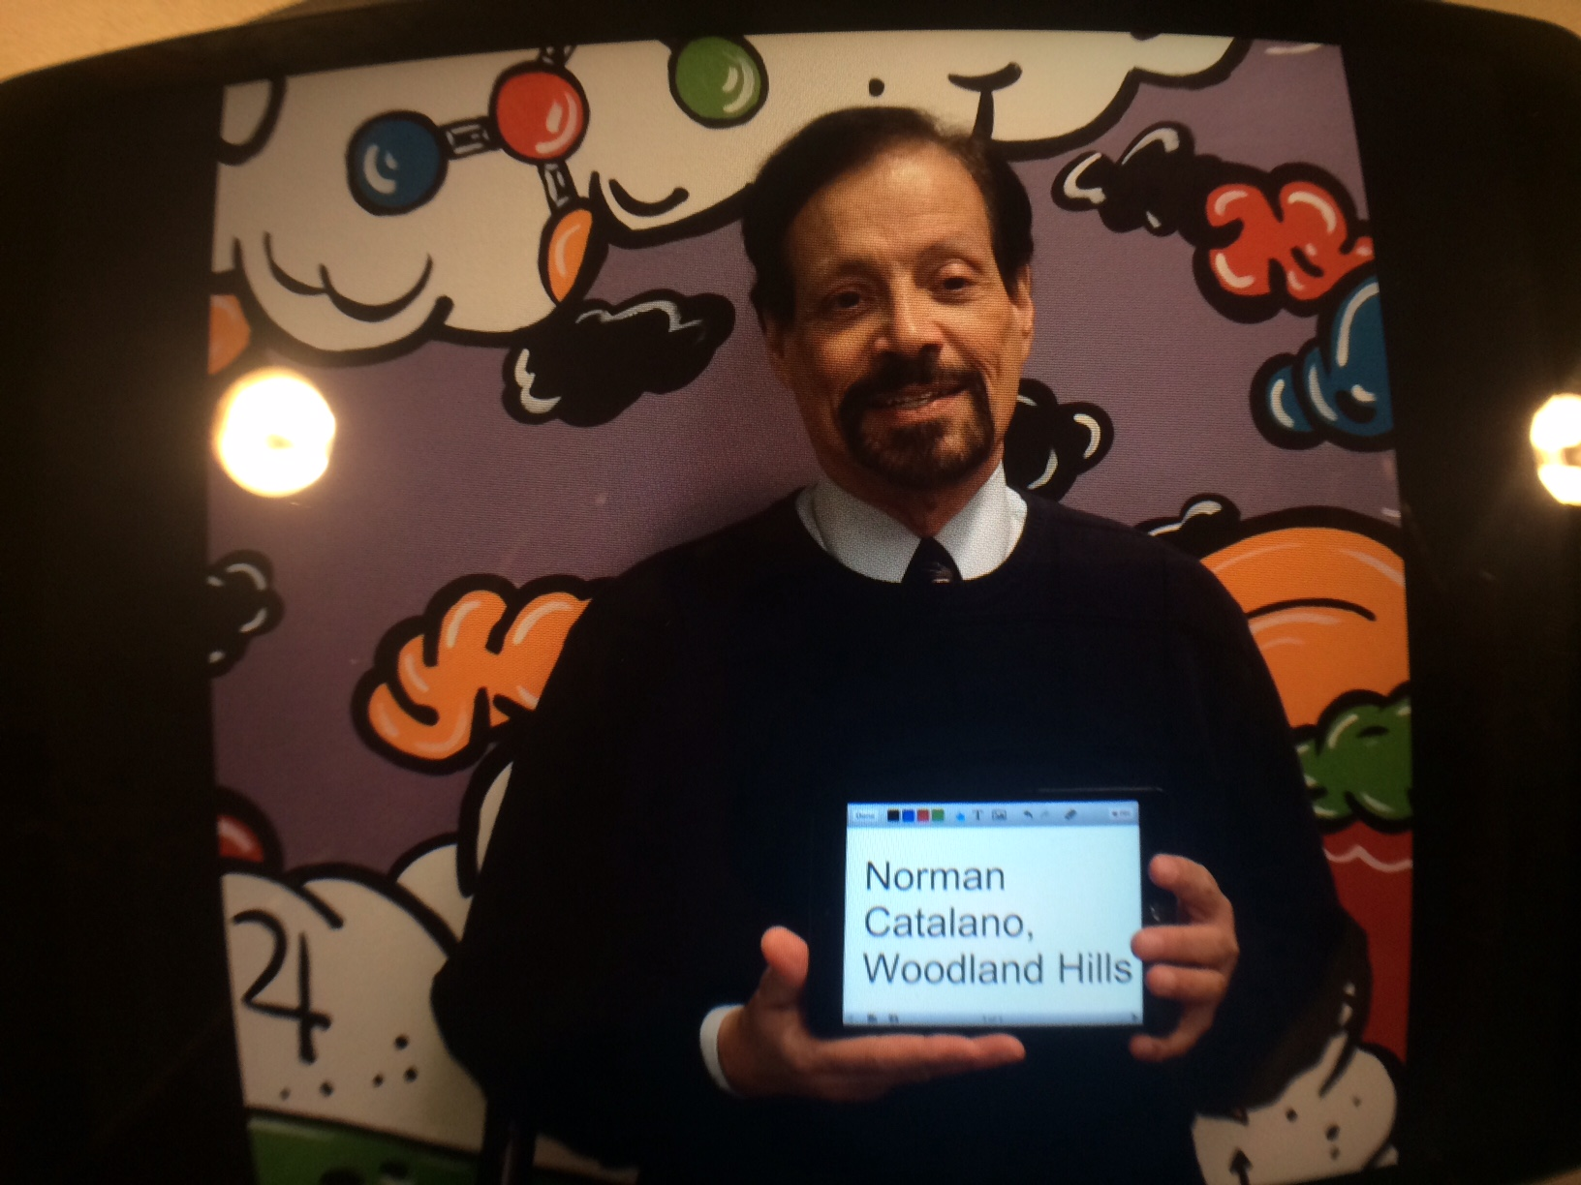
.
Seek out iPad mini w/ green
tape - “Documentation” + has
this homescreen. Before session
starts, have attendees create
Digital name tags and get photo
taken by you. It is crucial for all
to participate for resulting
transformED animated collage
IMPORTANT - Documentation project

Slide 5
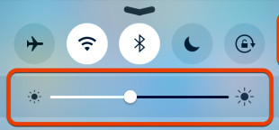
1) Open Educreations APP on iPads:
“New lesson”, ignore microphone prompt
In large font, type: Name
School
2) Turn brightness down on iPad
3) Stand near wall mural
Use these instructions with participants

Slide 6
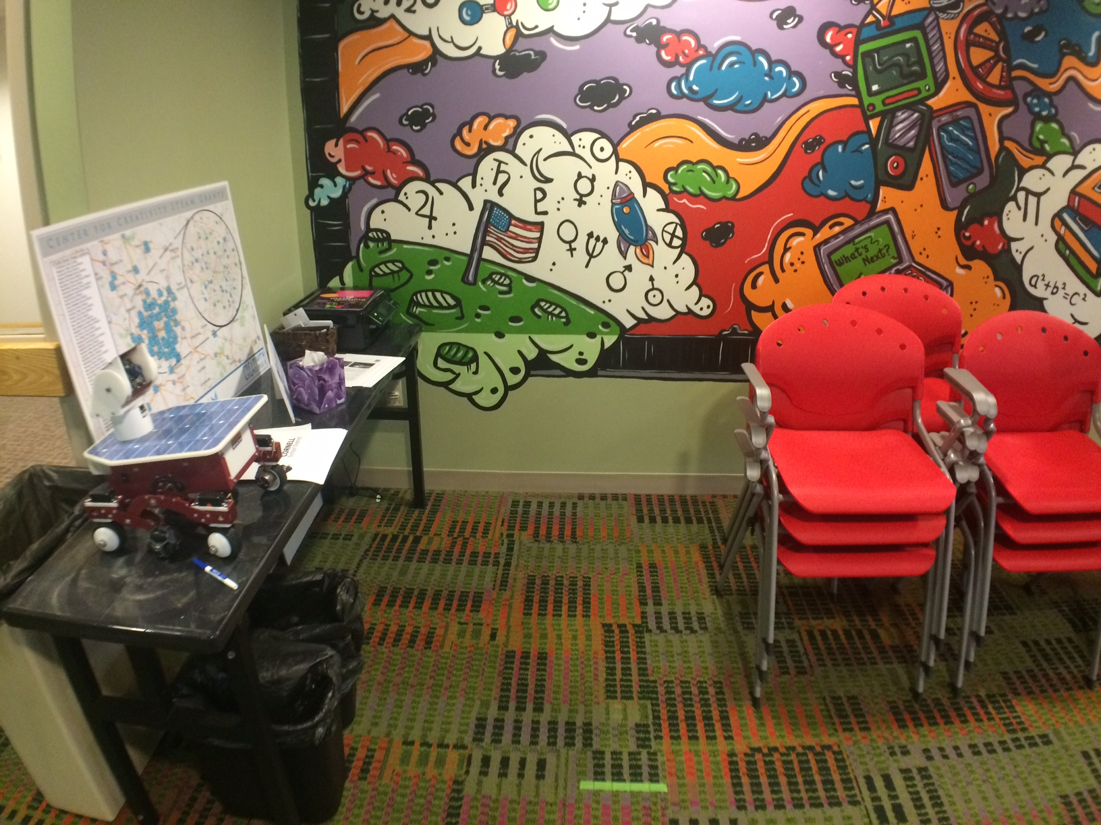
Teachers stand against wall between flag + rocket ship.
Confirm iPad brightness has been turned down.
Take photo using iPad camera.
Verify they turned out “ok” and are added to the other images of educators from previous sessions in photos.
Photo Area

Slide 7
11:40 “Sign-in” + Intro to Augmented Reality
12:00 Examples of various applications of AR
12:20 Ted Talk + Break
12:30 Aurasma - Create AR, refine AR
2:00 Discuss ideas, share list from Edutopia
2:10 Create design plan for integration
2:25 Post-survey http://bit.ly/surveylink
Schedule

Slide 8
Session participants will be able to:
Discuss Augmented Reality
Describe exps. of various applications of AR
Create an AR overlay and trigger image
List ideas for use with students
Leave with an action plan to integrate
Learning objectives

Slide 9
http://bit.ly/surveylink
Post Survey

