Slide 1
Page File Management in Windows
-Suprotik Dey

Slide 2
What is Paging?
Paging is a memory overflow management technique used by an Operating System. It behaves like a virtual memory.
Ferranti introduced paging on the Atlas in the 1970s.
Paging has been a feature of Microsoft Windows since Windows 3.0 in 1990.
It continued as a feature in the current Windows NT kernel currently we see in action.
It can be found as a hidden file in the root directory named pagefile.sys.

Slide 3
Why do we need it?
In a multi-process OS like Windows, programs interact with the memory using virtual memory addresses, and the OS makes each and every process think that it has a huge chunk of logical address space.
The total amount of memory required to run all the programs simultaneously may be greater than the amount of physical memory required.
So, the idea is to take out the program memory chunks from RAM and store it in HDD, what is currently not required.

Slide 4
How does it work?
In Windows, the RAM is broken into equal 4KB blocks called page frames.
The memory chunk present in each frame is known as a page.
When the memory being used by all the existing processes exceeds the available RAM, the OS moves pages of one or more virtual address spaces to the HDD. This frees RAM frames for new demands.

Slide 5
Who manages it?
The OS manages the loading and storing of pages using a lookup page table with the help of MMU(Memory Management Unit).
Pages are swapped in following algorithms like demand fetch.
Pages are swapped out following algorithms like LRU.
Page Faults – When page requested is not found in RAM.

Slide 6
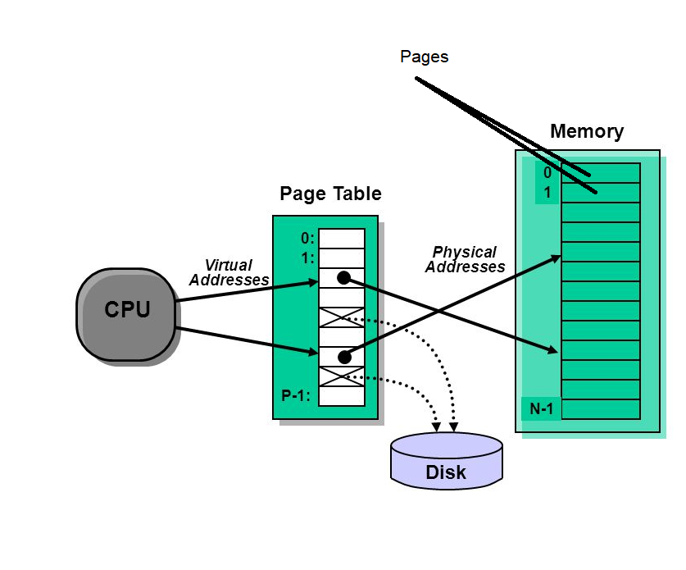
Visualization of Paging

Slide 7
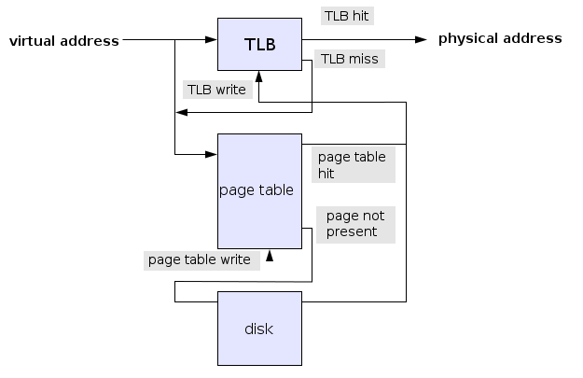

Slide 8
What are the problems?
Kernel cannot be moved out of the physical memory at any time.
Thrashing – When page faults are too frequent and CPU spends maximum time swapping. The system becomes unresponsive.
The pagefile is on the drive with heavy I/O.

Slide 9
References
https://support.microsoft.com
https://en.wikipedia.org
https://stackoverflow.com

