Slide 1
IIEST HUMANOID PROGRAMME
AN INITIATIVE OF ROBODARSHAN, IIEST SHIBPUR

Slide 2

Our Initiative

Slide 3
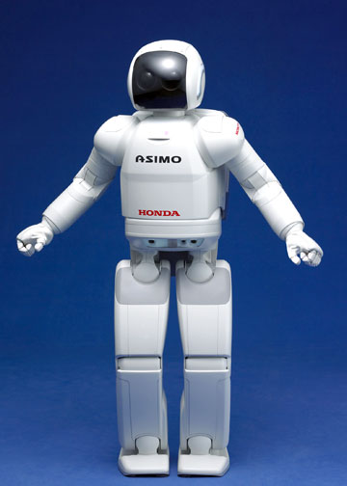
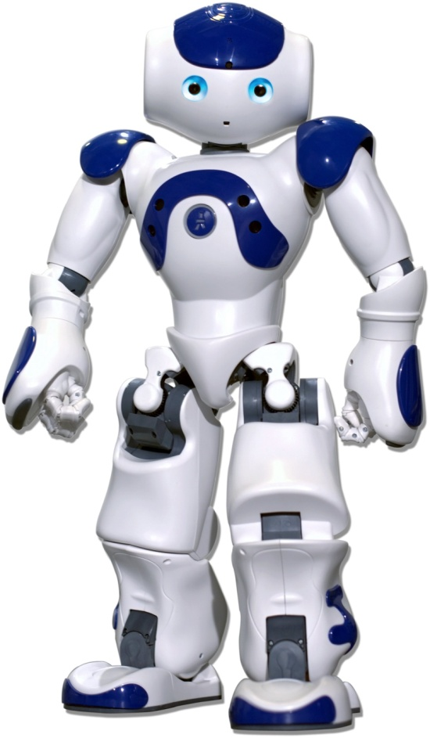
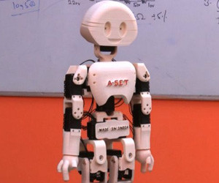
WHAT ARE HUMANOIDS ?
Some great examples of existing Humanoid robots : NAO by SoftBank Robotics, Asimo from Honda and Manav from A-Set Institute, India.

Slide 4
What are the features?
A humanoid stands as a direct machine replacement to a human.
Features include a fully autonomous robot with cognitive and mechanical abilities of a human being.
Cognitive abilities:
Object detection
Object tracking
Face recognition
Emotion detection
Speech recognition
Speech synthesis
Context detection
Question answering
Area mapping
Self awareness
Mechanical abilities:
Bipedal locomotion
Arm gripping
Facial expressions
Touch feeling
A full human like movement

Slide 5
Where do we fit in?
Most Humanoid robots existing today fall in either of the following categories:
Built by multi national companies using enormous capital and proprietary hardware and software. Built by experts and huge price.
Commercially available, built in large scale but having very restricted cognitive capabilities, rendering it to be nothing more than a luxury toy.
We aim to fill this gap. We have started using open source software packages, easily available harware kits and also built some by our own.
After a certain threshold of development, we aim to make the be whole project open-source. All license will be retained by Robodarshan. This is a long term project.

Slide 6
Utilities
India is a developing country and people will decide this project to be an unnecessary luxury toy.
But, it will be CHEAP and will serve the following utilities:
Attending children, elderly people and the disabled.
Educating children in rural areas where teachers are scarce.
Doing simple household chores.
Much more, the sky is the limit!

Slide 7
Current progress..

Slide 8
Currently, we are concentrating on software.
The major ground level models are towards the finishing stage.
All major progresses have been achieved using machine learning.
Also we have made some progress in the Face part of our humanoid.
The progress is depicted in the next few slides

Slide 9
Object recognition and tracking
Object tracking has been modeled using common household objects including bottle, cellphone, person, etc and it has proved to be quite accurate.
Tracking has also been achieved quite successfully.

Slide 10
Speech Detection and Synthesis
Speech is quite a hard task to achieve, so, currently, we are using Google’s Speech API
However, we are working on a model which can detect and synthesise speech offline.

Slide 11
Face Recognition
We have built a face recognition model, which can store new faces and identify stored faces from the database quite accurately.

Slide 12
Facial Emotion Recognition
We tend to show a complex mix of emotions.
We have developed a model to classify into 6 general types of emotions, but since we tend to show a mixture in any instance, the accuracy is low.

Slide 13
Context Detection and General Behaviour
We have classified all context into two major parts: Instructions and General Chatting.
The instructions will be handled by a simple model, while the complex chatting part will be done on cleverbot api. We will eventually replace it with an offline version.
We finally aim to build a temporal model with vision and speech mapped together.

Slide 14
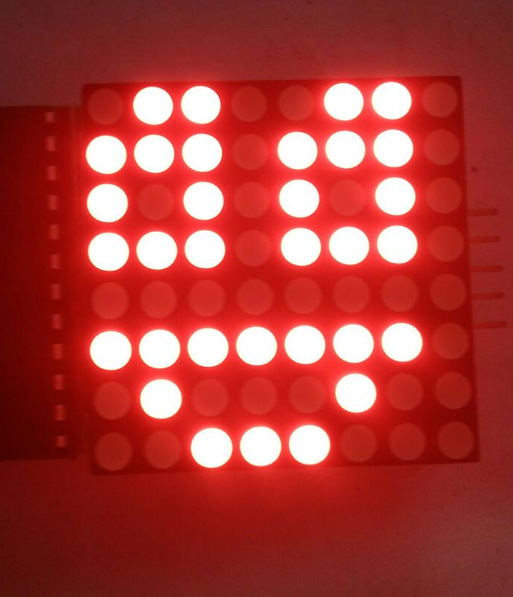
Facial emotion expression
We have built an LED Matrix face capable of showing common emotions modelled in a natural way.

Slide 15
Area mapping
Sonars and camera will help map nearby surroundings.

Slide 16
Next moves..

Slide 17
Setting up the body
We are going to set up an aluminum chassis with servos for the whole body.

Slide 18
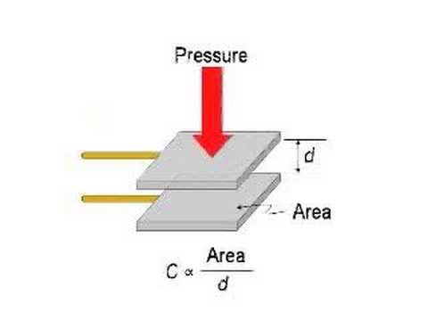
Pressure point development
We intend to make our robot very much interactive with the environment, thus pressure points are to be set up all over.
The goal is to make a cheap pressure sensor

Slide 19
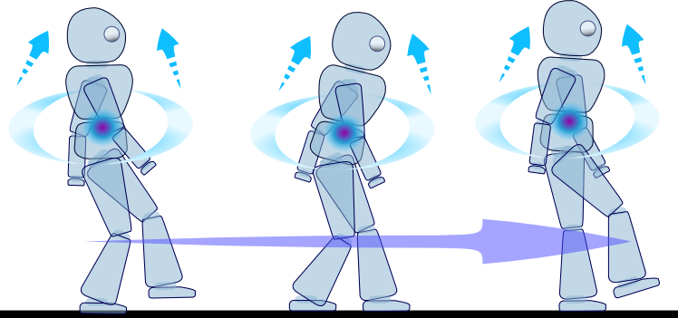
Locomotion
LOCOMOTION PLANNING
CONTACT AND COLLISION DETECTION
STATIC EQUILIBRIUM TEST

Slide 20
Behavioural Model
The objective of this module is to develop new mechanisms and functions in order to realize natural bilateral interaction by expressing emotions, behaviours and personality in a human-like manner.

Slide 21
Overview of data flow
All lower level models like object detection, face recognition, etc will constantly supply data to higher models like the context analysis model.
Autonomous hardware routines like walking and balancing will run on microcontrollers.
Instructions will be fed from high level models to hardware through microcontrollers.

Slide 22
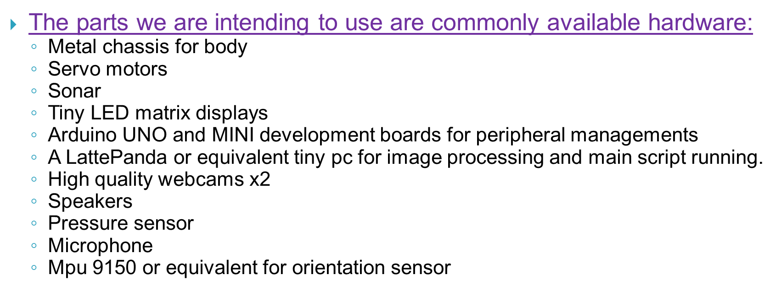
HARDWARE IMPLEMENTATIONS

Slide 23
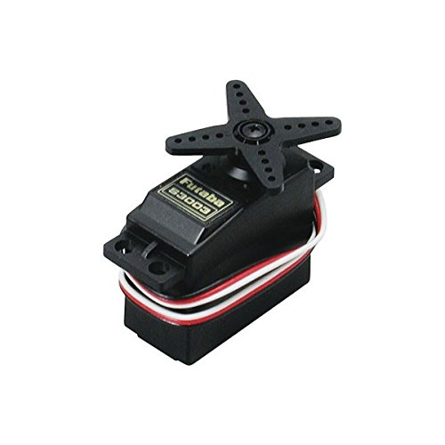
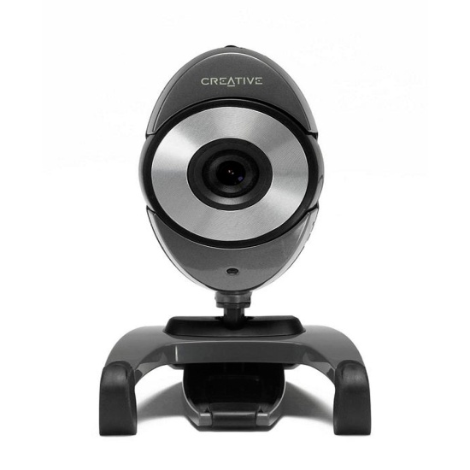
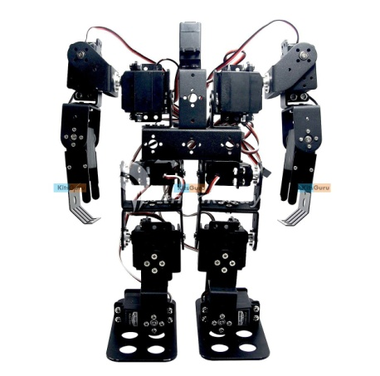
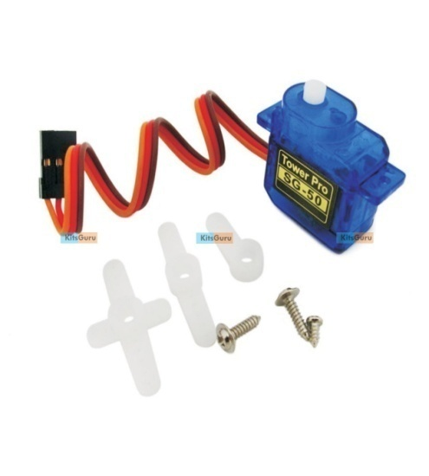
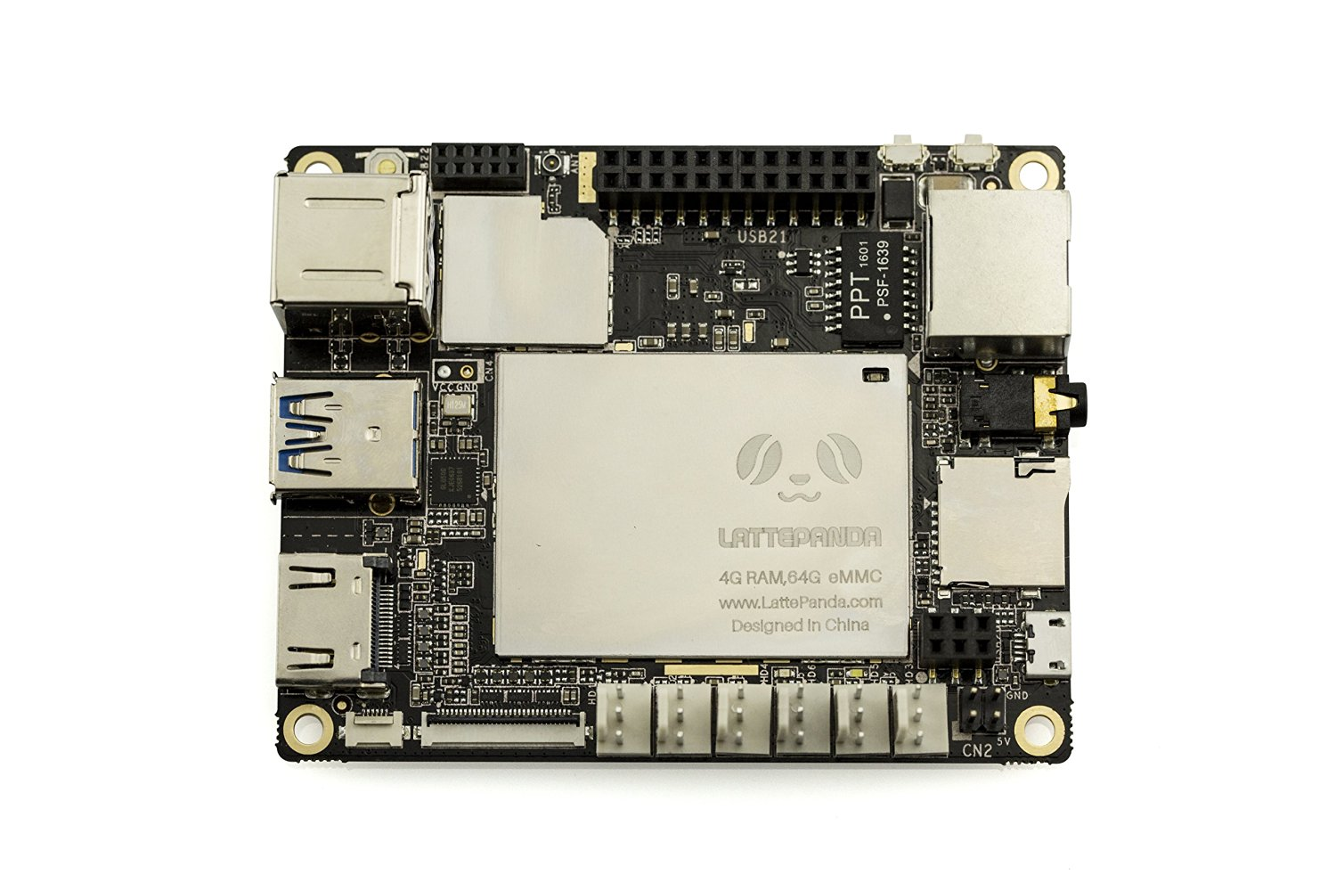
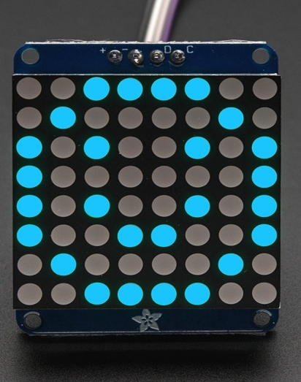
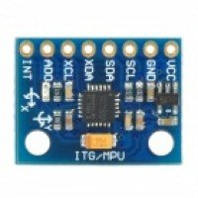

Slide 24
List of contributors
Punyajoy Saha (3rd Yr)
Ranit Chaterjee (3rd Yr)
Suprotik Dey (3rd Yr)
Sayan Ganguly (3rd Yr)
Vivek Sharma (3rd Yr)
Pratik Basu(2nd Yr)
Sarvajeet Haldar(2nd Yr)
Sobhan Mondal(2nd Yr)
Pragyesh Bajpai(2nd Yr)
VISIT US AT: http://robodarshan.in/
https://www.facebook.com/robodarshan/

Slide 25
THANK YOU

