Slide 1
General Concept
ML Models are able to modify live video
Individual models are opaque
Camera hardware is moving towards running trained ML models on-device
This creates a series of opportunities

Slide 2
Options
All implementations break down into three steps:
Identify trigger element in image
Mask or identify item to be altered
Alter item and return altered footage
Object | Trigger | Action
Person | Key Logo | Erase
Face | Key Logo | Replace
Vehicle | Key Logo | Recolor
Person | Action | Erase/Replace Face

Slide 3
Example: Remove Tagged Person
“Cloak of Invisibility”

Slide 4
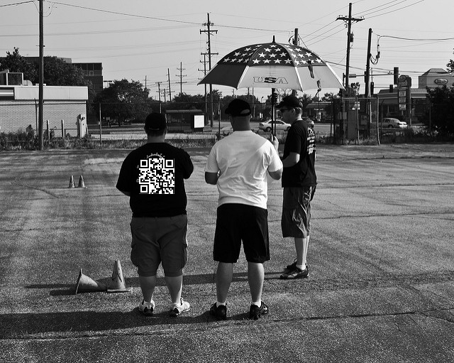
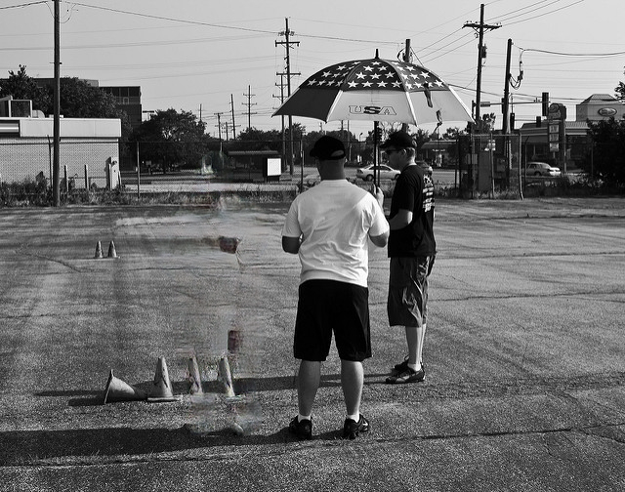
Cloak of Invisibility

Slide 5
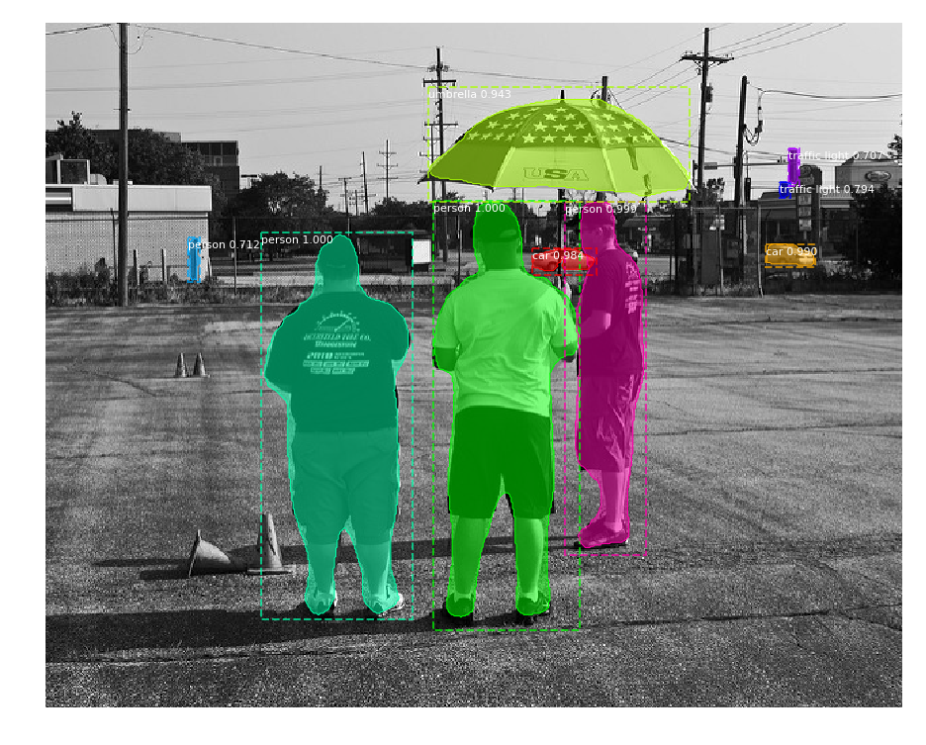
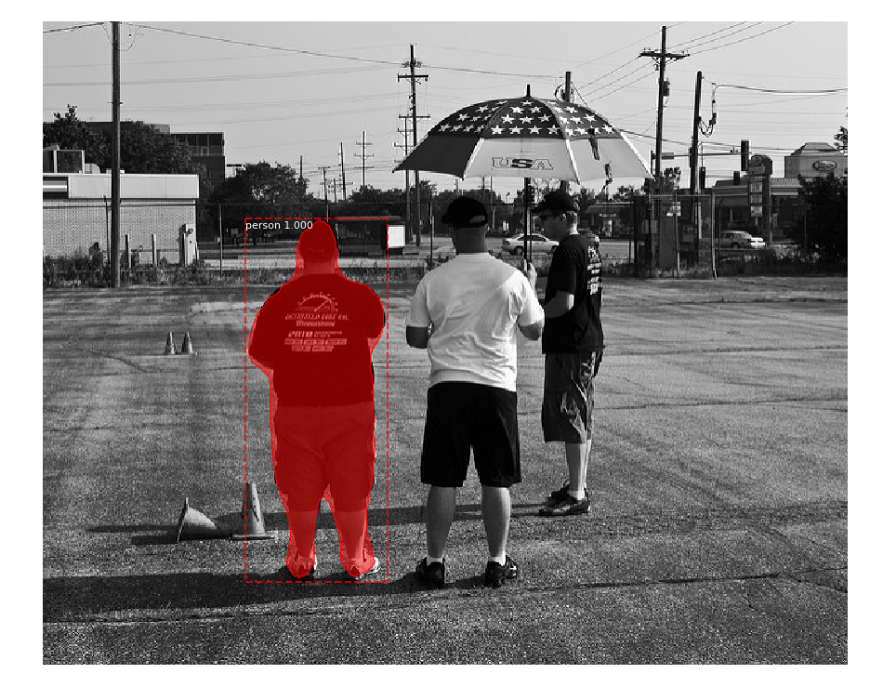

Pipeline
1) Video Feed
2) Detect Objects
3) Identify Trigger
4) Create Mask
5) Inpainting

