Slide 1
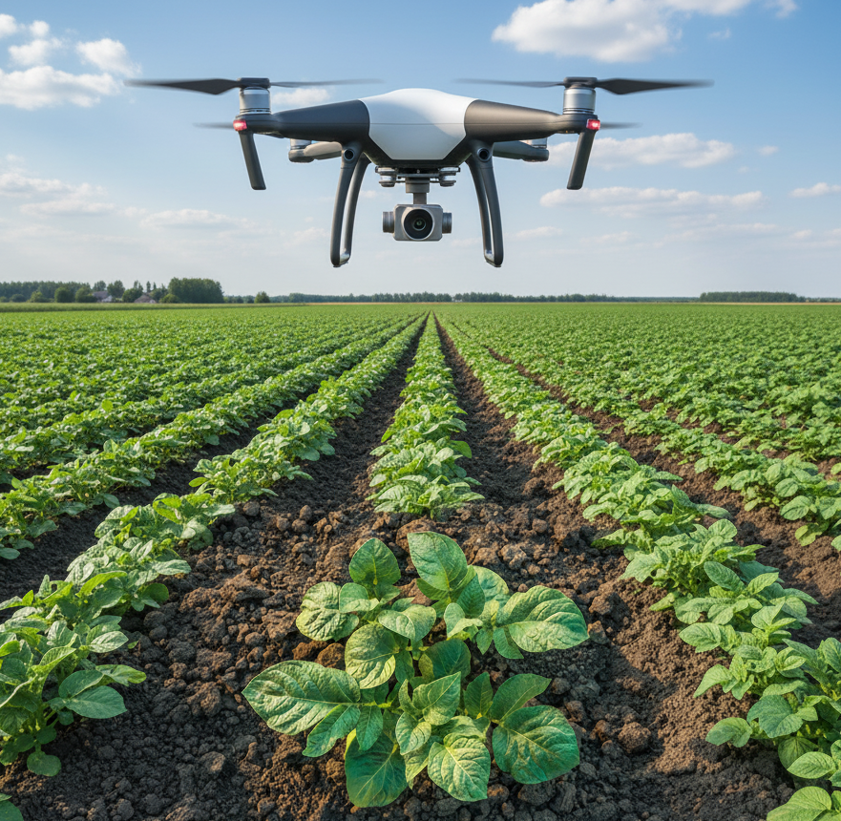
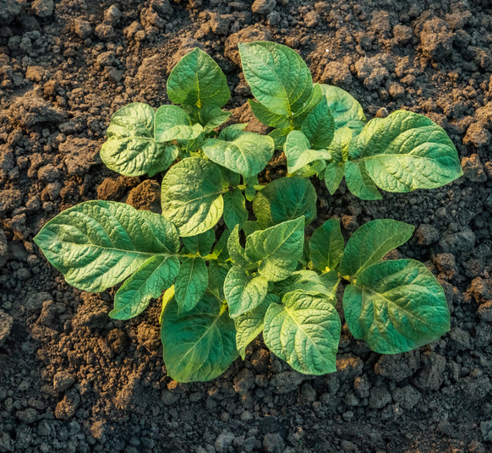
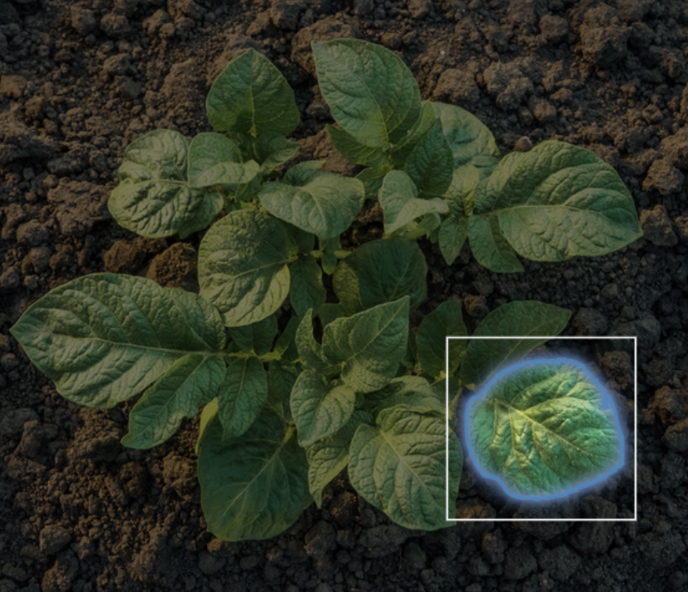
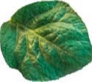
PlantDis – Desktop analysis of leaf images
Disease detection model
Automatic segmentation of
all leaves
One of the leaf
after segmentation
Top down image of
potato plant from drone
or camera in glasshouse
Cropped drone
image
Potato healthy

