Slide 1
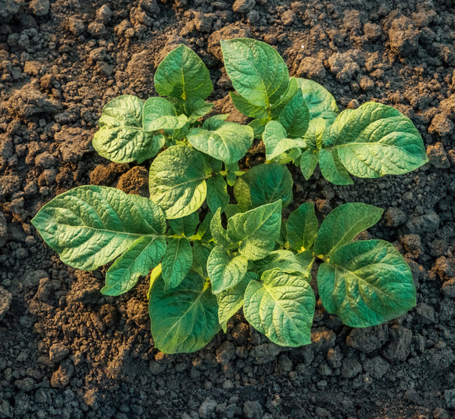
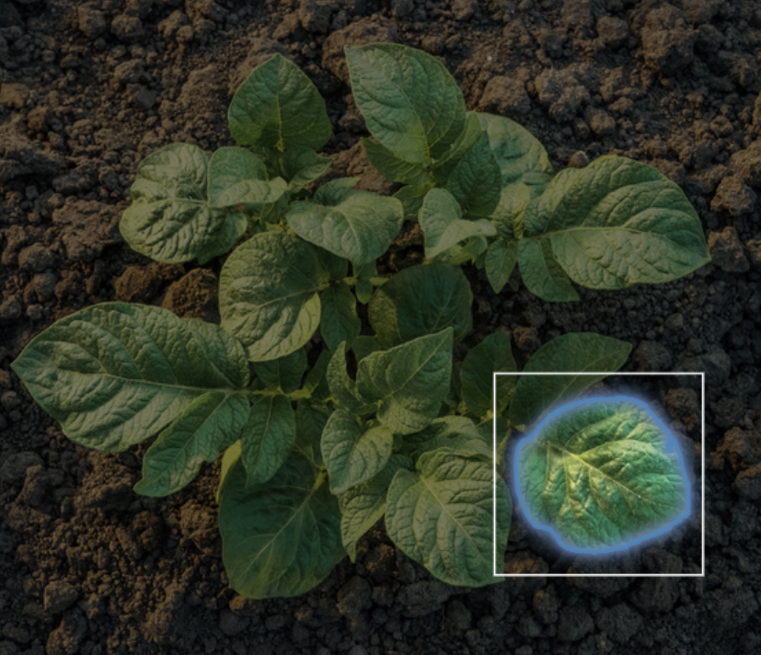
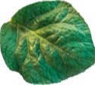
PlantDis – A Plant Disease Detection App
Disease detection model
Top down image of
potato plant
User drawing
bounding box
Image after
segmentation (SAM)
Potato healthy

