Slide 1
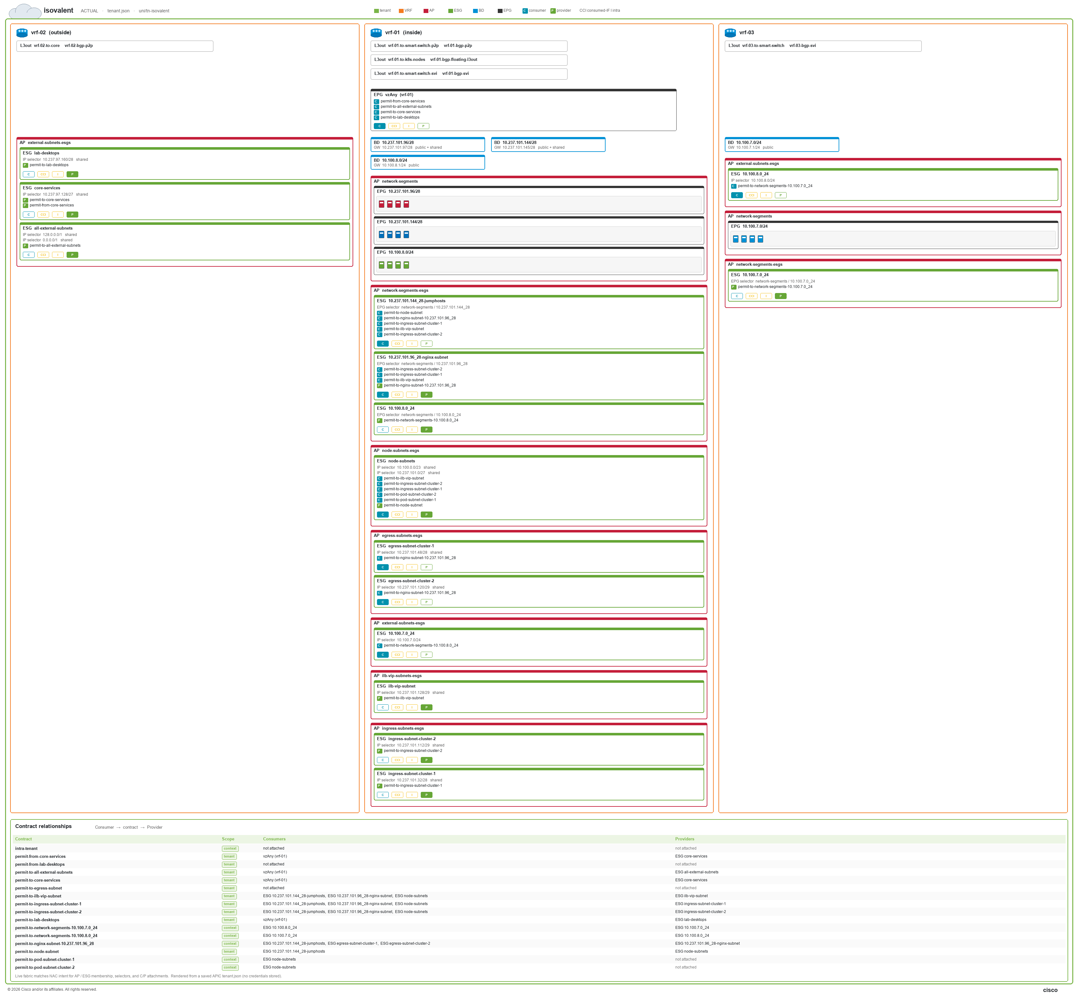
Notes:
isovalent
ACTUAL · tenant.json · uni/tn-isovalent
Live fabric matches NAC intent for AP / ESG membership, selectors, and C/P attachments. Rendered from a saved APIC tenant.json (no credentials stored).

