Slide 1
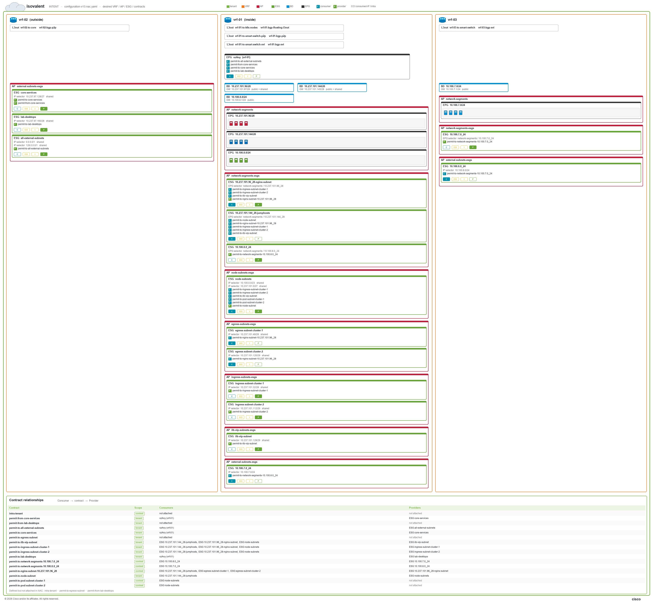
Notes:
isovalent
INTENT · configuration-v13.nac.yaml · desired VRF / AP / ESG / contracts
Defined but not attached in NAC: intra-tenant · permit-to-egress-subnet · permit-from-lab-desktops

