Slide 1

Lending Club Case Study
Screenshot

Slide 2
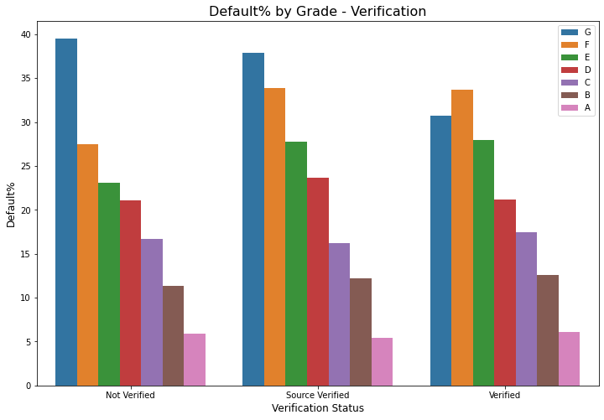

Slide 3
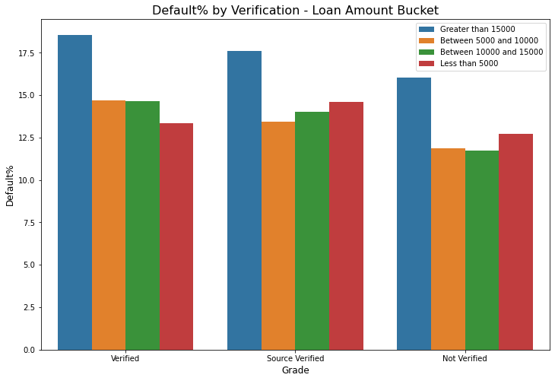

Slide 4
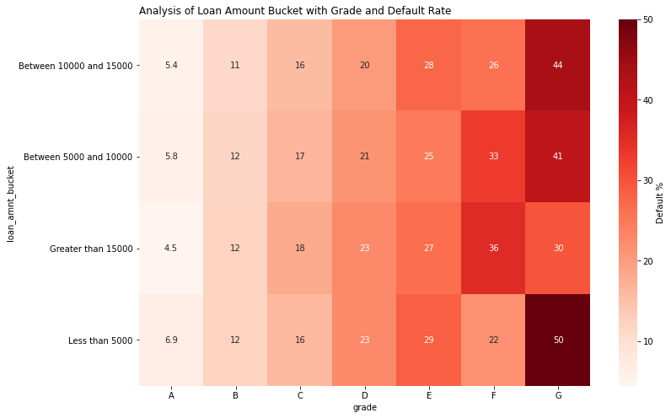

Slide 5
