Slide 1

SAMSUNG PRISM
Generative AI
Hackathon
3rd Edition 2026 – 27
Theme ID - Theme 4 · Streaming Live RAG
Project - Streaming Live RAG
Team Name - Fantastic 4
College Name - SRM Univ
Member 1 - Sneh Prasad · sp0701@srmist.edu.in
Member 2 - Purva Jain · pj8602@srmist.edu.in
Member 3 - Agadh Khanolkar · ak1920@srmist.edu.in
Member 4 - Srushti More · sm1436@srmist.edu.in
Submission GitHub link - github.com/spsneh07/Prism-Streaming-Live-rag
Notes:
Team Fantastic 4, SRM Univ. Theme 4, Streaming Live RAG. One line: retrieval that starts while the user is still speaking, splits compound requests, and refines the answer when late details arrive. All numbers in this deck come from a development benchmark on a 16-document synthetic corpus; the official Theme 4 corpus was not available.

Slide 2
Theme 4 — Streaming Live RAG
THE PROBLEM
Natural speech is not a clean search query.
1
Asks several questions
in one utterance
2
Adds an important detail
halfway through
Conventional RAG generally waits for the complete utterance, then runs one search.
3
Corrects itself
mid-sentence
4
Asks to change
a previous answer
CONVENTIONAL RAG
Speak
Wait
Retrieve
Answer
STREAMING LIVE RAG
Speak
Partial transcript
Retrieve
More speech
Refine
Answer
Objective Retrieve useful context while the conversation is still unfolding.
Notes:
Voice users speak one natural sentence, not a search query. It can hide several questions, a late constraint, a correction, or a request to reformat the last answer. Typical RAG waits for silence and sends the whole sentence as one query. Theme 4 asks for retrieval that works while the conversation is still unfolding.

Slide 3
Existing Solutions & Gaps
Typical query-then-retrieve pipelines
Streaming Live RAG (ours)
Query handling
Whole utterance → one query
One utterance → N sub-queries
Retrieval timing
Starts after the user stops speaking
Starts during speech, once the partial transcript is specific
Multi-intent requests
Intents blended into a single query
Decomposed, retrieved in parallel, fused
Late-arriving details
Usually a fresh query over the whole context
Delta-only retrieval; answer v1 → v2
Unnecessary retrieval
Every turn searches the corpus
Presentation / chit-chat turns → SUPPRESS
Session refinement
Little answer state kept between turns
Session memory keeps claims, citations, sub-queries
Grounding
Citations are often best-effort
Every claim validated; calibrated abstention
Measured on our conventional baseline: early retrieval 0% · multi-intent 0% · 8 searches on 8 no-search turns · refinement continuity 0%
Development benchmark · 16-document synthetic corpus · held-out split, 63 cases / 77 turns · written by the system's author; not an official Samsung evaluation
Notes:
We do not claim every existing system behaves this way; this is the typical query-then-retrieve pattern, which is also what our conventional baseline implements. The bottom line is measured on that baseline in our development benchmark.

Slide 4
Our Solution
01
02
03
04
05
06
Incremental transcript
Retrieval controller
Multi-intent decomposer
Parallel retrieval
Evidence fusion + reranking
Grounded answer
chunks arrive while the user is still speaking
WAIT
one utterance → N sub-queries
dense + BM25 for every sub-query
RRF · dedup
cross-encoder rerank
cited claims, validated; abstains when evidence is missing
RETRIEVE
SUPPRESS
utterance end
KEY IDEA
Speech
Live retrieval before utterance end
Controller
Retrieval
Provisional retrieval and answer-sentence scoring run while the user is talking; results are reused when they stop.
Answer
Retrieval began 1.29 s before the user finished
Actual trace · Demo 2 (Theme 4 guide example) · real-time pace · scripts/demo_stream.py --scenario multi_intent
Notes:
Six stages. The controller runs on every transcript chunk and decides WAIT, RETRIEVE or SUPPRESS. As soon as the partial transcript is specific, retrieval starts in the background. The panel shows the real Demo 2 trace: first chunk WAIT at 0.00 s, RETRIEVE at 0.81 s, second RETRIEVE at 1.62 s, utterance end at 2.11 s. Retrieval began 1.29 s before the user finished.

Slide 5
System Architecture
RETRIEVE during speech → provisional retrieval, reused at utterance end
01
02
03
Parallel retrieval × N
06
07
09
Streaming transcript input
Retrieval controller
Multi-intent decomposer
RRF fusion
Reranker
Grounding / citation validator
WAIT
04
Dense
MiniLM
05
BM25
sparse
chunks on one clock
RETRIEVE
segment · re-attach · carry entities
quota · dedup · versions
cross-encoder
id · evidence · text · numbers
SUPPRESS
late detail or presentation turn
delta sub-queries only (refinement)
validated claims
08 Session memory (session-scoped only)
answer vN · claims · citations · per-sub-query results; 30-min idle TTL, no user id
SUPPRESS: presentation-only request
10 Streaming response
SSE → dashboard: answer vN + citations + uncertainty
reshape the previous answer from session memory · no corpus search
11 Telemetry every stage emits events on one monotonic clock → live dashboard · SSE · JSONL export · benchmark
main flow
provisional, during speech
late-detail refinement
suppression
Notes:
Main flow left to right: transcript chunks, controller, decomposer, parallel dense and BM25 retrieval per sub-query, RRF fusion with a coverage quota, cross-encoder rerank, then the grounding validator and the SSE response. Green dashed: RETRIEVE decisions during speech start provisional retrieval in the background; results are reused at utterance end. Blue: a late detail is classified as a refinement; session memory supplies the prior sub-queries and claims and only delta sub-queries are searched. Purple: a presentation-only request is SUPPRESSED and the previous answer is reshaped from session memory with no corpus search. Session memory is process-local, 30-minute idle TTL, no user identifier. Every stage emits telemetry on one clock.

Slide 6
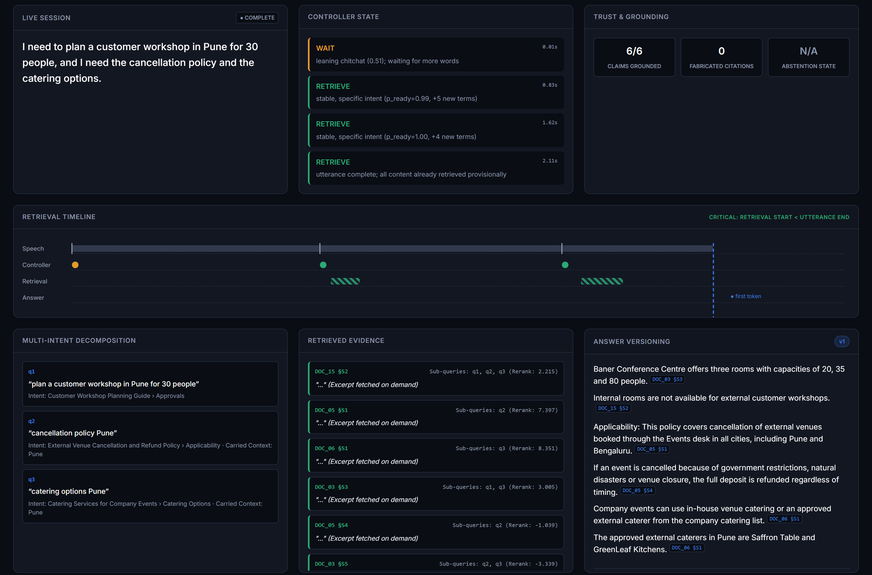
Demo & Product Walkthrough
DEMO 2 · ONE SENTENCE, THREE SEARCHES
0.00 s
“I need to plan a customer”
WAIT
not specific yet
0.80 s
“workshop in Pune for 30 people,”
RETRIEVE
q1 starts, provisional
1.61 s
“and I need the cancellation policy and the catering options.”
RETRIEVE
q2, q3 start · “Pune” carried
2.11 s
utterance ends
ANSWER
3/3 reused · 1 duplicate dropped · 6/6 claims grounded
Actual dashboard, captured from the running app · Demo 2 at real-time pace
WAIT
RETRIEVE
Sub-query decomposition
Parallel retrieval
Fusion
Grounded answer
Notes:
This is the Theme 4 guide's own example, run live in our dashboard. The transcript arrives in three chunks. First chunk: WAIT, not specific yet. Second chunk: RETRIEVE, the first sub-query starts while the user is still talking. Third chunk: two more sub-queries, with Pune carried into both. At utterance end all three are reused, fused (one duplicate catering FAQ dropped) and answered with 6 of 6 claims grounded. The capacity sub-intent is answered with a Pune venue that fits 30 people (Baner Conference Centre, DOC_03 §S3), via the quantity-constraint check. Timings are from scripts/demo_stream.py --scenario multi_intent.

Slide 7
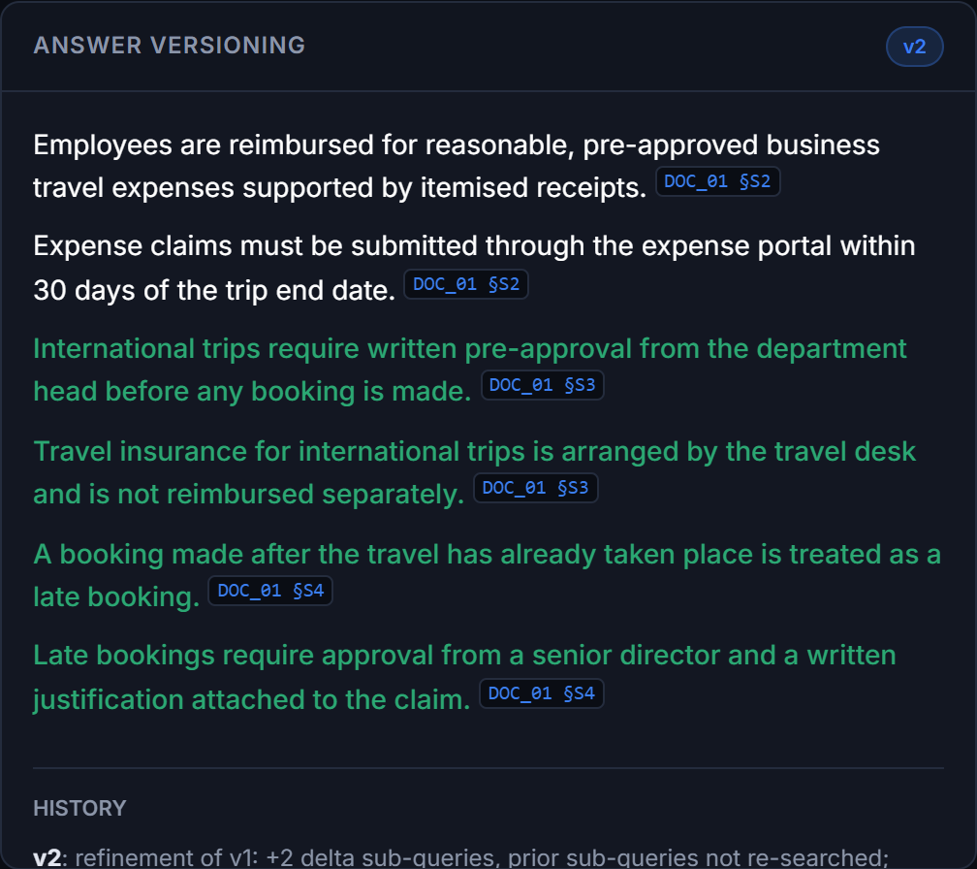
From First Answer to Refined Answer
01 · EARLY RETRIEVAL
02 · LATE DETAIL
Demo 1 · the user keeps talking while evidence arrives
Demo 3 · a new constraint refines the answer
0.0 s
“So I'm heading to Singapore next month”
WAIT
Answer v1
2 claims · reimbursement rule
2.8 s
“to visit a customer, and before I book anything”
RETRIEVE
User adds
“The trip was international and the booking was made after travel.”
6.0 s
“I'd like to know the daily meal allowance”
RETRIEVE
8.8 s
“for international travel.”
RETRIEVE
Delta retrieval
refinement detected → 2 new sub-queries; prior sub-queries re-searched: 0
Actual dashboard · v2: green = added claims
10.3 s utterance ends → evidence already retrieved, answer cites DOC_01 §3
Answer v2
2 claims kept + 4 added
Retrieval started 7.47 s before the user finished
Held-out: early retrieval on 90% of eligible turns, mean lead 4.4 s
No full-session restart. Refinement continuity 100% vs 0% (baseline)
Development benchmark · 16-document synthetic corpus · held-out split, 63 cases / 77 turns · written by the system's author; not an official Samsung evaluation
Notes:
Left, Demo 1: the controller waits on the vague opening, retrieves as soon as the request is specific, and refines the query as more words arrive. Retrieval started at 2.83 s; the utterance ended at 10.30 s. Right, Demo 3: the second turn adds two constraints. It is classified as a refinement, only two delta sub-queries are searched, the v1 claims are kept and four new claims are added in v2. The session is not restarted. Continuity is 100% on the 7 held-out refinement turns vs 0% for the baseline.

Slide 8
Tools & Technology
STREAMING & API
RETRIEVAL & RANKING
MODELS & PROCESSING
FastAPI + Uvicorn async API server
Server-Sent Events live event stream
asyncio parallel sub-query retrieval
Pydantic request / response models
all-MiniLM-L6-v2 dense embeddings
BM25 (in-house) sparse retrieval
RRF (in-house, k = 60) rank fusion
ms-marco-MiniLM-L6-v2 cross-encoder reranker
Python 3.13 · NumPy core pipeline
PyTorch (CPU) + HF transformers model inference
scikit-learn logistic regressions: controller, abstention gate
FRONTEND
TESTING & EVALUATION
DEPLOYMENT
HTML · CSS · vanilla JavaScript live dashboard, no framework
fetch stream reader consumes the SSE event stream
pytest 61 tests: 60 pass, 1 strict expected failure
benchmark + report scripts held-out evaluation, gates
matplotlib · JSONL plots · telemetry export
Docker CPU-only image
Docker Compose app · tests · benchmark profiles
No LLM calls by default answers are extracted from the corpus; LLM cost per turn $0; runs entirely on CPU
Notes:
Only technologies actually in backend/requirements.txt and the repo. BM25 and RRF are implemented in-house. The dashboard is plain HTML, CSS and JavaScript that reads the SSE stream. There is an optional LLM synthesizer interface, but it is off by default and not used for any reported number.

Slide 9
Impact & Use Cases
POTENTIAL USE CASES
WHAT THE ARCHITECTURE CHANGES
A
Voice & conversational assistants
retrieval starts while the user is still talking
LOWER PERCEIVED WAIT
SAME PIPELINE
90%
187 → 21 ms
B
Voice-driven enterprise search
policies, travel, facilities, HR
turns where retrieval starts before the user finishes
time to first token without → with early retrieval
Device support & troubleshooting
multi-part problem descriptions in one breath
MULTIPLE INTENTS
INCREMENTAL REFINEMENT
C
78% vs 0%
100% vs 0%
compound requests split correctly
late details handled without restart
D
Enterprise knowledge assistants
cited answers, or an explicit “not in the documents”
FEWER UNNECESSARY RETRIEVALS
GROUNDED ANSWERS
Real-time information assistants
late details refine the answer instead of restarting
1 vs 8
100% · 0
E
searches on turns that need none
claims supported · fabricated citations
Prototype only: not deployed in production.
Development benchmark · 16-document synthetic corpus · streaming Live RAG vs conventional baseline unless noted
Notes:
These are potential use cases, not deployments. The right side shows what the architecture changes, measured on the development benchmark: retrieval before the user finishes, lower time to first token than the same pipeline without early retrieval, compound requests split, late details handled without restart, fewer unnecessary searches, and grounded answers.

Slide 10
Results & Evaluation
MEAN RETRIEVAL LEAD
4.4 s before the utterance ends
TIME TO FIRST TOKEN AFTER SPEECH ENDS (MEAN)
Conventional RAG
14 ms
Streaming Live RAG
21 ms
Same pipeline, no early retrieval
187 ms
The baseline is faster: it does less work per turn. Early retrieval hides most of our extra compute.
TRADE-OFF: CONSERVATIVE ABSTENTION
The gate refused 12 of 63 answerable turns: citation hit rate 73% equals the baseline (84% without the gate), while correct abstention rises 33% → 83%.
G1 PASS
G2 PASS
G3 PASS
G4 PASS
G5 PASS
G6 PASS
Gates
G1: Docker on dev machine only
Development benchmark · 16-document synthetic corpus · held-out split, 63 cases / 77 turns · written by the system's author; not an official Samsung evaluation
Notes:
All bars are from results/benchmark.json, held-out split. The first three are the Theme 4 capabilities: 90% vs 0% early retrieval, 78% vs 0% multi-intent, 100% vs 0% refinement continuity. Be explicit about the trade-off: citation hit rate is 73% for both systems, because our abstention gate is conservative and refused 12 of 63 answerable turns; without the gate the same pipeline scores 84%. Correct abstention is 83% vs 33%. The baseline has a lower time to first token, 17 ms vs 47 ms, because it does less work; without early retrieval our pipeline would take 247 ms.

Slide 11
Innovation Highlights & Limitations
INNOVATION HIGHLIGHTS
LIMITATIONS
01
02
03
Synthetic development corpus
16 documents; corpus and all eval sets written by the system's author
Retrieval before utterance end
WAIT / RETRIEVE / SUPPRESS
Multi-intent decomposition
provisional retrieval + sentence scoring during speech
learned per-chunk decision, logged with its reason
the corpus decides which clauses merge
No official validation
the official Theme 4 corpus was not available
Conservative abstention
12 of 63 answerable held-out turns refused; citation hit 73% = baseline
04
05
06
Parallel retrieval
Fusion + reranking
Session-aware refinement
Off-target extractive sentences
a second, on-topic sentence can miss the question
dense + BM25 for every sub-query, concurrently
coverage quota · dedup · superseded docs dropped
late details → delta-only retrieval
Extractive, simulated
grounded but not fluent answers; speech simulated from transcripts
07
08
09
Surface-cue decomposition
implicit multi-intent without a connective stays one query
Answer versioning
Grounding validation
Retrieval telemetry
v1 → v2 with retained / added / removed log
id exists, was retrieved, text & numbers match
every event on one clock → UI, SSE, JSONL
Docker on one machine
verified on the development machine only
Development benchmark · 16-document synthetic corpus · full list: docs/limitations.md
Notes:
Left: what is new, all implemented and shown in the demos. Right: the honest limitations from docs/limitations.md. The most important are the synthetic, same-author corpus, the lack of official validation, and the conservative abstention gate that keeps citation hit rate at the baseline level.

Slide 12
What's Next
Planned work, not implemented yet.
Now
Validate
Next
Improve
Later
Scale
Official corpus
run on the official Theme 4 corpus and held-out replay; re-author gold labels and demos
Semantic abstention
larger independent calibration set or a small NLI answerability model
True speech streaming
ASR with revisable partial hypotheses; cancel stale provisional retrievals
Independent evaluation
evaluation sets not written by the system's author; wider coverage
Evidence aggregation
better answer-sentence selection; optional LLM synthesis behind the validator + entailment check
Latency
cut reranking cost on the critical path
Learned retrieval control
learned segmenter for implicit multi-intent; more controller training data
Large corpora
FAISS / HNSW index above ~100k chunks
Notes:
Everything here is future work from docs/limitations.md. First priority: run on the official corpus and an independently written evaluation set. Then fix the abstention trade-off and answer-sentence selection. Then real streaming ASR, lower rerank latency, and a scalable index.

Slide 13
Why Streaming Live RAG?
USER IS SPEAKING
AFTER THE USER STOPS
TRADITIONAL
Speak
Wait
Search
Answer
OUR SYSTEM
Understand partial intent
Retrieve early
Continue listening
Decompose
Fuse
Refine
Answer
RAG that starts working before the user finishes speaking.
90% early retrieval
78% multi-intent identified
100% refinement continuity
100% claims supported
Development benchmark · 16-document synthetic corpus
Notes:
Same sentence, two systems. A traditional pipeline is idle while the user speaks. Ours understands the partial intent, retrieves early, keeps listening and decomposes during speech; after the user stops it only fuses, refines and answers. We do not claim a lower time to first token than the bare baseline; the point is that the work happens during speech and the answer handles multi-intent requests and late details. Closing line: RAG that starts working before the user finishes speaking.

Slide 14
Checklist — Updated on Public GitHub
Y
Working prototype code — public GitHub repo
github.com/spsneh07/Prism-Streaming-Live-rag
Y
README with reproducible setup instructions
README §3: exact commands from a clean clone (Windows 11, Python 3.13, CPU)
Y
Docker
image built and run, health check and tests inside the container; verified on the development machine only
PENDING
Demo video, max 5 minutes (YouTube or Drive link)
[ DEMO VIDEO LINK — TO BE ADDED BY THE TEAM ]
Y
Presentation file (PPT or PDF)
SRM_Univ_Fantastic_4_Submission.pptx
Status as of the final build of this deck.
Notes:
Demo video is not recorded yet: replace the placeholder with the YouTube or Drive link before submitting. Docker was verified on one development machine only.

Slide 15
STREAMING LIVE RAG
Thank you
Team Fantastic 4 · SRM Univ
https://github.com/spsneh07/Prism-Streaming-Live-rag
Contact Sneh Prasad · sp0701@srmist.edu.in
Sneh Prasad · Purva Jain · Agadh Khanolkar · Srushti More
Organised by the Language AI Team and the PRISM Team, Samsung R&D Institute India
Notes:
Thank you. Repository: https://github.com/spsneh07/Prism-Streaming-Live-rag. Contact: Sneh Prasad, sp0701@srmist.edu.in.

