Slide 1
Financial Market Risk Profiling and Regime Detection
Clustering, Gaussian Mixture Models, Hidden Markov Models and Linear Dynamical Systems
Machine Learning · Project Review 2
Made by Srushti More [298], Agadh Khanolkar [299], Sneh Prasad [311] · 12 October 2026
Unit III Clustering & mixture models
Unit IV HMM, Sum-Product & LDS
Notes:
Good morning. Our project has two parts that map to Units III and IV. Part A groups 12 NSE stocks into risk profiles with K-means, Gaussian mixtures and hierarchical clustering, and studies how the choice of distance changes the groups. Part B finds hidden market regimes in the NIFTY 50 with a Hidden Markov Model, runs exact Sum-Product inference that we coded ourselves, and compares it with a continuous Linear Dynamical System. Everything runs from one notebook on a laptop, and every number on these slides comes from that run.

Slide 2
Problem statement and objectives
Risk is not one number, and markets do not behave the same way all the time. We ask two questions:
A
Which stocks share a risk profile?
B
Which market regime are we in?
7 risk features per stock: return, volatility, skew, kurtosis, VaR, CVaR, drawdown
Compare K-means, GMM and hierarchical clustering
Test Manhattan, Cosine and Mahalanobis distances, with PCA
Measure how stable the clusters are with ARI
3-state Gaussian HMM fitted to NIFTY 50 daily returns
Exact Sum-Product (forward-backward) posteriors, coded in NumPy
Viterbi decoding as a separate max-product algorithm
Compare with continuous LDS / Kalman models on held-out data
12 stocks
9 sectors, NSE, Oct 2021 to Sep 2026
2,893 days
NIFTY 50 returns, 2015 to Sep 2026
31 tests
pytest: all pass
~1 min
whole notebook, Restart & Run All, CPU
Notes:
The problem: a single number like volatility hides the shape of risk, and a single model of the market ignores that markets switch between calm and stressed periods. Part A builds a 7-feature risk profile for each stock and clusters them. Part B infers hidden regimes over time. The numbers at the bottom are real: 12 stocks across 9 sectors, about 2,900 index days, 31 automated tests that all pass, and a full run of about half a minute.

Slide 3
System architecture and workflow
PART A · Unit III · 12 stocks
Data layer
1. Cached CSV
2. yfinance
3. eod2 NSE dataset (GitHub)
4. Synthetic fallback, always labelled
Align trading dates, forward-fill gaps of 3 days or less, log returns
Risk features
7 per stock, z-scored
PCA
3 PCs = 93% of variance
Clustering
K-means · GMM · Ward
+ precomputed distances
Evaluation
Silhouette · DB · CH
ARI stability
Outputs
20 figures
CSV tables
results .json
slides
PART B · Unit IV · NIFTY 50
Returns (%)
Chronological split
train ≤ 2023 < test
Gaussian HMM
Baum-Welch EM
10 restarts
Inference
Sum-Product (ours)
Viterbi (ours)
LDS / Kalman
Trend + log-vol
predictive test
Run everything: Financial_Risk_Regime_Project.ipynb → Restart & Run All (about 1 minute; ends with "All checks passed")
Notes:
This is the whole pipeline. The data layer tries a local cache first, then yfinance, then a public NSE end-of-day dataset on GitHub, and only then synthetic data, which is labelled synthetic on every chart. Prices are aligned to one trading calendar. Short gaps are forward-filled and never back-filled, so no future prices leak into the past. Part A turns each stock into 7 risk features, standardises them, applies PCA and clusters them. Part B splits index returns by date, fits the HMM on the training years only, runs our own inference code and compares it with Kalman models. Running the notebook top to bottom produces all figures and tables.

Slide 4
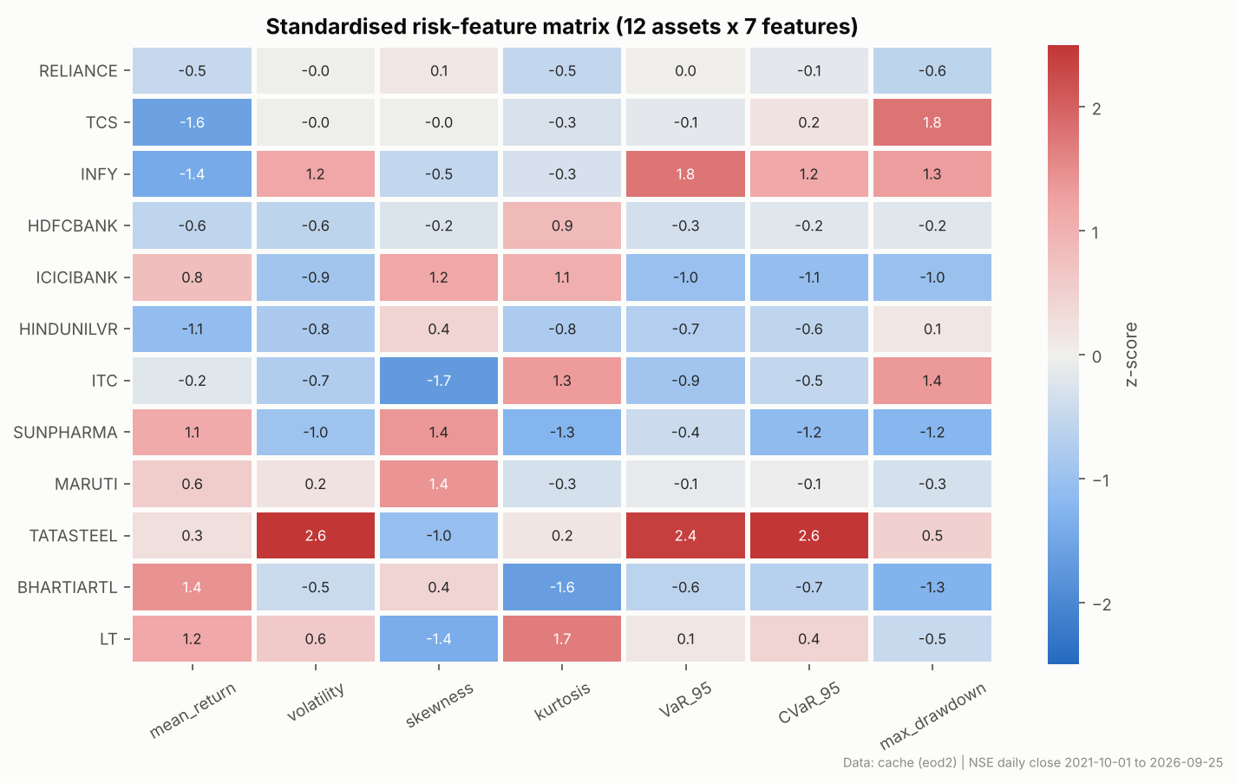
Dataset, preprocessing and risk features
PART A
Source | NSE end-of-day closes (eod2 dataset), split and bonus adjusted
Universe | RELIANCE, TCS, INFY, HDFCBANK, ICICIBANK, HINDUNILVR, ITC, SUNPHARMA, MARUTI, TATASTEEL, BHARTIARTL, LT
Window | 2021-10-01 to 2026-09-25 · 1,235 daily log returns
Cleaning | Common calendar; forward-fill gaps of 3 days or less; no back-fill
Scaling | StandardScaler (z-score) before any distance-based method
Features per stock (daily log returns rₜ)
Mean return · Volatility σ · Skewness · Excess kurtosis
VaR₉₅ = −q₀.₀₅(r) CVaR₉₅ = −E[ r | r ≤ q₀.₀₅ ]
Max drawdown = maxₜ (1 − Wₜ / maxₛ≤ₜ Wₛ), Wₜ = exp(Σ r)
VaR, CVaR and volatility are highly correlated (ρ ≈ 0.95). This is why Mahalanobis distance and PCA matter.
Red = above average, blue = below average. INFY, TCS and TATASTEEL have the deepest drawdowns, and ITC and LT the most negative skew.
Notes:
We use real NSE data adjusted for splits and bonuses. The window is about five years, roughly 1,235 trading days. Each stock becomes seven features. VaR and CVaR are historical estimates at 95%, reported as positive losses. Max drawdown is the worst peak-to-trough fall. Features are z-scored because otherwise volatility, measured in percent, would be swamped by kurtosis, which is a large unitless number. The heatmap already shows the structure the clusters will find. One caveat: the data is adjusted for splits but not for dividends.

Slide 5
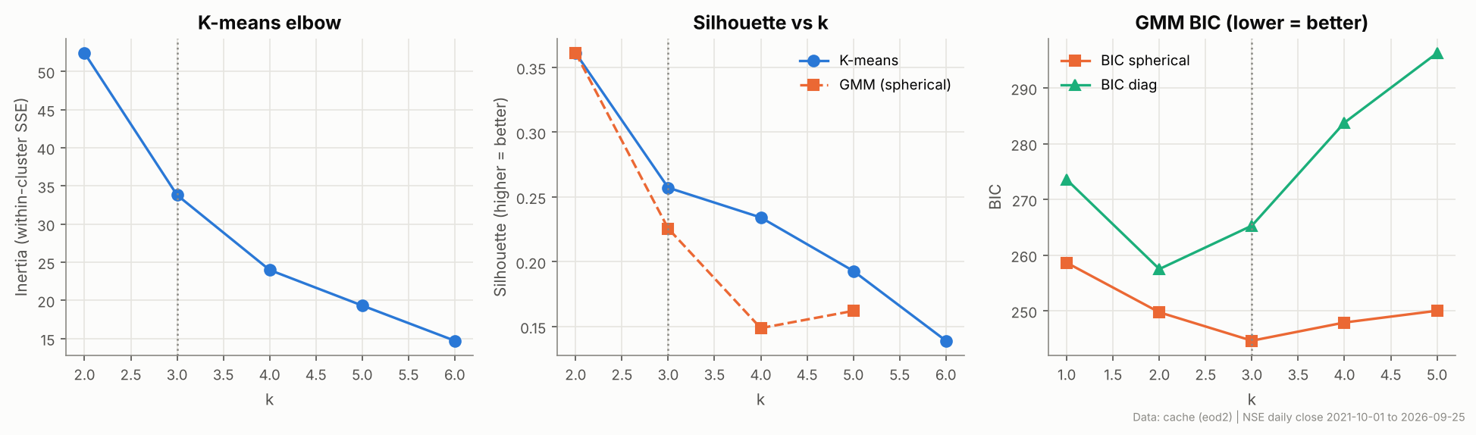
Clustering: K-means, GMM and hierarchical
PART A
K-means
min Σₖ Σᵢ∈Cₖ ‖xᵢ − μₖ‖²
Hard assignments; k-means++, 20 inits. Defined only for squared Euclidean distance.
Gaussian mixture (EM)
p(x) = Σₖ πₖ 𝒩(x | μₖ, Σₖ)
Soft assignments. Spherical covariance with a variance floor of 0.1, since n = 12 is too small for full Σ.
Choosing k
GMM BIC is lowest at k = 3 (BIC 244.6, spherical covariance)
K-means silhouette favours k = 2 (0.361), so the criteria do not fully agree
K = 3 kept for the main comparison, based on BIC, to support the risk-profile interpretation
Without the variance floor, BIC kept falling as k grew because components shrank onto 2 to 3 points (overfitting)
Agglomerative
Ward: merge with min Δ SSE
Ward, average and complete linkage compared. Ward needs Euclidean distance.
Notes:
Three algorithms with three different objectives. K-means minimises within-cluster squared Euclidean distance, which is why we never call anything Manhattan K-means. A GMM is a probabilistic version fitted by EM. With only 12 assets a full covariance per component cannot be estimated, so we use spherical covariances with a variance floor. Ward linkage merges the pair of clusters that least increases the sum of squares, so it only makes sense with Euclidean distance. To choose k: GMM BIC is lowest at 3, but K-means silhouette favours 2, which just isolates two outliers, so the criteria do not fully agree. We kept K equals 3 for the main comparison, based on BIC, because it supports the risk-profile interpretation, and we say so openly.

Slide 6
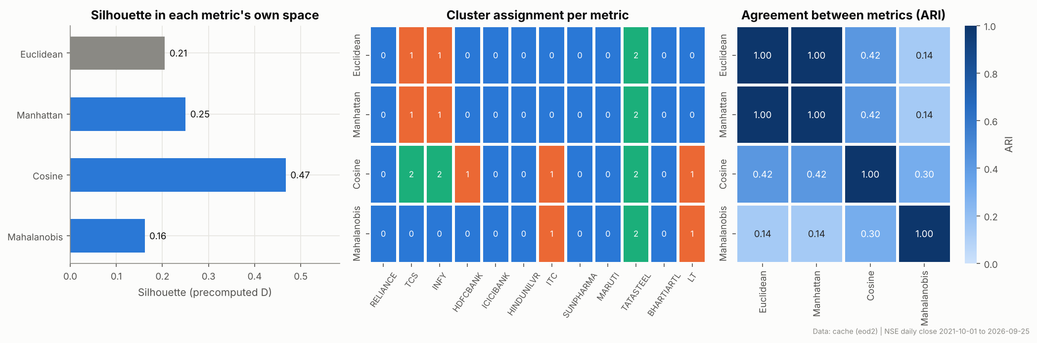
Distance metrics and PCA
PART A
Manhattan
d = Σⱼ |xⱼ − yⱼ|
True metric, less sensitive to one extreme feature. Scale dependent, so we z-score first.
Cosine
d = 1 − x·y / (‖x‖‖y‖)
Compares the shape of the risk profile, not its size. Not a metric. Near-zero vectors are flagged (none here).
Mahalanobis
d² = (x−y)ᵀ S⁻¹ (x−y)
Removes feature correlation. Raw S condition number 524; Ledoit-Wolf shrinkage (λ = 0.43) brings it to 5.80; pseudo-inverse.
Fair comparison
Every metric uses the same average-linkage clustering on a precomputed D, never Ward. Silhouette is computed in each metric's own D; DB and CH only in Euclidean space.
PCA
PC1 53% (tail risk), PC2 22%, PC3 18%. 3 PCs keep 93%.
Notes:
For a fair metric comparison we hold the algorithm fixed: agglomerative average linkage on a precomputed distance matrix. Euclidean and Manhattan give the same partition here. Cosine finds the most separated groups in its own geometry, with silhouette 0.47, because it groups stocks by the shape of their risk profile rather than how extreme it is. Mahalanobis gives the lowest silhouette, but it stops the three nearly duplicate tail-risk features from counting three times. Its covariance was badly conditioned, so we used Ledoit-Wolf shrinkage plus a pseudo-inverse. On PCA: the first component is essentially tail risk, and three components keep 93% of the variance.

Slide 7
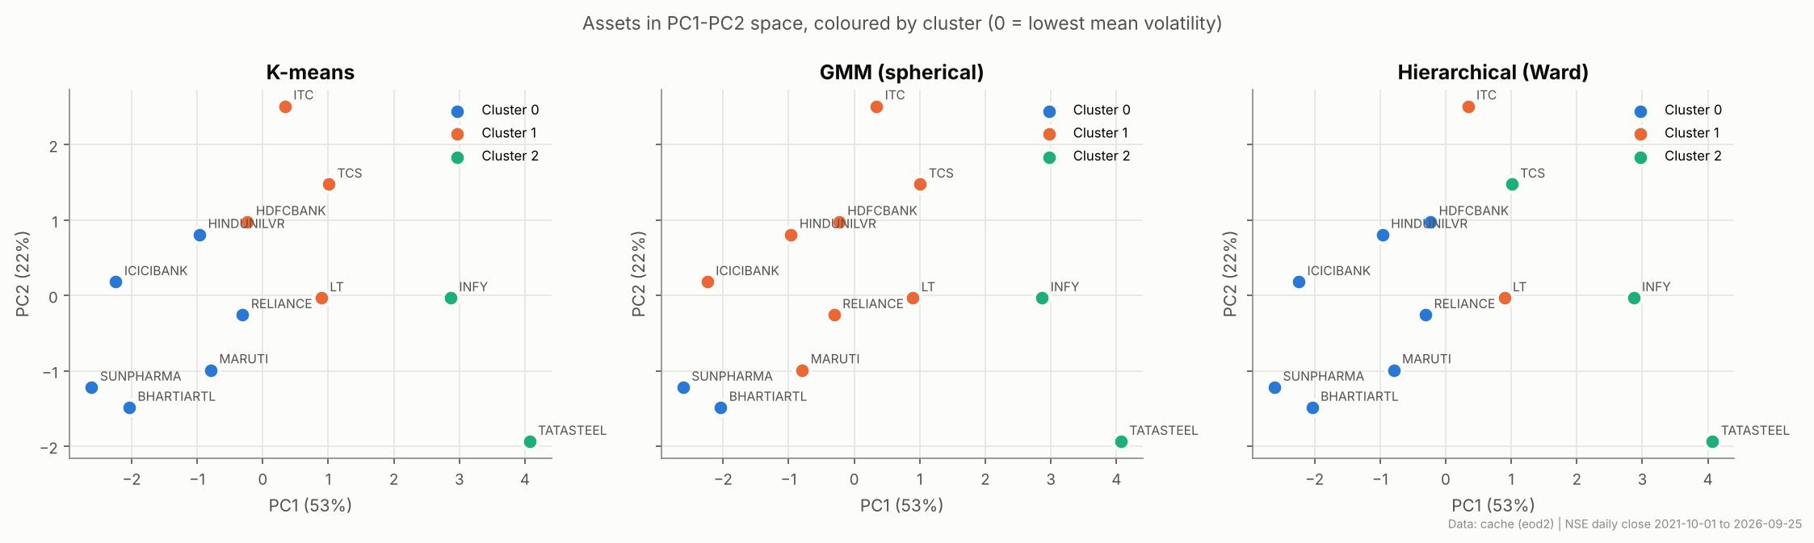
Part A results: risk profiles and stability
PART A
Cluster (Ward, K=3) | Members | Ann. vol | CVaR₉₅ | Max DD
0 · Low risk | RELIANCE, HDFCBANK, ICICIBANK, HINDUNILVR, SUNPHARMA, MARUTI, BHARTIARTL | 21.3% | 3.0% | 26.8%
1 · Tail risk | ITC, LT (skew −0.62, kurtosis 6.5) | 22.6% | 3.3% | 40.0%
2 · High risk | TCS, INFY, TATASTEEL | 26.4% | 4.0% | 49.3%
Stability (ARI ignores label numbering)
Seeds: K-means ARI 0.34 with one random start vs 0.78 with k-means++ (20 starts); Ward is deterministic
Block bootstrap (100×): ARI only 0.26 to 0.50; Mahalanobis is the most stable
Silhouette: Ward 0.27 · K-means 0.26 · GMM 0.23
Notes:
Ward has the best silhouette, so it is our main partition. Three groups appear. A low-risk core of seven names. A tail-risk pair, ITC and LT: their volatility is average, but returns are negatively skewed and fat-tailed, with a 40% drawdown. And a high-risk group: the two IT majors plus Tata Steel, with the largest CVaR and drawdowns near 50%. On stability, the honest finding is that with 12 assets, resampling the trading days changes the clusters a lot: bootstrap ARI is only about 0.26 to 0.50. Mahalanobis is the most stable. K-means with a single random start is unstable, and k-means++ with 20 starts fixes most of that. Note that the PCA plot is for visualisation only; it does not prove the clusters are good.

Slide 8
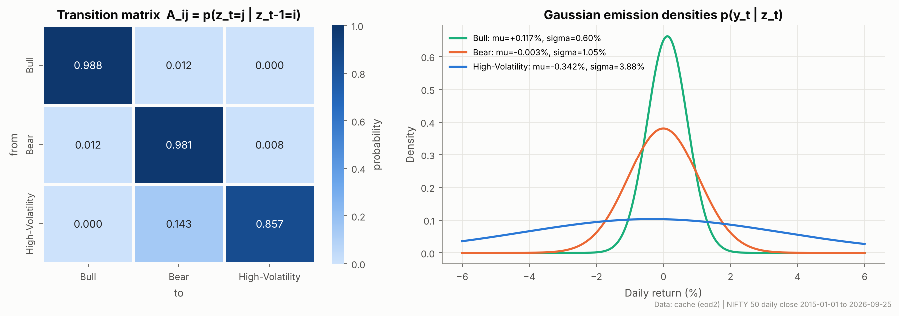
Hidden Markov Model: transitions and emissions
PART B
Model
zₜ ∈ {1,2,3}, p(z₁) = π
p(zₜ = j | zₜ₋₁ = i) = Aᵢⱼ
yₜ | zₜ = k ~ 𝒩(μₖ, σₖ²)
Fitted by Baum-Welch on 2213 training days (2015 to 2023), best of 10 random restarts
Naming rule (state ids are arbitrary)
Largest σ → High-Volatility
Of the other two: higher μ → Bull, lower μ → Bear
BIC: 1 state 6606 · 2 states 5901 · 3 states 5796 · 4 states 5837 → BIC is lowest at 3 states
4 states has slightly better test log-lik (-1.1726 vs -1.1744/day); we keep 3 for the Bull / Bear / High-Vol interpretation
What the model learned
Bull and Bear are very persistent (stay probability 0.988 and 0.981; expected runs of about 86 and 51 days)
High-Volatility (σ ≈ 3.9%/day) is short (about 7 days) and always exits to Bear, never straight to Bull
"Bear" has a mean near 0 (−0.003%) and σ ≈ 1.05%: in practice a choppy, risk-off regime more than a crash
Notes:
The HMM has three hidden states, a transition matrix and one Gaussian per state for daily percent returns. We fit it on 2015 to 2023 only, with ten random restarts of EM, and keep the best likelihood. We never assume state 0 means Bull: names come from the learned parameters. The largest variance is High-Volatility, and of the other two the higher mean is Bull. BIC selects three states as the best balance of fit and complexity, although a four-state model scores slightly better on held-out likelihood; we keep three because they map onto Bull, Bear and High-Volatility, so the best number of states depends on the criterion. The transition matrix is easy to read: calm regimes persist for weeks or months, and the crisis state lasts about a week and always passes through Bear on the way back. The Bear label is a statistical interpretation: its mean is close to zero, so it is better described as choppy or risk-off.

Slide 9
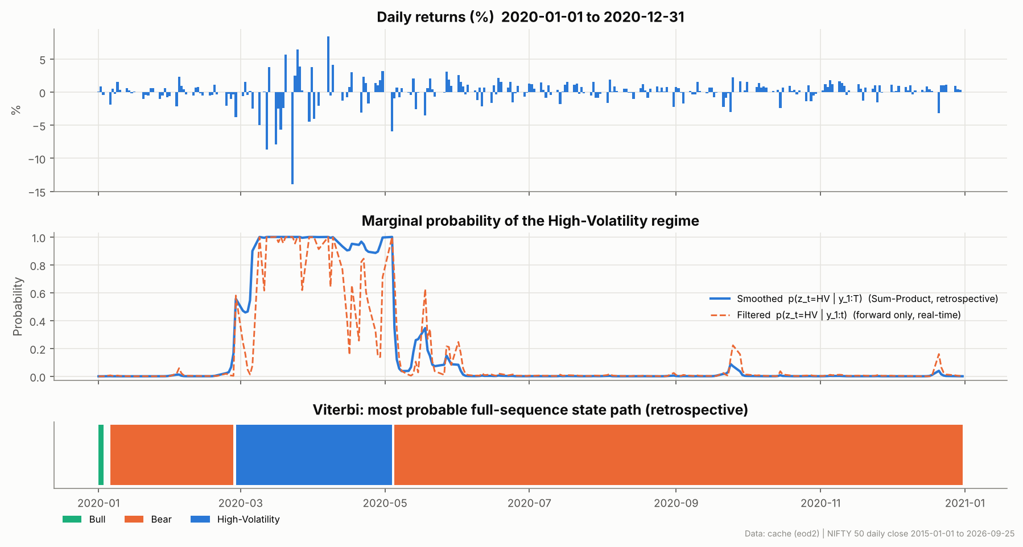
Sum-Product versus Viterbi decoding
PART B
Sum-Product
αₜ(j) = bⱼ(yₜ) Σᵢ αₜ₋₁(i) Aᵢⱼ
βₜ(i) = Σⱼ Aᵢⱼ bⱼ(yₜ₊₁) βₜ₊₁(j)
γₜ(i) = αₜ(i) βₜ(i) / p(y₁:T)
Sums over all paths. Gives the marginal p(zₜ | all data) for each day.
Viterbi
δₜ(j) = bⱼ(yₜ) maxᵢ δₜ₋₁(i) Aᵢⱼ
ψₜ(j) = argmaxᵢ δₜ₋₁(i) Aᵢⱼ
then trace back the pointers
Maximises over paths. Gives one jointly most likely sequence z*.
Verified (log-space, NumPy)
log p(y₁:T) identical to hmmlearn: -3642.938
max |γ − γ_hmmlearn| = 1.2e-12; every row sums to 1
Toy 2-state HMM: matches enumeration of all 8 paths (p(y) = 0.10248)
Viterbi = hmmlearn on 100% of days; differs from argmax γ on 3.7% of days
2020 COVID crash. Filtered (orange) is real-time: it uses data up to day t only. Smoothed (blue) and the full-sequence Viterbi path are retrospective: they use the whole series.
Notes:
This is the key distinction. Sum-Product, the forward-backward algorithm, sums over every possible state sequence and gives, for each day, the probability of each regime given all the data. Viterbi replaces the sum with a max and returns the single most probable whole path. They can disagree, and here they do on about 3.7% of days, because the best path is not the same as picking the best state each day. We wrote both in NumPy in log space with log-sum-exp, so 2,900 steps do not underflow. We checked them three ways: same likelihood as hmmlearn, same posteriors to 1e-12, and on a toy example against brute-force enumeration of all 8 paths. The 2020 plot shows the regime switching into High-Volatility in March and leaving in May. The smoothed curve and the Viterbi path are retrospective, since they use the whole series; only the filtered curve is what we would have known in real time.

Slide 10
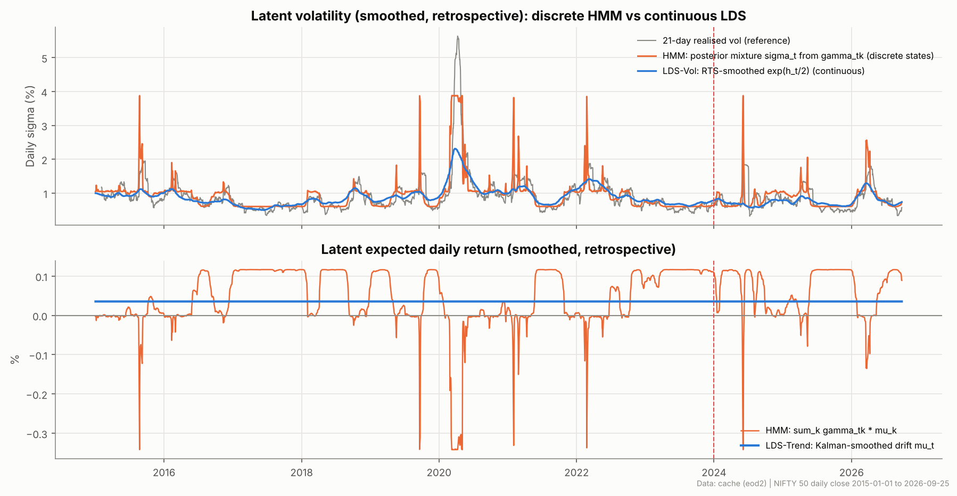
Continuous LDS (Kalman filter) versus HMM
PART B
Linear-Gaussian state space
xₜ = F xₜ₋₁ + c + wₜ, wₜ ~ 𝒩(0, Q)
yₜ = H xₜ + d + vₜ, vₜ ~ 𝒩(0, R)
Kₜ = Pₜ|ₜ₋₁Hᵀ(HPₜ|ₜ₋₁Hᵀ + R)⁻¹
NumPy Kalman filter + RTS smoother; Q and R fitted by maximum likelihood on training data
Two LDS models
LDS-Trend: random-walk drift of returns. MLE gives Q → 0, so the drift is constant: daily returns have no predictable trend
LDS-Vol: AR(1) log-variance on log r² (quasi-likelihood). φ = 0.988, half-life ≈ 56 days
Volatility estimates both follow 21-day realised volatility (correlation: HMM 0.79, LDS-Vol 0.80). The HMM jumps; the LDS moves smoothly.
Notes:
The LDS has a continuous hidden state instead of a discrete one. We implemented the Kalman filter and the Rauch-Tung-Striebel smoother ourselves and fitted the noise variances by maximum likelihood. The first model treats expected return as a slowly drifting random walk. The data pushes the drift noise to zero, which is a genuine finding: there is no exploitable trend in daily index returns. The second treats log-volatility as a mean-reverting AR(1), observed through log squared returns, a standard linearisation. It gives a smooth volatility curve with a two-month half-life. The HMM curve jumps between three levels. Both track realised volatility with correlation around 0.8. The HMM and LDS are not equivalent models: one has discrete states, the other continuous ones.

Slide 11
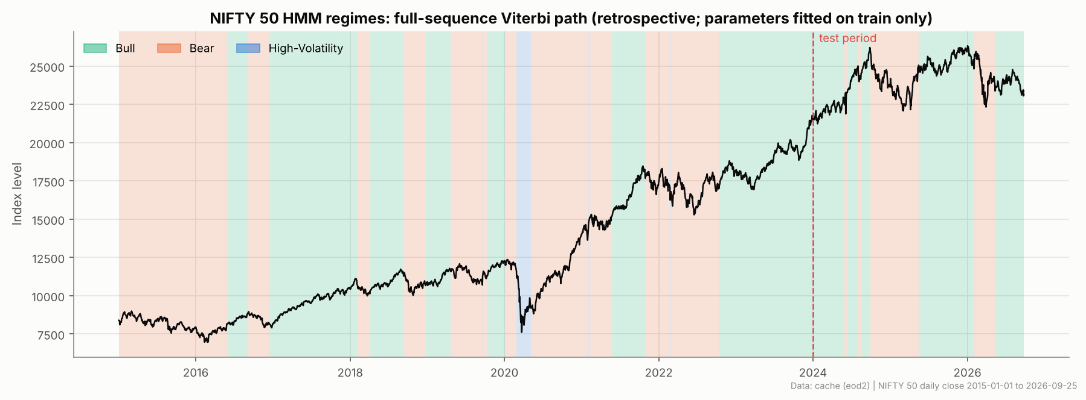
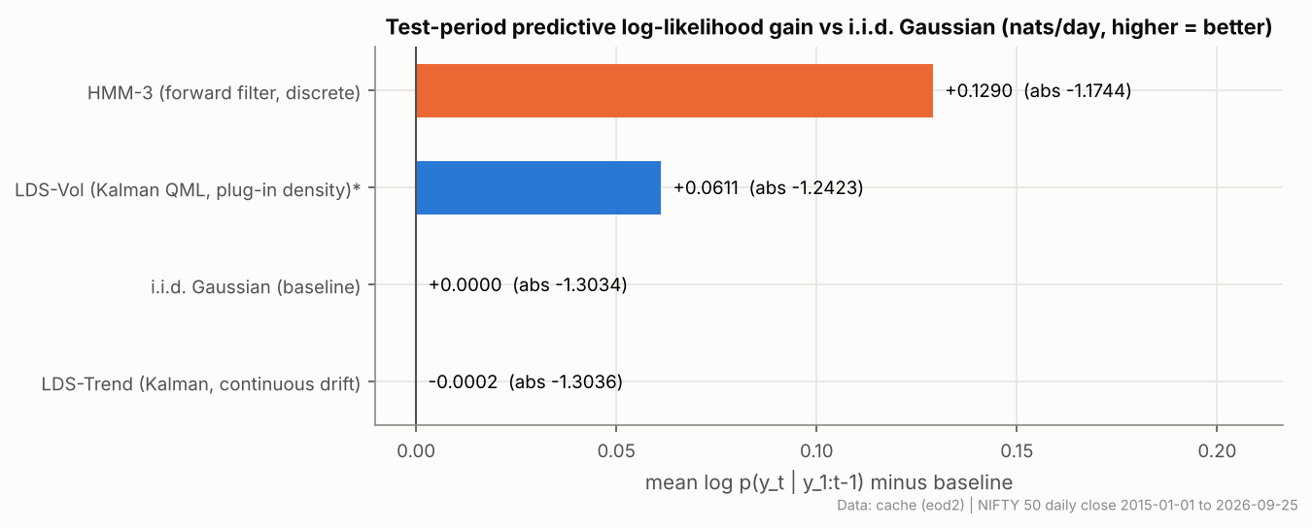
Results, limitations and discussion
Findings (held-out test: Jan 2024 to Sep 2026)
HMM-3 beats the i.i.d. baseline by 0.129 nats/day; LDS-Vol by 0.061; LDS-Trend by about 0
Scoring: one-step predictive density p(yₜ | y₁:ₜ₋₁), same data and units for all models
Test-period shares (retrospective Viterbi labels): 65% Bull, 35% Bear, under 1% High-Vol
Limitations (stated openly)
Only 12 assets, so cluster stability under resampling is modest (ARI about 0.3 to 0.5)
Regime names are statistical; "Bear" has a mean near 0
LDS-Vol density is a quasi-likelihood approximation (marked *)
Prices adjusted for splits and bonuses, not dividends; yfinance was blocked in the build environment, so the NSE GitHub dataset was used
HMM-4 fits the test data slightly better (−1.1726 vs −1.1744) but has a worse BIC
Notes:
Top left: the Viterbi regimes over eleven years. High-Volatility marks the COVID crash, Bull covers the 2017 and 2023 to 2024 rallies, and Bear covers 2015 to 2016 and the late-2024 correction. The parameters were fitted only on data up to 2023, but the regime colours come from full-sequence Viterbi decoding, so they are a retrospective labelling, not real-time predictions. Bottom left is the fair comparison: each model gives a predictive density for tomorrow's return using only past data, scored on the test period. The HMM is clearly best, LDS-Vol helps because it captures volatility clustering, and LDS-Trend equals the baseline. The limitations on the right are stated openly, especially the small number of assets and that regime names are interpretations.

Slide 12
Conclusion and future scope
Implemented and verified
Key takeaways
Future scope (not built)
K-means, GMM, Ward / average / complete linkage on real NSE data
Manhattan, Cosine and Mahalanobis (shrinkage + pseudo-inverse); PCA; ARI stability
3-state Gaussian HMM with our own Sum-Product and Viterbi, checked against hmmlearn and brute force
Kalman filter, RTS smoother and two MLE-fitted LDS models, with a fair predictive comparison
One self-contained notebook and 31 passing tests
Three risk tiers: core, tail-risk (ITC, LT), high-risk (IT majors + steel)
The choice of distance changes the clusters (ARI as low as 0.14)
Discrete regimes forecast better than a continuous trend, because volatility clustering matters more than drift
Larger universe (NIFTY 100 or 500) for more stable clusters
Multivariate HMM emissions (returns + volatility + breadth)
Student-t emissions; switching LDS; regime-aware portfolio backtest
Notes:
To conclude: everything in the green column is implemented, run on real data and covered by tests. The yellow column holds the main lessons: risk profiles depend on the distance you choose, and for daily index returns, modelling volatility regimes matters far more than modelling drift. The orange column is future work that we have not built. Thank you, and we are happy to take questions or run the live demo.

