Slide 1
Financial Market Risk Profiling and Regime Detection
Clustering · GMM · Hidden Markov Models · Linear Dynamical Systems
Machine Learning · Project Review 2
Made by Srushti More [298], Agadh Khanolkar [299], Sneh Prasad [311]
Notes:
Our project answers two questions: which stocks share a similar risk profile, and which hidden regime the market is in.

Slide 2
Two questions, one pipeline
A
Which stocks share a risk profile?
12 NSE stocks · K-means, GMM, Hierarchical
B
Which market regime are we in?
NIFTY 50 · HMM vs Kalman LDS
Real NSE data
2015 to Sep 2026
Risk features
7 per stock
Models
Cluster · HMM · LDS
Evaluate
Silhouette · ARI · test score
Outputs
20 plots · 31 tests
One notebook: Restart & Run All (about 1 minute on a laptop)
Notes:
Part A groups 12 NSE stocks by risk. Part B finds hidden regimes in the NIFTY 50. One notebook loads real data, computes the features, runs every model and produces all plots in about a minute.

Slide 3
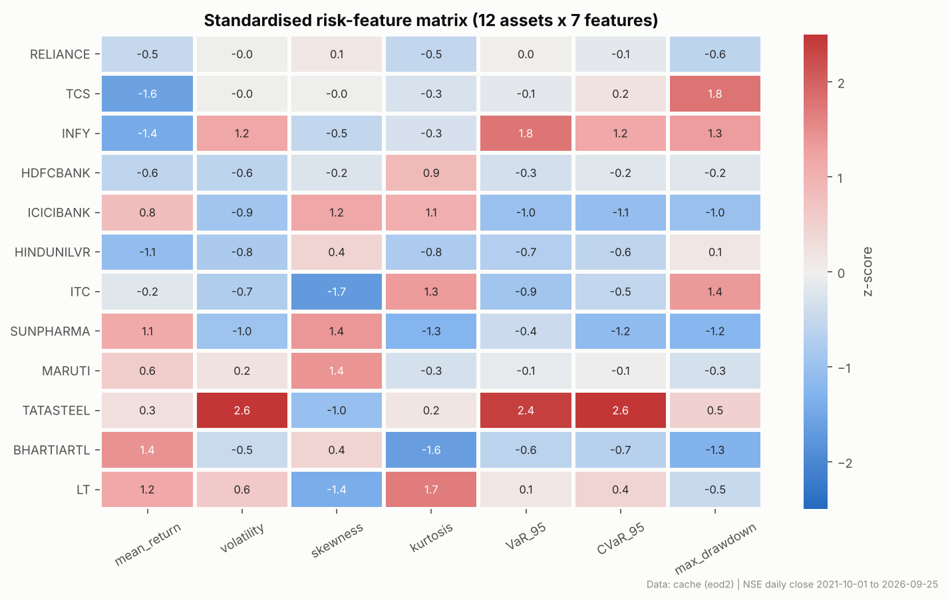
Data and risk features
PART A
12 stocks · 9 sectors
NSE daily closes, Oct 2021 to Sep 2026
Mean return, volatility
Skewness, kurtosis
VaR 95% and CVaR 95%
Maximum drawdown
All features z-scored before clustering
Notes:
Each stock is described by seven risk numbers, including tail-risk measures like VaR, CVaR and drawdown. We standardise them so no single feature dominates. In the heatmap, red means riskier than average.

Slide 4
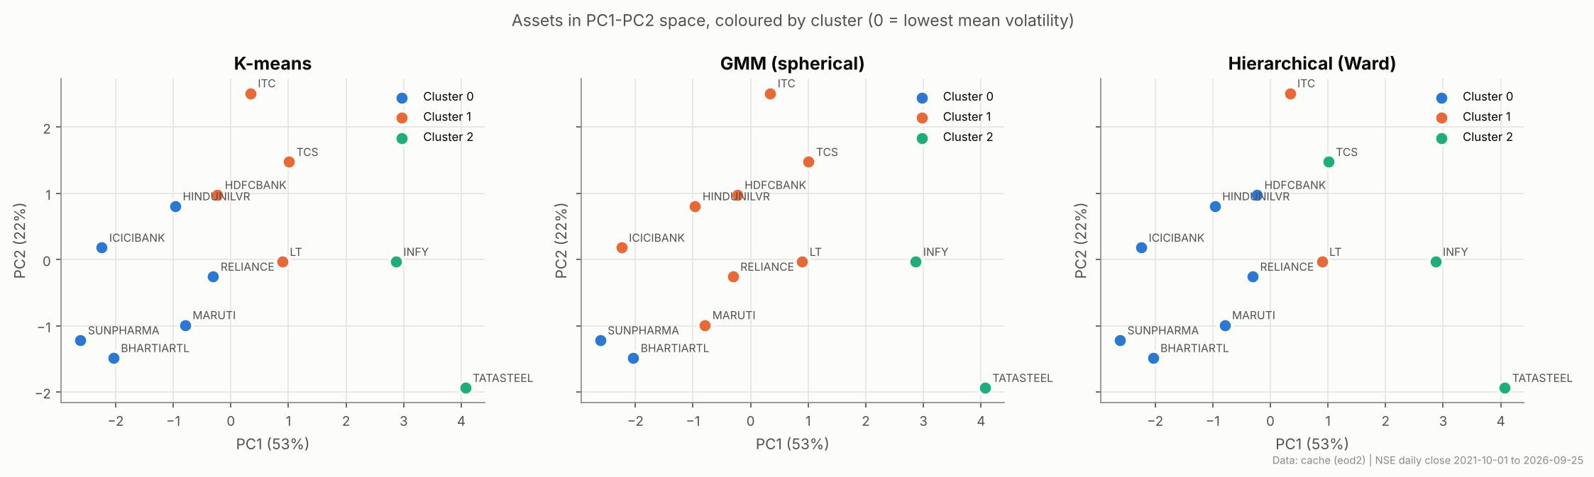
Part A: three risk profiles
PART A
Low risk
7 stocks: banks, FMCG, pharma, telecom, auto
Tail risk
ITC, LT: negative skew, fat tails
High risk
TCS, INFY, TATASTEEL: ~49% drawdown
Distance metric matters: Manhattan, Cosine and Mahalanobis give different groups. Mahalanobis is the most stable (ARI).
Notes:
We used K equals 3 based on GMM BIC. K-means silhouette favours 2, so the criteria do not fully agree, and we kept 3 for the risk-profile interpretation. Hierarchical Ward clustering gives the cleanest groups: a low-risk core, a tail-risk pair, ITC and LT, and a high-risk group, the IT majors plus Tata Steel. Changing the distance changes the groups, and Mahalanobis was the most stable under resampling.

Slide 5
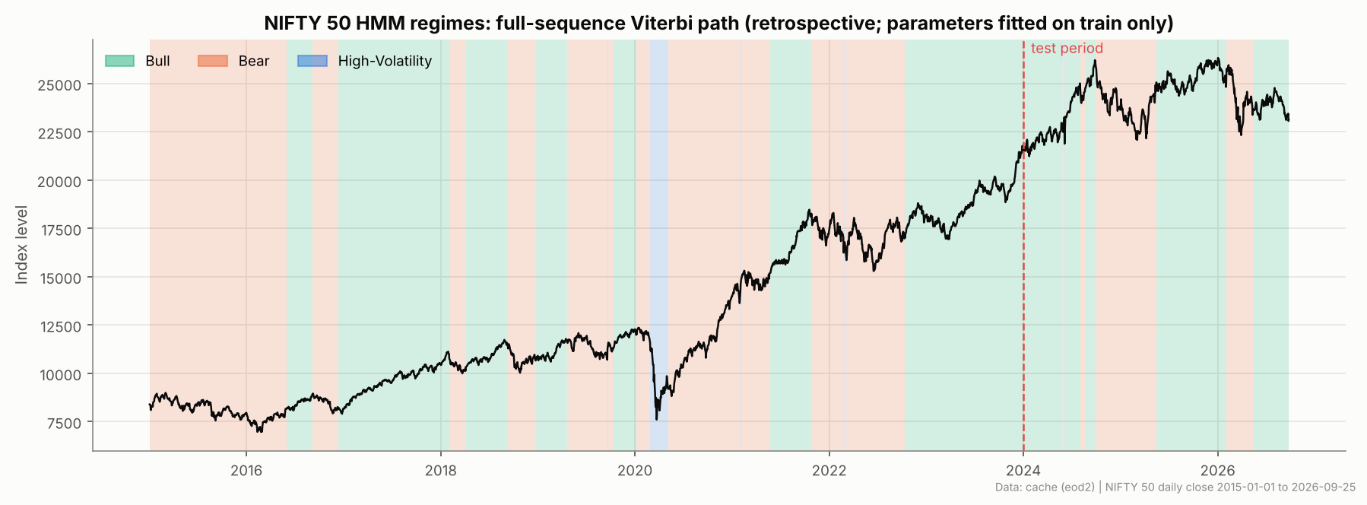
Part B: hidden market regimes
PART B
Bull
+0.12%/day · calm · ~86-day runs
Bear
≈0%/day · choppy · ~51-day runs
High-Vol
σ 3.9%/day · ~7 days · COVID 2020
Retrospective view: full-sequence Viterbi labels; parameters fitted on 2015–2023 only. BIC selects 3 states (4 states scores slightly better on test data).
Notes:
The HMM learns three regimes from daily returns alone. We name them from the learned parameters, not the state numbers. It finds the COVID crash as the high-volatility regime. Its parameters were fitted only up to 2023. This chart is a retrospective labelling from full-sequence Viterbi decoding, not a real-time prediction. BIC selects three states; a four-state model scores slightly better on held-out data, but three give the clearest interpretation.

Slide 6
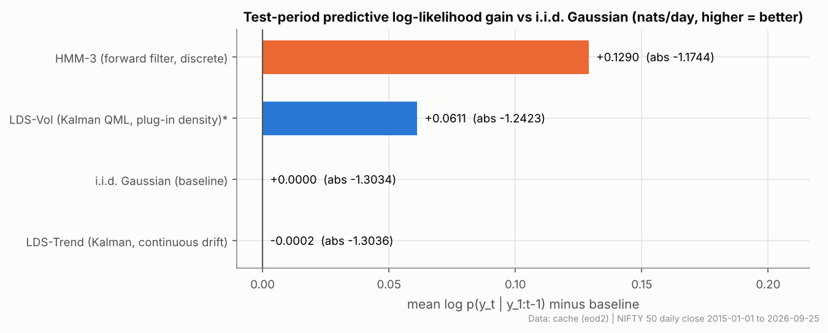
Inference and HMM vs LDS
PART B
Sum-Product (forward-backward)
Sums over paths → p(regime | data) each day
Viterbi
Maximises over paths → single best regime sequence
On unseen 2024–26 data the discrete HMM predicts best. The continuous Kalman LDS gives smooth volatility but cannot capture regime jumps.
Coded in NumPy, verified
Matches hmmlearn exactly; checked against brute force
Notes:
Sum-Product gives the probability of each regime on each day; Viterbi gives the single best path. Both are written in NumPy and match the library exactly. We compared the HMM with a continuous Kalman-filter LDS on unseen data. The HMM predicts best, because volatility regimes matter more than trend.

Slide 7
Conclusion
Built
Learned
Next
3 clustering methods + 3 distances
HMM with our own Sum-Product and Viterbi
Kalman LDS comparison · 31 tests
Stocks form 3 risk tiers
Distance choice changes clusters
Regimes beat smooth trends
More stocks (NIFTY 100)
Multivariate HMM
Regime-aware portfolio
Thank you · Live demo: the notebook
Notes:
To sum up: we built and tested everything on real data. Stocks fall into three risk tiers, the choice of distance matters, and discrete regimes forecast better than smooth trends. Thank you.

